Slide 1
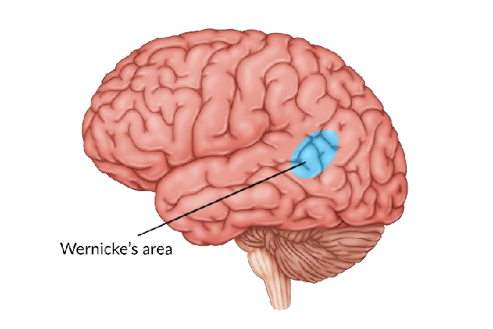
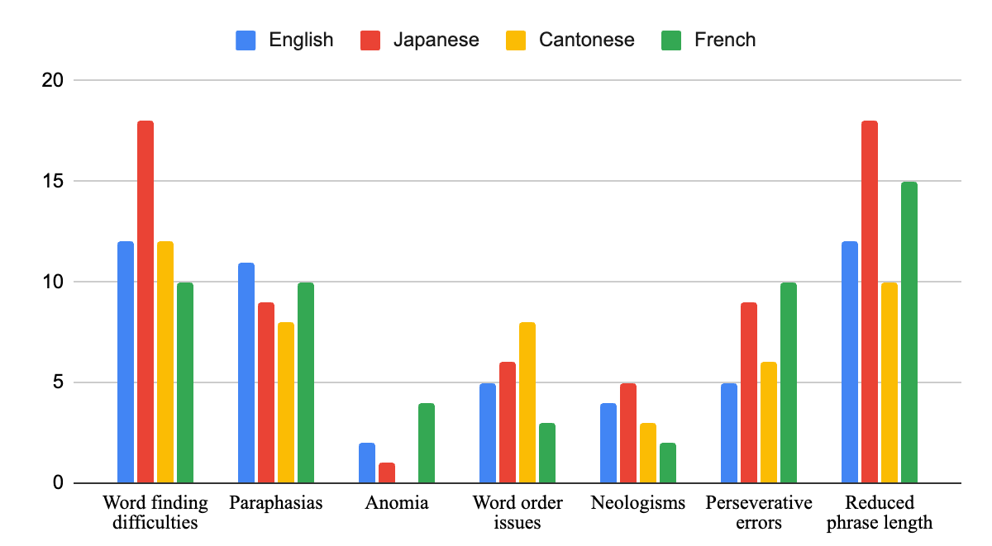
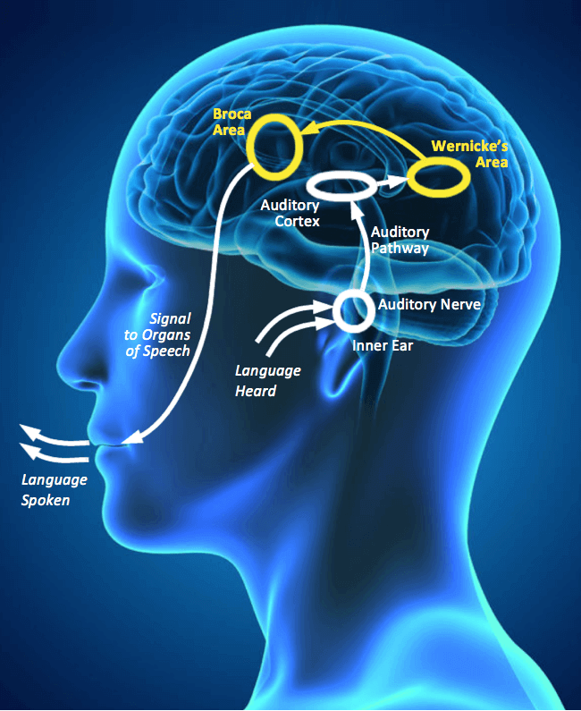
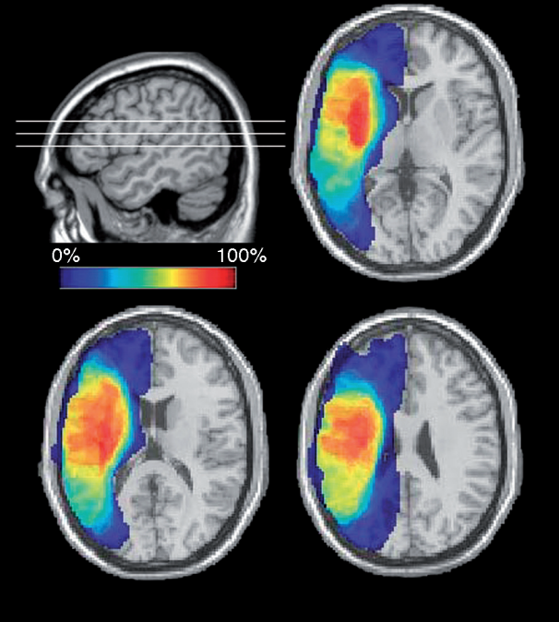
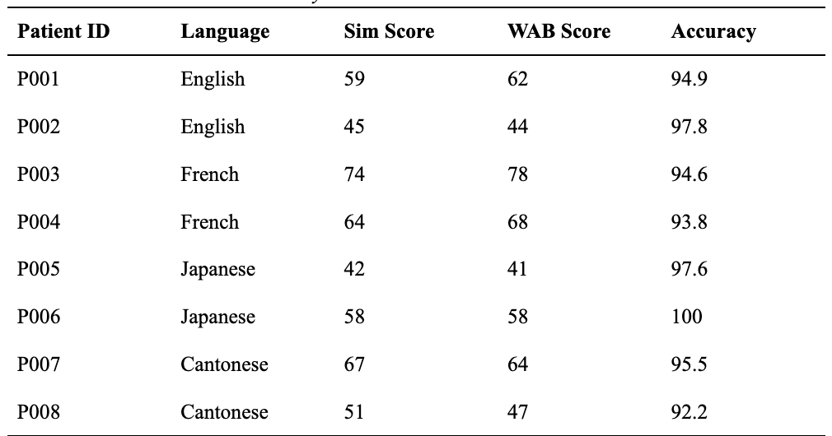
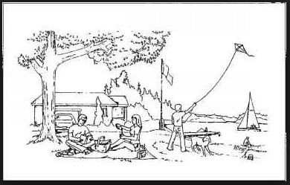
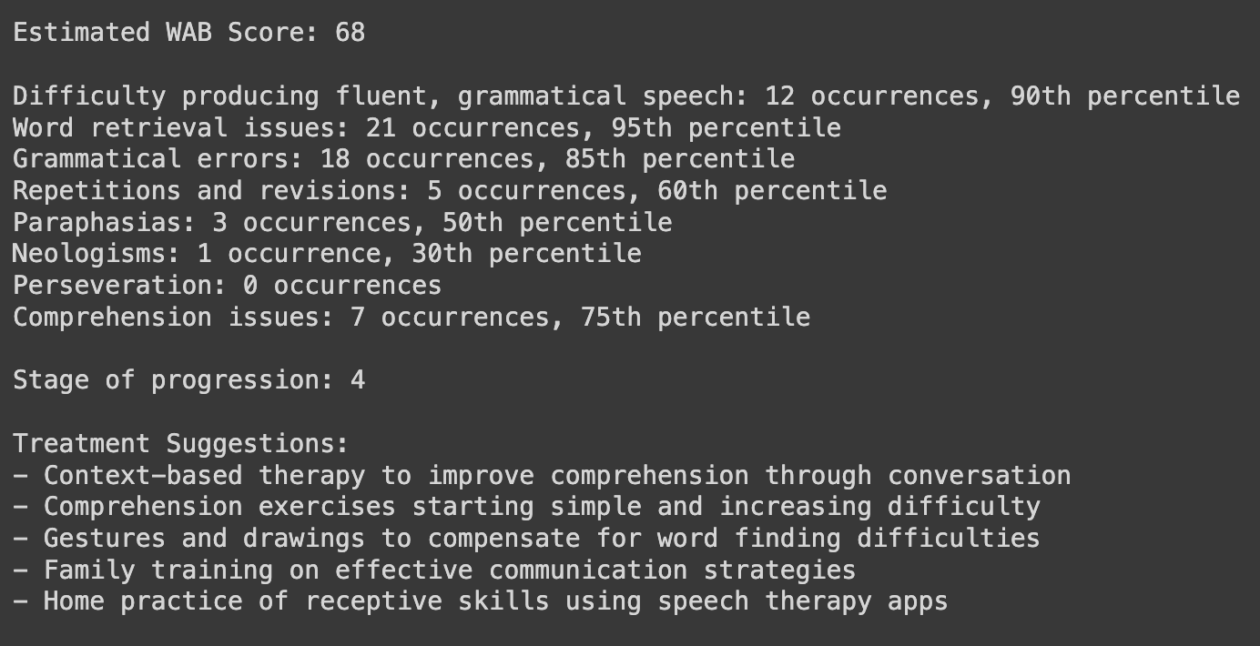
PERSONALIZED SPEECH ANALYSIS FOR WERNICKE’S APHASIA PATIENTS
Sreekar Baddepudi
INTRODUCTION
METHODOLOGY
CONCLUSION
Wernicke's aphasia (WA) is a neuro-logical disorder caused by damage, often from a stroke, to specific language networks in the human brain. This disorder is hard to treat because of the intricate and individualized nature of its pathogenesis. While there is no standardized treatment for Wernicke's aphasia, speech therapy can improve language skills and facilitate alternative means of communication for WA patients.
STEP 1: VALIDATING LLM FOR WERNICKE’S APHASIA ANALYSIS
This application demonstrates successfully modeling of the trusted gold standard WAB testing toolkit that can be used by the clinicians for
Identifying universal linguistic biomarkers that transcend language barriers and those that lie within them
Minimizing human error in treatment and diagnosis, and speed up the analysis of complex diseases
Personalizing aphasia treatment by generating language exercises tailored to a patient's unique deficits and native language.
Assisting large-scale automated assessments to measure trends across various demographics
Multilingual capabilities of the application expands the reach of aphasia care, ensuring that patients from diverse backgrounds have access to cutting-edge diagnostic and therapeutic resources
Methods:
Examined linguistic content and structure of 13 speech transcripts from Aphasia bank
Analyzed data for linguistic nuances, paraphasia, and neologisms that may indicate aphasia
Leveraged multilingual capabilities to identify language-specific patterns in English, French, Cantonese, Japanese speech transcripts
Results:
The LLM systematically examined the linguistic content and structure of the collected data
The LLM successfully identified the linguistic nuances, paraphasia, and neologisms that may be indicative of aphasic speech patterns
Analysis revealed universal vs. language-specific deficits
Linguistic Analysis of Aphasic Speech
(Neuroscience Bite: Wernicke’s Area, October 2022)
By leveraging large language models (LLM), we can determine symptoms apparent in WA patients and discretize those that are unique to individuals and populations with structurally distinct languages. By analyzing universal symptoms associated with Wernicke’s aphasia, the model has the potential to reduce the subjective guess work and judgment that heavily relies on the expertise and interpretive ability of individual therapists, bridging the gap between contemporary linguistic research and clinical practice
FUTURE WORK
Create a comprehensive understanding of each patient's condition by combining speech pattern analysis with real-time brain activity measurements.
STEP 2: PROMPT ENGINEERING
Integration of speech analysis data with EEG and fMRI brain imaging to capture real-time brain activity and functional connectivity patterns during language processing.
Use Retrieval Augmentation Generation (RAG) for long term memory to track patient’s progress and make recommendations as they make progress
Include aphasia diagnosis like motor ability and image recognition parameters in the model to analyze and assist with increased accuracy
Prompt engineering is the process of designing and refining prompts to guide AI models in generating desired outputs.
Methods:
Constructed optimized prompts to provide appropriate context, background, examples and directives to the Claude v.2.1
Tested numerous prompt formulations and model parameters formulations to discern optimal prompts, used
Tailored prompts to specific nuances and complexities of aphasic speech
Tested and configured LLM hyper-parameters that produced the most consistent outputs: Temperature of 0.5, Top P of 0.2, Top K of 250
Four Steps of Prompt Engineering
(Jays Language Processing Disorder: Symptoms (2/3) - Vocalsaints, 2021)
Provide relevant context and data
ENGINEERING GOALS
Identify the problem
Define clear, concise prompt
Refine and Iterate
Output
Design an application that can pick out unique and universal grammatical, syntactical, and content-specific patterns in the speech of people with Wernicke’s aphasia, who speak structurally distinct native languages.
The app should then make suggestions regarding the specific neural networks that may be affected in an individual, accounting for cognitive linguistic uniqueness, and point the user toward highly customized therapies offered in their local area
STEP 3: DATA ANALYSIS
(Adelman & Smith, 2009)
REFERENCES
WAB Score Simulation
Acharya, Aninda B., and Michael Wroten. "Wernicke Aphasia." StatPearls [Internet]. Treasure Island (FL): StatPearls Publishing LLC, 2023 Jan. 2023 Aug 8. PMID: 28722980.
Binder JR. Current Controversies on Wernicke's Area and its Role in Language. Curr Neurol Neurosci Rep. 2017 Aug;17(8):58. [PubMed: 28656532].
Fridriksson J, den Ouden DB, Hillis AE, Hickok G, Rorden C, Basilakos A, Yourganov G, Bonilha L. Anatomy of aphasia revisited. Brain. 2018 Mar 01;141(3):848-862. [PMC free article: PMC5837461] [PubMed: 29360947].
American Speech-Language-Hearing Association. Aphasia. Available at: https://www.asha.org/public/speech/disorders/aphasia/. Accessed November 2, 2023.
Ropper AH, Samuels MA, Klein J et al. Adams and Victor's Principles of Neurology 11th Edition. ( 2019) ISBN: 9780071842617.
Kassebaum NJ, Murray CJ, Lopez AD. Burden of disease and injury. In: Murray CJ, Lopez AD, eds. The Global Burden of Disease: A Comprehensive Assessment 1990-2010. Cambridge, MA: Harvard University Press; 2012: Chapter 1.
Benjamin N, Leveque C, Howard D, Lindamer L, Turk A, Haaland K. Communication disorders in adults: Stroke.2018;49(10):2736-2744.
Rizzi, L. (1997). The fine structure of the left periphery. In: L. Haegeman (Ed.), Elements of grammar: A handbook of generative syntax (pp. 281-337). Kluwer Academic Publishers.
Lazard, G. (1994). Grammaire comparée des langues romanes. Presses universitaires de France.
Huddleston, R., & Pullum, G. K. (2002). The Cambridge grammar of the English language. Cambridge University MacWhinney, B., Fromm, D., Forbes, M., & Holland, A. (2011). AphasiaBank: Methods for studying discourse. Aphasiology, 25, 1286-1307.
Robson, H., Zahn, R., Keidel, J.L., Binney, R.J., Sage, K., & Lambon Ralph, M.A. (2014). The anterior temporal
We first validated and established that Large Language Models (LLMs) can accurately analyze the unique linguistic patterns in Wernicke's aphasia speech.
Next, we fed the prompts to the model so that it could evaluate the speech samples and predict the Western Aphasia Battery-Revised (WAB-R) scores. The WAB is a comprehensive instrument covering critical domains including spontaneous speech, auditory comprehension, repetition, and naming.
Strong concordance emerged between the large language model’s predicted WAB scores and the benchmark Western Aphasia Battery (WAB) standardized scores provided.
The optimized model reached approximately 95% score consistency with genuine WAB results.
Precision was highest for simulated fluency and auditory comprehension metrics, correctly closely matching specialist-derived ratings.
MATERIALS
Speech transcripts from AphasiaBank
The samples, obtained from Aphasia Bank were carefully selected to ensure a representative sample of individuals with Wernicke’s aphasia. All individuals studied here had received a clinical diagnosis from medical professionals. Each of these patients had performed the same protocol, as outlined and peer-reviewed by the TalkBank.
(Western Aphasia Battery-Revised, July 1, 2019)
APPLICATION
Anthropic Claude v2.1 Large Language Model
Estimated WAB score
Linguistic analysis of aphasic speech
Suggested treatments
Code Output
The Large Language Model (LLM) played a large role in this research. It served as a language processor that could navigate through the intricacies of natural language. This study used Anthropic’s Claude v.2.1 Claude's advanced architecture and training on a vast corpus of text enabled it to understand and generate human-like responses with remarkable coherence and contextual awareness.
Utilizing standardized assessments like WAB-R scores to analyze patient speech severity
Parsed patient’s speech to report the number of occurrences of neologisms, semantic/syntactic deficits specific to Wernicke's presentations
Evaluated whether suggested therapies match expert care plans for sample cases and validated that they we were in alignment
ACKNOWLEDGEMENTS
Dr. Van Zak- From teaching me the ropes of conducting basic study analysis to helping me through my initial research projects, Dr. Van Zak has been my unwavering mentor
Dr. Baldo- Dr. Baldo is a Research Neuropsychologist as well as the Director at the Center for Language, Mind, Imaging, and Brain. I am profoundly grateful for Dr. Baldo's invaluable support and commitment.
Dr. Fromm- Dr. Fromm's insights and knowledge of the AphasiaBank website were instrumental in shaping the direction of my research.
Dr. Kiran- Dr. Kiran graciously invited me to speak at the Center for Brain Resilience and gave vital feedback for how to improve this project.
Amazon Bedrock
Amazon Bedrock is a machine learning platform that helps developers build generative AI applications on Amazon's cloud computing platform. The application interface is built using AWS SDK for Python (Boto3) with Amazon Bedrock

