Slide 1
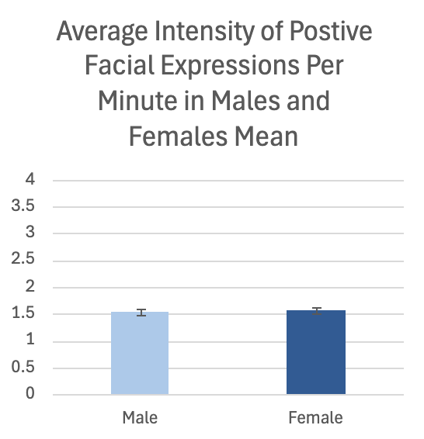
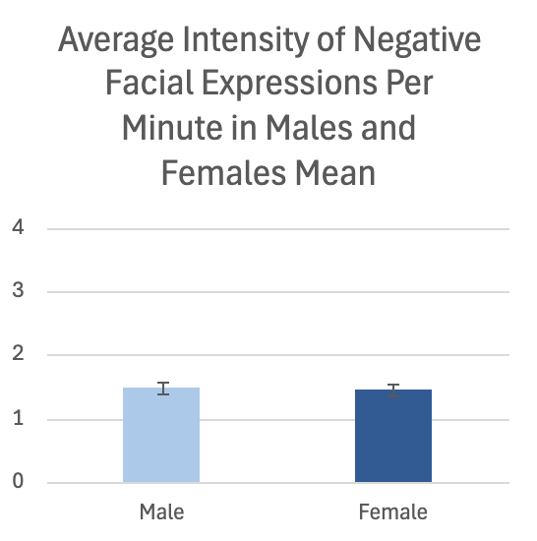
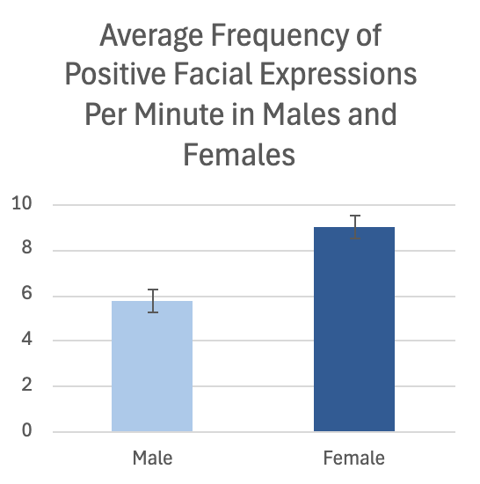
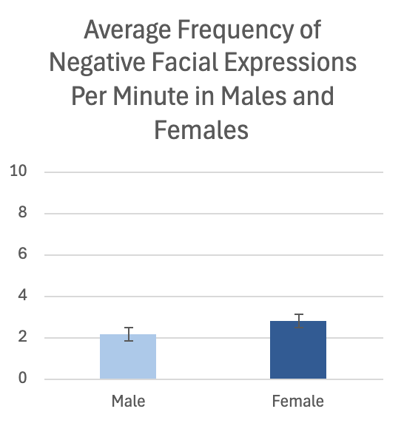
Investigating Gender Differences in Facial Expressiveness
Marin Farnsworth, Chloe Houghton, Anna Norman, Leila Moore, Tyson G. Harmon
Brigham Young University, Department of Communication Disorders
Introduction
Aphasia is an acquired language disorder, typically caused by stroke or traumatic brain injury, damaging language processing centers in the brain.
Emotion (i.e., prosody, gestures, body language, facial expressions, and word choice) is critical in language for both individuals with and without aphasia.
There is little to no research on emotional facial expressivity differences between men and women with aphasia.
Research has shown that women are generally more emotionally expressive than men (Ashmore, 1990; Brody & Hall, 1993; Hall, 1984).
The present study aims to investigate how gender influences the quantity and intensity of emotional facial expressions in people with aphasia (PWA) and healthy adults.
Hypothesis: females will have a higher frequency and intensity of positive and negative facial expressions than men.
Data Collection
Two different undergraduate research assistants were involved in data collection. Data files were randomly assigned to each research assistant. Facial coding occurred with the audio muted to eliminate bias from emotionally laden words. Research assistants coded in 20-minute intervals with a 5-minute break after each coding interval. Inter- and intra-rater reliability checks were performed for 10% of samples to ensure reliable data within and across coders.
Results
Frequency of Positive Facial Expressions:
Significant difference found between genders.
t(101.84) = 4.47, p < .001
Intensity of Positive Facial Expressions:
No significant difference between genders.
t(80.385) = .51, p > .611
Frequency of Negative Facial Expressions:
No significant difference found between genders.*
W = 1584, p > .132
Intensity of Negative Facial Expressions:
No significant difference found between genders.*
W = 997.5, p > .400
*Given the non-normal data distribution, a Mann-Whitney U test was used to assess these data sets
Methods
Participants
In this study, a modified FACES protocol was used to code emotional facial expressions in two discourse settings for 26 male and 26 female participants. Participant video files were randomly selected from Aphasia Bank. For each gender, half of the participants were PWA and half were control participants. PWA participants told their stroke story and control participants told an illness story. Then, both PWA and control participants told an important life event story.
Protocol
Emotional facial expressions were coded according to frequency, valence, and intensity. The intensity values ranged from 1 (least intense) to 4 (most intense), depending on how many facial units were involved. To begin facial coding, undergraduate research assistants watched 30 seconds of the video to familiarize themselves with a participant’s baseline facial expression. Then, research assistants would return to the beginning of the video and code any deviations, positive or negative, from the baseline facial expression. This process continued until the end of the video. Following completion of the participant’s data file, research assistants performed secondary coding of the data file the following week.
Training Process
After being instructed on study protocol, research assistants completed practice files. Following completion of coding practice, research assistants coded pass-off files. Their results were compared to a master coder's in regard to frequency, intensity, and valence. To pass off training and begin coding data for the study, research assistants had to attain 80% reliability in two variables and 70% reliability in one variable when compared to the master code.
Discussion
Women demonstrated a higher frequency of positive facial expressions compared to men.
No significant differences were found in:
The intensity of positive facial expressions.
The frequency and intensity of negative facial expressions
Findings support previous research showing women are more emotionally expressive, especially non-verbally (Ashmore, 1990; Brody & Hall, 1993; Hall, 1984)
Absence of gender differences in negative expressions contradicts studies suggesting women express negative emotions more than men (Hall, 1984)
Acknowledgements
We would like to express our gratitude to The McKay School of Education (MSE) Experiential Learning Grant for helping to fund this project. We would also like to give a special thanks to research assistants Anna N., Macall W., Audrey S., Leila M., Marin L., Mari M., Chloe H., Olivia S., and Tyson H., who helped make data analysis possible.
References
Ashmore, R. D. (1990). Sex, gender, and the individual. In L. A. Pervin (Ed.), Handbook of personality: Theory and research (pp. 486-526). New York: Guilford Press
Brody, L. R., & Hall, J. A. (1993). Gender and emotion. In M. Lewis & J. M. Haviland (Eds.), Handbook of emotions (pp. 447-460). New York: Guilford Press
Hall, J. A. (1984). Nonverbal sex differences: Communication accuracy and expressive style. Baltimore: Johns Hopkins University Press
Kring, A. M., & Sloan, D. M. (2007). The facial expression coding system (FACES): Development, validation, and utility. Psychological Assessment, 19(2), 210–224. https://doi.org/10.1037/1040-3590.19.2.210
Kring, A. M., & Sloan, D. M. (1991). The Facial Expression Coding System (FACES): A Users Guide. [Unpublished manuscript].
MacWhinney, B., Fromm, D., Forbes, M. & Holland, A. (2011). AphasiaBank: Methods for studying discourse. Aphasiology, 25,1286-1307.

