Slide 1
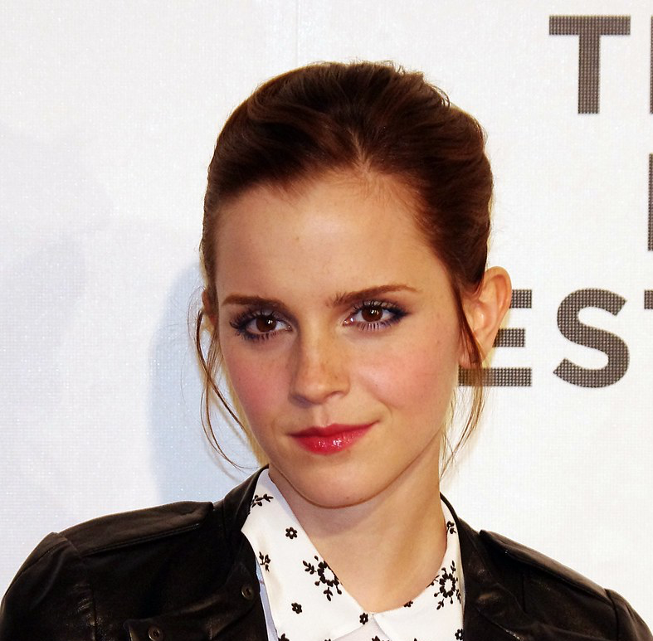
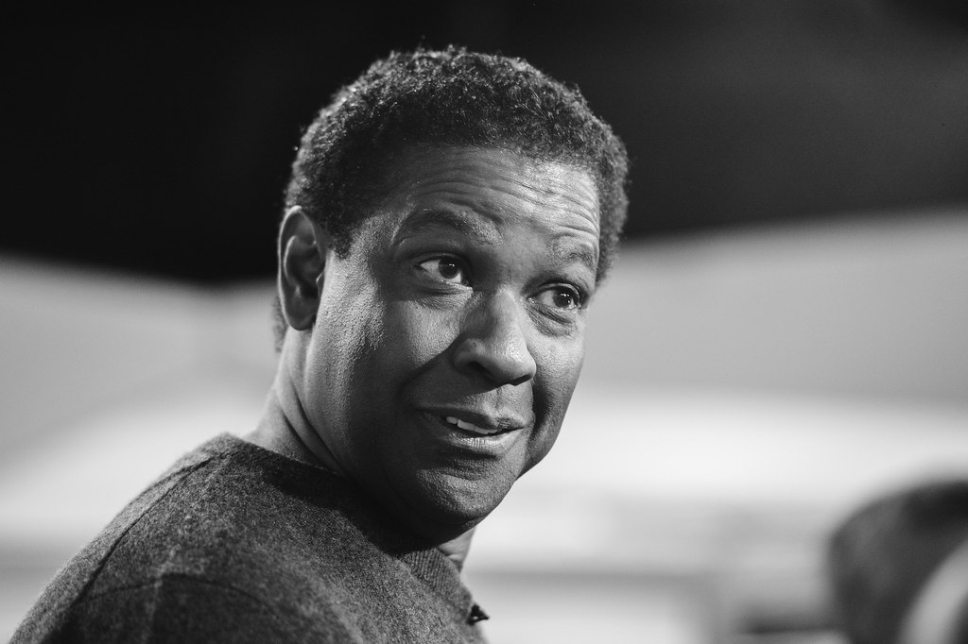
Reliability of Emotional Facial Expression Coding Within and Across Raters
Chloe K. Houghton, Anna L. Norman, Macall R. Walker, Tyson G. Harmon
Brigham Young University, Department of Communication Disorders
Introduction:
Aphasia is an acquired language disorder caused by damage to the language processing centers of the brain.
Emotion (e.g., prosody, word choice, and nonverbal communicative elements) is critical for day-to-day communication for people with or without aphasia.
For people with aphasia (PWA), this interaction is particularly important due to relatively spared emotional processing, which has the potential to either facilitate or interfere with language processing (Blackett et al., 2024; Harmon et al., 2022; Ramsberger, 1996).
Emotional facial expressions are one aspect of emotional processing that can provide insight about how aphasia impacts emotional experiences.
Additionally, there are different ways to analyze facial expressions, such as Likert scales, computer software, etc. (Blonder et al., 1993).
However, there is little information about the reliability of facial coding techniques that rely on human coders.
Thus, the purpose of this study is to explore the reliability within and across coders utilizing a modified Facial Expression Coding System (FACES; Kring & Sloan, 1991).
Aims:
1. Does intra-rater and inter-rater reliability surpass 70% for all of the following dependent variables: frequency and intensity of positively valenced emotional facial expressions, frequency and intensity of negatively valenced emotional facial expressions ?
Hypothesis: Intra-rater reliability and inter-rater reliability results for frequency and intensity of positively valenced emotional facial expressions and frequency and intensity of negatively valenced emotional facial expressions across two coders will reach or surpass 70% in all four dependent variables.
Methods:
Participants: This study used samples from 52 people with and without aphasia, obtained from Aphasia Talk Bank (MacWhinney et al., 2011). 26 of these participants had aphasia. The samples used included two narrative discourse tasks (i.e., stroke/illness story and important life event story.)
Protocol: Research assistants were trained to use a modified Facial Expression Coding System (FACES) to code emotional facial expressions (Kring & Sloan, 1991). The FACES protocol is designed for human coders to identify facial expressions according to valence (positive/negative), intensity (Likert scale of 1-4 based on units of the face), and duration (time start until time end). The original FACES protocol was intended for coding facial expressions of participants who were performing an observation task. The modified protocol was designed to apply this coding system to emotional facial expressions produced during discourse tasks.
Data Analysis: To obtain intra-rater and inter-rater reliability, at least 10% of samples were recoded within and across undergraduate coders. Intraclass correlation coefficients were obtained for reliability analysis. The results investigate intra-rater and inter-rater reliability across three variables: interval accuracy, valence accuracy, and intensity correlation. Data analysis for these variables was performed using Pearson's r.
Training Process:
Research assistants began training with a briefing of the FACES protocol and explanation of the project. Team leads coded video segments with research assistants to demonstrate how to rate valence and intensity. Research assistants then completed a series of practice files to familiarize themselves with the coding process and ask questions.
After completing a series of practice files, the research assistants completed pass-off files, during which they were required to work independently. Coders passed the training after obtaining at least 80% accuracy or r = .8 in two of the three categories (i.e., interval accuracy, valence accuracy, and intensity correlation) and 70% accuracy or r = .7 in one of the categories when compared against the master coding. To assess pass-off data, coder data was compared with the team leads' codes across three variables: interval accuracy (i.e., number of matched codes divided by the total number of codes), valence accuracy (i.e., percentage of matched valence codes), and intensity correlation (i.e., Pearson's r). Upon meeting this criteria, research assistants began coding data for the study.
Results:
Inter-Rater Reliability
As hypothesized, the frequency for both positive and negative facial expressions and the intensity for positive facial expressions surpassed r = 0.7 for inter-rater reliability.
Contrary to the hypothesis, the intensity for negative facial expressions did not surpass r = 0.7 for inter-rater reliability.
Intra-Rater Reliability (MW)
As hypothesized, the frequency for both positive and negative facial expressions and the intensity for positive facial expressions surpassed r = 0.7 for MW's intra-rater reliability.
Contrary to the hypothesis, the intensity for negative facial expressions did not surpass r = 0.7 for MW's intra-rater reliability.
Intra-Rater Reliability (ML)
As hypothesized, the frequency and intensity for both positive and negative facial expressions surpassed 0.7 for ML's intra-rater reliability.
Discussion:
Our reliability results demonstrate that negative intensity was the most difficult variable for which to achieve high reliability between and within coders.
Participants generally produced less negative facial expressions making the weight of each intensity rating greater for negative compared with positive facial expressions.
The operationalized intensity rating system for negative facial expressions is more ambiguous than for positive facial expressions.
Our protocol should be modified with clearer, replicable examples for these ratings.
A lack of replicable examples for negative facial expressions may be a contributing factor to lower reliability for negative intensity.
Future Direction:
This project is a part of a larger study investigating facial expressivity between PWA and healthy adults. Another subset of this project is investigating facial expressivity between genders.
The results from this study, specifically in regards to negative intensity, will help to make informed changes about the modified FACES protocol for three new research assistants training to facial code.
A new project investigating facial expressivity between aphasia types is underway.
Emotional Facial Expression: neutral non-neutral back to neutral
Negative
Negative
Positive
Positive
Results
Table 1: Inter-rater and intra-rater reliability
 | Frequency |  | Intensity
 | Positive | Negative | Positive | Negative
Inter-rater | .766 | .986 | .896 | .634
Intra-rater (MW) | .978 | .965 | .772 | .655
Intra-rater (ML) | .904 | .867 | .704 | .774
References
Blackett, D., Borod, J. C., Speer, S. R., Pan, X., & Harnish, S. M. (2024). The effects of emotional stimuli on word retrieval in people with aphasia. Neuropsychologia, 192, 108734. https://doi.org/10.1016/j.neuropsychologia.2023.108734
Blonder, L. X., Burns, A. F., Bowers, D., Moore, R. W., & Heilman, K. M. (1993). Right hemisphere facial expressivity during natural conversation. Brain and Cognition, 21(1), 44–56. https://doi.org/10.1006/brcg.1993.1003Blonder, L. X., Burns, A. F., Bowers, D., Moore, R. W., & Heilman, K. M. (1993). Right hemisphere facial expressivity during natural conversation. Brain and Cognition, 21(1), 44–56. https://doi.org/10.1006/brcg.1993.1003
Harmon, T. G., Neilsen, C., Loveridge, C., & Williams, C. (2022). Effects of positive and negative emotion on picture naming for people with mild to moderate aphasia: A preliminary investigation. Journal of Speech, Language and Hearing Research, 1–19.
Kring, A. M., & Sloan, D. M. (2007). The facial expression coding system (FACES): Development, validation, and utility. Psychological Assessment, 19(2), 210–224. https://doi.org/10.1037/1040-3590.19.2.210
Kring, A. M., & Sloan, D. M. (1991). The Facial Expression Coding System (FACES): A
Users Guide. [Unpublished manuscript]
MacWhinney, B., Fromm, D., Forbes, M. & Holland, A. (2011). AphasiaBank: Methods for studying discourse. Aphasiology, 25,1286-1307.
Openverse. (n.d.). https://openverse.org/ projects
Wikimedia Commons. https://commons.wikimedia.org/wiki/Main_Page
Ramsberger, G. (1996). Repetition of emotional and nonemotional words in aphasia. Journal of
Medical Speech-Language Pathology, 4(1), 1–12. 913. https://doi.org/10.1207/s15327752jpa8502.
Wikimedia Commons. https://commons.wikimedia.org/wiki/Main_Page
Acknowledgements:
We would like to express our gratitude to The McKay School of Education (MSE) Experiential Learning Grant for helping to fund this project. We would also like to give a special thanks to research assistants Anna N., Macall W., Audrey S., Leila M., Marin L., Mari M., Chloe H., Olivia S., Tyson H., who helped make data analysis possible.

