Slide 1




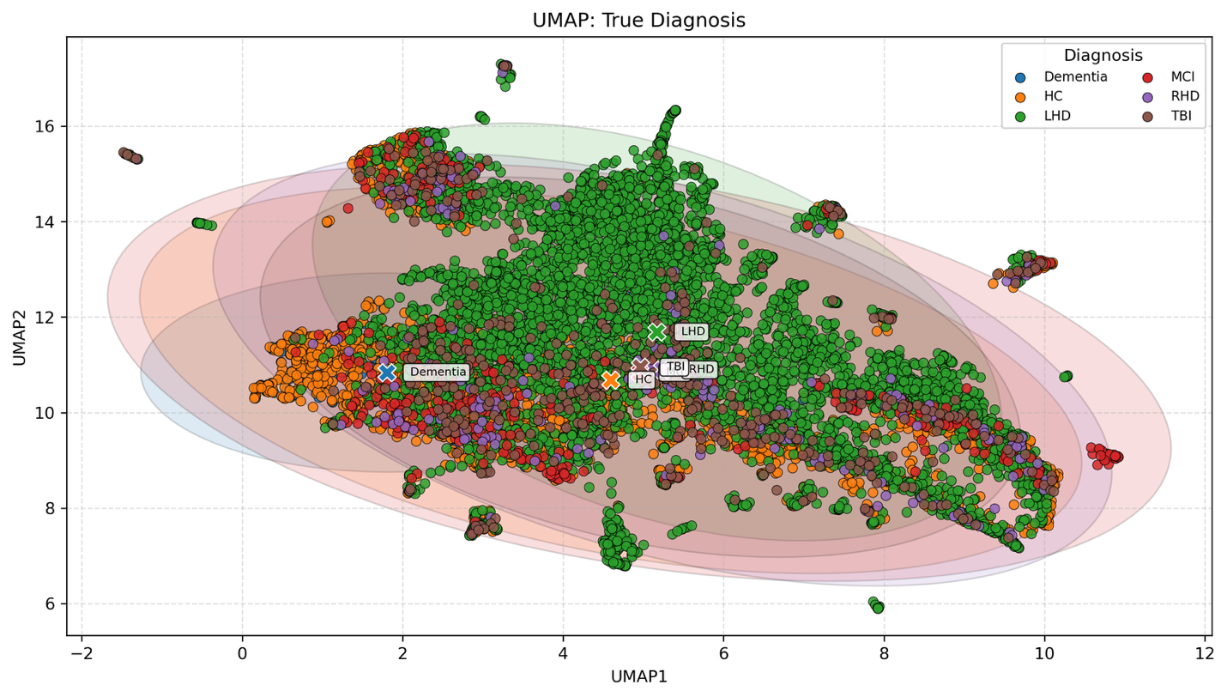
Mapping Patient Linguistic Profiles to Underlying Neurological Conditions using AI
Charalambos Themistocleous and Brielle Stark
¹Department of Special Needs Education, Faculty of Education, University of Oslo, Oslo 0371, Norway
²Speech, Language and Hearing Sciences Department, Indiana University Bloomington, 2631 E Discovery Parkway, Bloomington, IN 47408, USA
Introduction
Results
Individuals with left-hemisphere damage (LHD), right-hemisphere damage (RHD), dementia, mild cognitive impairment (MCI), traumatic brain injury (TBI), and healthy controls are characterized by overlapping clinical profiles affecting communication and social interaction.
Language provides a rich, non-invasive window into neurological health, yet objective and scalable methods to automatically differentiate between conditions with are lacking.
This study developed comprehensive neurolinguistic computational measures of these conditions evaluated on corpora and develop a multiclass ML screening and language assessment model (NeuroScreen).
The individuals for this study were drawn from Neural Databank collected and developed by the second author (Stark et al., 2023), now part of the Aphasia Bank, and data from the TalkBank consortium (https://talkbank.org), which following a similar protocol. Each clinical bank (e.g., AphasiaBank, RHDBank) has an established discourse protocol that elicits a variety of discourse genres (MacWhinney, 2025).
Employing natural language processing (NLP) via the Open Brain AI platform (http://openbrainai.com), we extracted multiple linguistic features from the speech samples, including readability, lexical richness, phonology, morphology, syntax, and semantics.
A Deep Neural Network architecture (DNN) classifies these conditions from linguistic features with high accuracy (up to 91%).
A linear mixed-effects model approach was employed to determine the biomarkers of the neurological conditions, revealing distinct, quantitative neurolinguistic properties.
LHD and TBI show widespread deficits in syntax and phonology; MCI is characterized by fine-grained simplification; patients with dementia present with specific lexico-semantic impairments; and RHD shows the most preserved profile.
Ultimately, the outcomes provide an automatic detection and classification model of key neurological conditions affecting language, along with a novel set of validated neurological markers for facilitating differential diagnosis, remote monitoring, and personalized neurological care.
Group | Lexicon & Vocabulary | Phonology & Morphology | Syntax & Structure | Readability & Complexity | Notable Patterns / Compensations
LHD | Fewer total words, lower lexical diversity | Reduced syllable complexity; fewer nouns, verbs, and modifiers | Shorter, simpler sentences | Language is markedly easier to read | Impoverished semantic, lexical, phonological, syntactic output
TBI | Fewer total and content words but relatively higher diversity within reduced output | Simpler phonology; mixed morphological use with some compensatory strategies | Shorter, less complex sentences | Language objectively simplified | Varied vocabulary despite reduced output; simpler language in terms of readability; simpler syntax
Dementia (amnestic) | Slight reductions in word count and diversity; preference for shorter words | Phonology largely intact; mild reductions in some word classes | Mild reduction in complex structures (e.g., dependent clauses) | Moderately simplified language | High individual variability; some objective semantic, lexical, morphological, and syntactic simplification
MCI (mostly amnestic) | Fewer total and content words but relatively higher diversity within reduced output | Mild phonological impairments: morphology largely preserved | Shorter sentences; reduced use of complex syntax (e.g., prepositional phrases) | Language simpler and more accessible than controls | Varied vocabulary despite reduced output; simpler language in terms of readability; simpler syntax
RHD | Similar to healthy controls overall, small decrease in comparative adjectives, second-person pronouns and cardinal numbers | Phonology and morphology largely intact | Syntax comparable to controls | No significant changes | Subtle decreases in specific vocabulary (e.g., comparative adjectives)
Goals
Methods
Discussion
Stark, et al. (2023). Test–retest reliability of microlinguistic information derived from spoken discourse in persons with chronic aphasia. JSLH
McKinney, W. (2010). Data Structures for Statistical Computing in Python. https://doi.org/10.25080/Majora-92bf1922-00a
Themistocleous, C. (2024). Open Brain AI and language assessment. Frontiers in Human Neuroscience, 18.
Fig. 1. NeuroScreen machine learning pipeline architecture for automated neurological assessment.
Fig.1 UMAP visualization of linguistic profiles colored by clinical diagnosis.

