Slide 1
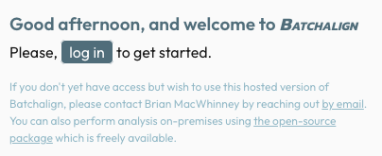
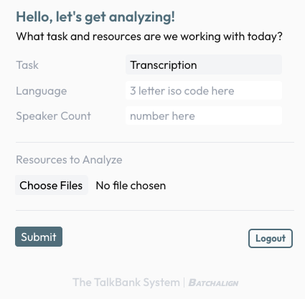
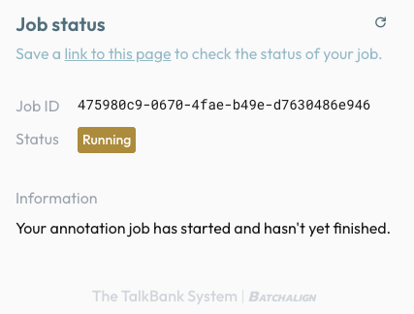
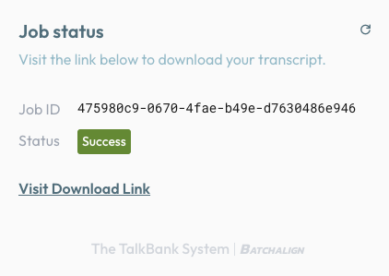
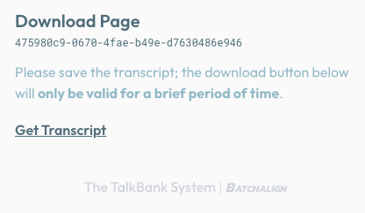
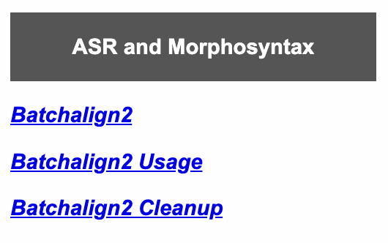
Language Transcription and Analysis Web Service
Davida Frommª, Brian MacWhinneyª, & Houjun Liu^{b}
ªCarnegie Mellon University, ^{b}Stanford University
OBJECTIVE
METHOD
RESULTS – FINAL PRODUCT
To facilitate free, fast, and easy automated transcription and morphosyntactic analysis for discourse analysis by clinicians.
The aim of this poster presentation is to introduce a new web service for transcription and morphosyntactic tagging that requires no technical expertise [1].
Go to this web address -- https://whisper.talkbank.org/ -- to log in.
Here is the transcript after doing the TRANSCRIPTION task, human checking, and then the MORPHOSYNTACTIC ANALYSIS task:
@Begin
@Languages: eng
@Participants: PAR Participant, INV Investigator
@Options: multi
@ID: eng|Fridriksson|PAR|||||Participant|||
@ID: eng|Fridriksson |INV|||||Investigator|||
@Media: red7, audio
*PAR: <the guy> [//] the lady's pouring a drink . •
%mor: det|the-Def-Art noun|lady~part|s verb|pour-Ger-S det|a-Ind-Art noun|drink-Acc .
%gra: 1|2|DET 2|4|NSUBJ 3|2|CASE 4|6|ROOT 5|6|DET 6|4|OBJ 7|4|PUNCT
%wor: the •1385_1605• guy •1665_1885• the •1985_2205• lady's •2385_2805• pouring •3195_3685• a •3725_3845• drink •3845_4085• .
*PAR: they're having a picnic . •
%mor: pron|they-Prs-Nom-P3~aux|be-Fin-Ind-Pres-P3 verb|have-Part-Pres-S det|a-Ind-Art noun|picnic-Acc .
%gra: 1|3|NSUBJ 2|3|AUX 3|5|ROOT 4|5|DET 5|3|OBJ 6|3|PUNCT
%wor: they're •4795_5285• having •5285_5405• a •5525_5645• picnic •5645_5885• .
*PAR: the &-uh boy is flying a kite . •
%mor: det|the-Def-Art noun|boy aux|be-Fin-Ind-Pres-S3 verb|fly-Part-Pres-S det|a-Ind-Art noun|kite-Acc .
%gra: 1|2|DET 2|4|NSUBJ 3|4|AUX 4|6|ROOT 5|6|DET 6|4|OBJ 7|4|PUNCT
%wor: the •7785_8005• uh •8065_8285• boy •10385_10605• is •10745_10965• flying •11985_12405• a •12565_12685• kite •12795_13085• .
*PAR: his dog is playing [/] playing around . •
%mor: pron|his-Prs-Gen-S3 noun|dog aux|be-Fin-Ind-Pres-S3 verb|play-Part-Pres-S adv|around .
%gra: 1|2|NMOD-POSS 2|4|NSUBJ 3|4|AUX 4|5|ROOT 5|4|ADVMOD 6|4|PUNCT
%wor: his •14105_14325• dog •14665_14885• is •14985_15205• playing •15555_16045• playing •16955_17445• around •17465_17885• .
*PAR: &-uh the [//] on the other side of the dog is the man &-uh fishing . •
%mor: adp|on det|the-Def-Art adj|other-S1 noun|side adp|of det|the-Def-Art noun|dog aux|be-Fin-Ind-Pres-S3 det|the-Def- Art noun|man noun|fishing-Ger .
%gra: 1|4|CASE 2|4|DET 3|4|AMOD 4|11|OBL 5|7|CASE 6|7|DET 7|4|NMOD 8|11|COP 9|11|DET 10|11|COMPOUND 11|11|ROOT 12|11|PUNCT
%wor: uh •19425_19645• the •20505_20725• on •23105_23325• the •23325_23485• other •23485_23605• side •23605_23885• of •23885_24045• the •24045_24205• dog •24465_24685• is •24785_25005• the •25025_25245• man •26965_27185• uh •27405_27625• fishing •27855_28345• .
*PAR: and this one is this boy is playing in the water . •
%mor: cconj|and det|this-Def-Dem-Sing noun|one aux|be-Fin-Ind-Pres-S3 det|this-Def-Dem-Sing noun|boy aux|be-Fin-Ind- Pres-S3 verb|play-Part-Pres-S adp|in det|the-Def-Art noun|water .
%gra: 1|8|CC 2|3|DET 3|8|NSUBJ-OUTER 4|8|COP 5|6|DET 6|8|NSUBJ 7|8|AUX 8|11|ROOT 9|11|CASE 10|11|DET 11|8|OBL 12|8|PUNCT
%wor: and •30435_30655• this •30925_31215• one •31235_31455• is •31595_31815• this •32005_32295• boy •32355_32575• is •32675_32895• playing •33165_33655• in •34955_35175• the •35175_35295• water •35295_35575• .
*PAR: and the sailboat is moving around . •
%mor: cconj|and det|the-Def-Art noun|sailboat aux|be-Fin-Ind-Pres-S3 verb|move-Part-Pres-S adv|around .
%gra: 1|5|CC 2|3|DET 3|5|NSUBJ 4|5|AUX 5|6|ROOT 6|5|ADVMOD 7|5|PUNCT
%wor: and •35755_35975• the •36435_36655• sailboat •36845_37615• is •37755_37975• moving •37975_38375• around •38535_38895• .
Figure 1. Log in page
6 Simple steps
BACKGROUND
Spontaneous speech is the most ecologically valid measure of communication abilities and the most important skill people with aphasia (PWA) want to improve.
Yet, transcription and discourse analysis are labor-intensive and require expertise that prevents many clinicians from analyzing connected speech samples [2].
Tools like CLAN ( https://dali.talkbank.org/clan/ ) make transcribing and analyzing language less onerous, but CLAN may not be available to everyone, and many potential users may not have the time to learn how to use the time-saving tools.
Recent advancements in automatic speech recognition (ASR) and natural language processing (NLP) have made it possible to develop an automated pipeline, Batchalign2, to create CHAT transcripts from audio or video files [3]. This has had a huge impact on speeding up the transcription process.
Yet, this pipeline is not feasible for many users who could benefit from it. For example, they may be unable to install Python, which is necessary for using the pipeline, or they may not have enough memory on their computer to run the ASR program.
LOG IN – The service is hosted by TalkBank based on an agreement to contribute data
Figure 2. Welcome screen
Select the task:
Transcription
Morphosyntactic analysis (using Universal Dependencies -- https://universaldependencies.org/)
Input language code (e.g., eng)
Enter # of speakers
5. Choose media file from your computer
6. Press Submit button
Figure 3. Job status pages – RUNNING, COMPLETED with download link
ASR RESOURCES at TALKBANK
https://talkbank.org/
Where can I GET batchalign?
What does it take to INSTALL and USE batchalign?
How do I CHECK and CLEAN UP A batchalign file?
Figure 5. Download page
Graph of the dependency structure of final sentence – viewable by triple clicking on the %gra tier.
FUTURE WORK
github repository for batchalign and other TalkBank tools
RESULTS – FIRST PASS
1. Add ability to run on a whole folder of uploaded files at once
2. Add ability to insert an English translation line for non-English materials
3. Based on #2, add ability to run on the web of the CLAN programs including EVAL and FluCalc
4. Add acoustic analysis
5. Add ability to analyze accuracy of script productions
pdf file with instructions for installing batchalign
pdf file with instructions for human checking of ASR transcript
After running the TRANSCRIPTION task, the ASR output needs to be checked by humans for the following:
Utterance termination decisions – sometimes need to split utterances, sometimes join
Speaker ID accuracy
Accuracy of words transcribed, including capitalization
Revision and repetition coding
Utterance termination markers – ASR uses only periods at the end of utterances
Other codes of interest – e.g., gem (task) markers, [+ exc] for non-task utterances, underscores and fillers for &-you_know and &-like
Then repeat steps 2-5 above using the checked transcript and choosing the MORPHOSYNTACTIC ANALYSIS task to get a new version of the transcript within a couple seconds with %mor tiers showing the universal dependency codes and %gra tiers showing grammatical relations for each of the words .
What about PRIVACY and CONFIDENTIALITY?
LIMITATIONS
The process is not fully automatic. A human still needs to check the file for accuracy and do some cleanup.
It works on MANY languages -- https://stanfordnlp.github.io/stanza/performance.html -- but some languages for some tasks work better than others.
Stanza models -- a Python library created by the Stanford NLP Group that provides a suite of tools for analyzing and processing text in many human languages -- are downloaded to CMU computers
The input files are transferred securely via https
We perform the analysis entirely locally to CMU computers
We forward the results back again via https to the user
References & Acknowledgment
[1] Liu, H., & MacWhinney, B. (2024). Morphosyntactic analysis for CHILDES. Language Development Research 4(1), 233-258.
[2] Bryant, L., Spencer, E., & Ferguson, A. (2017). Clinical use of linguistic discourse analysis for the assessment of language in aphasia. Aphasiology, 31(10), 1105-1126.
[3] Liu, H., MacWhinney, B., Fromm, D., & Lanzi, A. (2023). Automation of language sample analysis. Journal of Speech, Language, and Hearing Research, 66(7), 2421-2433.
This work was funded by NIH-NIDCD grant R01-DC008524 (2022-2027).

