Slide 1
AphasiaBank
Discourse Tasks
Control Participants

Slide 2
These instructions explain how to administer the discourse tasks of the AphasiaBank protocol and include the detailed script for examiners to follow.
Allow ample time for as full a response as each participant can provide using this protocol script.
To facilitate transcription, the examiner's speech, including verbal encouragers, should be kept to a minimum. Use nonverbal encouragers (e.g., head nods, facial expressions, eye contact) instead of verbal encouragers (e.g., “I see”, “mhm”, “yeah”) whenever possible.

Slide 3
SECTION I: FREE SPEECH SAMPLES
Start with a preliminary unrecorded conversation for social exchanges, signing consent forms, explaining about recording the session, answering any questions, and so forth.
BEGIN RECORDING
If your institution requires it, record the following preamble about informed consent, then lead in to the first recorded protocol item (Illness Story). If not, go straight to the Illness Story.
Investigator: "This participant has signed an informed consent form. These data can be used for ______________ (specify: research, teaching, or any purpose). These data are not to be used for ____________ (specify any restrictions)."

Slide 4
A. ILLNESS and COPING
1. “In this research project, I ask people who've had strokes to tell me what they remember about when they had their stroke. Since you haven't had a stroke, I wonder if you could tell me what you remember about any illness or injury you've had.”
If no response in approximately 10 seconds, prompt:
“Tell me about any time you’ve been sick or hurt.”

Slide 5
2. “Tell me about your recovery from that illness (or injury).
What kinds of things did you do to get better?"
If no response in approximately 10 seconds, prompt:
“Tell me about any things you did to get well.”

Slide 6
3. “Have you had any experience with people who have a difficult time communicating?”
If yes, “Please tell me what the problems were and what you did about it.”
If no, “Have you ever had trouble communicating with someone, like
talking to people from another country?”
If no response in approximately 10 seconds, prompt:
“Tell me about a time when you had trouble communicating
with someone or someone had trouble communicating with you.”

Slide 7
“Now I’m going to ask you to do a few more things where you need to talk. Please talk as much as you can about each one, because we’re really interested in knowing about your language."
B. IMPORTANT EVENT
“Thinking back, can you tell me a story about something important that happened to you in your life? It could be happy or sad or from any time -- from when you were a kid or more recently."
If no response in approximately 10 seconds, prompt:
"For instance, you could tell me about a trip you took or something about your family or your work -- anything."

Slide 8
SECTION II: PICTURE DESCRIPTIONS
“Now let’s look at some pictures.”

Slide 9
Picture #1

Slide 10
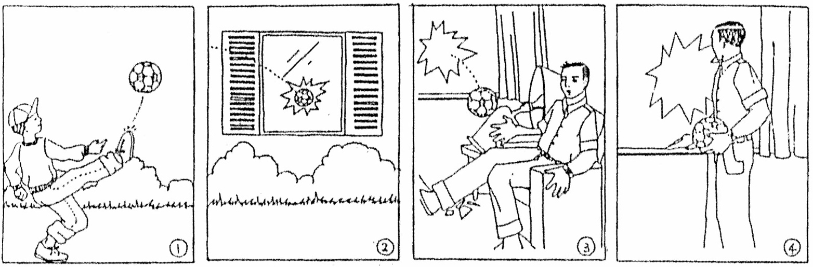
Notes:
Present picture #1 (Broken Window)
“Take a little time to look at the pictures. They tell a story. Take a look at all of them, and then I’ll ask you to tell me the story with a beginning, a middle, and an end. You can look at the pictures as you tell the story.”
If no response in 10 seconds, give second prompt:
“Take a look at the first picture (point to or indicate panel #1) and tell me what you think is happening.” If needed, direct attention to each panel sequentially, giving the prompt: “And what happens here?” or “And what happens in the second picture?” and so on.
For each panel, if no response, provide the prompt:
“Can you tell me anything about this picture?”

Slide 11
Picture #2

Slide 12
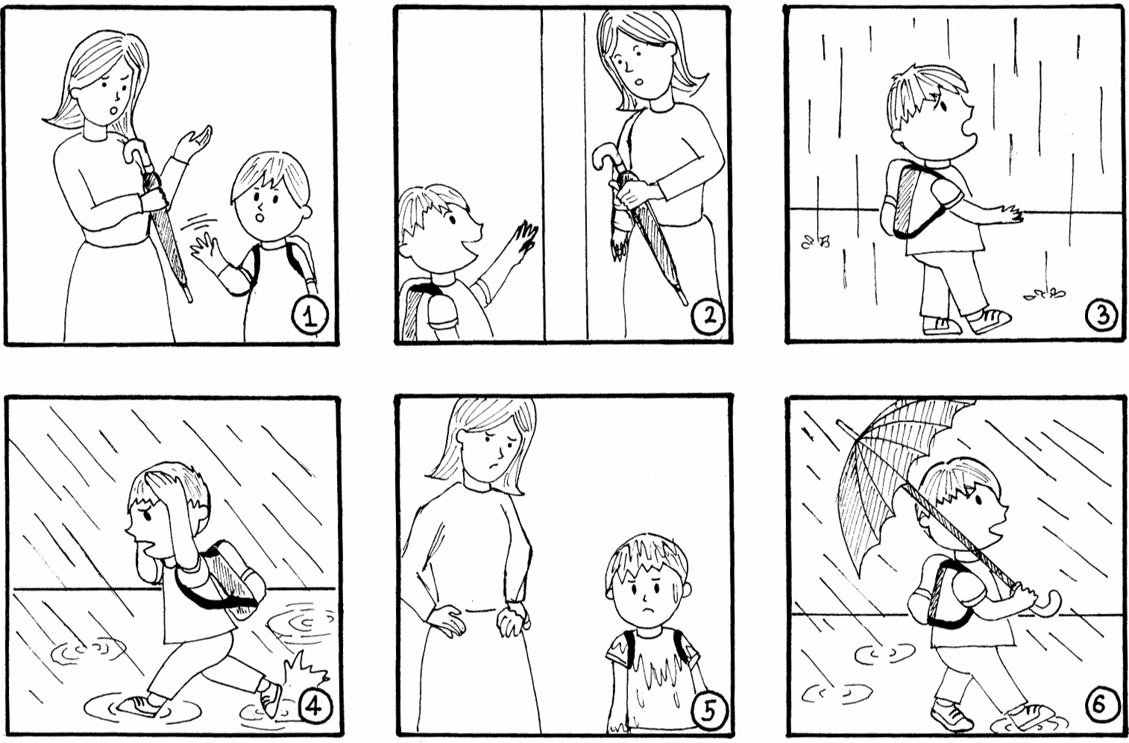
Notes:
Present Picture #2 (Refused Umbrella)
“Here are some more pictures that tell a story. Take a look at all of them, and then I’ll ask you to tell me the story with a beginning, a middle, and an end. Again, you can look at the pictures as you tell the story.”
If no response in 10 seconds, give second prompt:
“Take a look at the first picture (point to or indicate panel #1) and tell me what you think is happening.” If needed, direct attention to each panel sequentially, giving the prompt: “And what happens here?” or “And what happens in the second picture?” and so on.
For each panel, if no response, provide the prompt:
“Can you tell me anything about this picture?”

Slide 13
Picture #3

Slide 14
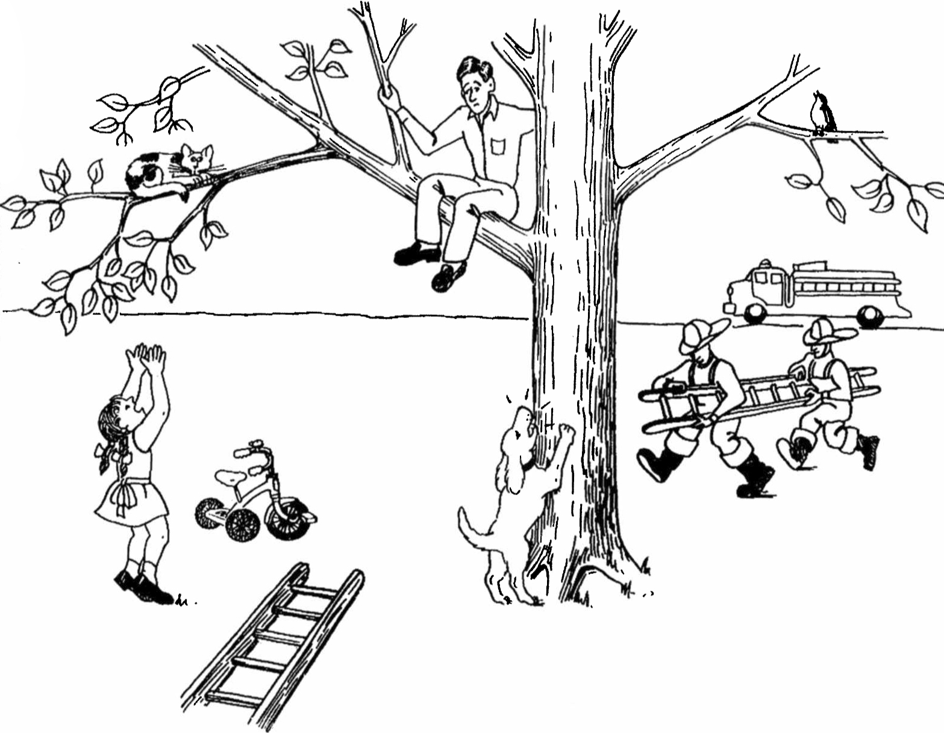
Notes:
Present Picture #3 (Cat Rescue)
“Here is another picture. Look at everything that’s happening and then tell me a story about what you see. Tell me the story with a beginning, a middle, and an end.”
If no response in 10 seconds, give second prompt:
“Take a look (point to picture) and tell me any part of the story.”
If fewer than 2 utterances, give third prompt:
“Anything else you can tell me about the story?”

Slide 15
Story Narrative

Slide 16

Notes:
CINDERELLA
“I’m going to ask you to tell a story. Have you ever heard the story of Cinderella? (Make note of answer for demographic data. If answer is no, ask participant to tell a fairy tale s/he knows.)
Do you remember much about it? Take a look through the pictures from the story book. They might remind you of how it goes. Then, after you finish looking at the pictures, you can tell me the story in your own words.”
After participant looks through all the pictures, remove the book or the pictures and prompt:
“Now tell me as much of the story of Cinderella as you can. You can use any details you know about the story, as well as the pictures you just looked at.”
If participant gives a response of fewer than three utterances, or seems to falter, allow 10 seconds, then prompt:
“What happened next?” or “Go on.”
Continue until participant concludes story or has clearly finished.

Slide 17
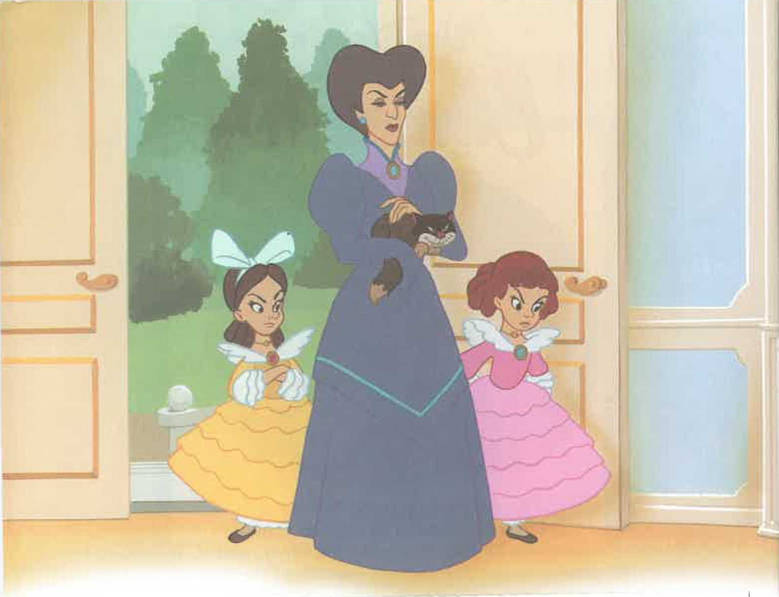

Slide 18
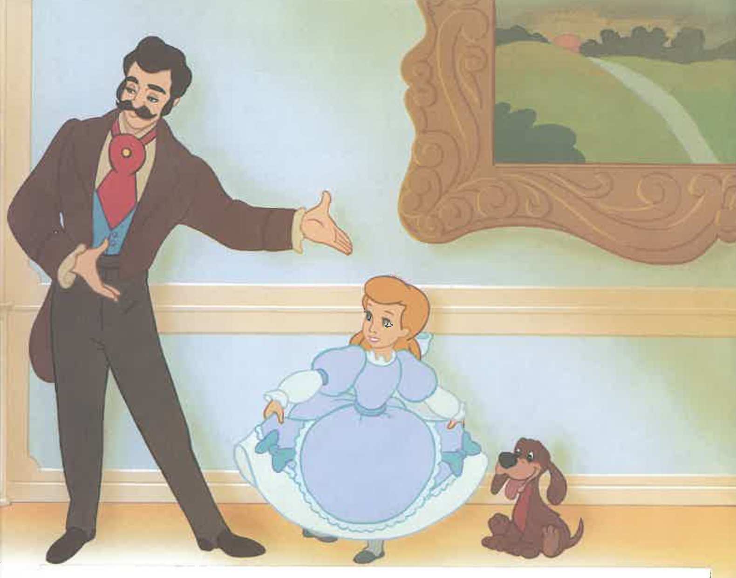

Slide 19
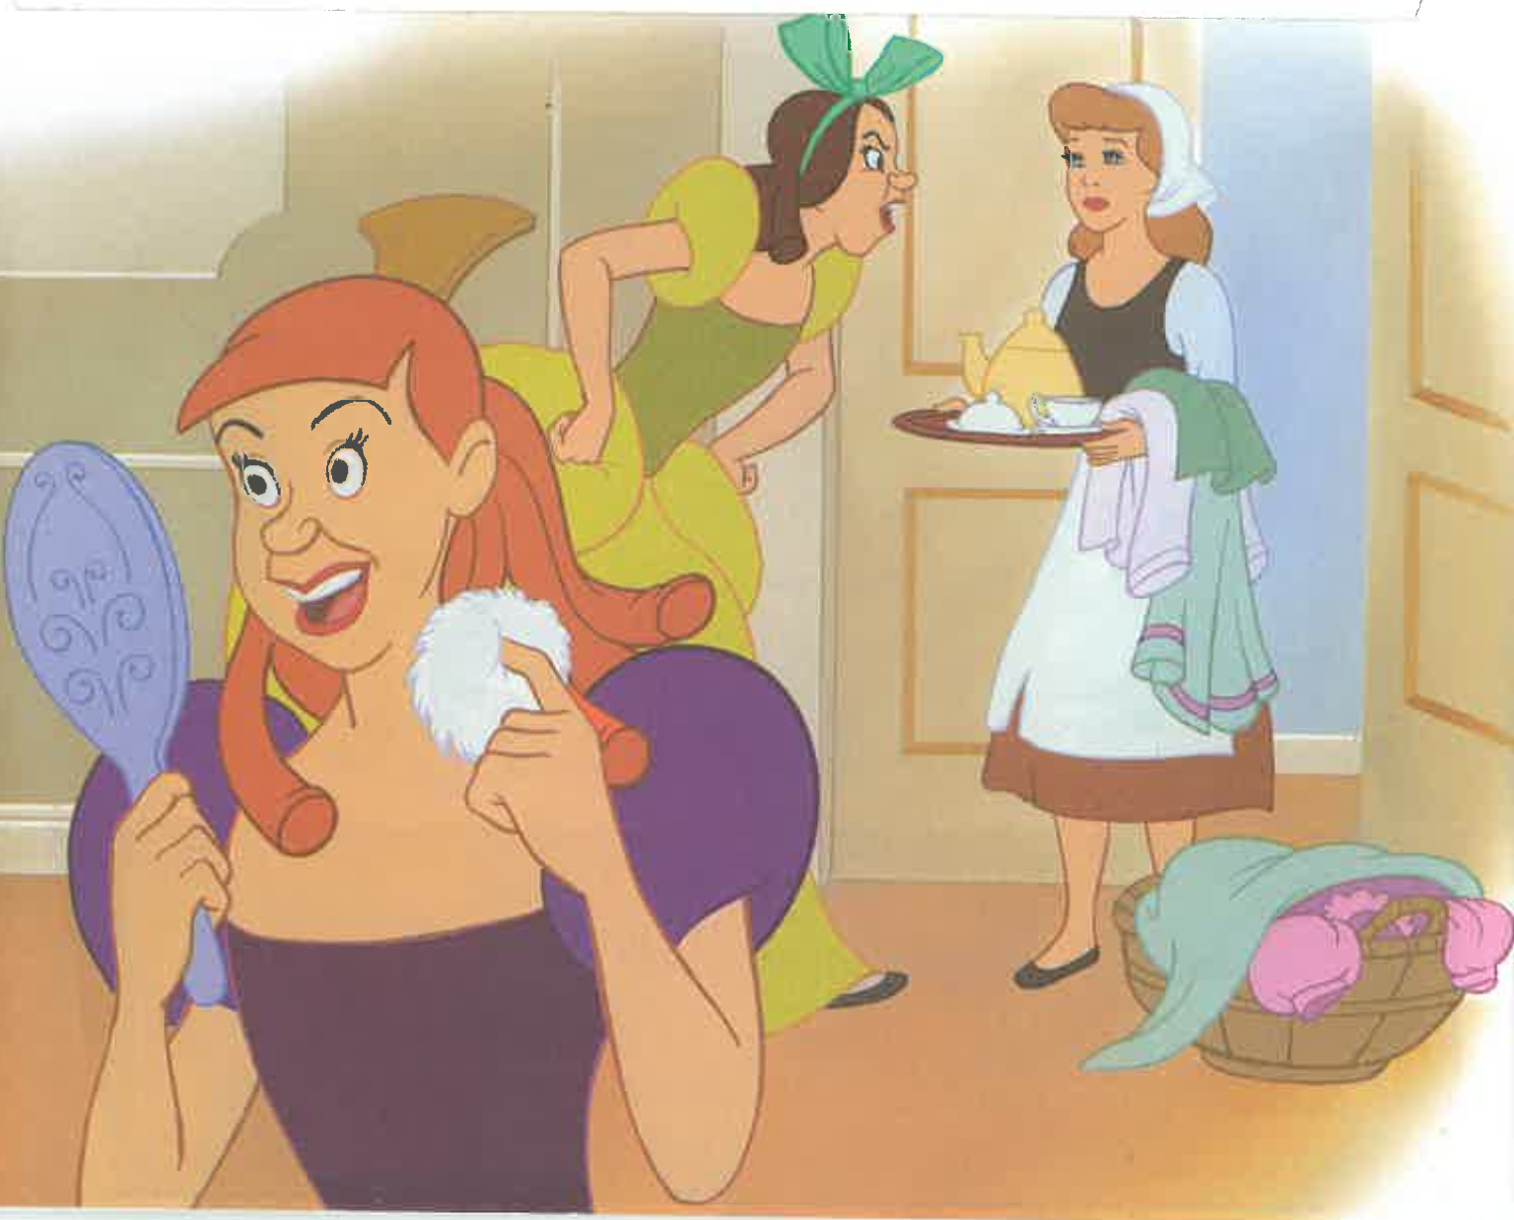

Slide 20
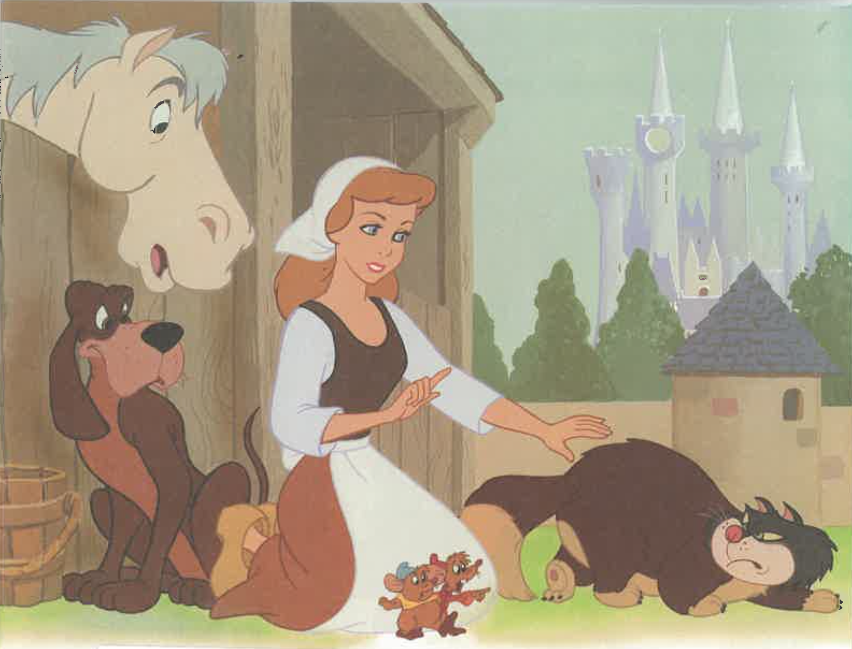

Slide 21
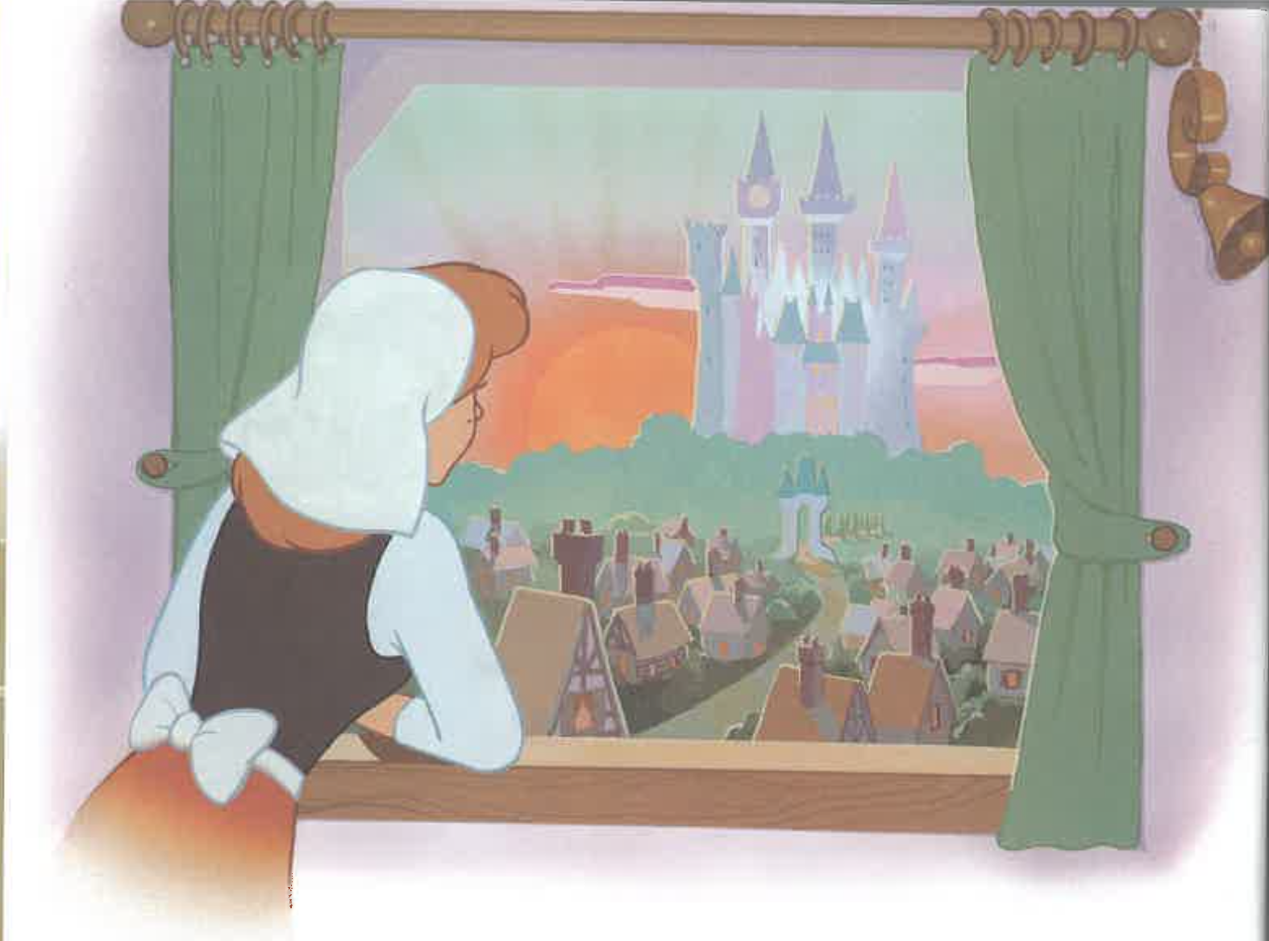

Slide 22
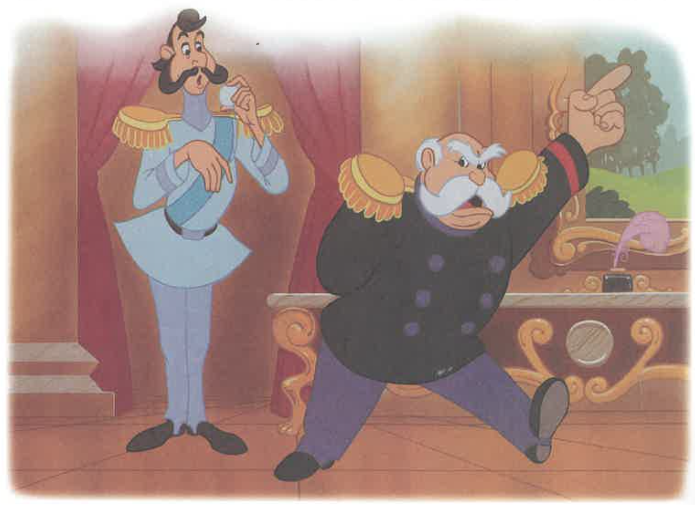

Slide 23
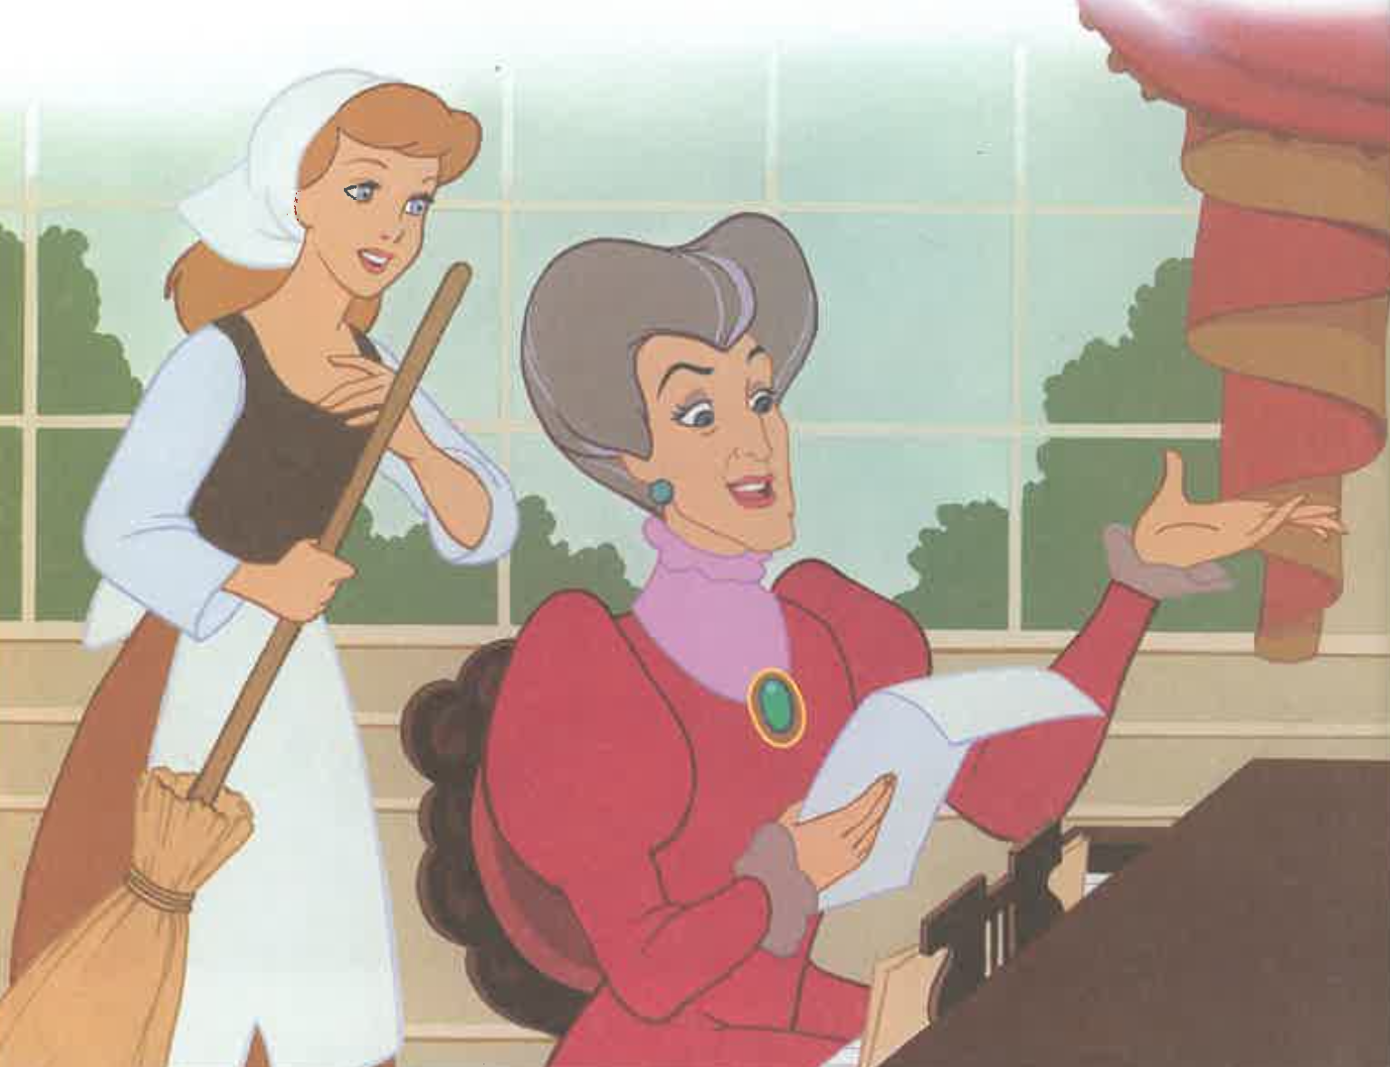

Slide 24
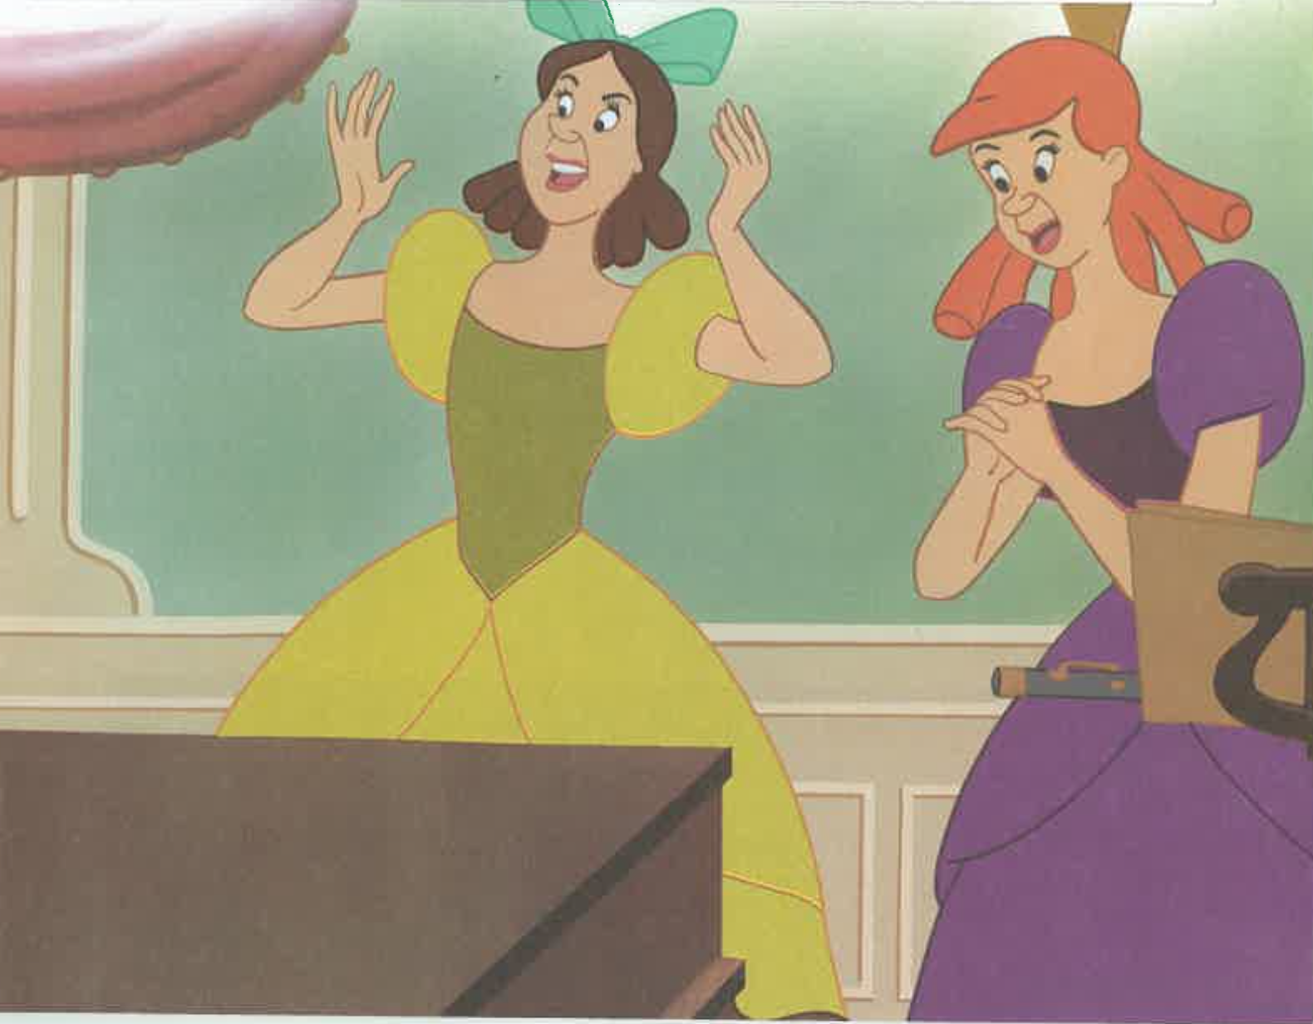

Slide 25
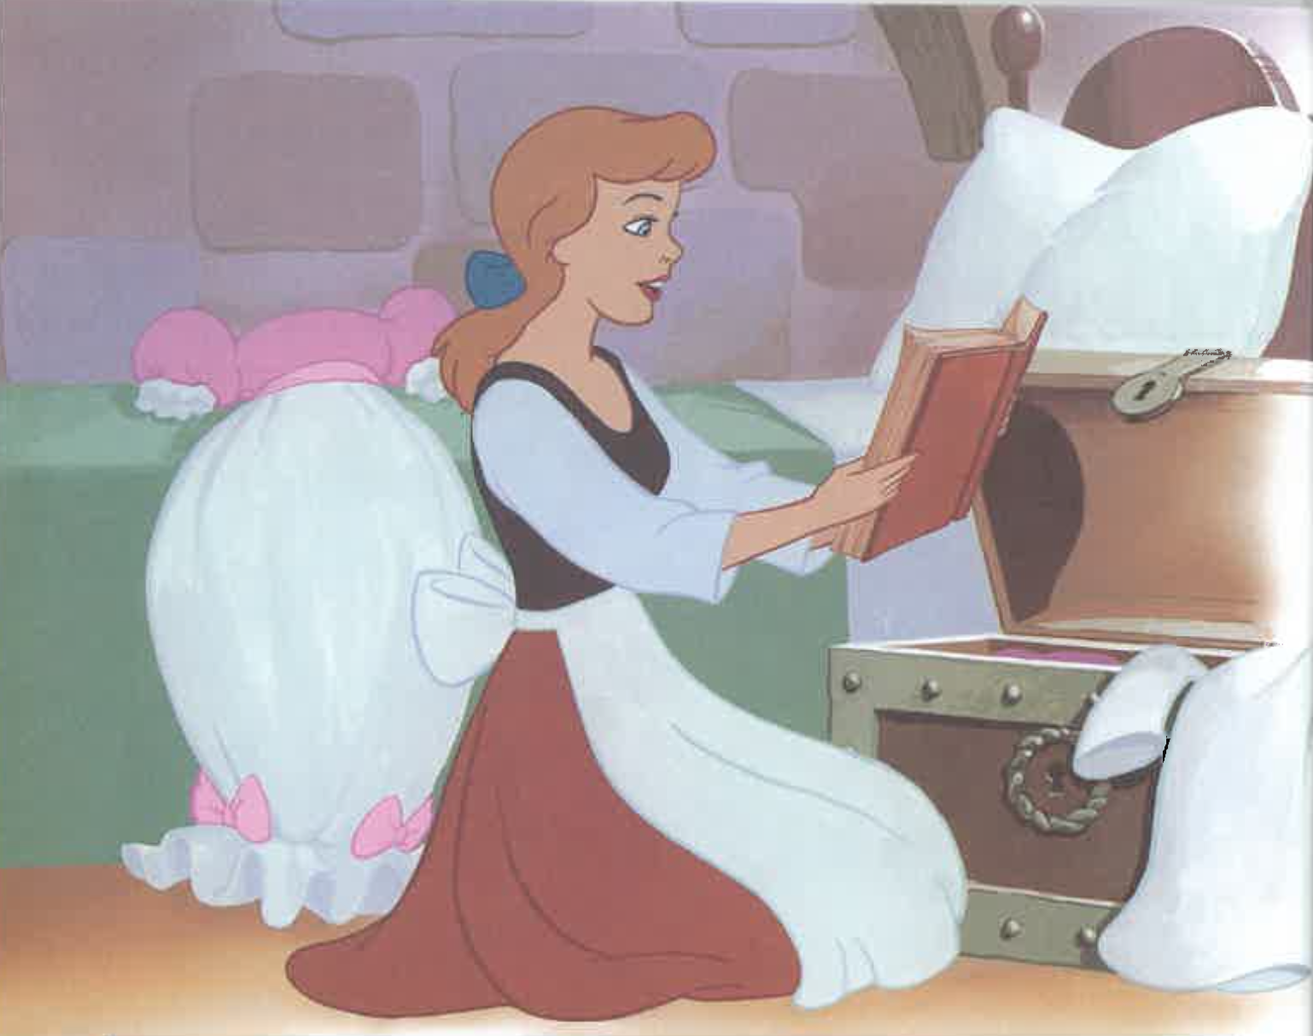

Slide 26
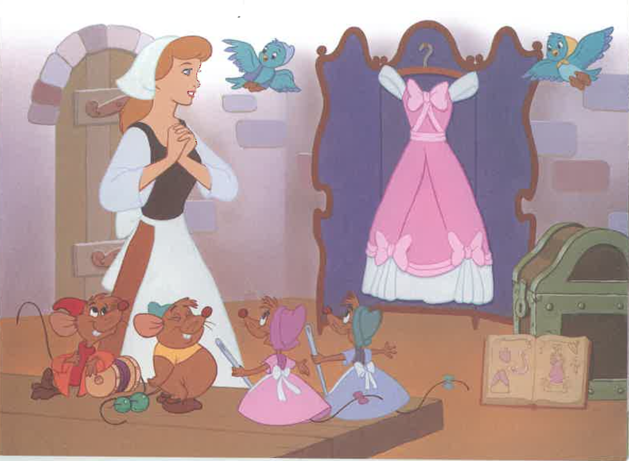

Slide 27
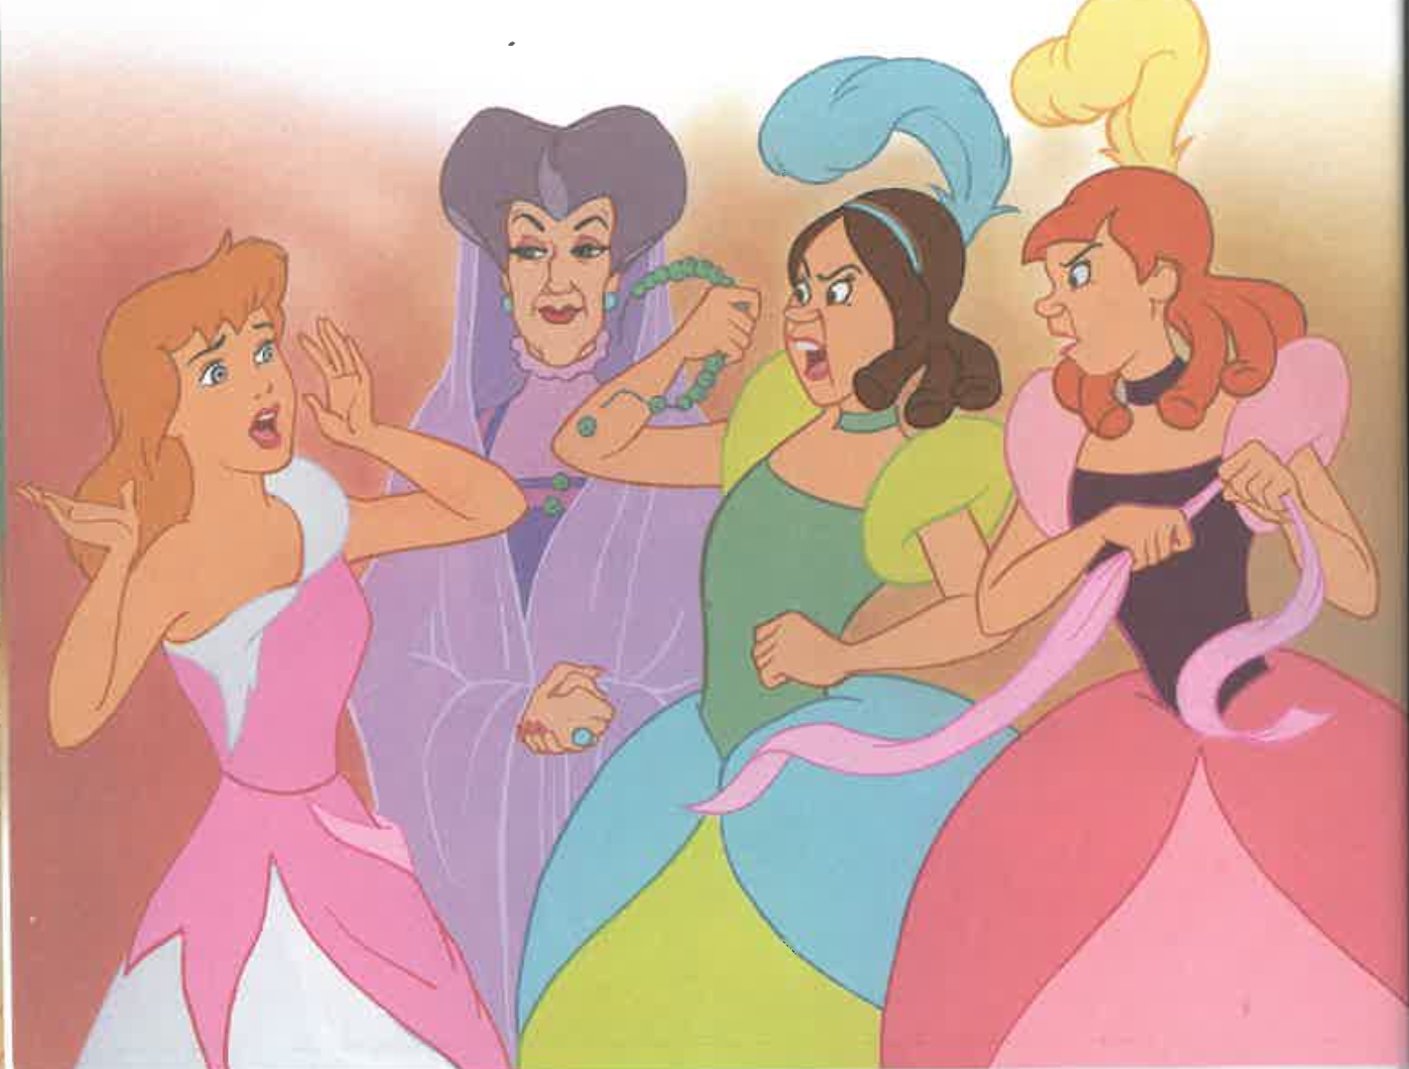

Slide 28
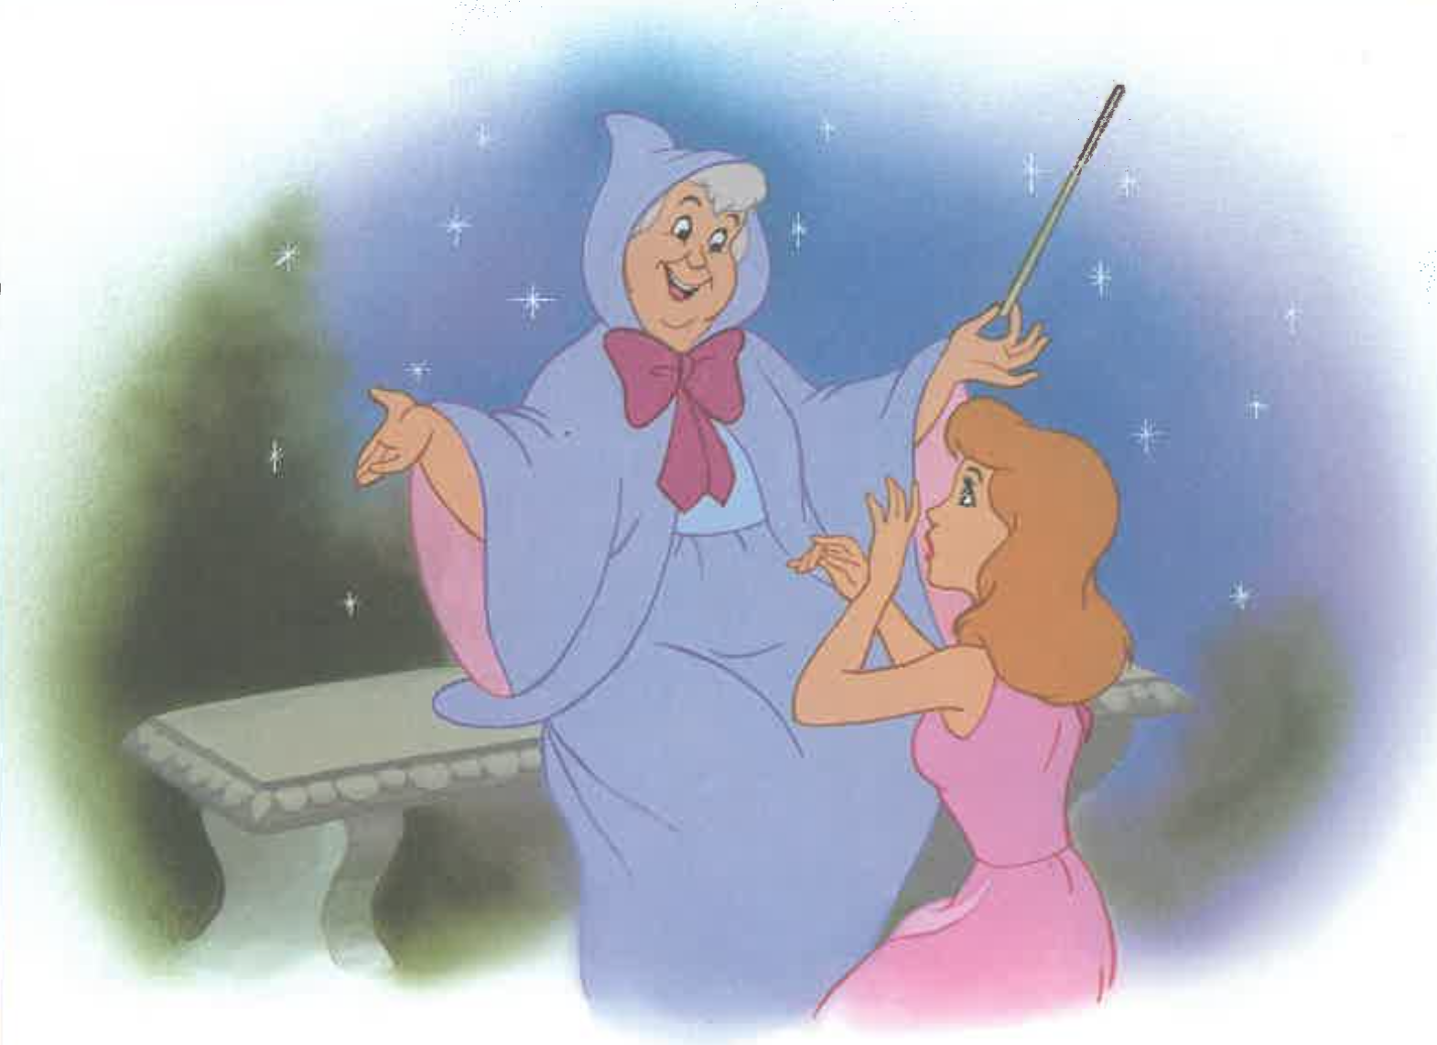

Slide 29
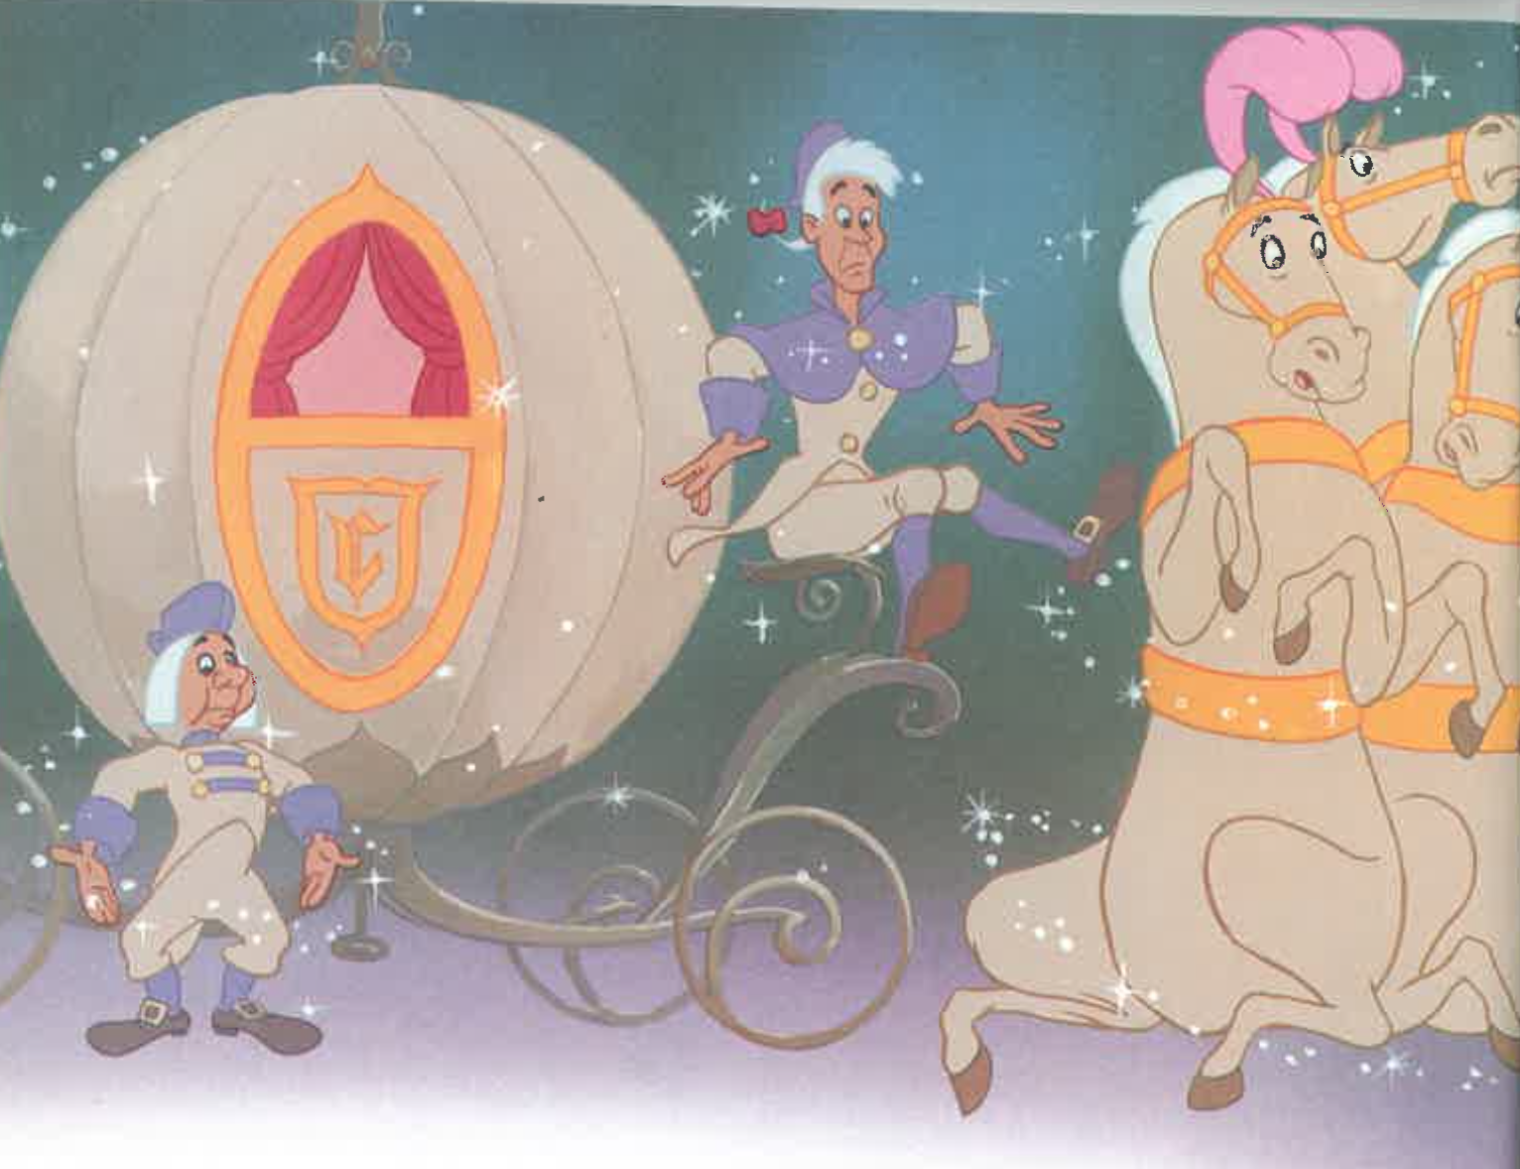

Slide 30
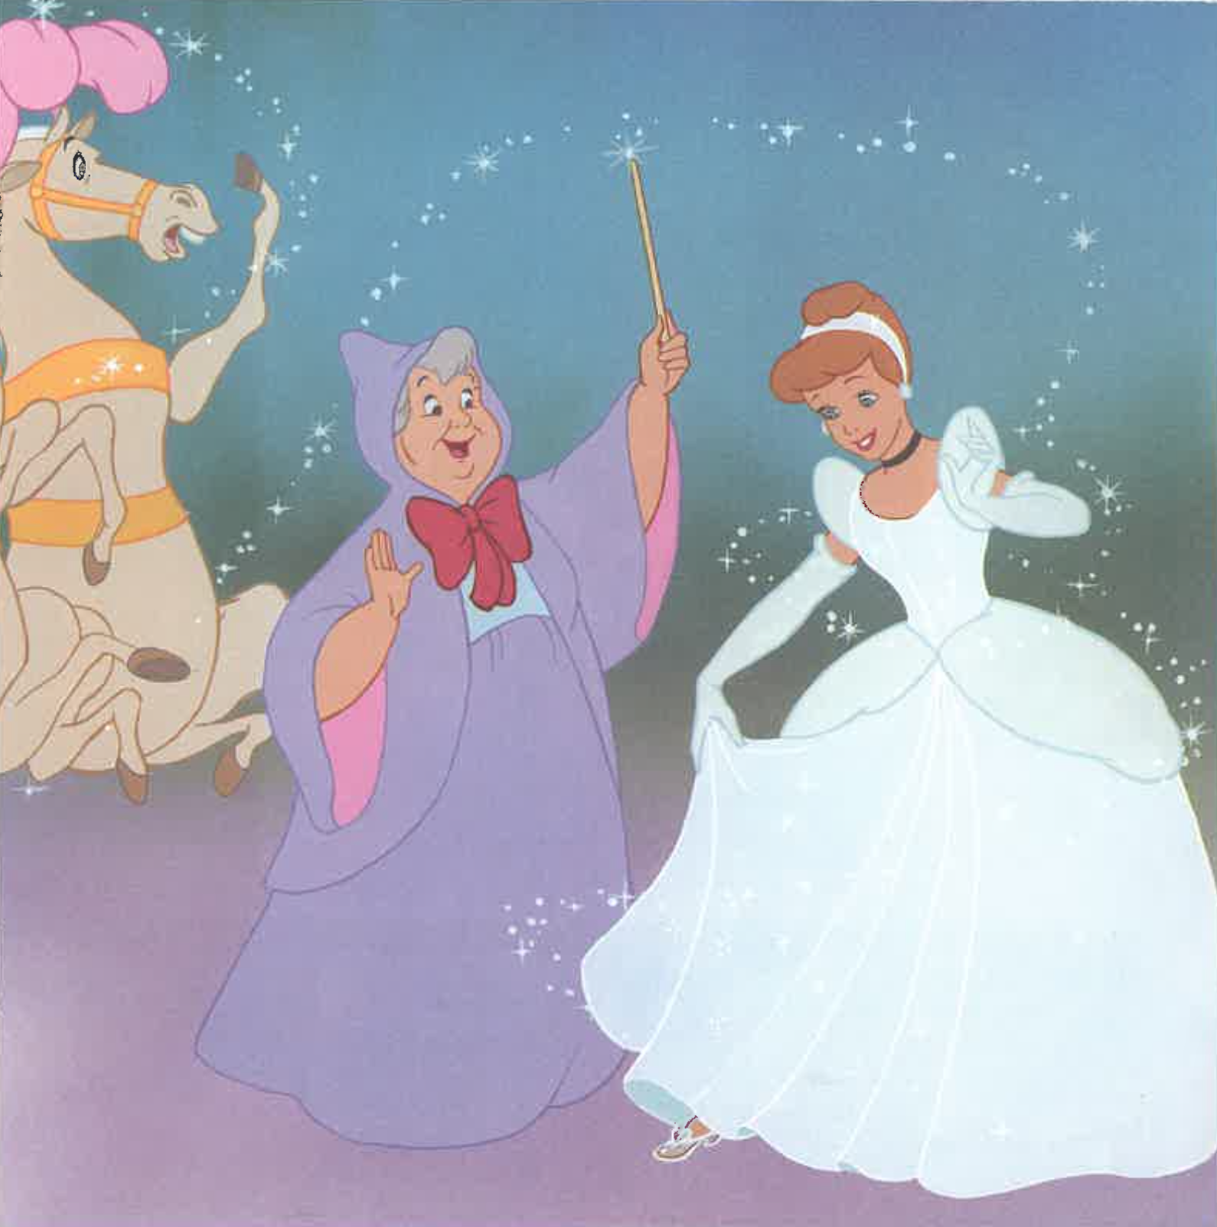

Slide 31
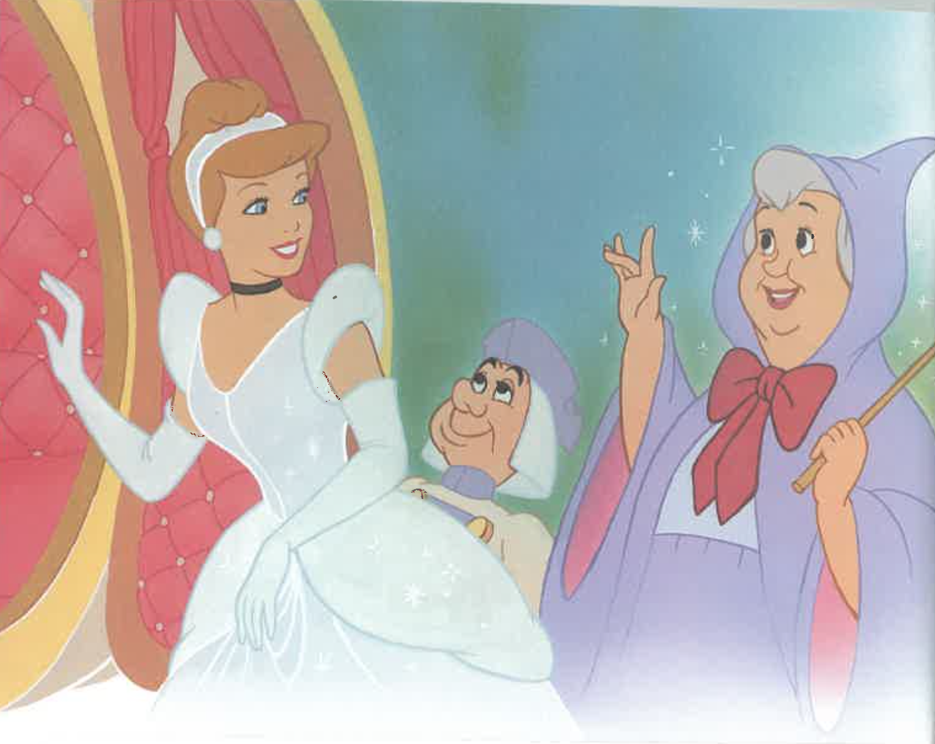

Slide 32
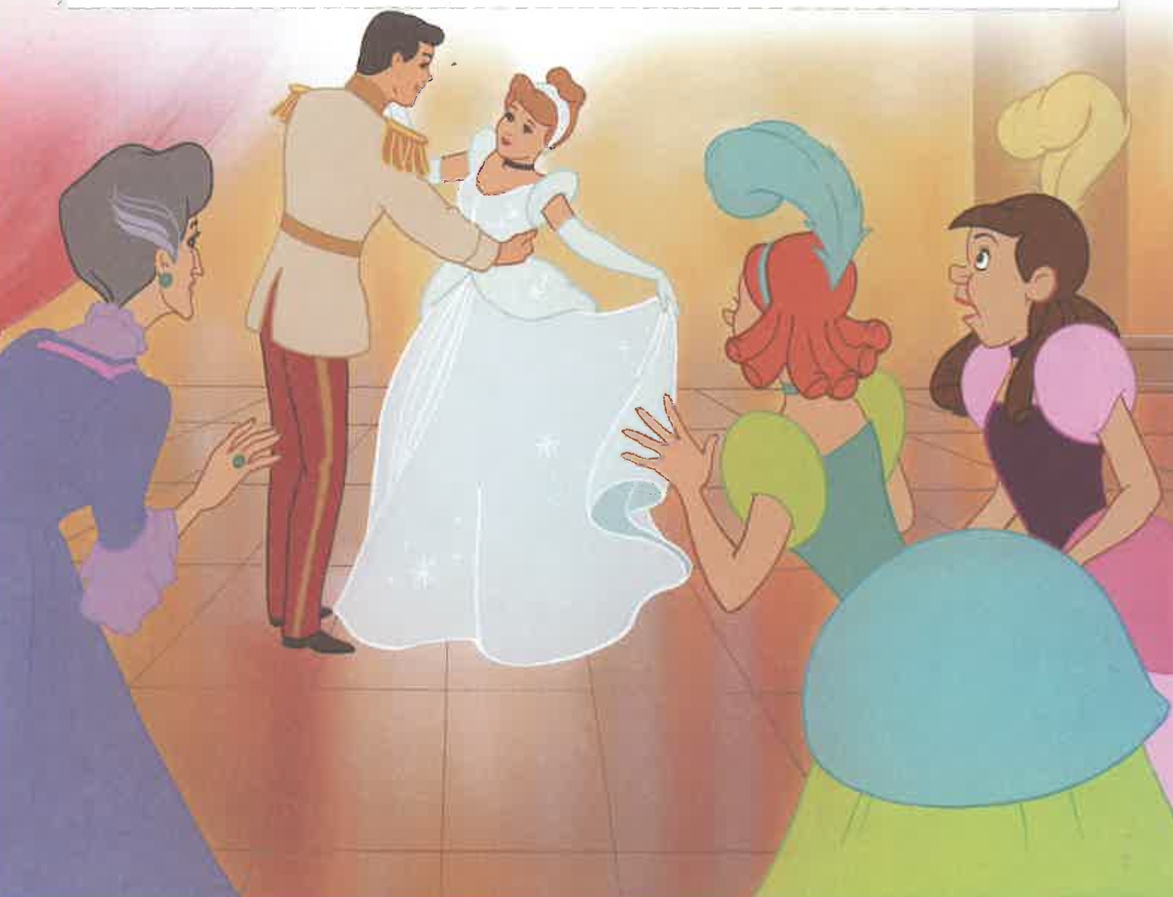

Slide 33
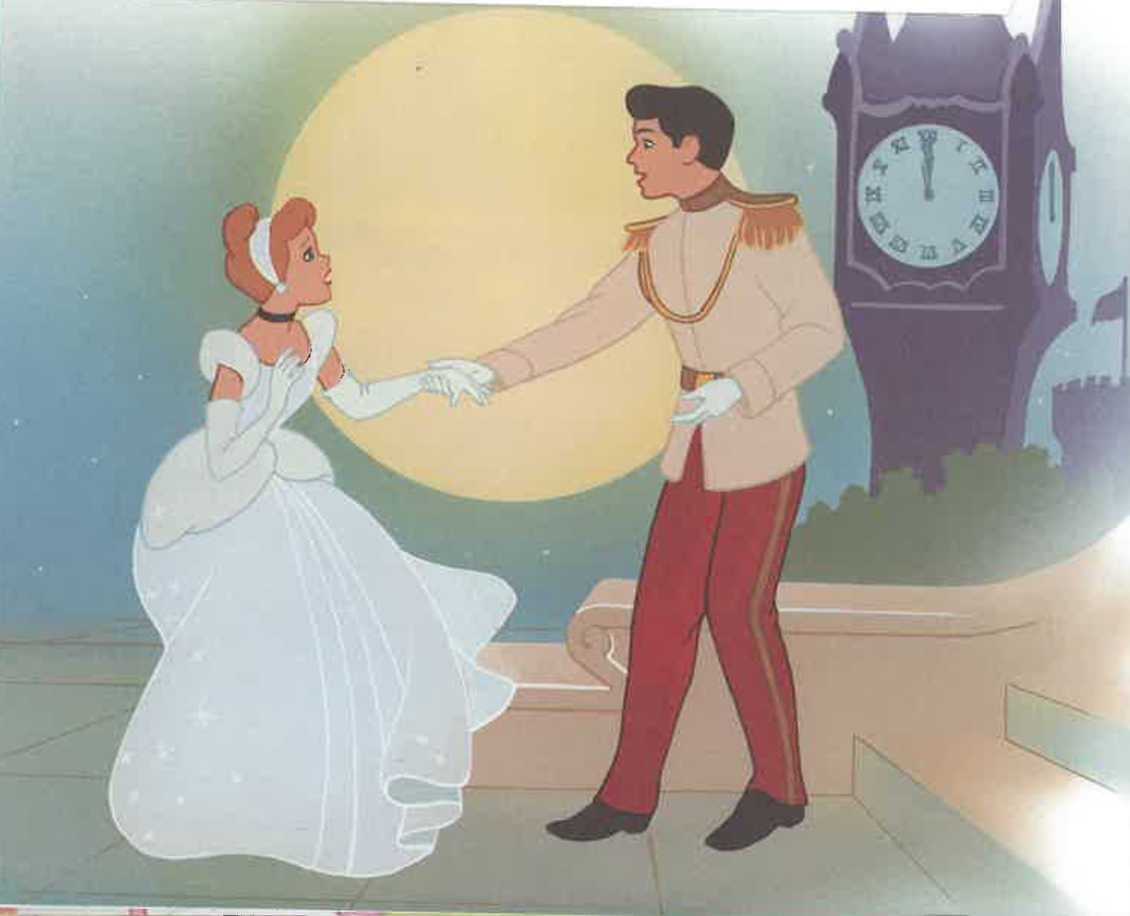

Slide 34
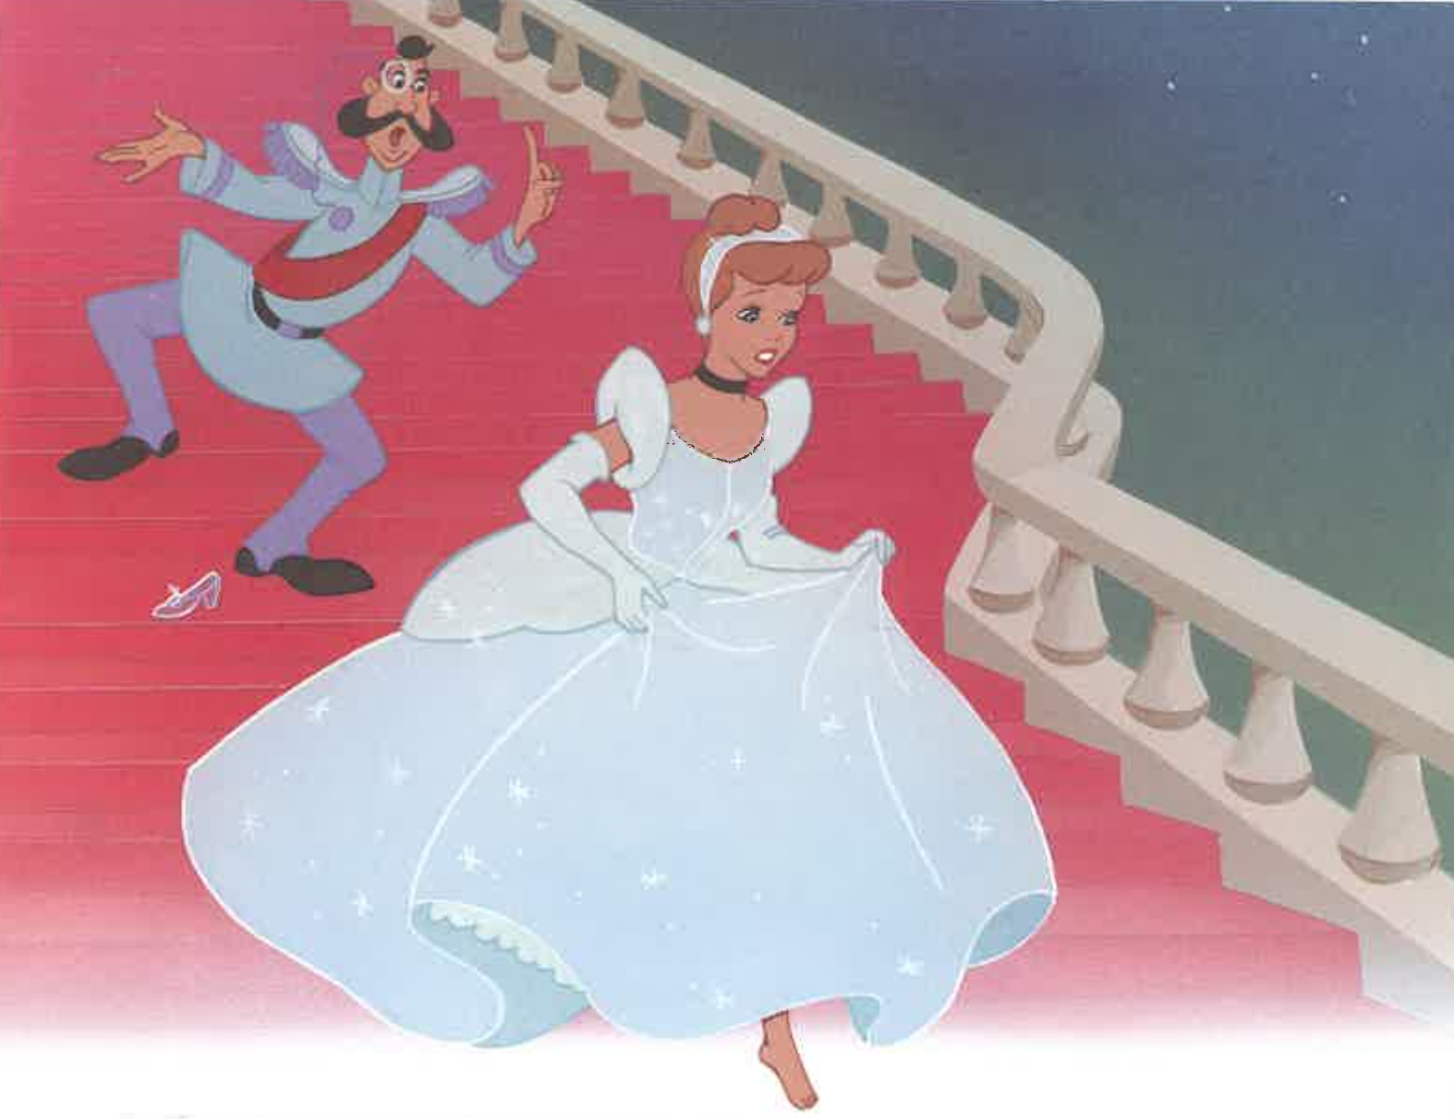

Slide 35
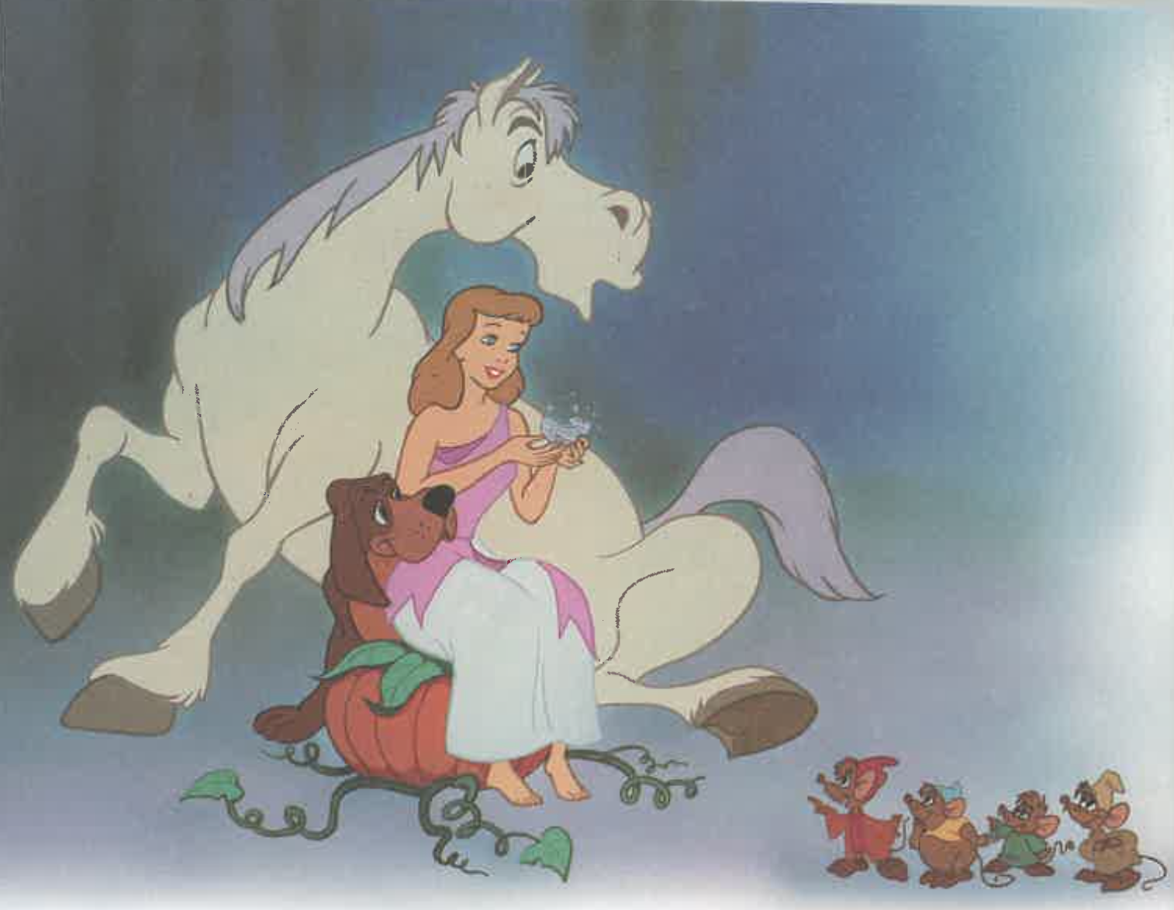

Slide 36
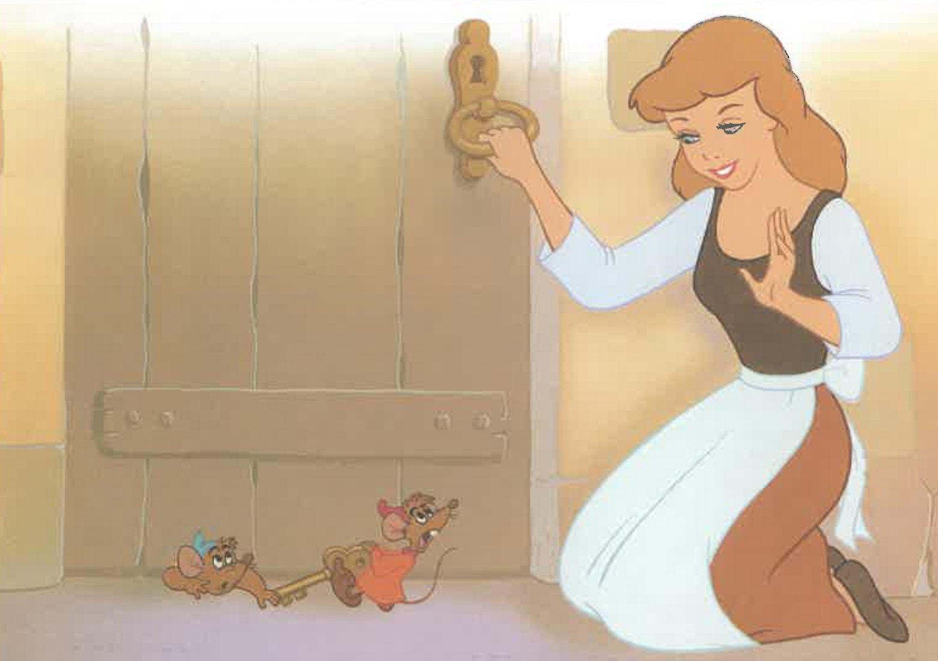

Slide 37
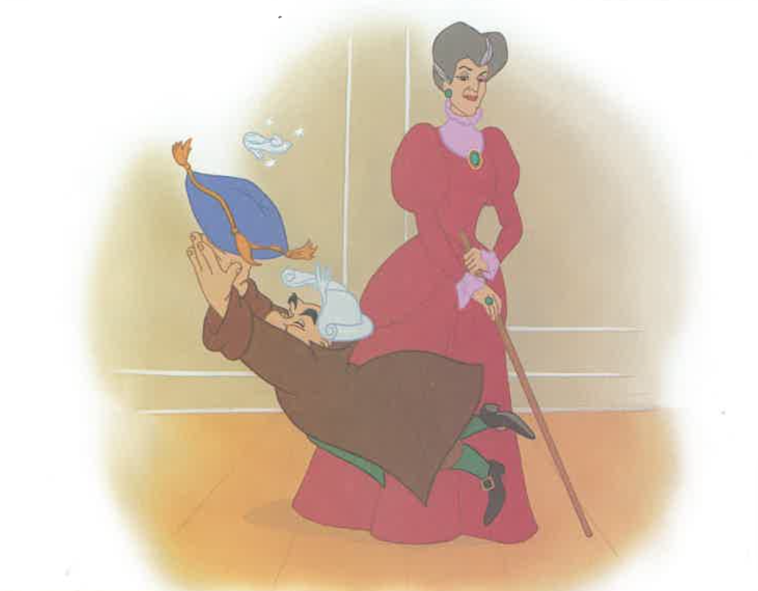

Slide 38
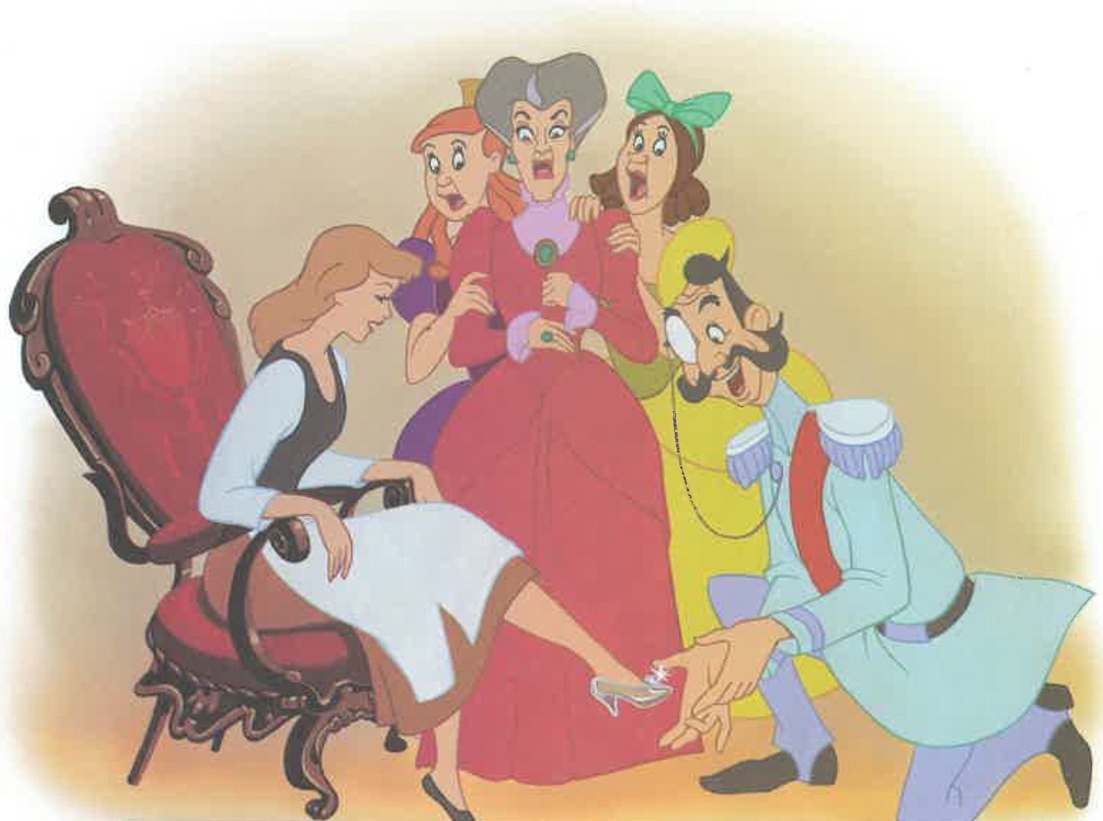

Slide 39
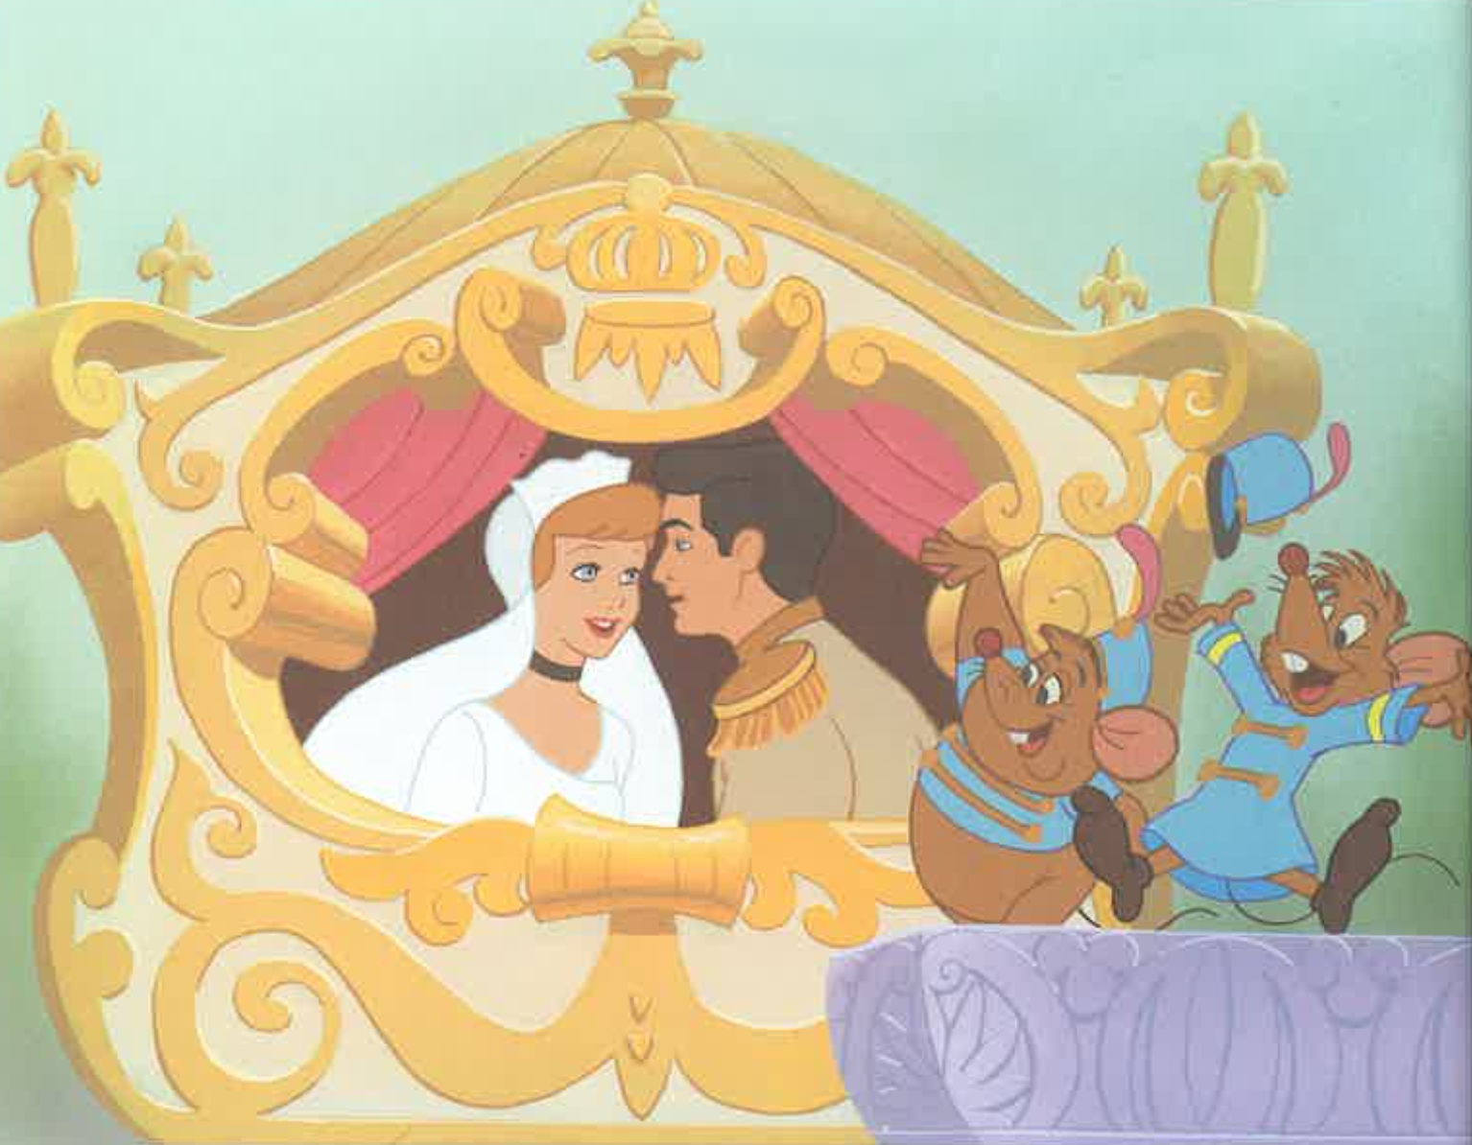

Slide 40
Notes:
Can you tell me the story of Cinderella?

Slide 41
Procedural Discourse
Notes:
Procedural Discourse Task (Sandwich)
Do not use a picture stimulus for this task.
“Let’s move on to something a little different. Tell me how you would make a peanut butter and jelly sandwich.”
(non-U.S. test sites may substitute another simple sandwich, such as Vegemite and cheese [Australia])
If no response in 10 seconds, give second prompt:
“If you were feeling hungry for a peanut butter and jelly sandwich, how would you make it?”

