Slide 1


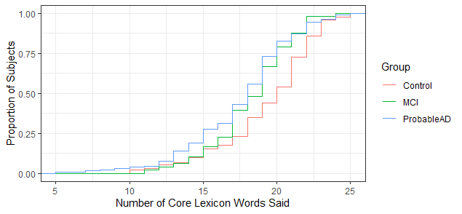
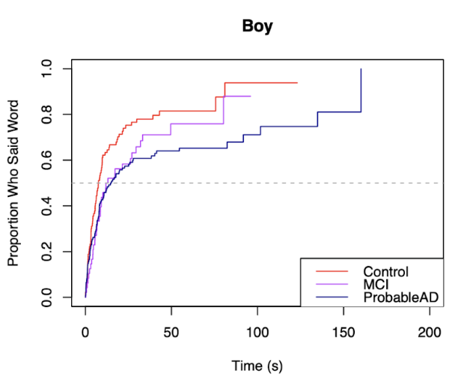
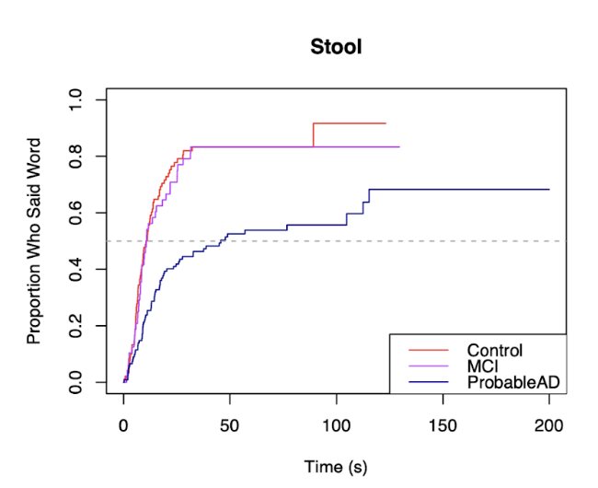
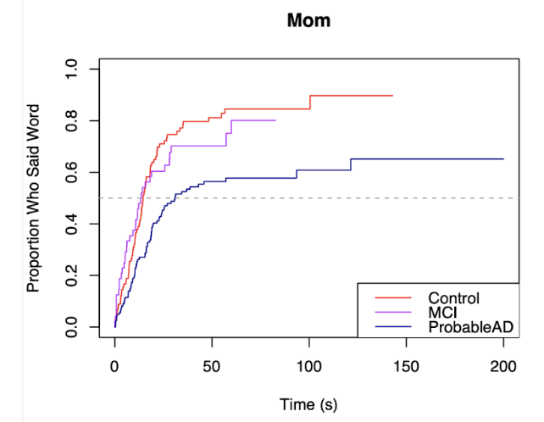
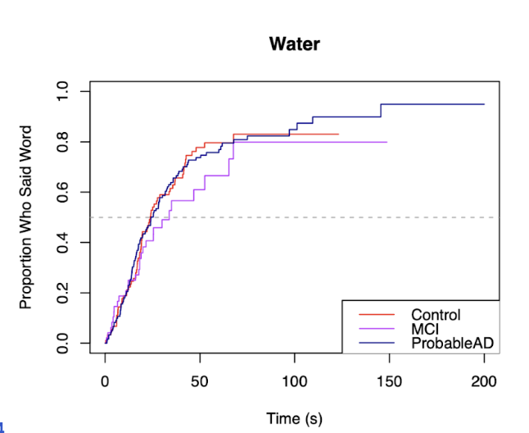
Changes in Typicality of Language Use in Dementia
Davida Frommª, Sarah Grace Dalton^{b}, Alexander Brickª, Gbenu Olaiyaª, Sophia Hillª, Joel Greenhouseª, and Brian MacWhinneyª
ªCarnegie Mellon University, ^{b}Marquette University
Background & Research Aims
Results
Language sample analysis tools are efficient and effective indicators of cognitive impairment in older adults.
Automatic detection of dementia from connected speech is achieving good accuracy in hundreds of studies (de la Fuente et al., 2020).
These tools are also simple, convenient, and non-invasive.
Use newly automated Core Lexicon analyses of Cookie Theft picture descriptions in:
              adults diagnosed with probable Alzheimer’s disease (AD)
              adults diagnosed with mild cognitive impairments (MCI)
              adults with no cognitive impairments (CTL)
              Core Lexicon measures “typicality” of words used based on normative data – words produced by 50% or more of controls on the same task (Dalton et al., 2020).
              Early indications of impairment from a simple language task could facilitate early intervention such as clinical drug trials, external memory aid treatments, counseling, or lifestyle changes.
1. Group differences in total number of core lexicon words spoken (max = 26)
ANOVA – significant difference across groups (F=7.62; p< 0.001)
Tukey pairwise tests -- significant difference between Control and ProbableAD groups (p<0.001);
no significant difference between Control and MCI (p=0.159) or MCI and Probable AD groups (p=0.438).
Figure 1. Cumulative distribution of total number of core lexicon words produced
Note: After about 18 words, the MCI group’s curve begins to look more like the ProbableAD group and less like the Control group. A one-way ANOVA showed this to be true (p = .007).
Below 18 words, the groups were not significantly different (p=0.425).
Methods
2. Group differences in elapsed time until core lexicon content word spoken (max = 14)
ANOVA - significant difference across groups (p< 0.001)
Control group produced 11/14 words sooner than the ProbableAD group and 2/14 sooner than MCI group.
MCI group produced 8/14 words sooner than the Probable AD group.
Figure 2. Kaplan-Meier curves showing elapsed time until a word was produced
Participants - from DementiaBank Pitt & Delaware corpora (Becker et al., 1994; Lanzi et al., 2023)
Transcripts used CHAT format (https://talkbank.org/manual/CHAT.pdf) and were analyzed using CORELEX commands in CLAN (https://talkbank.org/manuals/CLAN.pdf).
For more details, see https://aphasia.talkbank.org/discourse/CoreLexicon/
corelex +lcookie +t*par – scores 1 point for each word produced from the checklist
corelex +lcookie-short +t*par +w – measures when each content word was first produced
Cookie Theft Core Lexicon Checklist (* = content words)
a *dish *girl *mom/mommy/etc. *sink
and *dry he/him/etc. on *stool
be *fall in over the
*boy *flow *jar *run to
*cookie get little she/her/etc. *water
*window
Sample utterance from CHAT transcript:
*PAR: mom &-uh washing or drying dishes . •9650_13350•
%wor: mom •9650_10260• &-uh •10260_10660• washing •11400_11810• or
•11810_12010• drying •12010_12570• dishes •12570_13350• .
%mor: n|mom part|wash-PRESP coord|or part|dry-PRESP n|dish-PL .
 | ProbableAD n = 122 | MCI n = 48 | Control n = 90
Age – mean (SD) | 71.41 (4.4) | 72.23 (4.9) | 64.86 (4.2)
Sex | 30% M, 70% F | 50% M, 50% F | 36% M, 64% F
Education – mean (SD) | 11.83 (2.7) | 16.23 (2.2) | 14.51 (2.6)
MMSE – mean (SD) | 19.40 (2.3) | 28.00 (0.7) | 29.09 (0.55)
MoCA – mean (SD) | NA | 24.03 (1.1) | 27.55 (0.8)
Probable AD group significantly slower than Control group
Probable AD group significantly slower than MCI and Control groups
Probable AD group significantly slower than MCI and Control groups
No significant group differences
Discussion & Future Work
Core lexicon analysis is a straightforward, accessible tool for clinicians and researchers to use with this population for both early assessment and measurement of change in lexical skills over time.
Results of these analyses provide benchmarks for performance on a picture description task commonly used to elicit discourse in these populations and shed light on the lexical deficits encountered in MCI and Alzheimer’s disease.
References
Dalton, SGH, Hubbard, HI, Richardson, JD (2020) Moving toward non-transcription based discourse analysis in stable and progressive aphasia. In Seminars in Speech and Language 41, 32-44, Thieme Medical Publishers, New York.
Dalton, SG, Stark, BC, Fromm, D, Apple, K, MacWhinney, B, Rensch, A, Rowedder, M (2022) Validation of an automated procedure for calculating core lexicon from transcripts. J Speech Lang Hear Res 65, 2996-3003.
de la Fuente Garcia, S, Ritchie, CW, Luz, S (2020) Artificial intelligence, speech, and language processing approaches to monitoring Alzheimer’s disease: A systematic review. J Alzheimers Dis, 78, 1547-1574.
Goodglass, H, Kaplan, E, Barresi, B (2001) BDAE- 3: Boston Diagnostic Aphasia Examination—Third edition. Lippincott Williams & Wilkins, Philadelphia.
MacWhinney, B., Fromm, D., Forbes, M., & Holland, A. (2011). AphasiaBank: Methods for studying discourse. Aphasiology,
25(11), 1286-1307.

