Slide 1
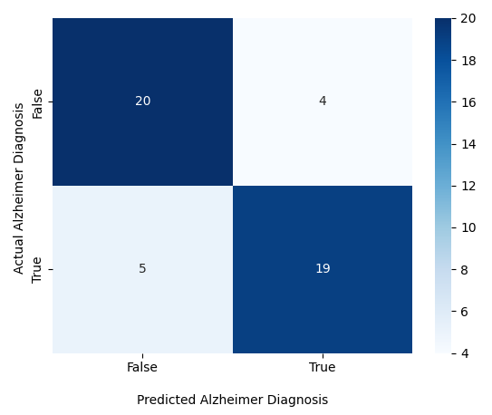
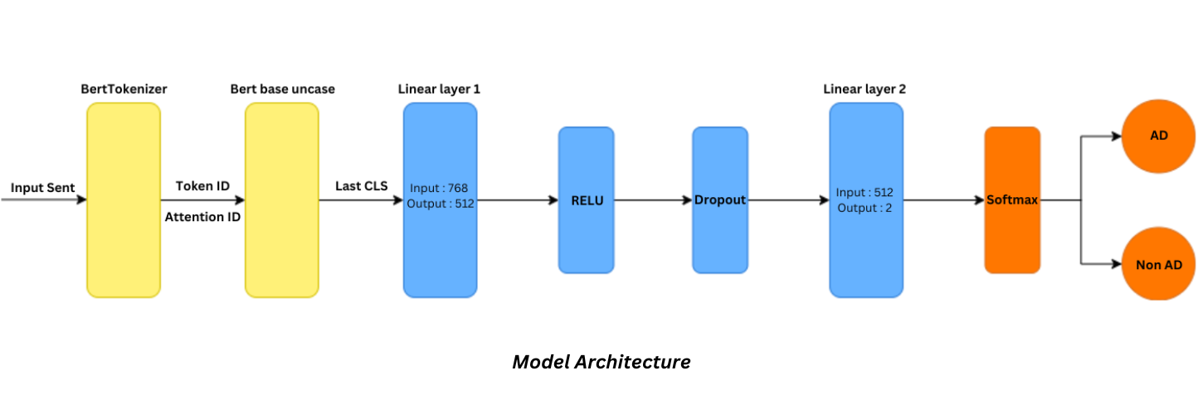
Comparative Study of Transfer Learning Techniques with BERT Family Models in Early Diagnosis of Alzheimer's Disease
Xuan Khoi Nguyen¹, Tuan Anh Ngo¹, Thu Nguyen¹, Phuc Pham¹, Huong Ha^{2*} and Lua Ngo^{2*}
¹ VNUHCM-High School For the Gifted, Ho Chi Minh City, Vietnam
² School of Biomedical Engineering, International University, VNU-HCMC, Ho Chi Minh City, Vietnam
*Corresponding address: htthuong@hcmiu.edu.vn, ntlua@hcmiu.edu.vn
Introduction
Alzheimer's disease (AD) is a common incurable neurodegenerative disorder causing memory loss, cognitive decline, and language problems. Significant emphasis has been placed on AD diagnosis.
Recent studies have focused on complex Computer Vision models that predict AD from brain scans, but these methods are accurate when the disease has progressed sufficiently and are costly. Meanwhile, natural language has been proven to be a reliable early sign of AD. Therefore, our research aims to standardize AD prediction via speech analysis using Natural Language Processing and BERT-family models. By comparing model accuracy and runtime, we identify the best options for real-world diagnostic development and implementation of language models.
Results
Table 3. Evaluation of 5 models’ performance on the validation set
Model | Accuracy | F1 | Precision | Recall
BERT | 73 | 75 | 70 | 79
DistilBERT | 77 | 78 | 76 | 79
RoBERTa | 69 | 67 | 71 | 62
ALBERT | 77 | 71 | 83 | 62
DeBERTa | 77 | 67 | 78 | 58
$2.8 Trillion
25%
75%
Projected annual expense for Alzheimer’s Disease in 2030
of Vietnam’s population will be over 65 in 2050
of Vietnamese patients do not receive timely diagnosis
Among 5 models constructed to diagnose early Alzheimer, DistilBERT demonstrated the best performance with an accuracy of 77% and a F1 score of 79%.
Figure 1. Alzheimer’s Disease by the numbers
Methodology
1. Dataset
ADReSS Challenge dataset: 156 speech samples and associated transcripts from non-AD (N=78) and AD (N=78)
2. Training Setup
2.1. Libraries
2.2. Data Preprocessing
2.3. Data Splitting
Learning Rate Scheduler: Automatically adjusts the learning rate of the models
Object-Oriented Fine-tuning: Fine-tune the hidden layers of the pre-trained models
The results show that the highest precision of the model in predicting Alzheimer's patients is 83% with 39 accurate and 9 inaccurate predictions.
Table 1. List of employed libraries for the project and their specific stages of use
20
4
9 different datasets were employed for 3 different stages (see Table 1)
Library name | Stage of use
re | Data preprocessing
numpy | Data preprocessing, Model training
pandas | Data preprocessing, Model training
Tensorflow | Model training
PyTorch | Model training
sklearn | Data preprocessing, Model training, Results extraction
keras | Model training
matplotib | Results extraction
seaborn | Results extraction
Exclude non-natural text and pad (add) or truncate (exclude) tokens
5
19
The dataset was split into 2 subsets: the training set and the validation/test set
Table 2. BERT-series models with their hyperparameters
 | BERT | DistilBERT | RoBERTa | ALBERT | DeBERTa
Batch size | 2 | 2 | 2 | 2 | 2
Epoch | 10 | 10 | 20 | 10 | 20
Learning rate | 10⁻⁵ | 10⁻⁵ | 10⁻⁵ | 10⁻⁵ | 10⁻⁵
Figure 3. Real prediction results of the fine-tuned model
2.4. Model & Hyperparameters
Conclusion
DistilBERT demonstrated a balance between accuracy and cost efficiency and thereby is the most suitable model for integration into applicable diagnostic tools.
After applying object-oriented programming (OOP) fine-tuning, the original BERT model achieved an precision of 83% in diagnosing patients.
In future studies, the model architecture could be modified by adding BiLSTM layers and building an ensemble of pre-trained models from the BERT family to boost diagnostic accuracy.
3. Optimization
Figure 2. General Predictive Models Architecture
References
[1] Shree, SR Bhagya, and H. S. Sheshadri. "Diagnosis of Alzheimer’s disease using rule based approach." (2016).
[2] Yang, Kuo, Emad A. Mohammed, and Behrouz H. Far. "Detection of Alzheimer's Disease Using Graph-Regularized Convolutional Neural Network Based on Structural Similarity Learning of Brain Magnetic Resonance Images." 2021 IEEE 22nd International Conference on Information Reuse and Integration for Data Science (IRI). IEEE, 2021.
[3] Shah, Zehra, et al. "Learning language and acoustic models for identifying Alzheimer’s dementia from speech." Frontiers in Computer Science 3 (2021): 624659.
[4] Dubois, Bruno, Gaetane Picard, and Marie Sarazin. "Early detection of Alzheimer's disease: new diagnostic criteria." Dialogues in clinical neuroscience (2009).
[5] Chien, Yi-Wei, et al. "An automatic assessment system for Alzheimer’s disease based on speech using feature sequence generator and recurrent neural network." Scientific Reports 9.1 (2019): 19597.
[6] Li, Jinchao, et al. "A comparative study of acoustic and linguistic features classification for Alzheimer's disease detection." ICASSP 2021-2021 IEEE International Conference on Acoustics, Speech and Signal Processing (ICASSP). IEEE, 2021.
[7] Becker, J. T., Boller, F., Lopez, O. L., Saxton, J., & McGonigle, K. L. (1994). The natural history of Alzheimer's disease: description of study cohort and accuracy of diagnosis. Archives of Neurology, 51(6), 585-594. Grant: NIA AG03705 and AG05133
[8] Mahajan, Pranav, and Veeky Baths. "Acoustic and language based deep learning approaches for Alzheimer's dementia detection from spontaneous speech." Frontiers in Aging Neuroscience 13 (2021): 623607.
[9] Balagopalan, Aparna, et al. "To BERT or not to BERT: comparing speech and language-based approaches for Alzheimer's disease detection." arXiv preprint arXiv:2008.01551 (2020).
[10] Liu, Ning, et al. "A transfer learning method for detecting Alzheimer's disease based on speech and natural language processing." Frontiers in Public Health 10 (2022): 772592.
[11] Jack Morris, 2022, ‘Does Model Size Matter? A Comparison of BERT and DistilBERT’, Weights & Biases, Oct 13, 2022
Acknowledgements
We would like to specifically express our gratitude to the Brain Health Lab of VNUHCM-International University, especially Dr. Huong Ha & Dr. Lua Ngo, for the support and mentorship throughout the research.
We also acknowledge DementiaBank for the dataset provided in the research, specifically supported by grants NIA AG03705 and AG05133.
Lastly, we acknowledge the aid in liaison provided by the Program for Research and Initiative in Science and Engineering (PRISE), hosted by VNUHCM-High School For the Gifted, which represented and connected us with the Brain Health Lab to secure research positions.

