Slide 1

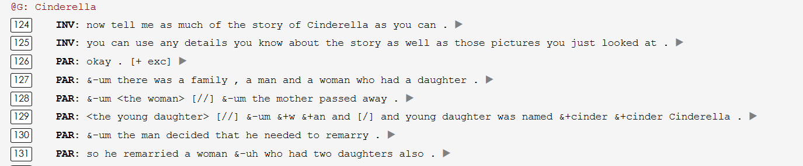
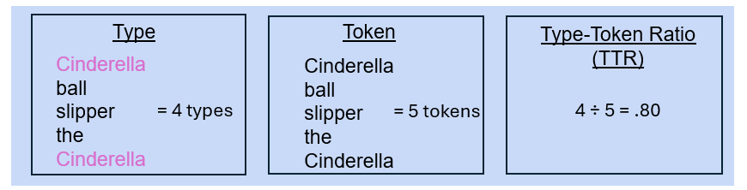
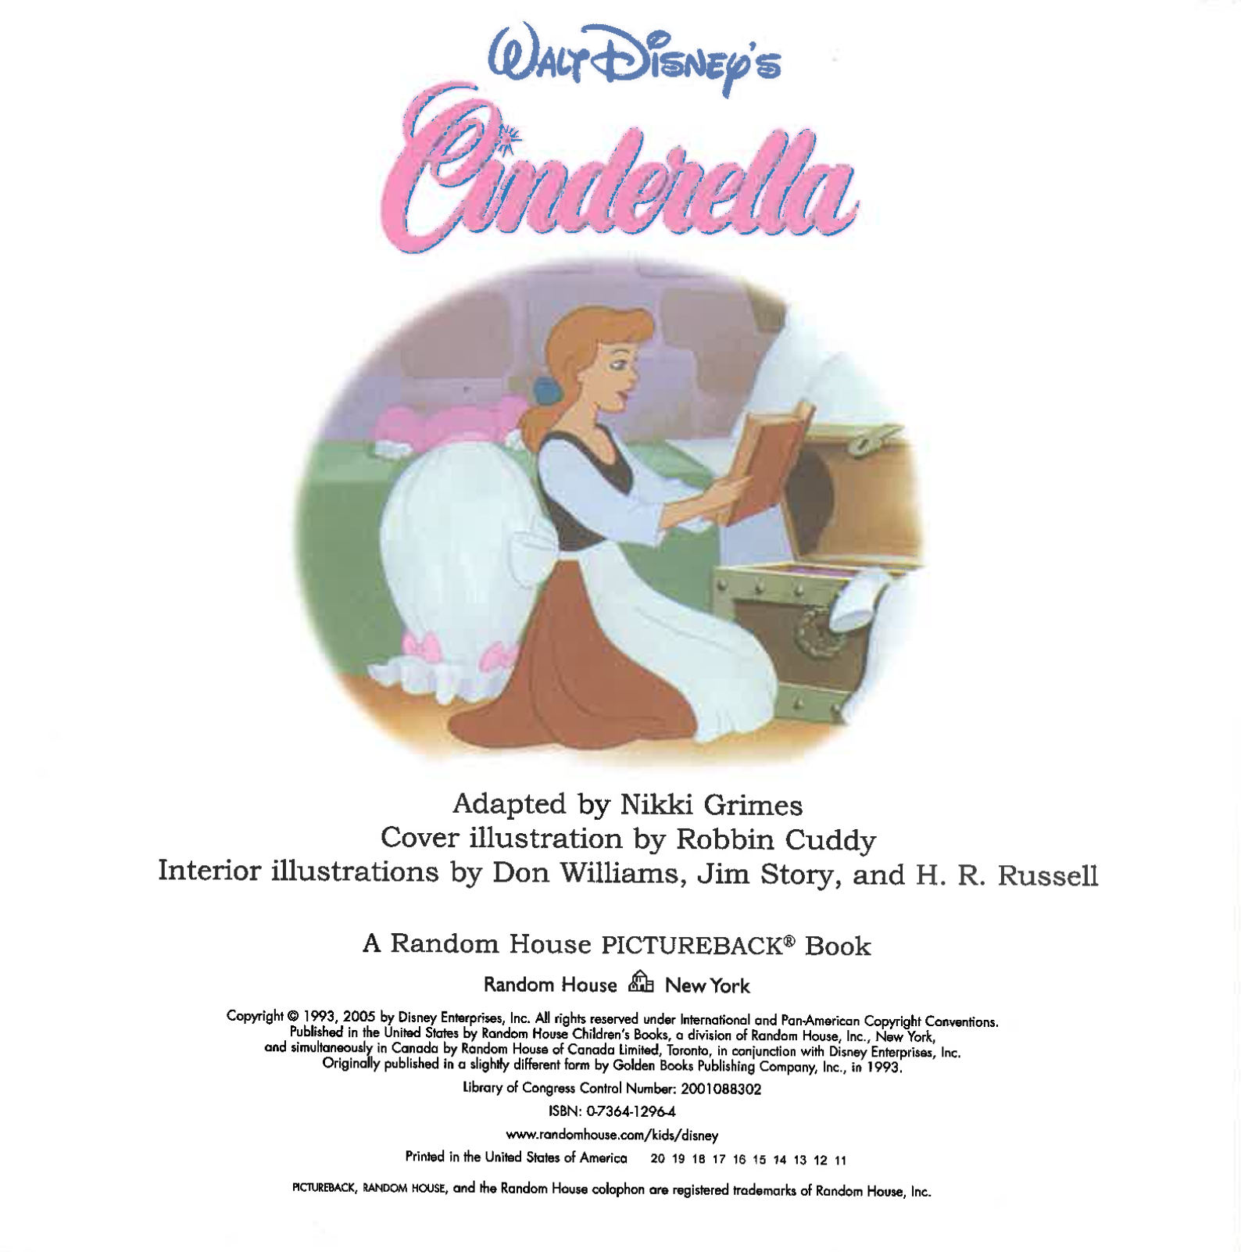

Assessment of Lexical Markers in Older Black/African American Adults at
Risk for Alzheimer’s Disease
Kira Jefferson, Faith Stagge & Alyssa M. Lanzi
University of Delaware
Introduction
Analysis of Connected Speech and Language
Discussion & Conclusion
An estimated 7.2 million Americans age 65 and older are living with Alzheimer’s disease (AD) dementia in 2025 (Alzheimer’s Association, 2025).
Mild cognitive impairment (MCI) due to AD is a possible transitional phase between normal aging and dementia, characterized by a detectable decline in cognitive skills that does not limit independence in everyday activities (American Psychiatric Association, 2013).
Individuals with MCI often show reduced lexical (i.e., word) retrieval difficulties, and decreased lexical diversity in connected speech and language compared to those without MCI (Filiou et al., 2020), However, the majority of these findings often reflect homogeneous ethnoracial (e.g., non-Hispanic White) samples (Evans et al., 2022).
The evaluation of lexical markers to assess cognitive status (i.e., MCI) has been extended to other ethnocultural backgrounds, such as Black/African American adults, particularly when describing pictures, but not yet to other connected speech and language tasks like storytelling (Evans et al., 2022).
Therefore, this study has two purposes:
cc
Discussion
Black/African American adults at risk for dementia due to AD do produce a greater number of lexical markers of type and tokens when producing a story, but not a statistically-significant difference from non-Hispanic White counterparts.
These results align with current research, which has demonstrated similar findings in picture description tasks (Evans et al., 2022).
This study provides additional evidence that analyzing connected speech and language in storytelling to evaluate cognitive decline may be an effective tool, regardless of ethnocultural differences.
Limitations
The available sample size of Black/African American adult connected speech and language was relatively small.
The predominantly female sample may limit the generalizability of these results to the entire US population of older adults.
One participant did not report a concern about memory changes, potentially lowering their risk for AD (Burmester et al., 2016).
Future Directions
Current and ongoing community-based recruitment efforts will enable an increase in Black/African American participants, thereby expanding the sample size for future analysis.
Development of culturally sensitive stimuli for diverse populations can be created with the partnership of diverse community members.
Future studies can explore differences between Black/African American adults who are cognitively unimpaired and those who are classified as having MCI.
Language samples are transcribed, coded, and linked to media files using a Codes for the Human Analysis of Transcripts (CHAT) format, which uses a state-of-the-art automatic speech recognition transcription system (MacWhinney & Fromm, 2022).
Computerized Language ANalysis (CLAN) is designed to analyze data transcribed in the CHAT formant (MacWhinney, 2025).
Using the CLAN program, the following three lexical markers were extracted from transcripts for analysis.
    FREQ Types: total word types as counted by FREQ command
    FREQ Tokens: total word tokens as counted by FREQ command
    FREQ TTR: type/token ratio as counted by FREQ command
Figure 2. Portion of the Cinderella story transcribed in CHAT format
1) First, to descriptively characterize lexical markers in connected speech and language produced during a storytelling task for Black/African American and non-Hispanic White adults at risk for MCI due to AD.
2) Second, to explore differences in lexical marker production in a connected speech language storytelling task between Black/African American adults at risk for MCI and their non-Hispanic White counterparts.
Figure 3. Example of lexical variables type, token, and type-token ratio
Procedures
Results
References & Acknowledgements
Connected speech and language samples were taken from the DementiaBank Delaware Corpus (Lanzi et al., 2023).
DementiaBank is a shared online database that facilitates research efforts to address the gaps in knowledge about language changes associated with MCI and dementia from AD (Lanzi et al., 2023).
All participants were age 60+, understood English, and the majority reported changes and/or concerns with their thinking and memory.
Participants completed a protocol of six different connected speech and language tasks, including retelling the story of Cinderella.
Table 2. Descriptive statistics of Connected Speech and Language produced telling the story of Cinderella
Table 1. Demographics of Participants
Alzheimer’s Association. (2025). 2025 Alzheimer’s disease facts and figures. Alzheimer’s & Dementia, 21(5).
American Psychiatric Association, DSM-5 Task Force. (2013). Diagnostic and Statistical Manual of Mental Disorders: DSM-5 (5th ed.). American Psychiatric Publishing. https://doi.org/ 10.1176/appi.books.9780890425596
Burmester, B., Leathem, J., & Merrick, P. (2016). Subjective cognitive complaints and objective cognitive function in aging: a systematic review and meta-analysis of recent cross-sectional findings. Neuropsychology review, 26(4), 376-393. DOI: 10.1007/s11065-016-9332-2
Evans, E. et al., (2022). Preliminary assessment of connected speech and language as a marker for cognitive change in late middle-aged Black/African American adults at risk for Alzheimer’s disease. Aphasiology, 36(8), 982–1005. https://doi.org/10.1080/02687038.2021.1931801
Filiou R.-P. et al., (2020). Connected speech assessment in the early detection of Alzheimer’s disease and mild cognitive impairment: A scoping review. Aphasiology, 34(6), 723–755. https://doi.org/10.1080/02687038.2019.1608502
Grimes, N. 2005 . Walt Disney's Cinderella, New York: Random House.
Lanzi, A. et al., (2023). DementiaBank: Theoretical rationale, protocol, and illustrative analyses. Am J Speech Lang Pathol, 32(2):426-438. https://doi.org/DOI: 10.1044/2022_AJSLP-22-00281
MacWhinney, B., & Fromm, D. (2022). Language sample analysis with TalkBank: An update and review. Frontiers in Communication, 7, Article 865498. https://doi.org/https://doi.org/10.3389/fcomm.2022.865498
MacWhinney, B. (2025). Tools for Analyzing Talk Part 2: The CLAN Program. https://talkbank.org/manuals/CLAN.pdf
 | n
Sex
Male | 1 (3.85%)
Female | 25 (96.15%)
Age
Mean (SD) | 68.6 (SD 6.9)
Min - Max | 60-82
Race
Black/African American | 13 (50%)
non-Hispanic White | 13 (50%)
 | Black/African American (n = 13) | non-Hispanic White (n = 13)
FREQ TYPE Mean (SD) | 186.77 (82.81) | 161.70 (62.40)
FREQ TOKEN Mean (SD) | 651.54 (453.27) | 494.92 (262.09)
FREQ TTR Mean (SD) | .35 (.11) | .35 (.06)
Table 1. Demographics of Participants to Date
We conducted 1:1 nearest neighbor matching between Black/African American and non-Hispanic White participants to balance covariates such as age, education, and biological sex between groups.
The education of our sample was as follows: high school graduate (n = 2), some college credit (n = 5), trade/technical/vocational school (n = 3), bachelor’s degree (n = 6), master’s degree (n = 9), and doctorate degree (n = 1).
Twenty-five out of twenty-six participants reported concern with their change in thinking or memory, categorizing them at a higher risk for future cognitive decline (Burmester et al., 2016).
When comparing lexical markers between Black/African American and non-Hispanic White, using Wilcoxon-Rank Sum tests, all analyses yielded non-statistically-significant results (all p’s > 0.05): FREQ Type (W = 69.5, p-value = 0.457), FREQ Tokens (W = 68, p-value = 0.4184), and TTR (W = 98.5, p-value = 0.4887).
Figure 1. Story of Cinderella used for storytelling task (Grimes, 2005)
This work is funded by NIA Grant 1RF1AG083823.

