Slide 1
DementiaBank Discourse Stimuli

Slide 2
Picture Description #1

Slide 3
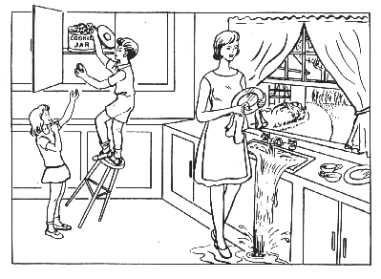
Notes:
“Here is a picture. Please tell me everything you see going on in this picture.” (~3 minutes)
If no response in 10 seconds, give second prompt:
“Take a look (point to picture) and tell me what’s happening in the picture.”
If fewer than 2 utterances, give third prompt:
“Anything else you can tell me about the picture?”

Slide 4
Picture Description #2

Slide 5
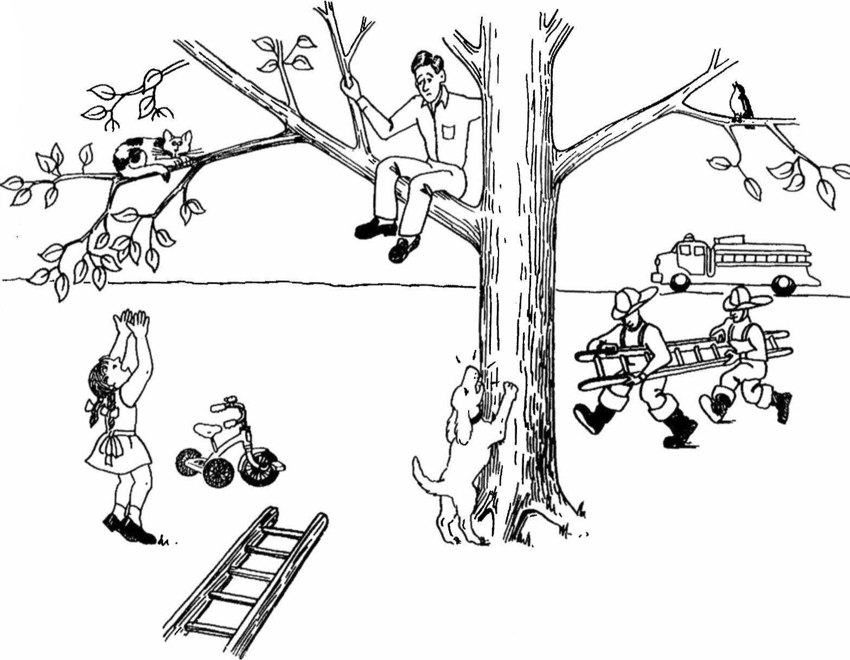
Notes:
“Here is another picture that tells a story. Look at everything that’s happening and then tell me a story about what you see. Tell me the story with a beginning, a middle, and an end.” (~3 minutes)
If no response in 10 seconds, give second prompt:
“Take a look (point to picture) and tell me any part of the story.”
If fewer than 2 utterances, give third prompt:
“Anything else you can tell me about the story?”

Slide 6
Picture Description #3

Slide 7
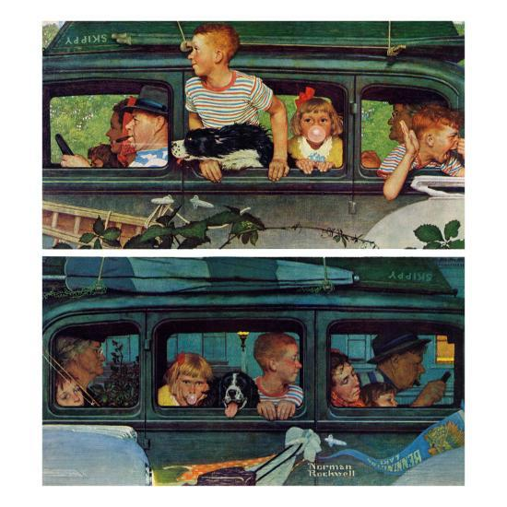
Notes:
“Here is another picture that tells a story. Look at everything that’s happening and then tell me a story about what you see. Tell me the story with a beginning, a middle, and an end.” (~5 minutes)
If no response in 10 seconds, give second prompt:
“Take a look (point to picture) and tell me any part of the story.”
If fewer than 2 utterances, give third prompt:
å“Anything else you can tell me about the story?”

Slide 8
Story Narrative

Slide 9
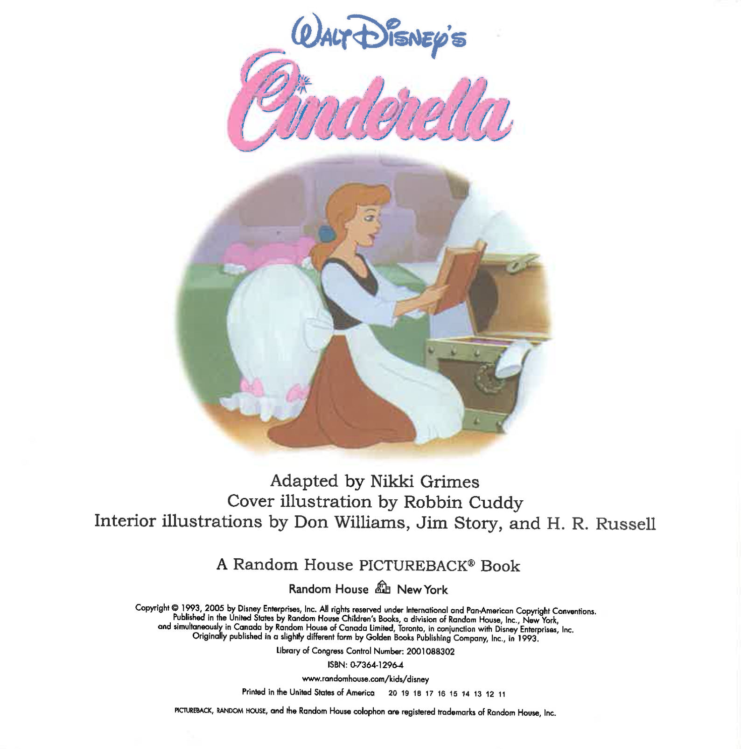
Notes:
“I’m going to ask you to tell a story. Have you ever heard the story of Cinderella?” (Make note of answer for demographic data. If the answer is no, ask the participant to tell a fairy tale s/he knows.)
“Do you remember much about it? These pictures might remind you of how it goes. We are going to take a look at the pictures, and then I’ll ask you to tell me the story in your own words.
Investigator advances through the slides (2-3 seconds per slide).
“Now tell me as much of the story of Cinderella as you can. You can use any details you know about the story, as well as the pictures you just looked at.”
If participant gives a response of fewer than three utterances, or seems to falter, allow 10 seconds, then prompt:
“What happened next?” or “Go on.”
Continue until the participant concludes the story or it is clear s/he has finished.

Slide 10
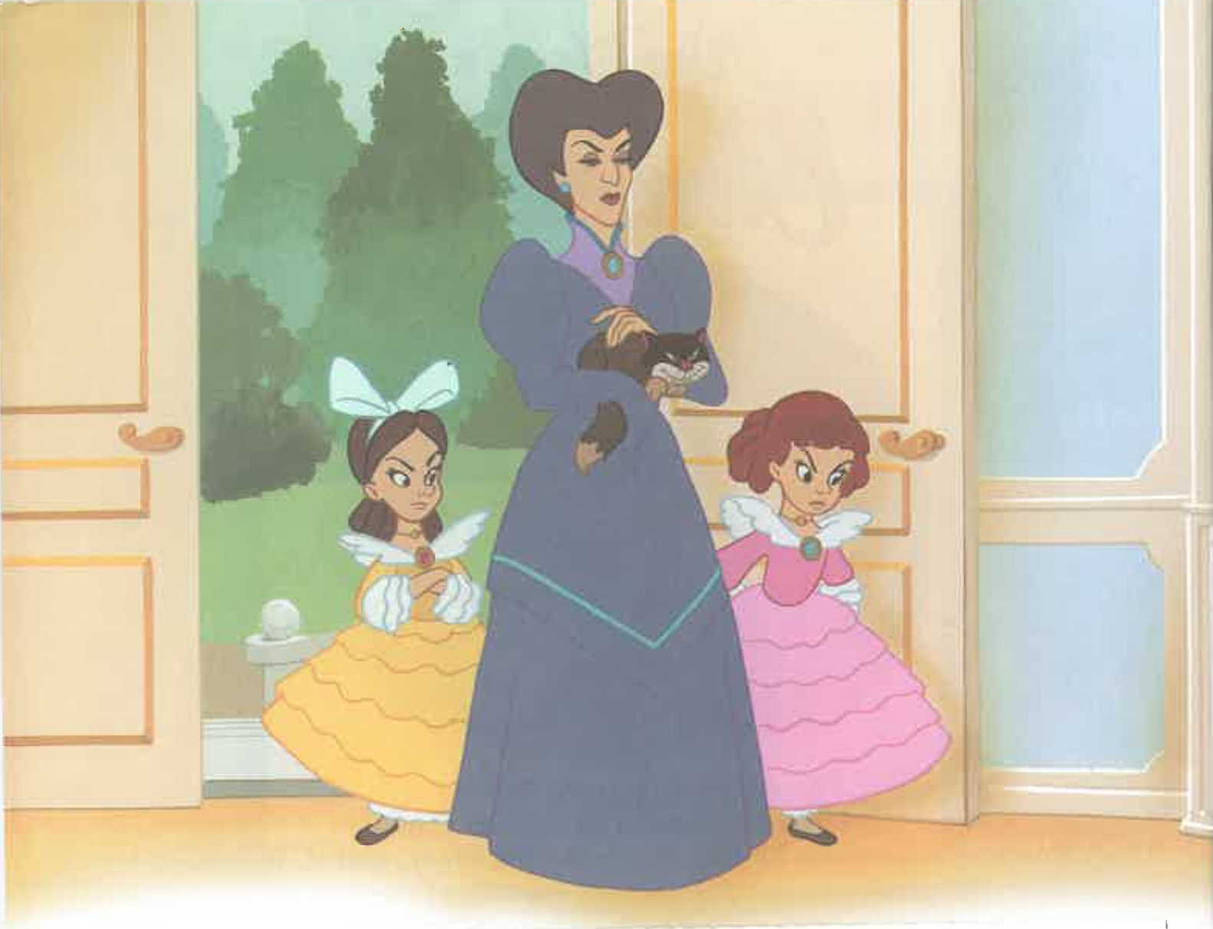

Slide 11
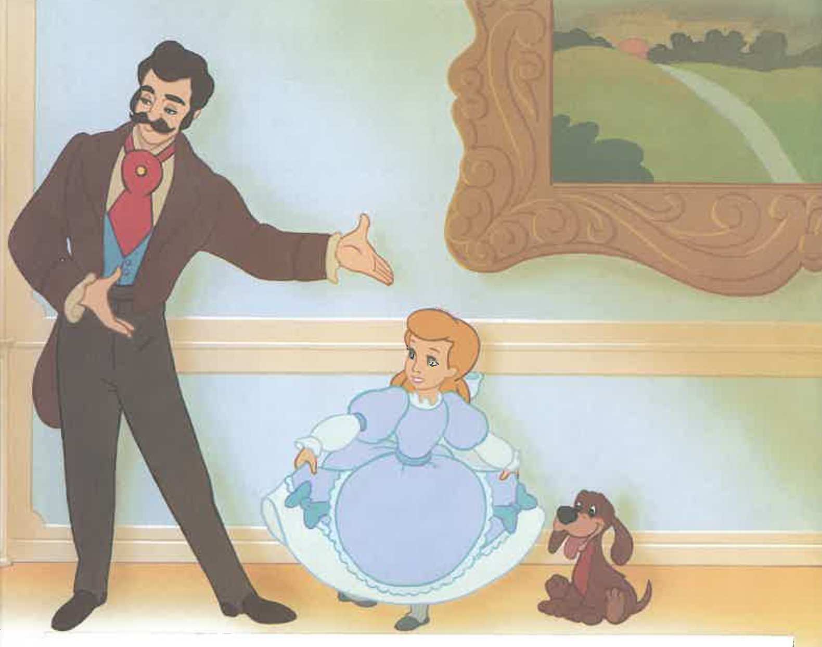

Slide 12
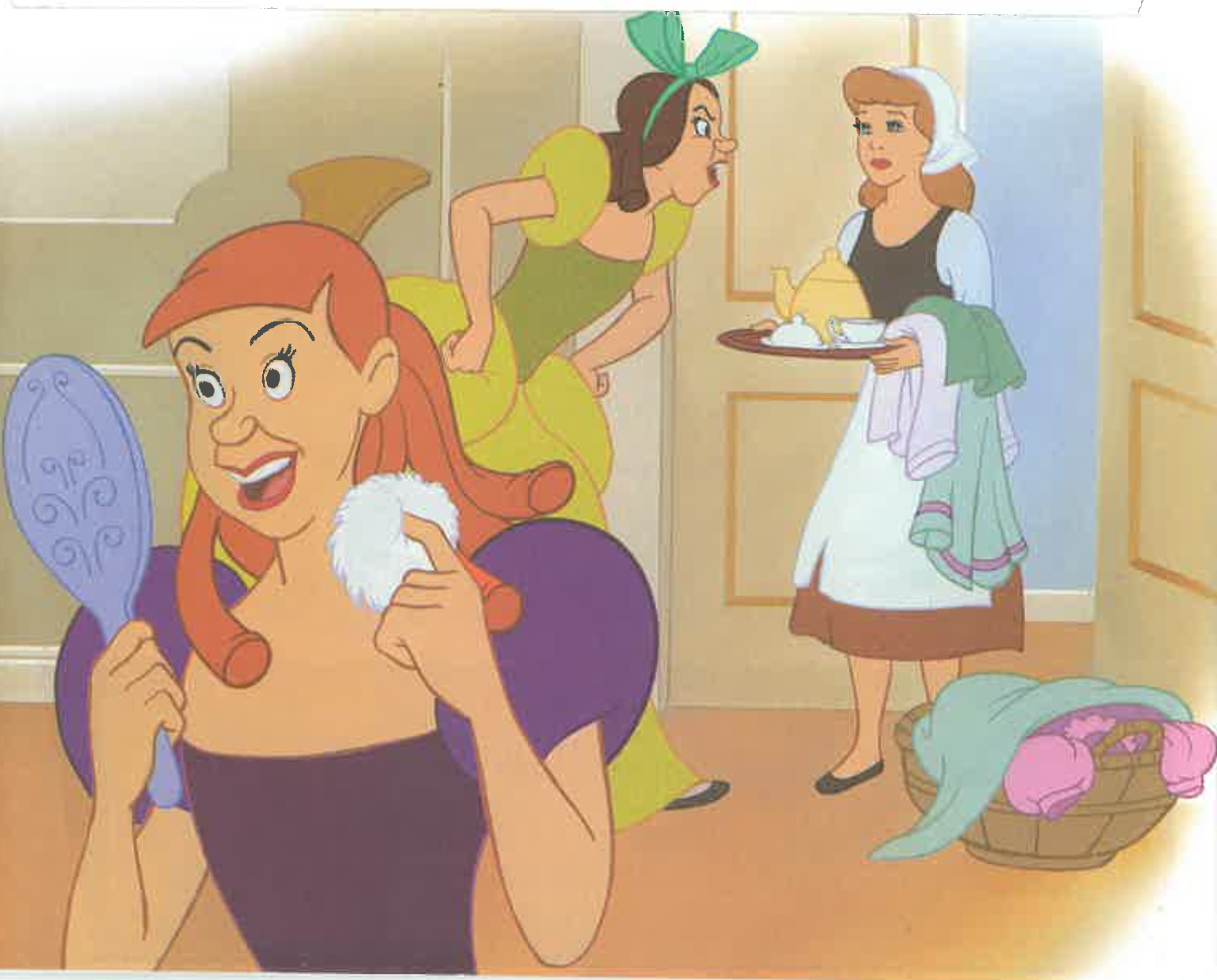

Slide 13
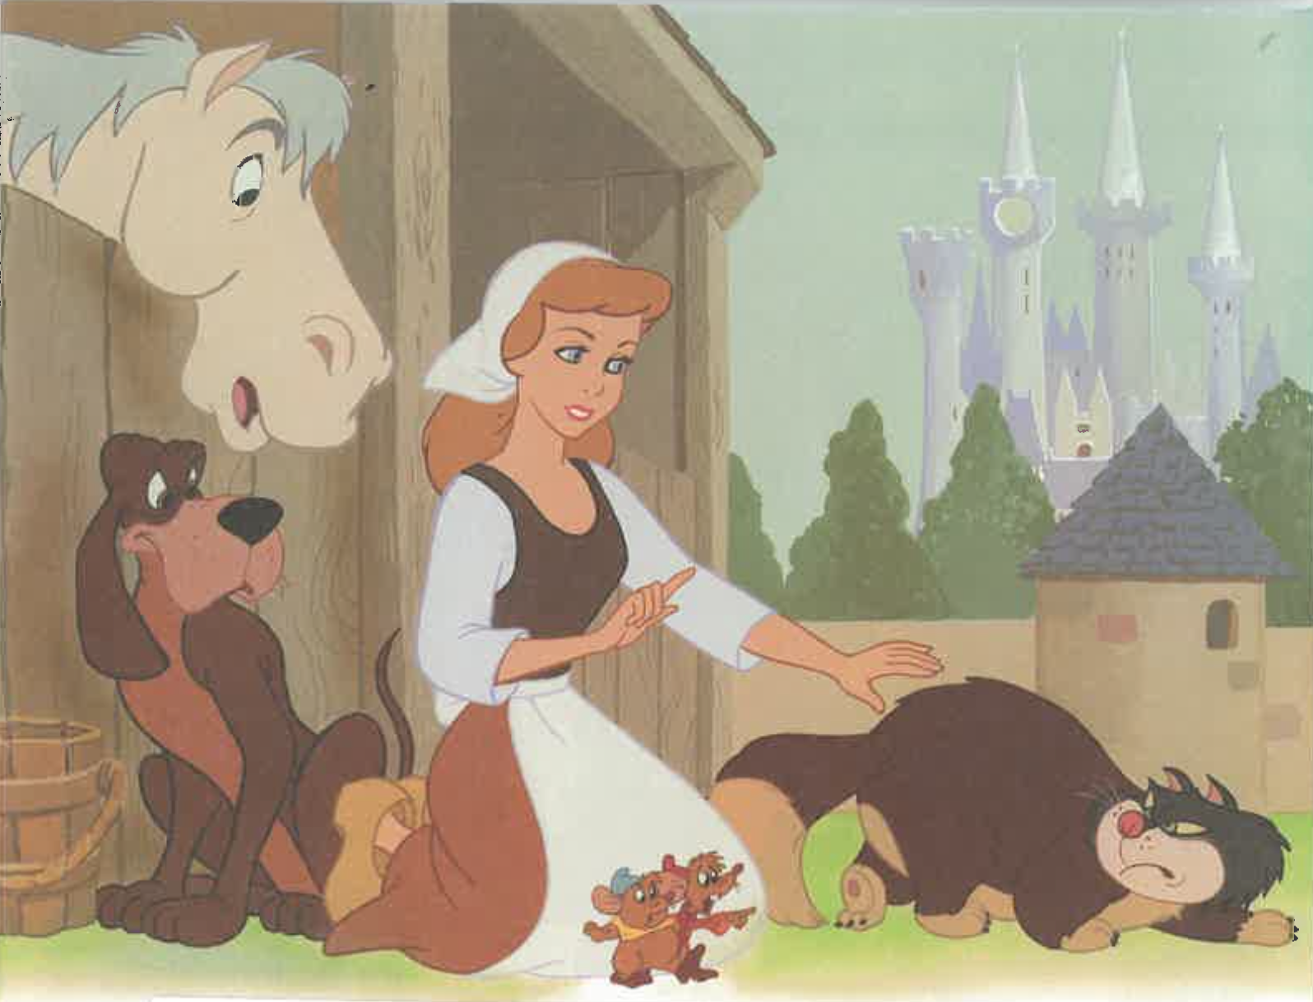

Slide 14
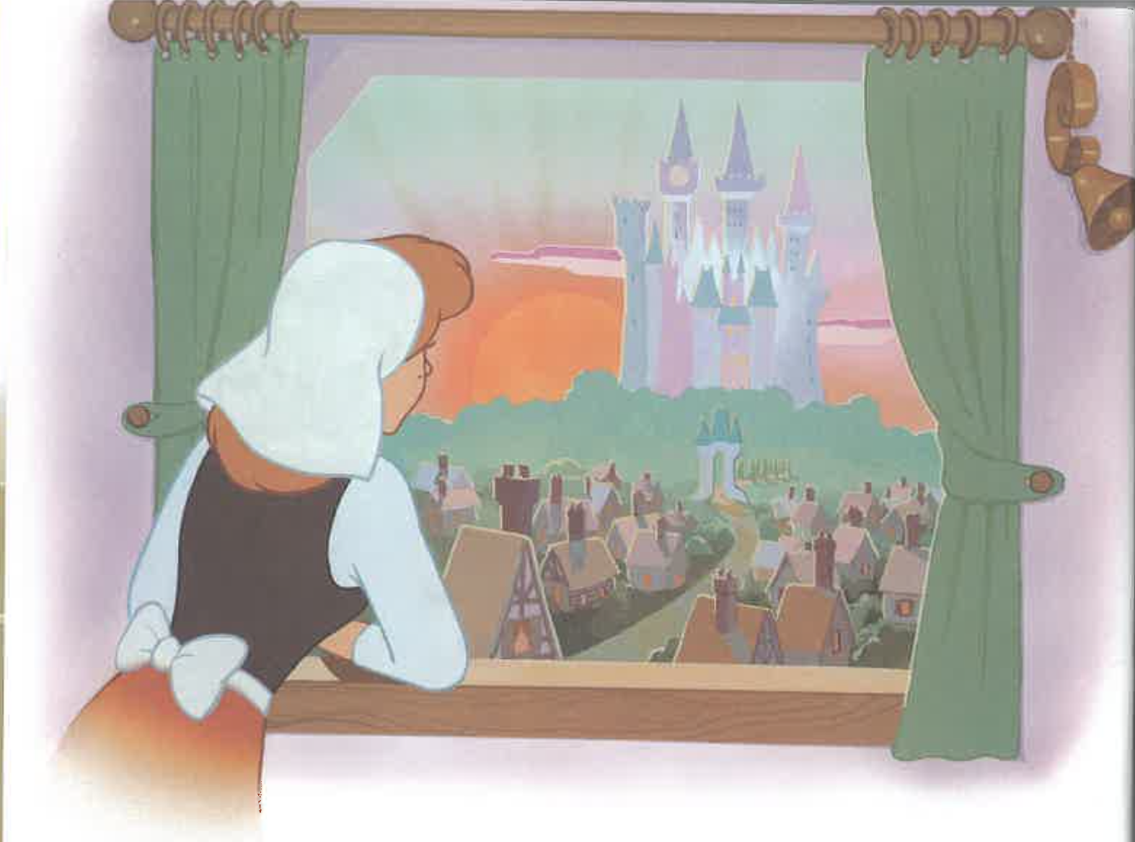

Slide 15
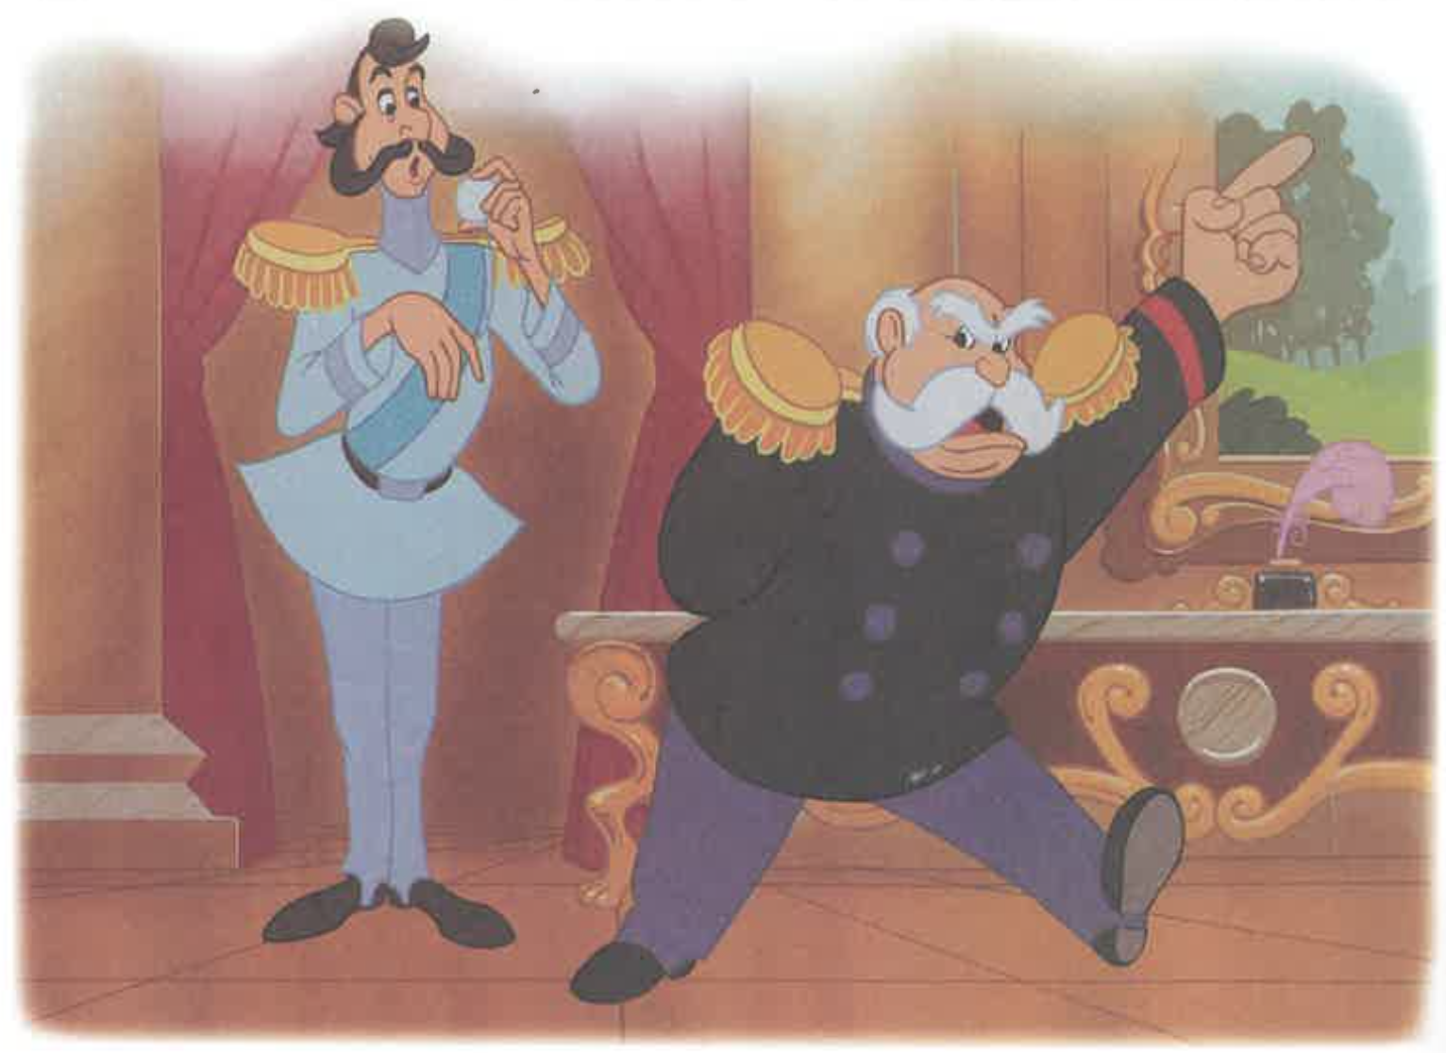

Slide 16
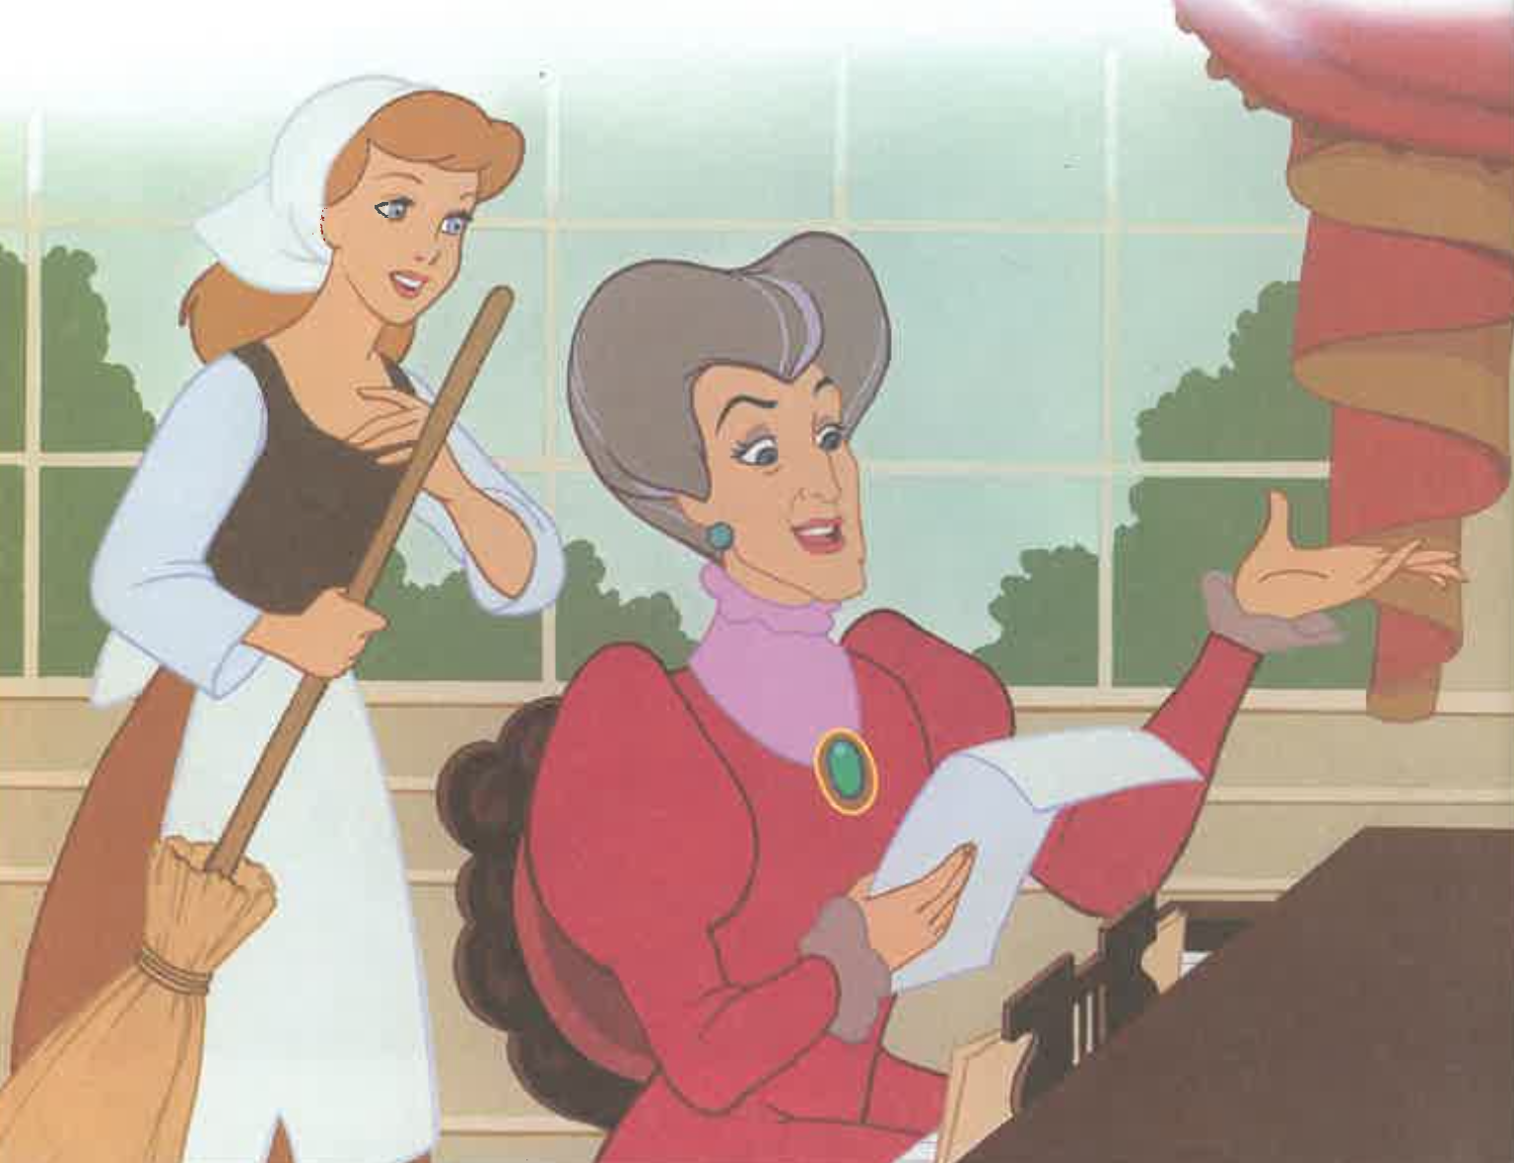

Slide 17
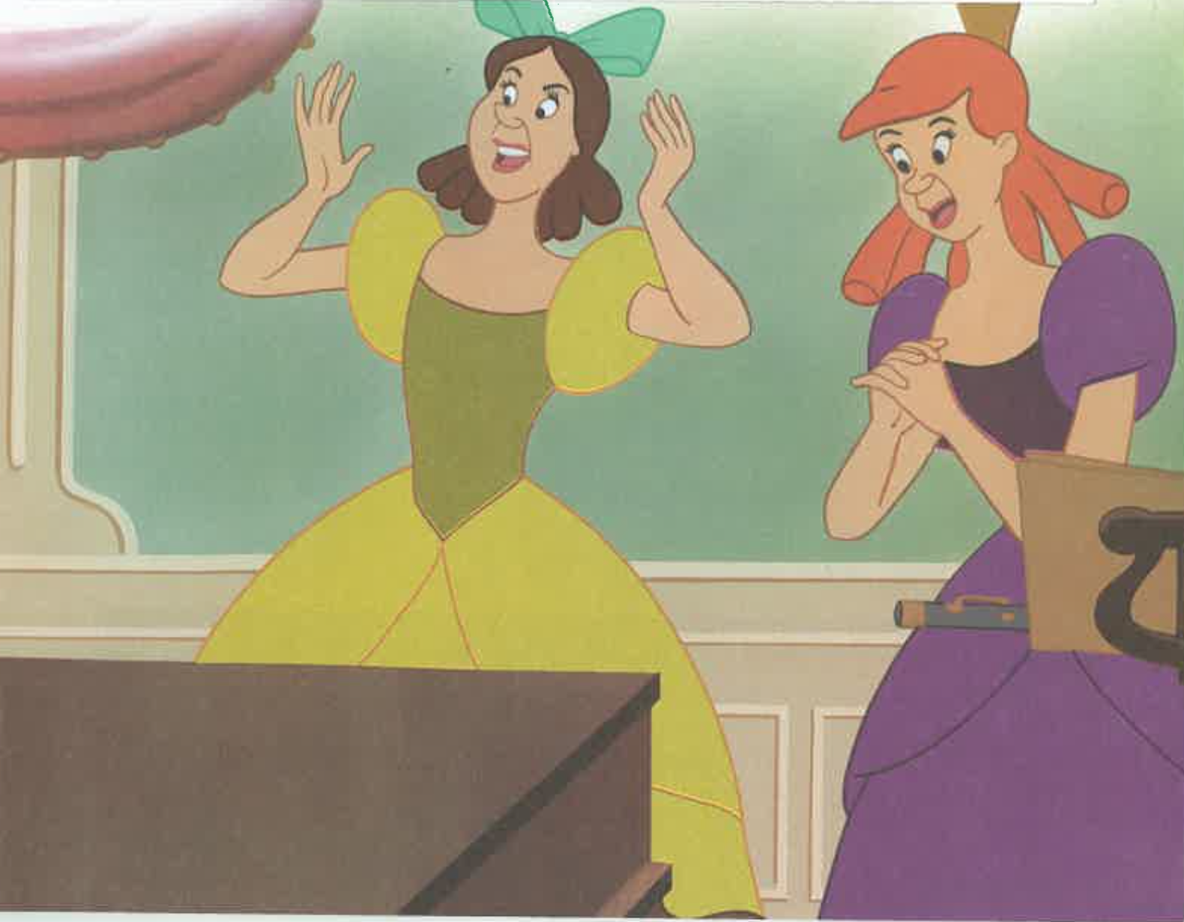

Slide 18
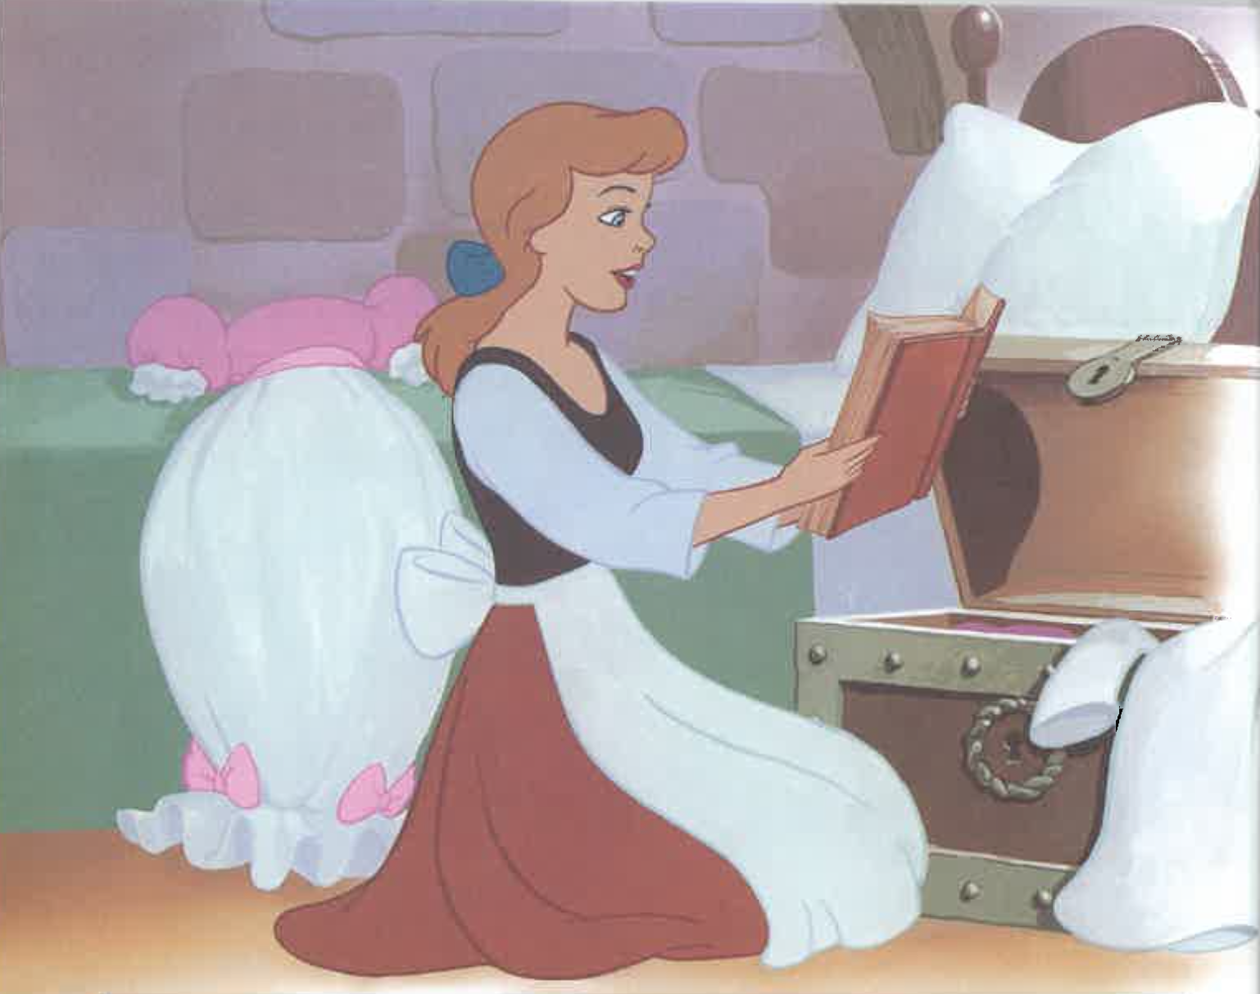

Slide 19
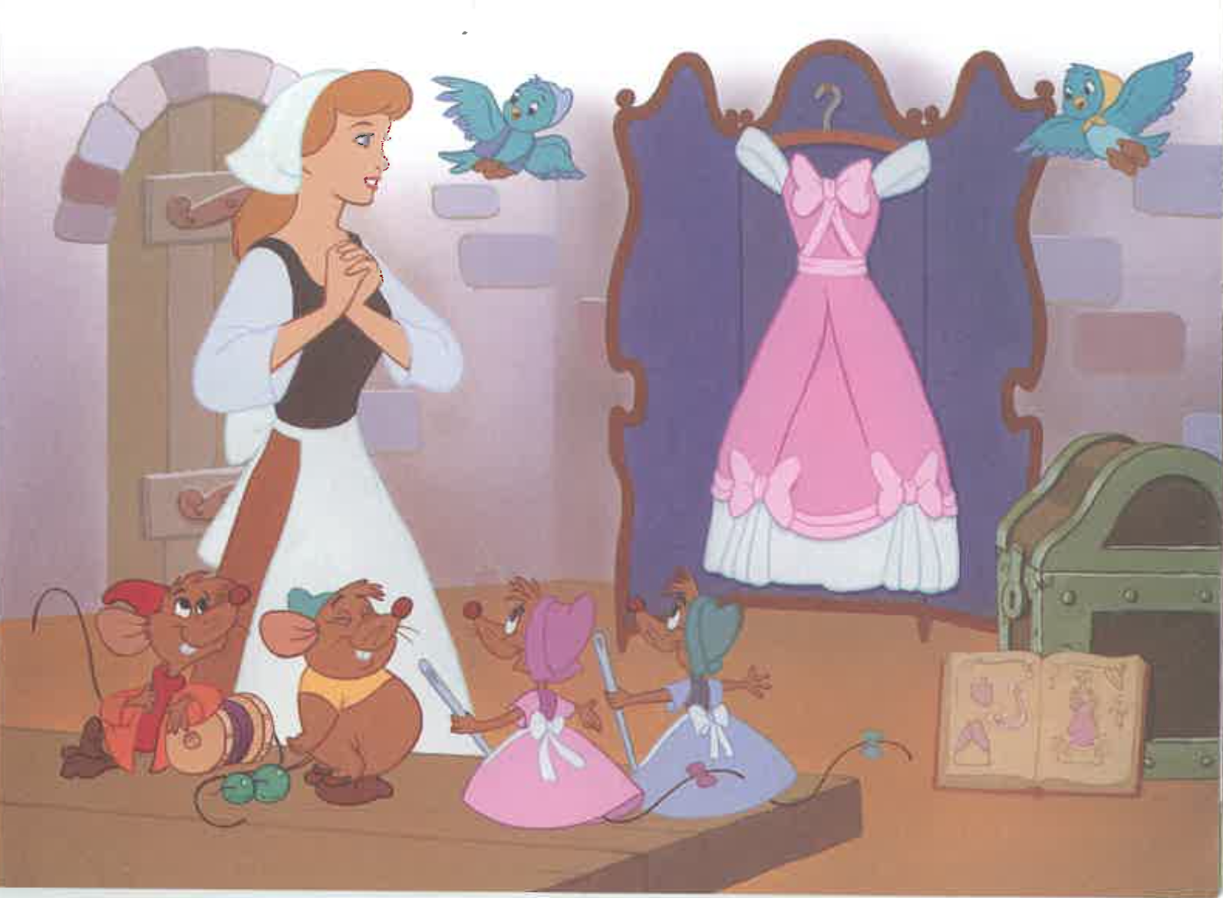

Slide 20
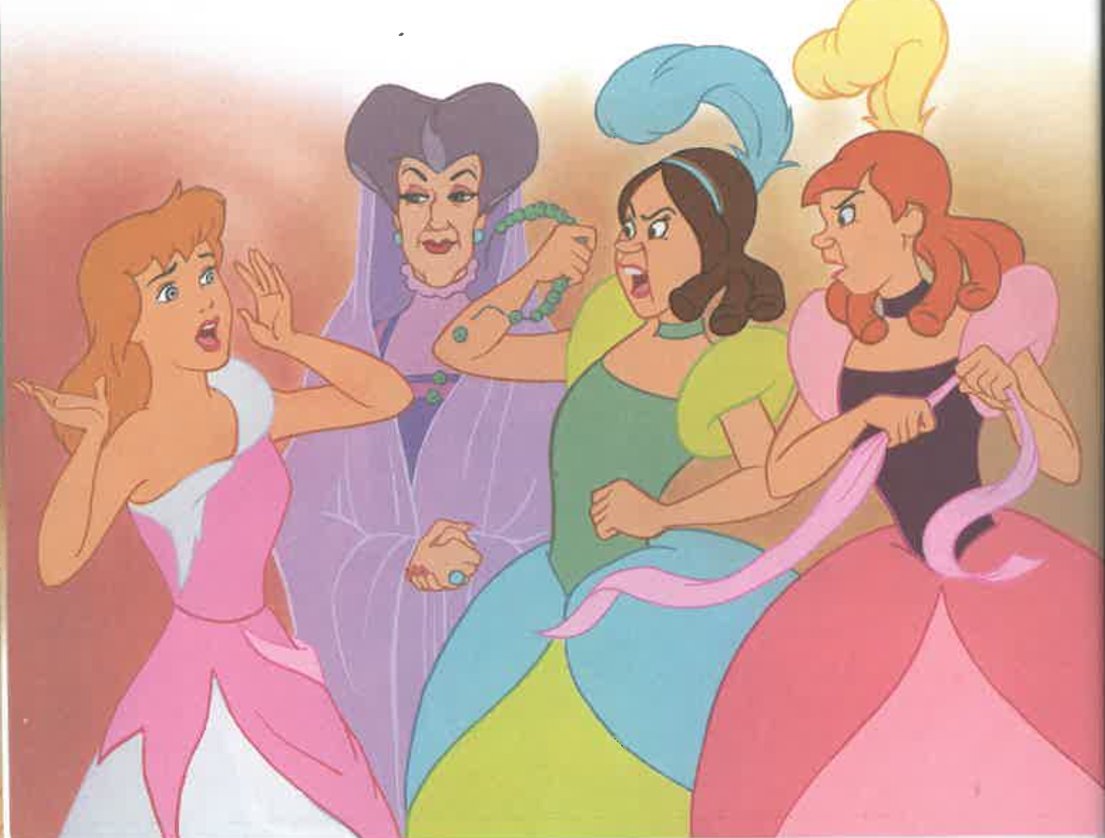

Slide 21
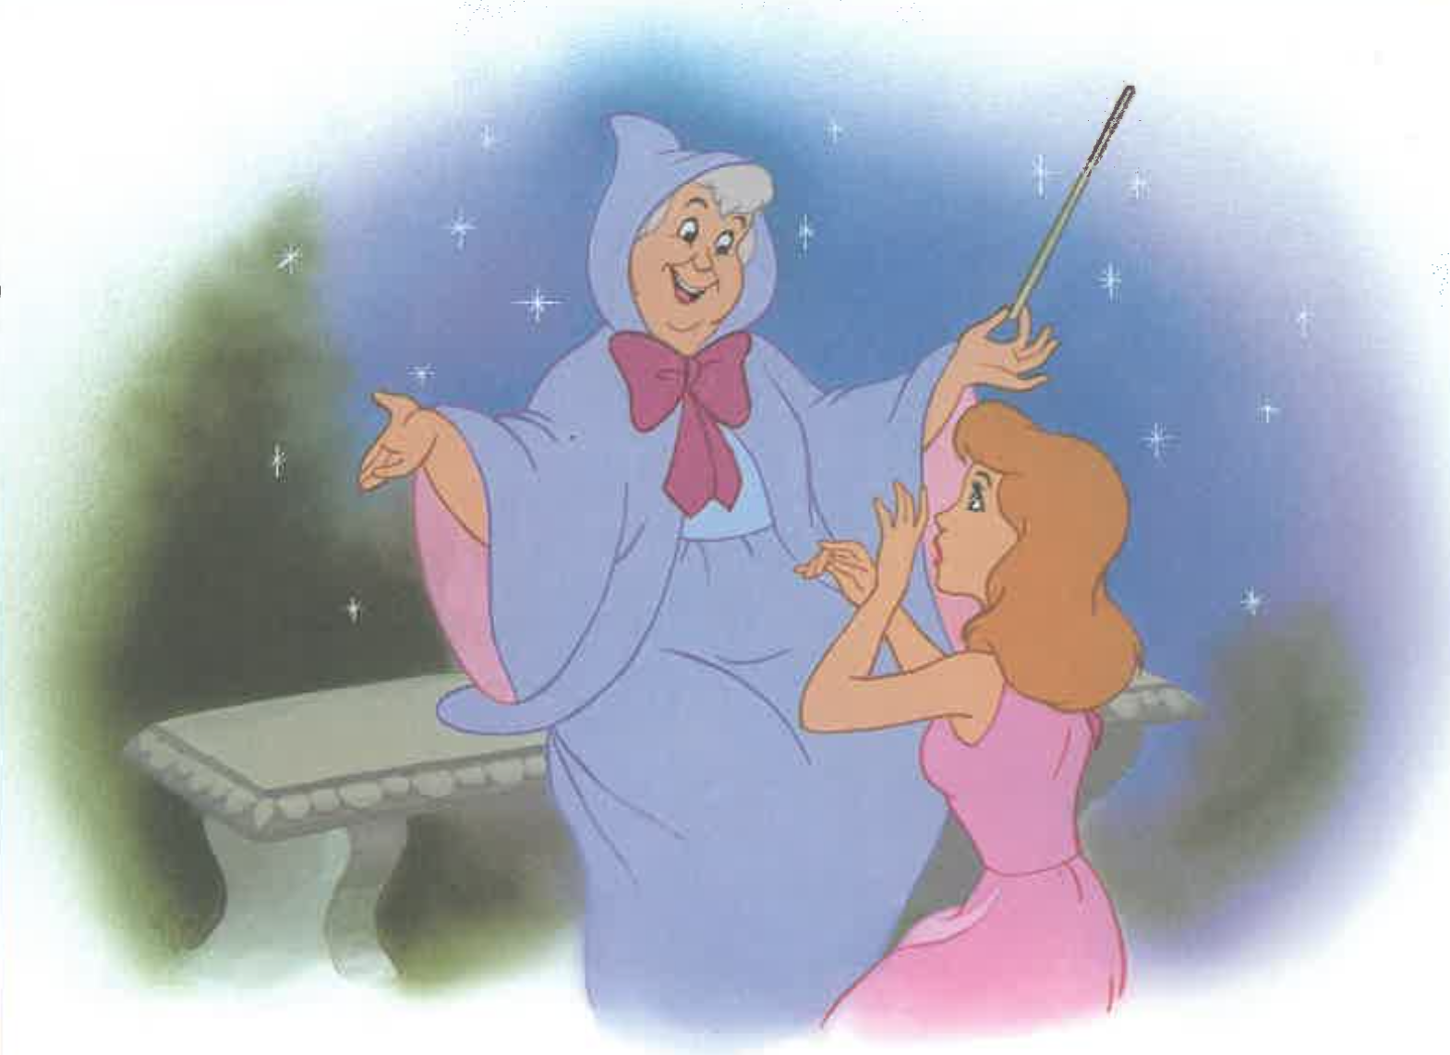

Slide 22
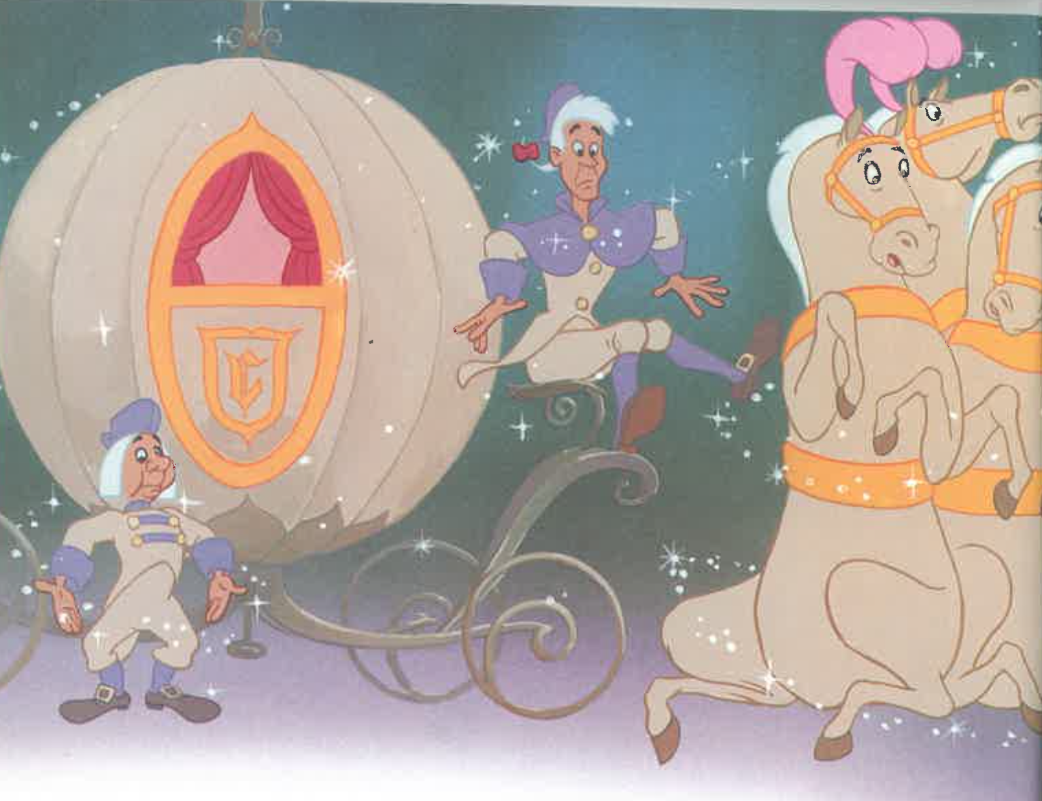

Slide 23
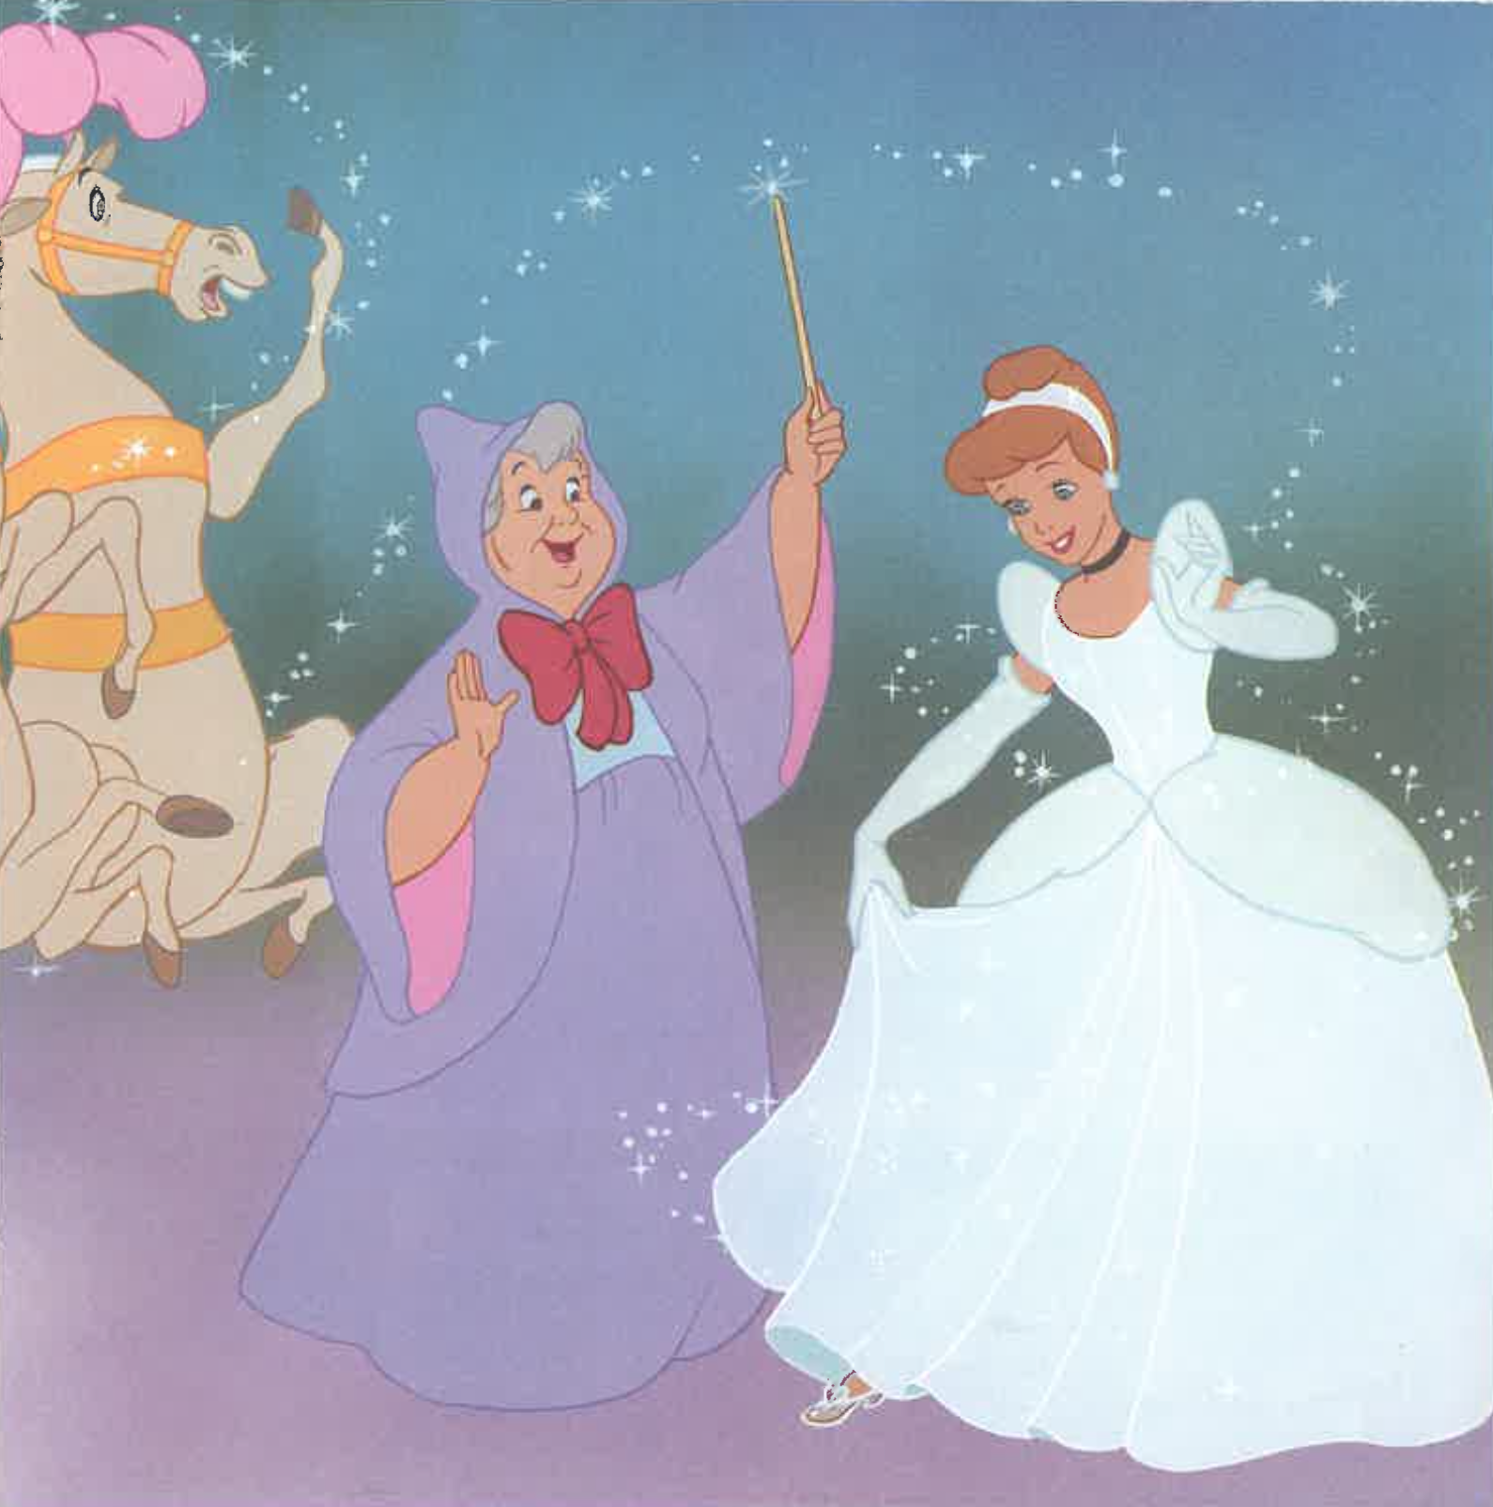

Slide 24
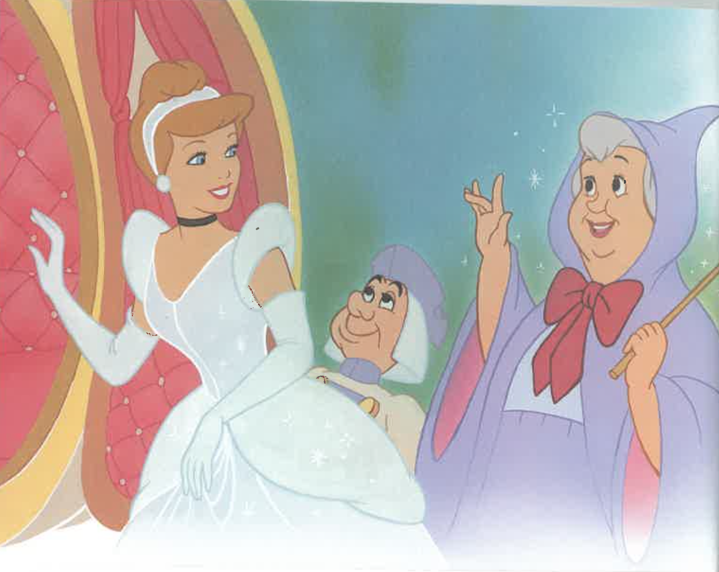

Slide 25
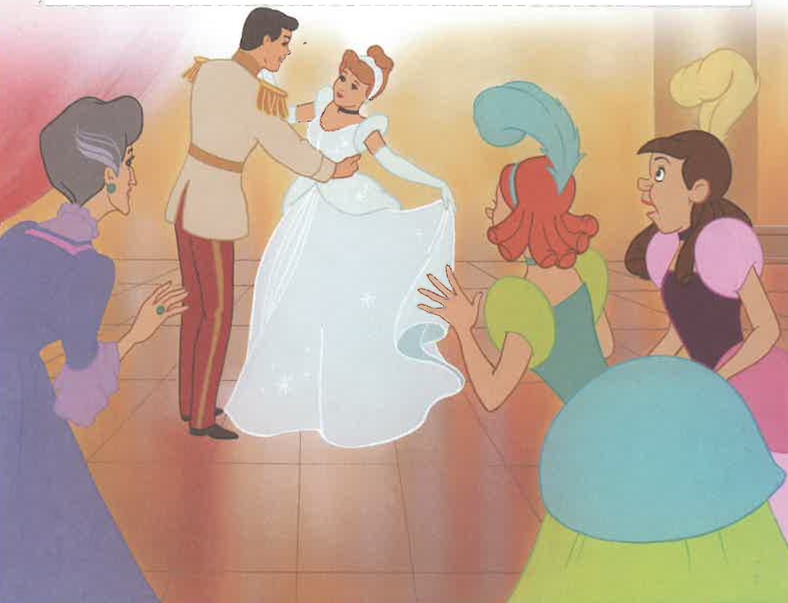

Slide 26
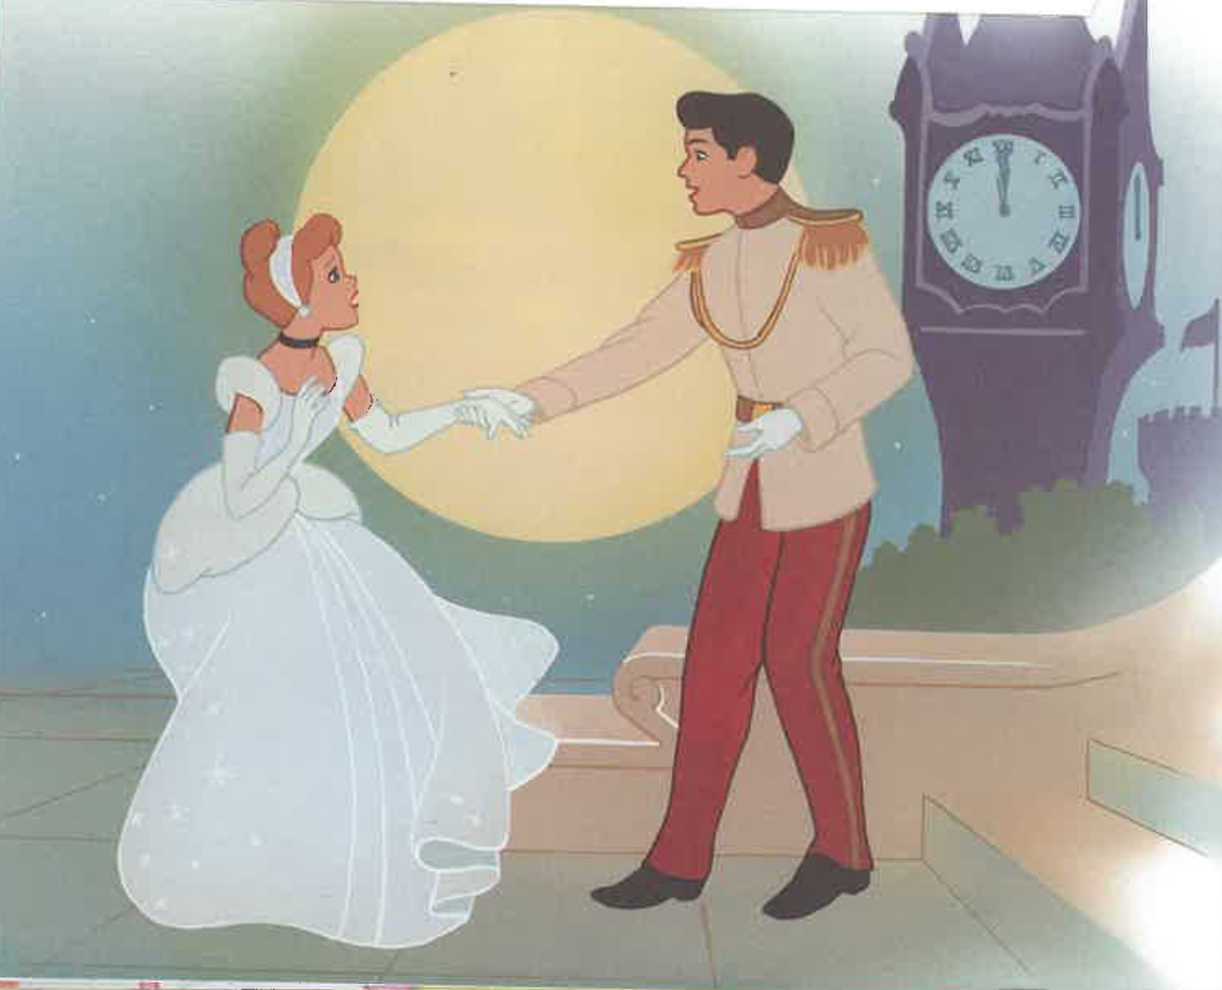

Slide 27
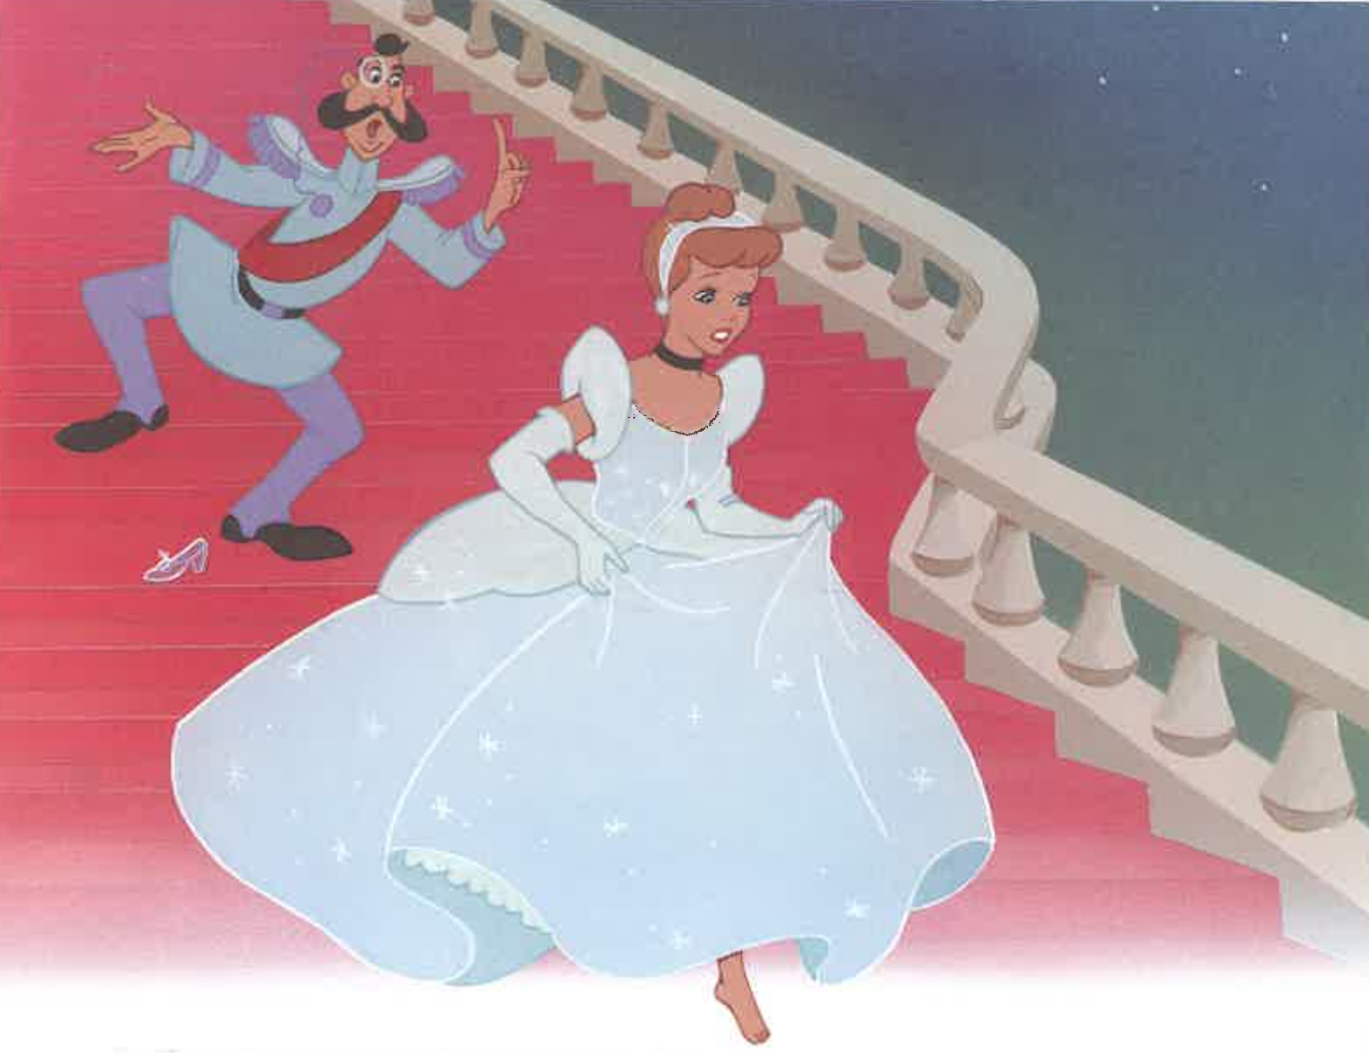

Slide 28
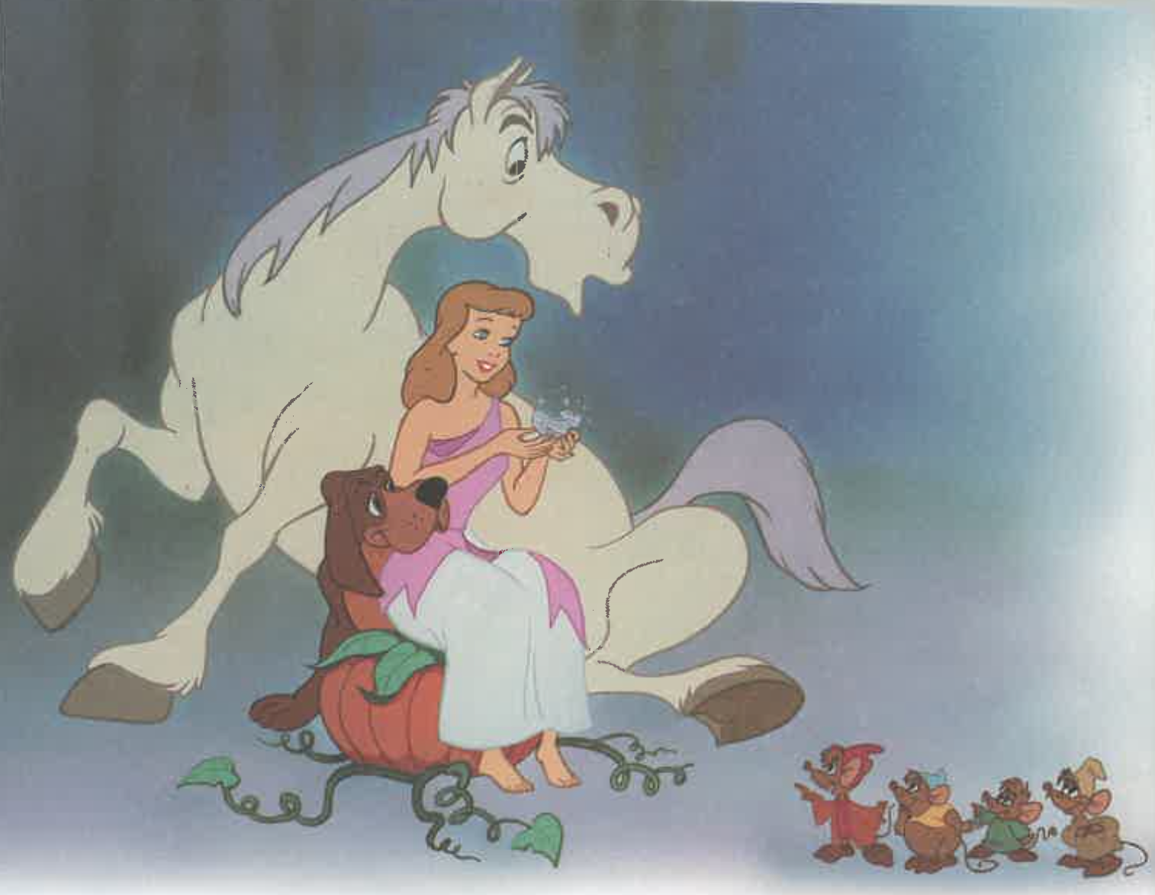

Slide 29
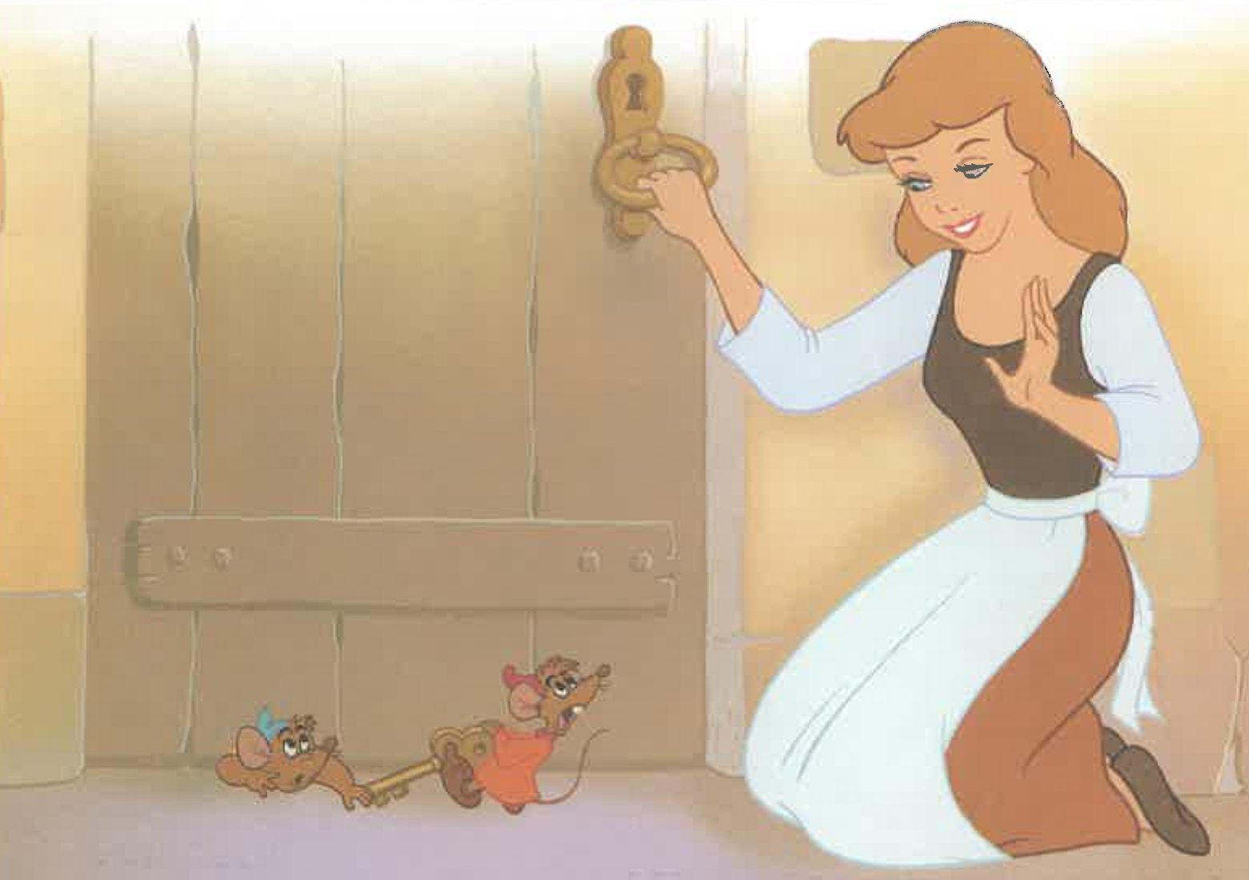

Slide 30
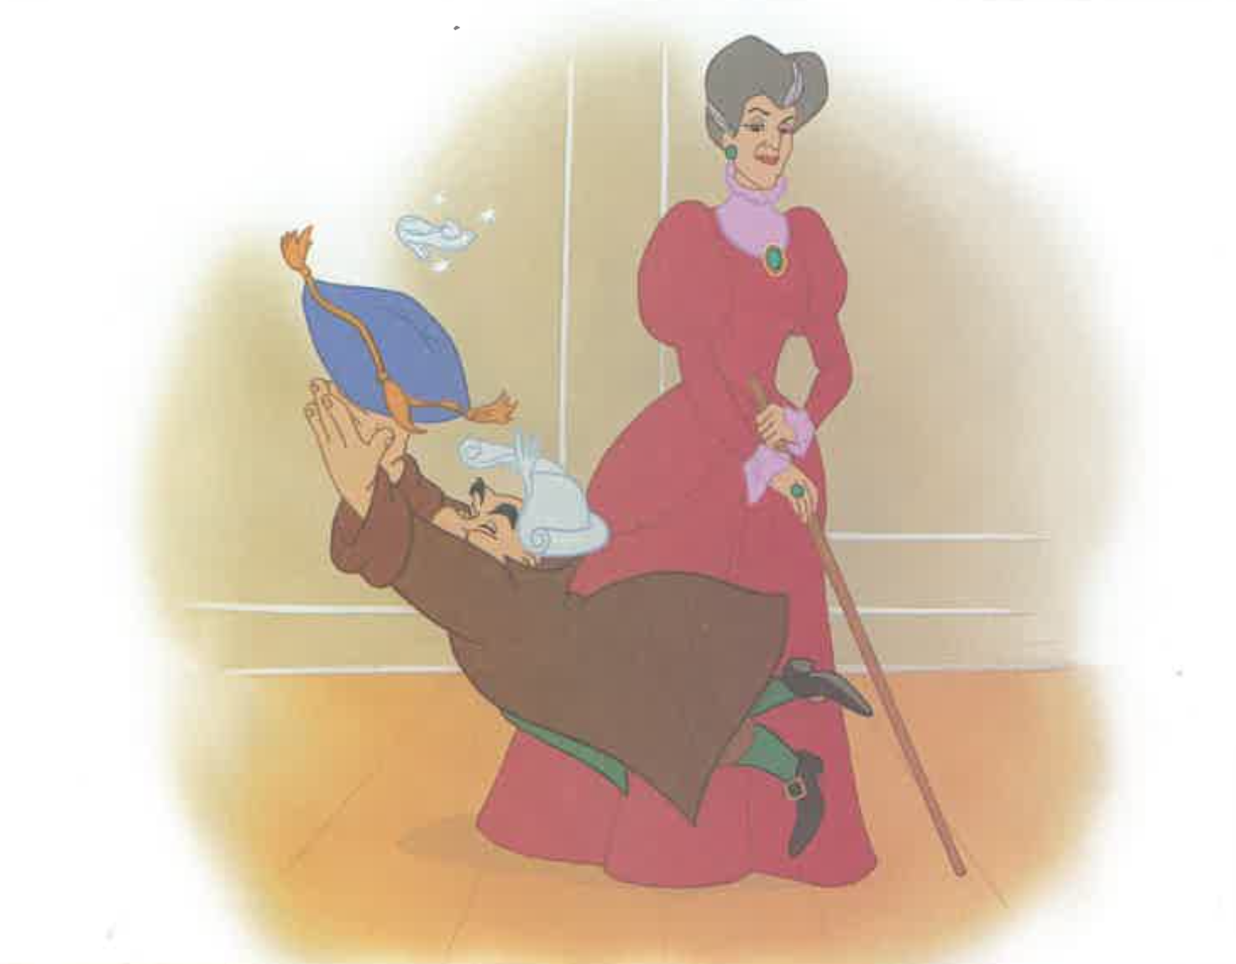

Slide 31
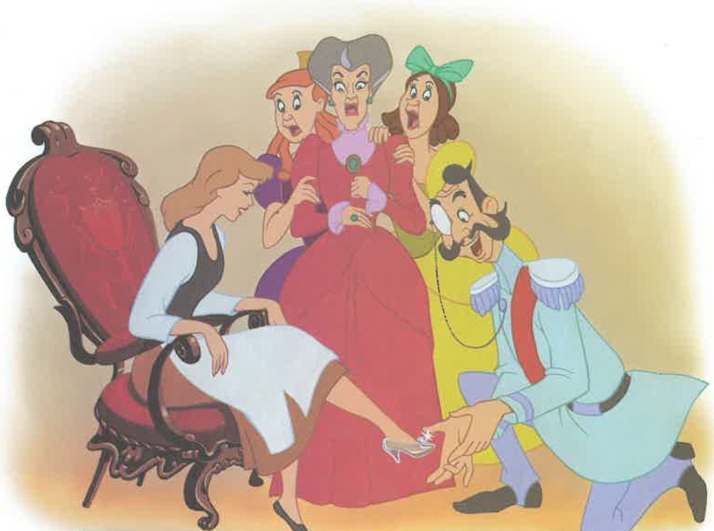

Slide 32
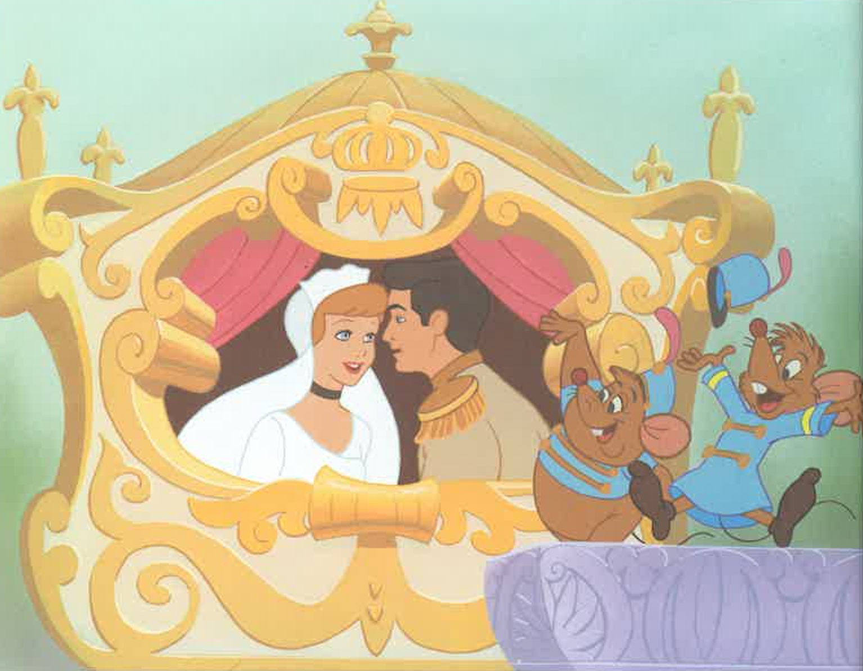

Slide 33
Notes:
Can you tell me the story of Cinderella? (~5 minutes)

Slide 34
Procedural Discourse
Notes:
“Let’s move on to something a little different. Tell me how you would make a peanut butter and jelly sandwich.” (~2 minutes)
If no response in 10 seconds, give second prompt:
“If you were feeling hungry for a peanut butter and jelly sandwich, how would you make it?”

Slide 35
Tell me how to make a peanut butter and jelly sandwich.

Slide 36
Free Speech
Notes:
“For this part, I would like you to tell me about your hometown or where you grew up.” (~4 minutes)
If no response in 10 seconds, give second prompt:
“What was it like where you grew up?”
If no response, prompt for another personal narrative.
"For instance, you could tell me about a trip you took or something about your family or your work -- anything."

Slide 37
Tell me about your hometown.

