Slide 1
Picture Stimuli
DementiaBank
Discourse Tasks

Slide 2
Picture #1

Slide 4
Picture #2

Slide 5
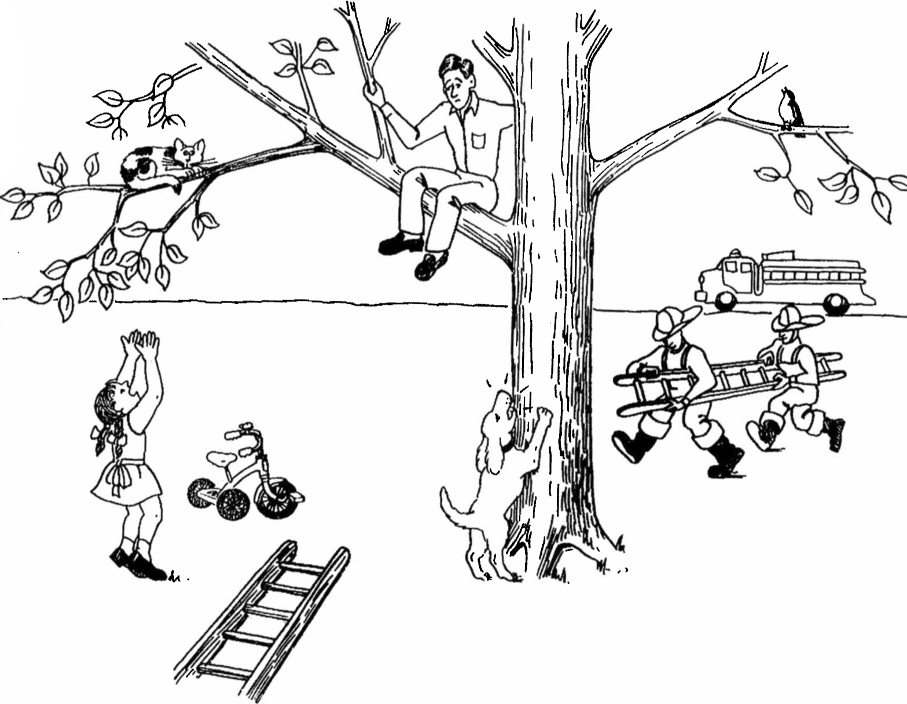

Slide 6
Picture #3

Slide 8
Story Narrative

Slide 9
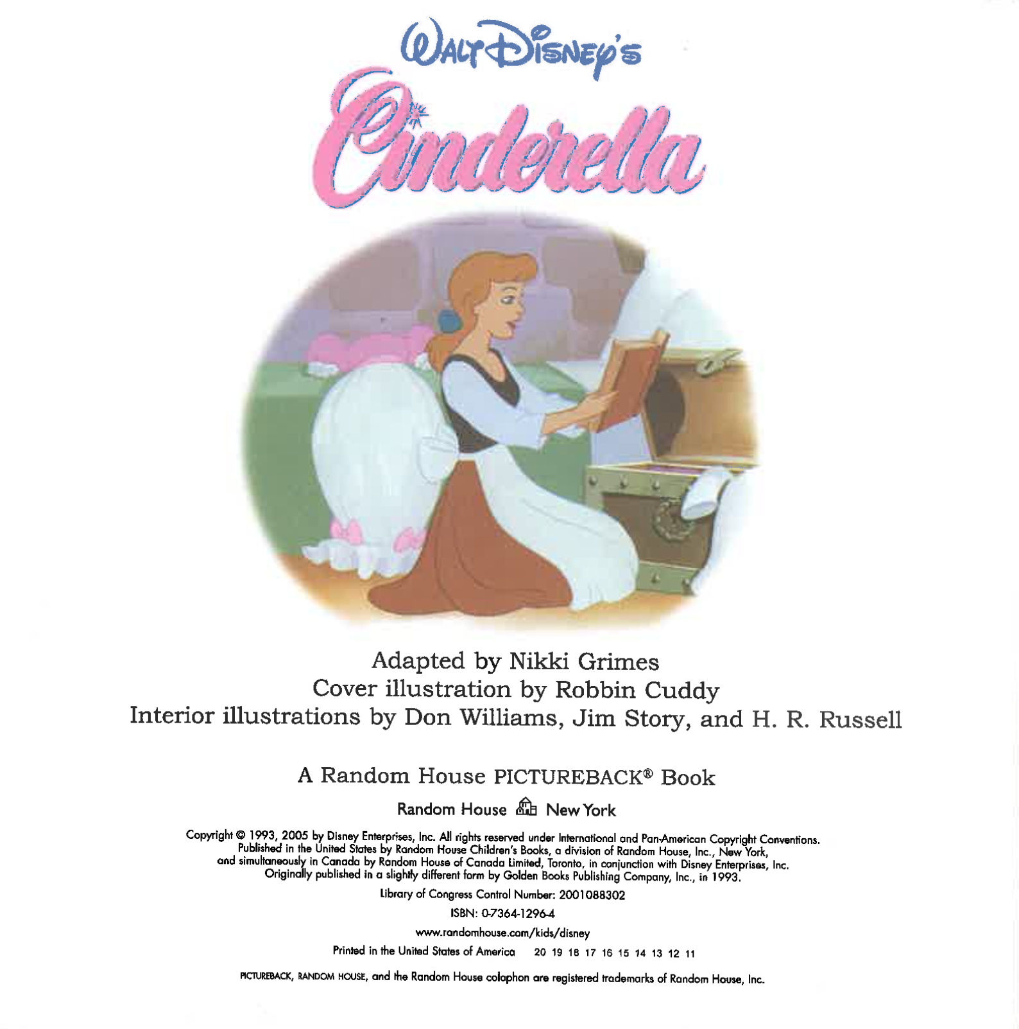
Notes:
“The next story that you are going to tell me is the story of Cinderella (point to cover of book). Have you heard this story before? Please open this book and tell me the story of Cinderella using the pictures in the book.”
If no response in 10 seconds, give second prompt:
“Take a look at the pictures in this book (open to the first page) and tell me the story of Cinderella.”
If fewer than 2 utterances, give third prompt:
“Anything else you can tell me about the story of Cinderella?”

Slide 10
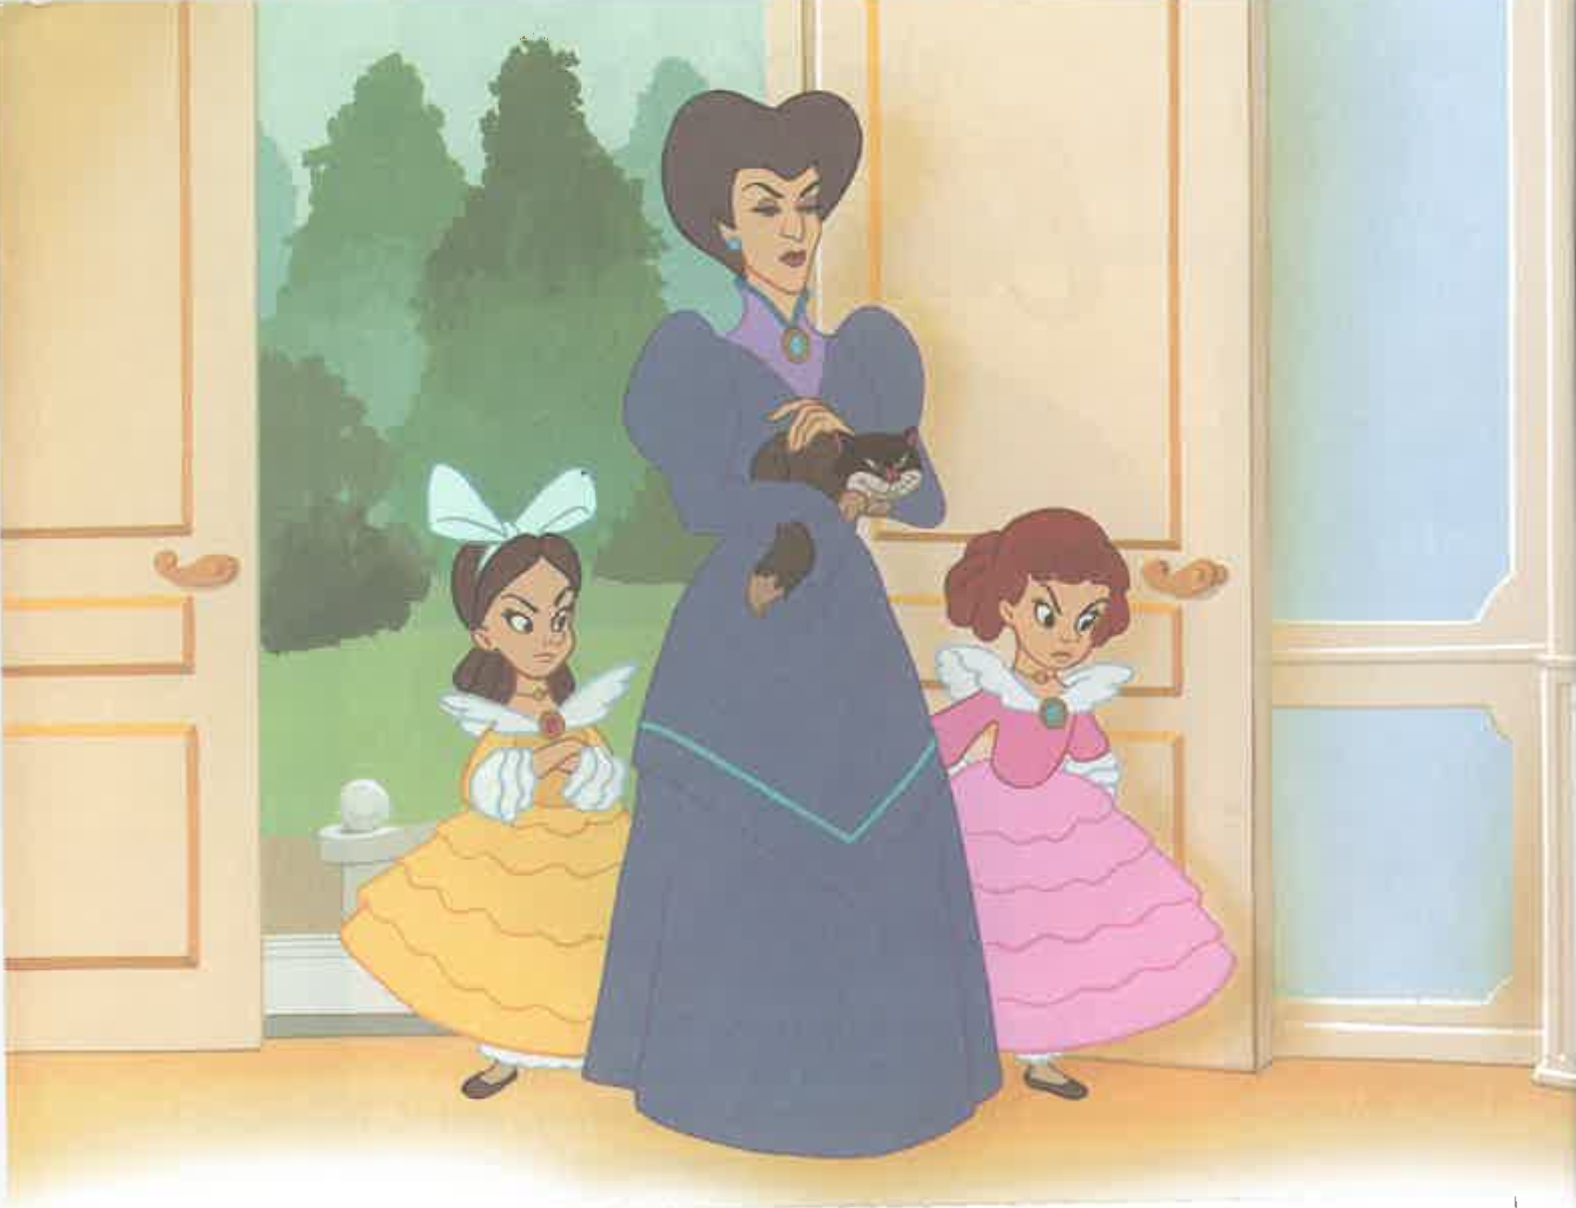

Slide 11
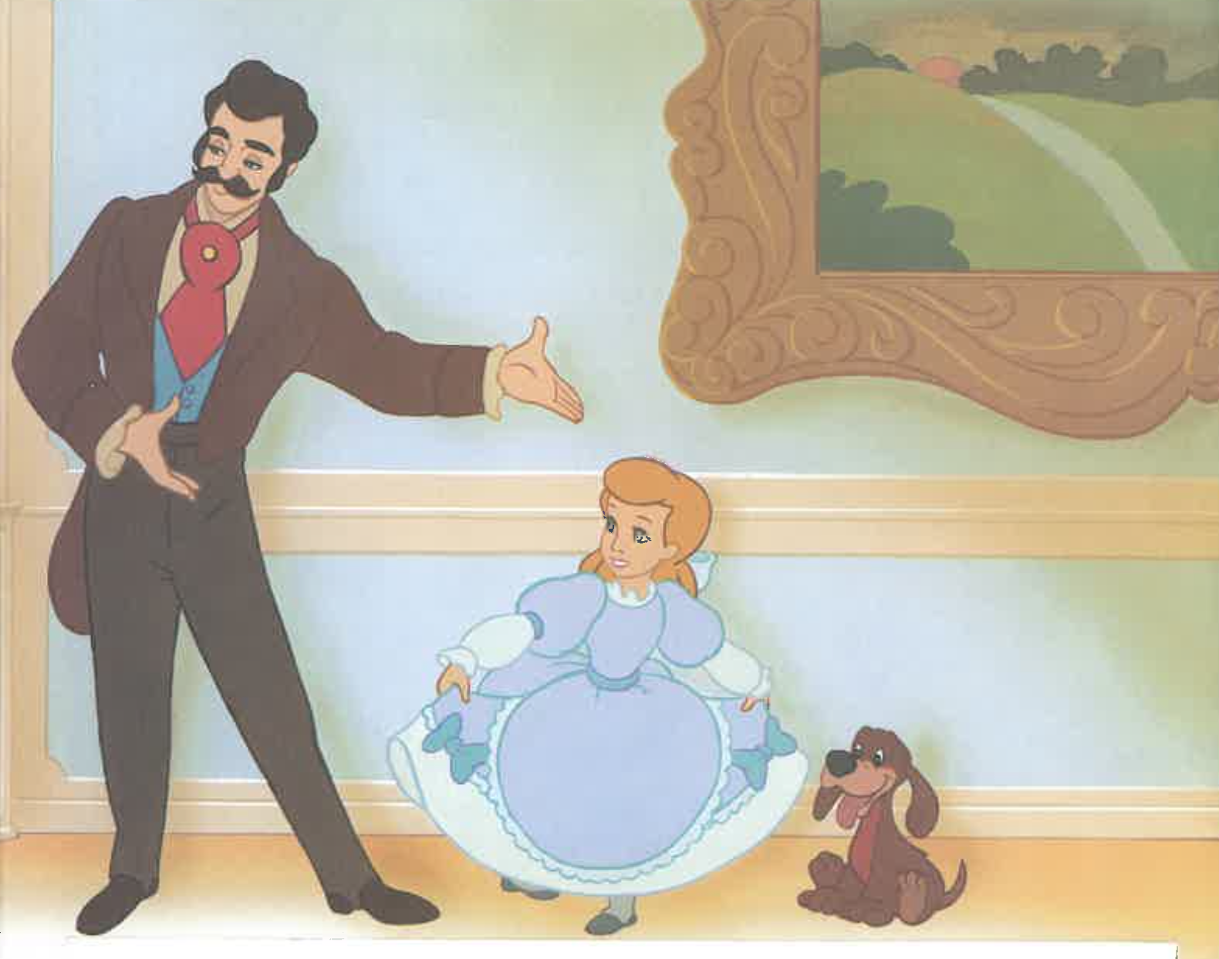

Slide 12
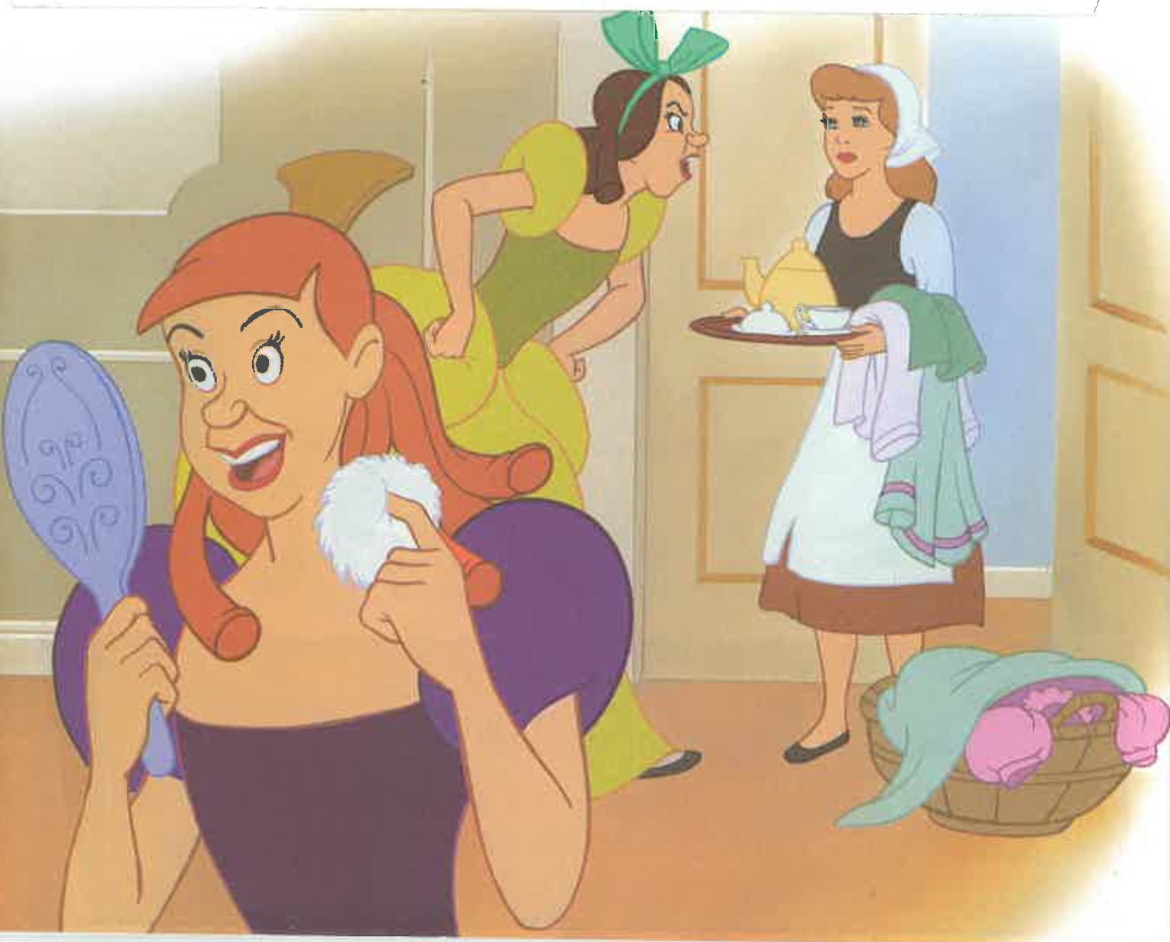

Slide 13
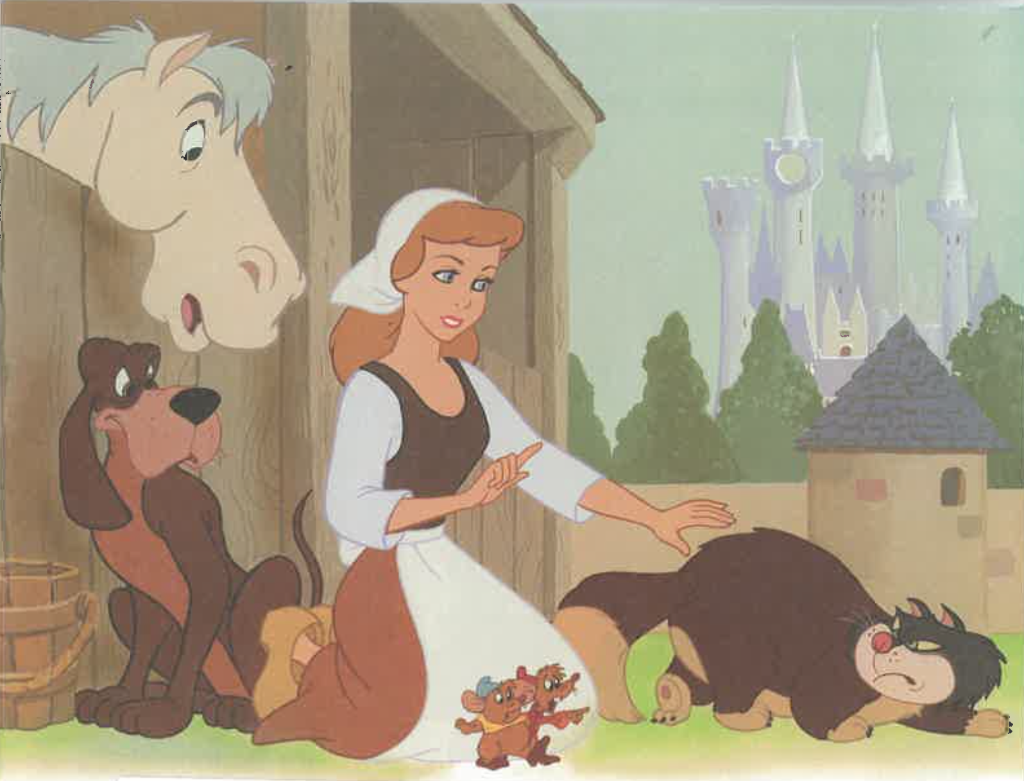

Slide 14
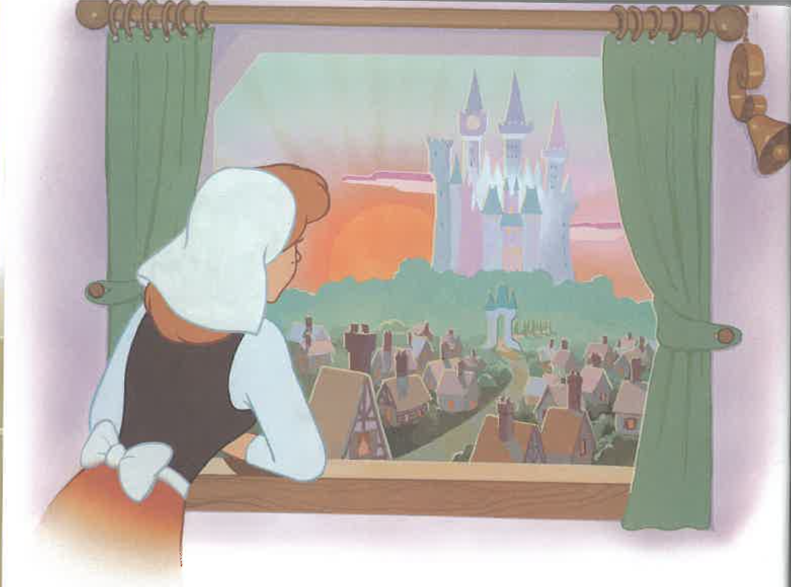

Slide 15
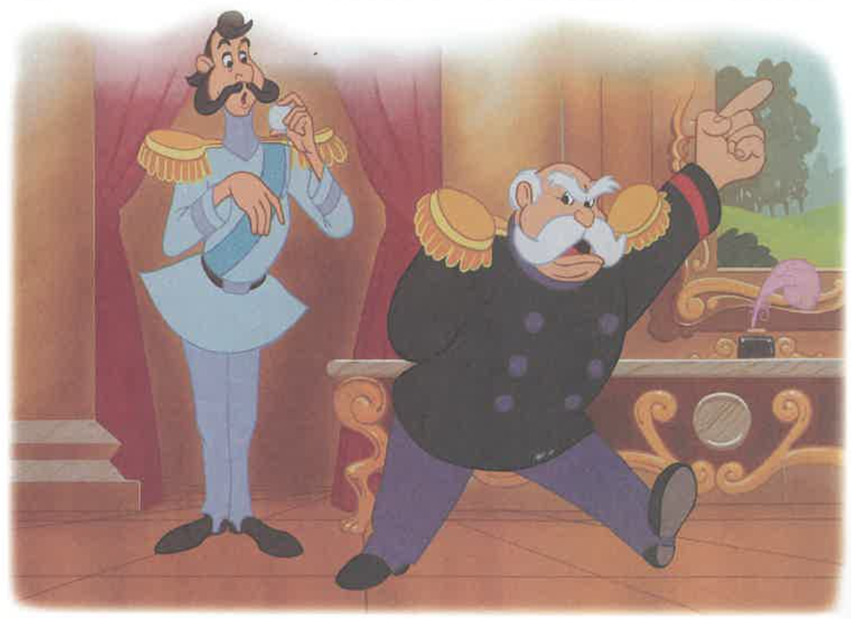

Slide 16
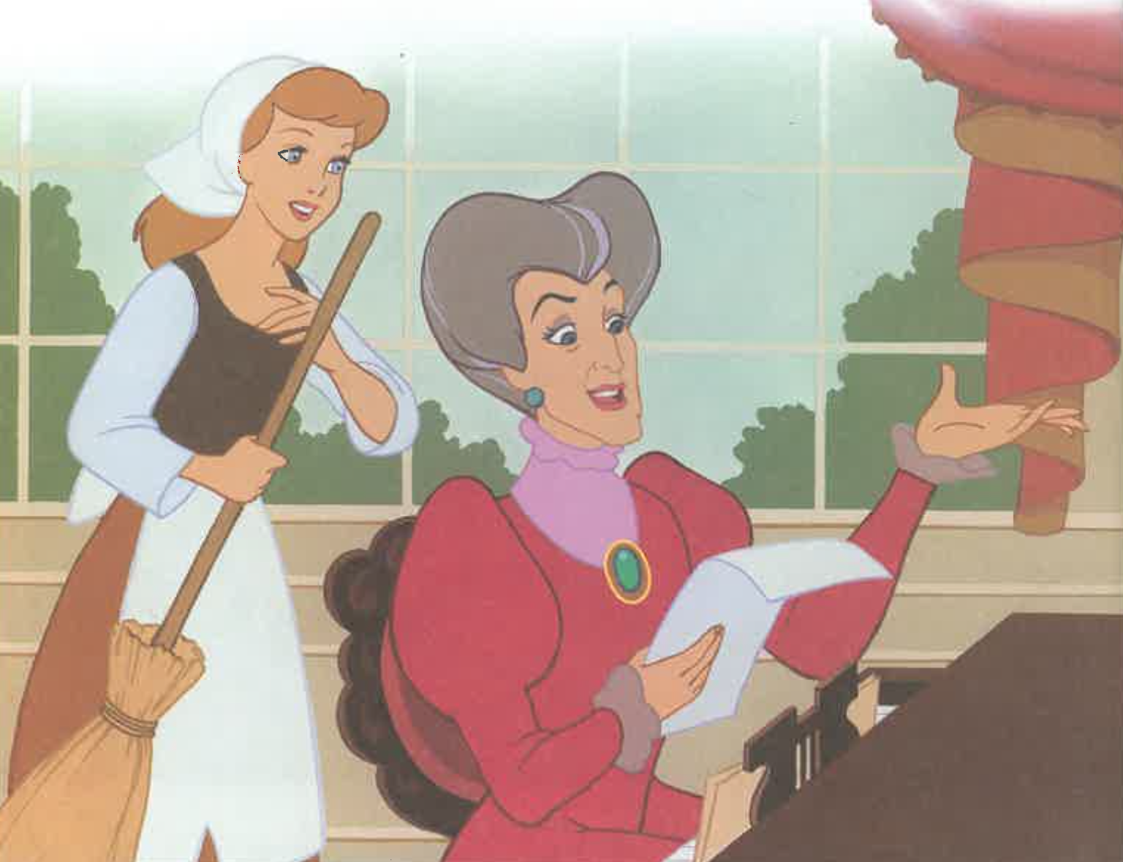

Slide 17
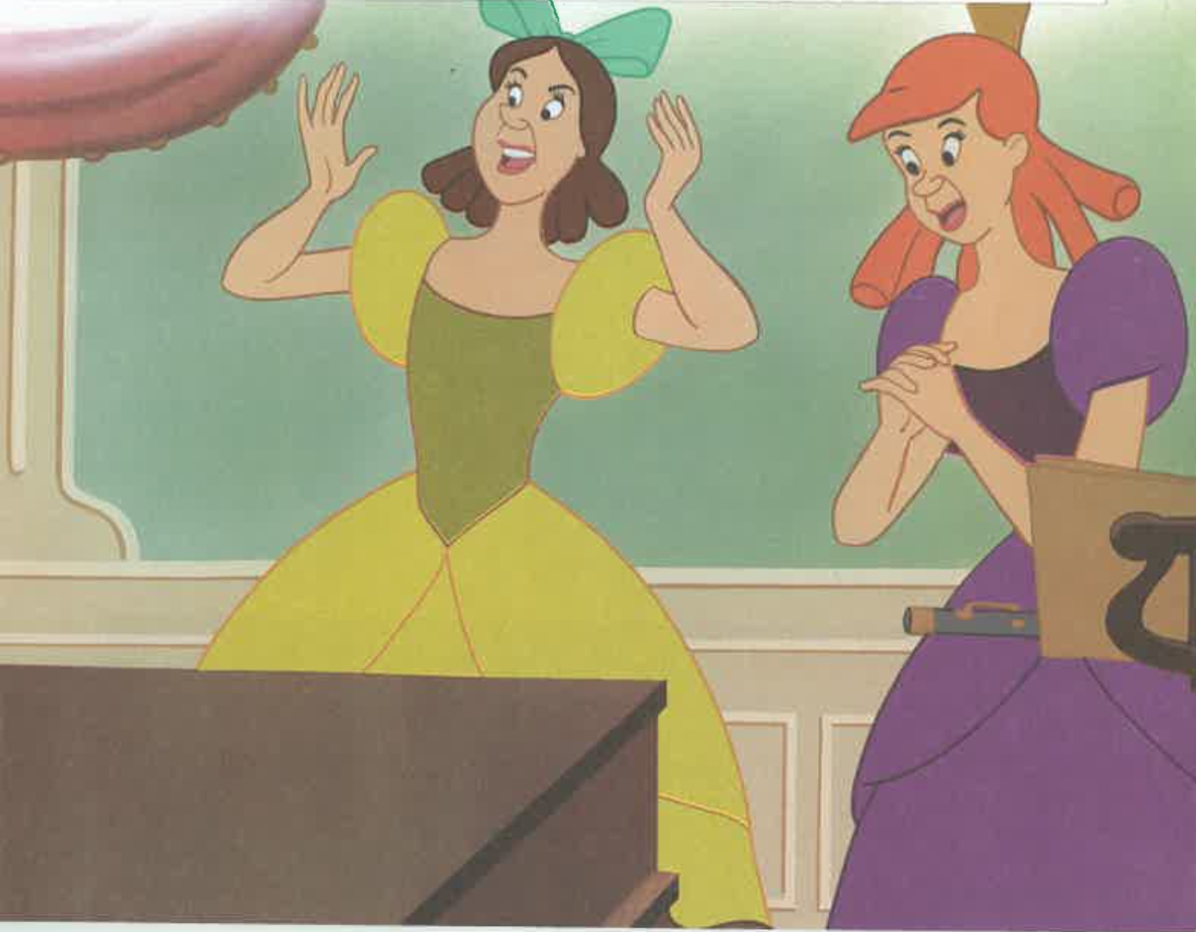

Slide 18
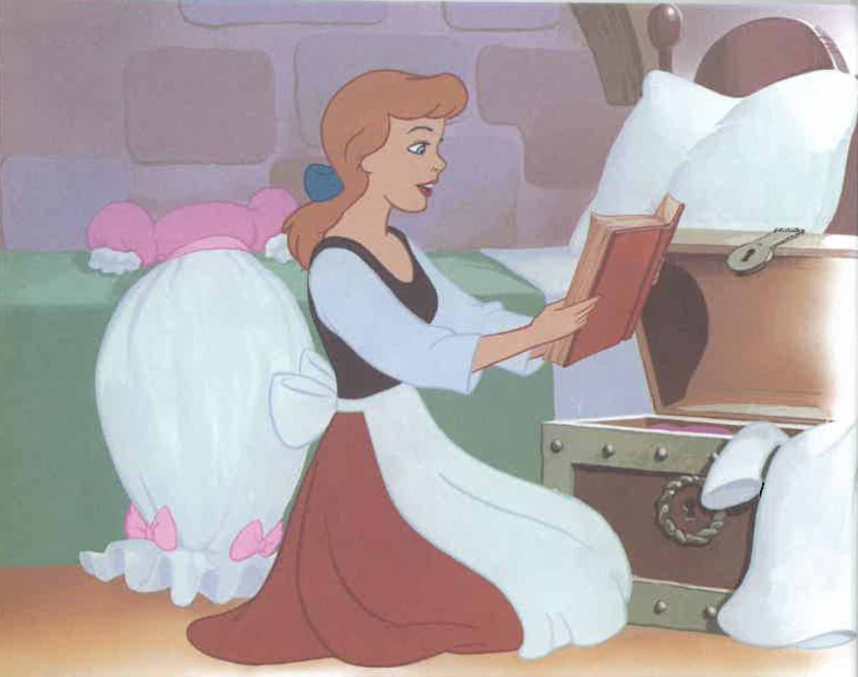

Slide 19
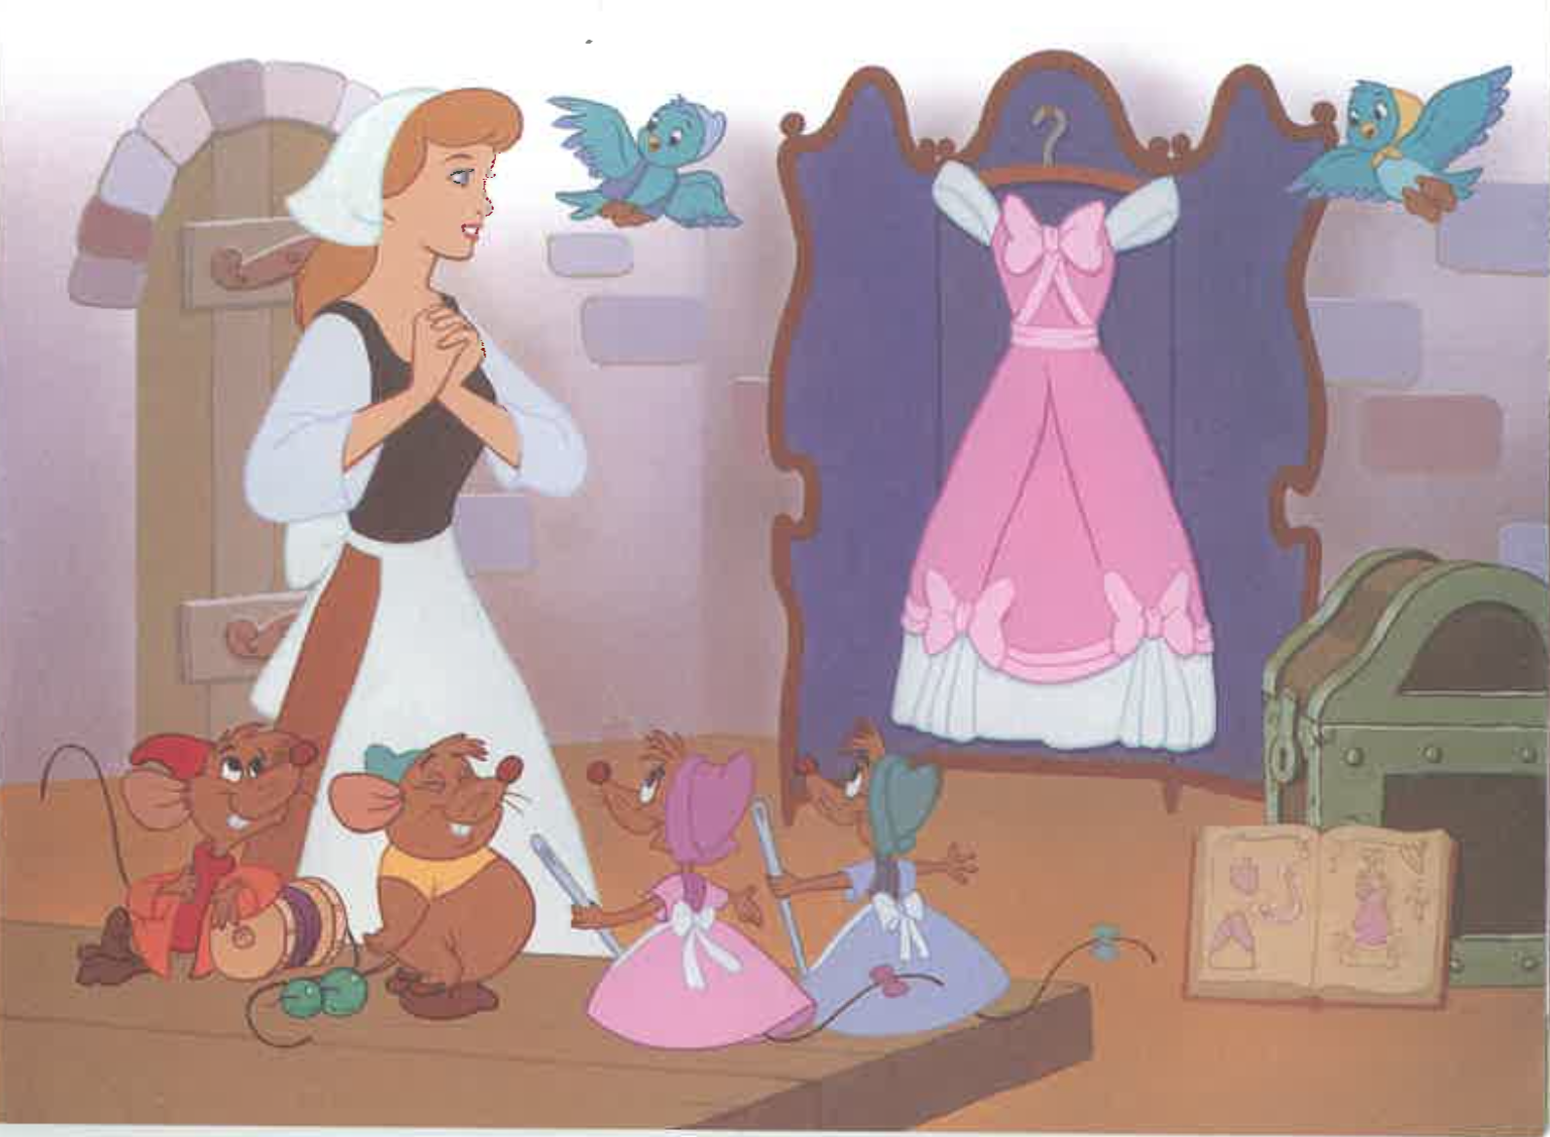

Slide 20
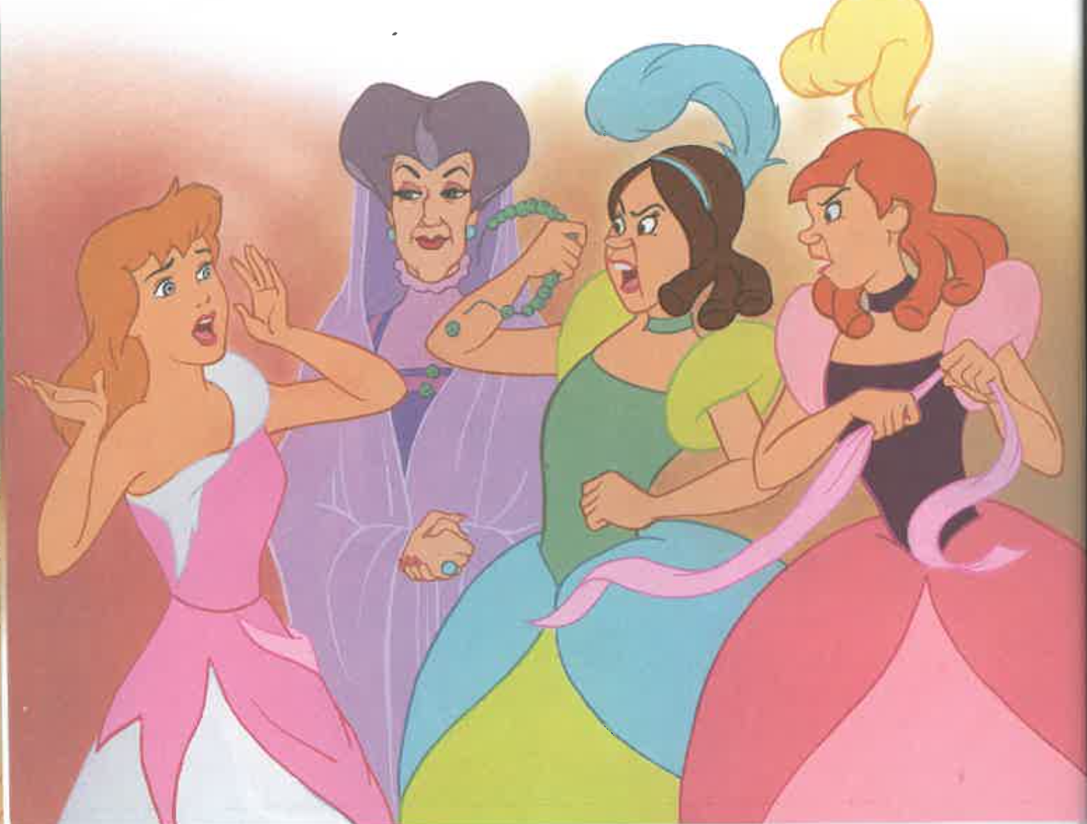

Slide 21
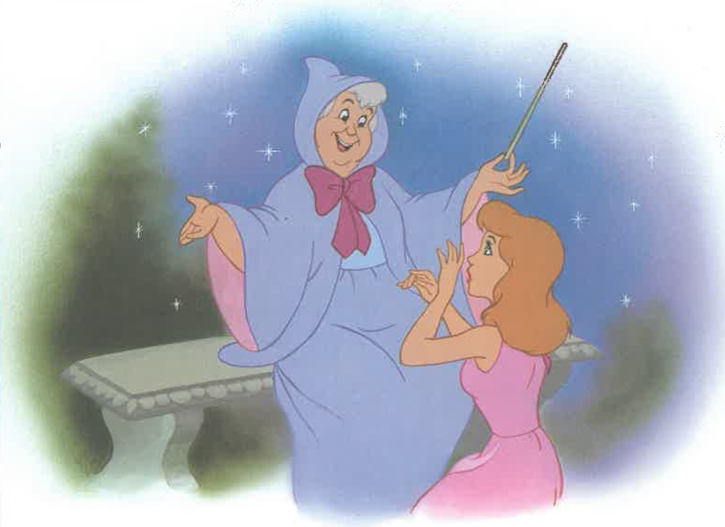

Slide 22
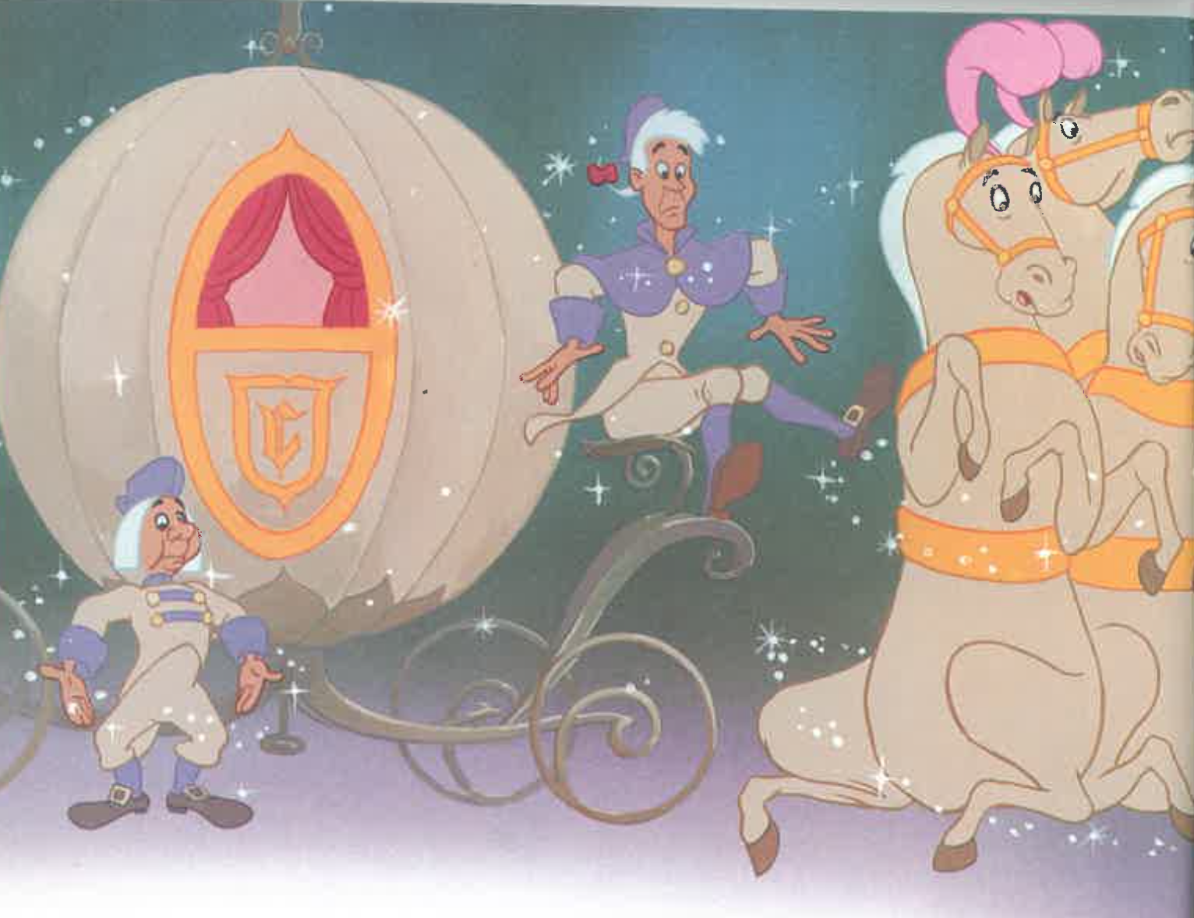

Slide 23
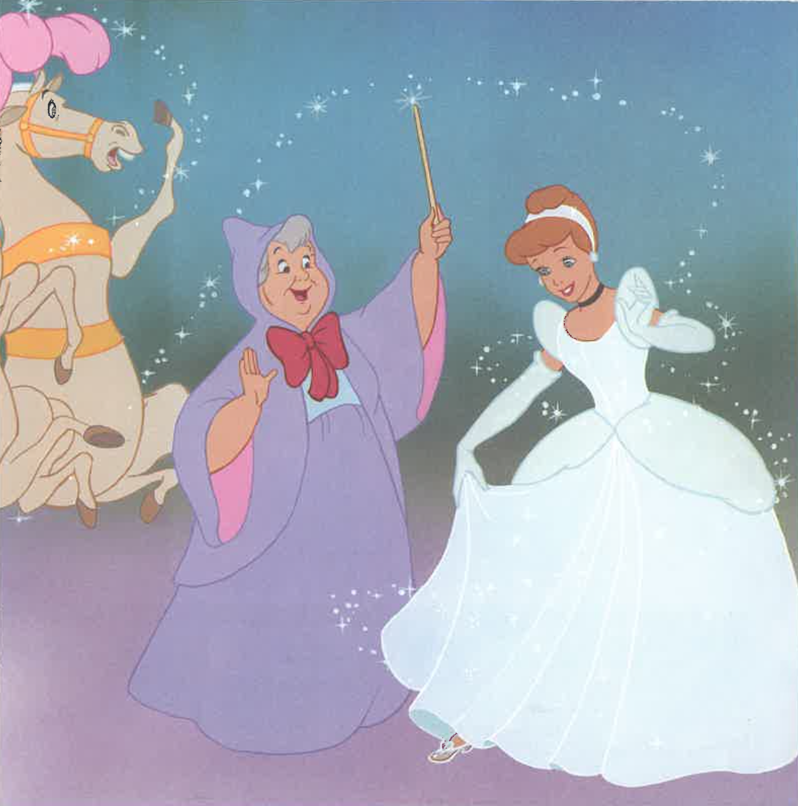

Slide 24
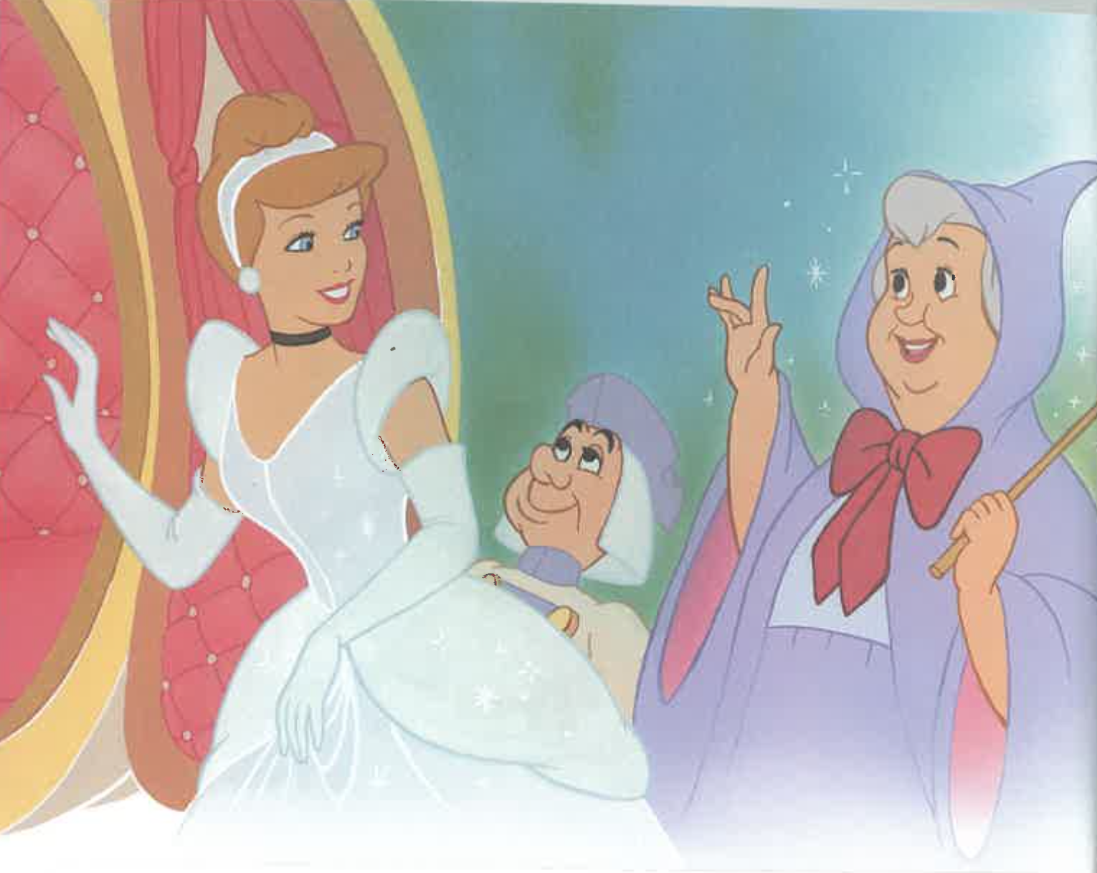

Slide 25
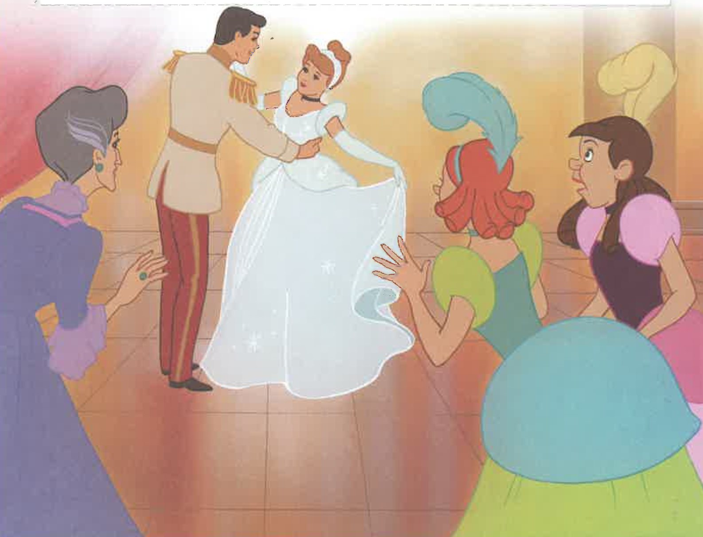

Slide 26
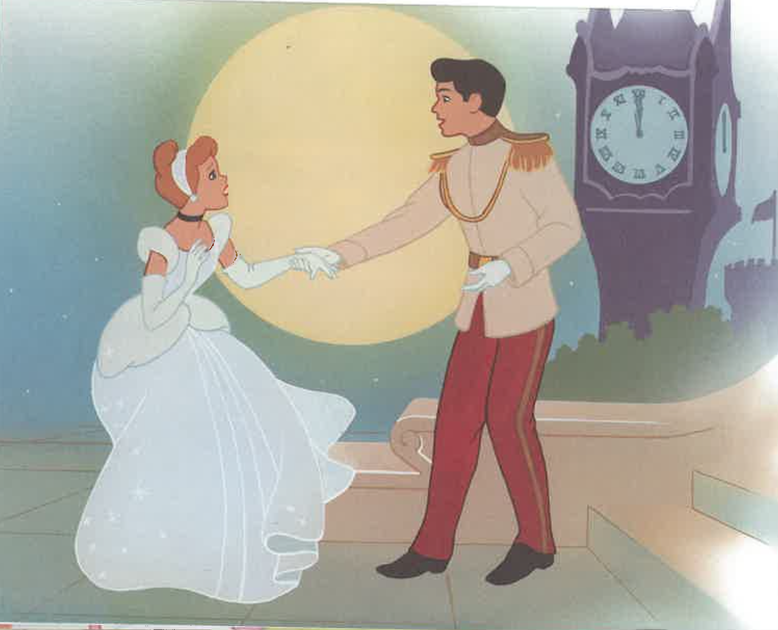

Slide 27
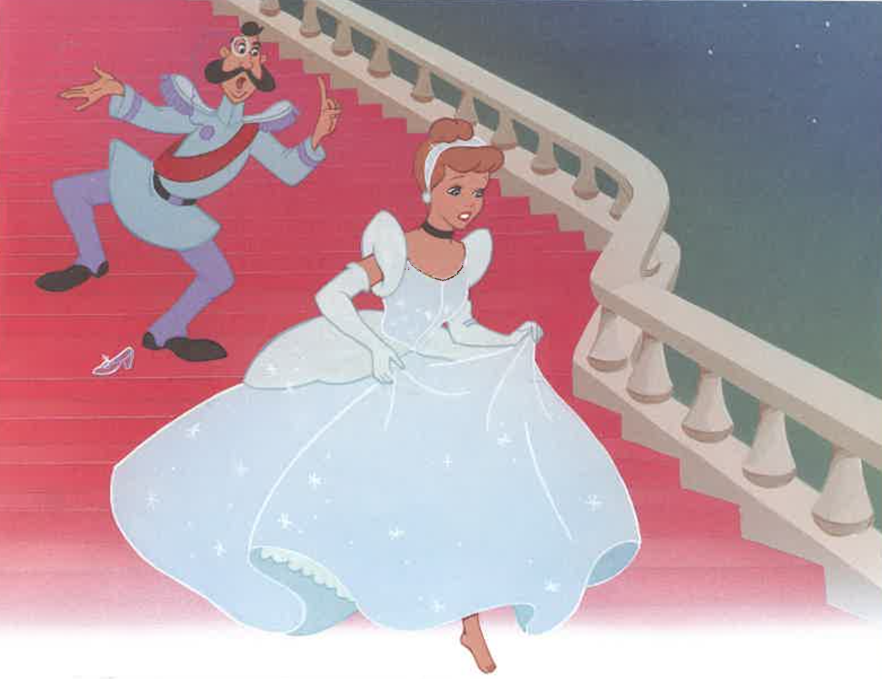

Slide 28
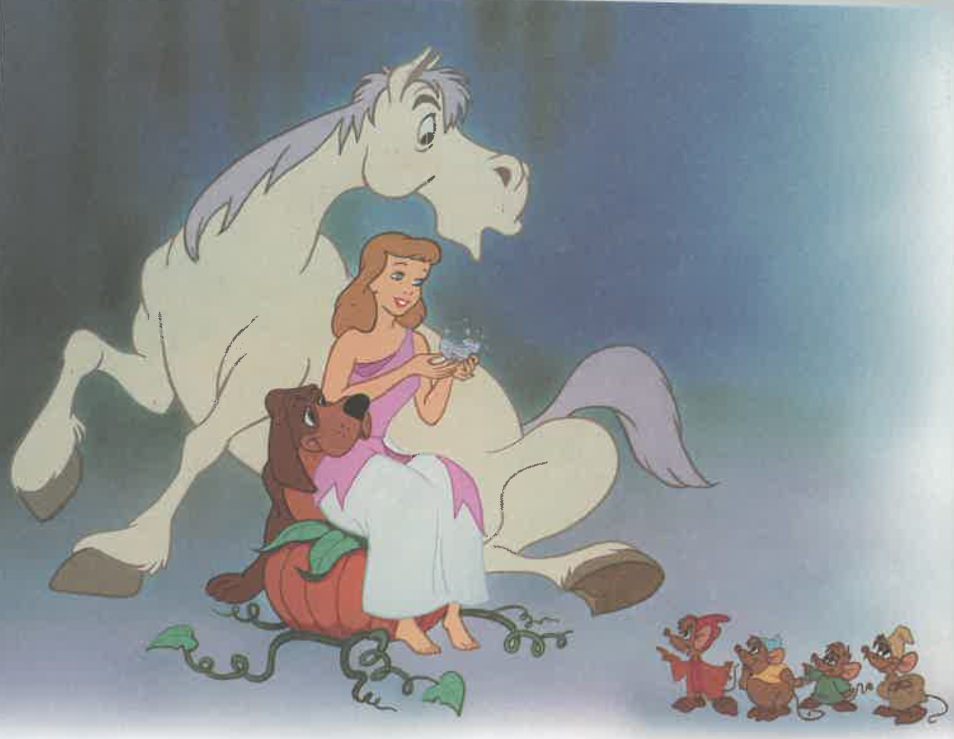

Slide 29
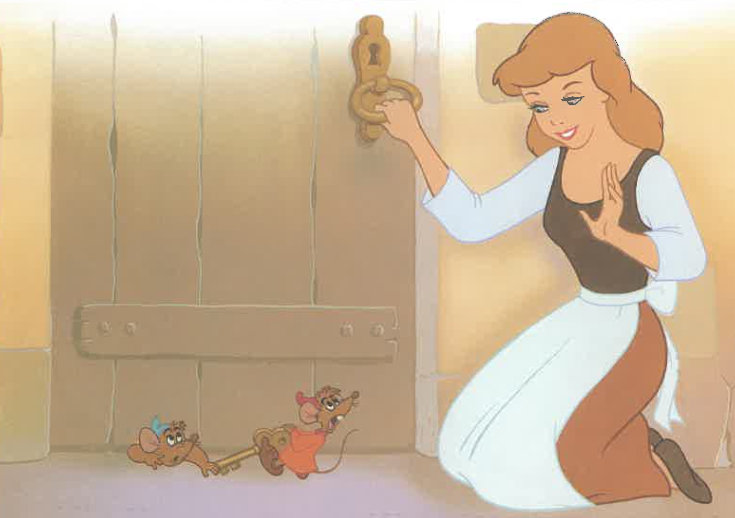

Slide 30
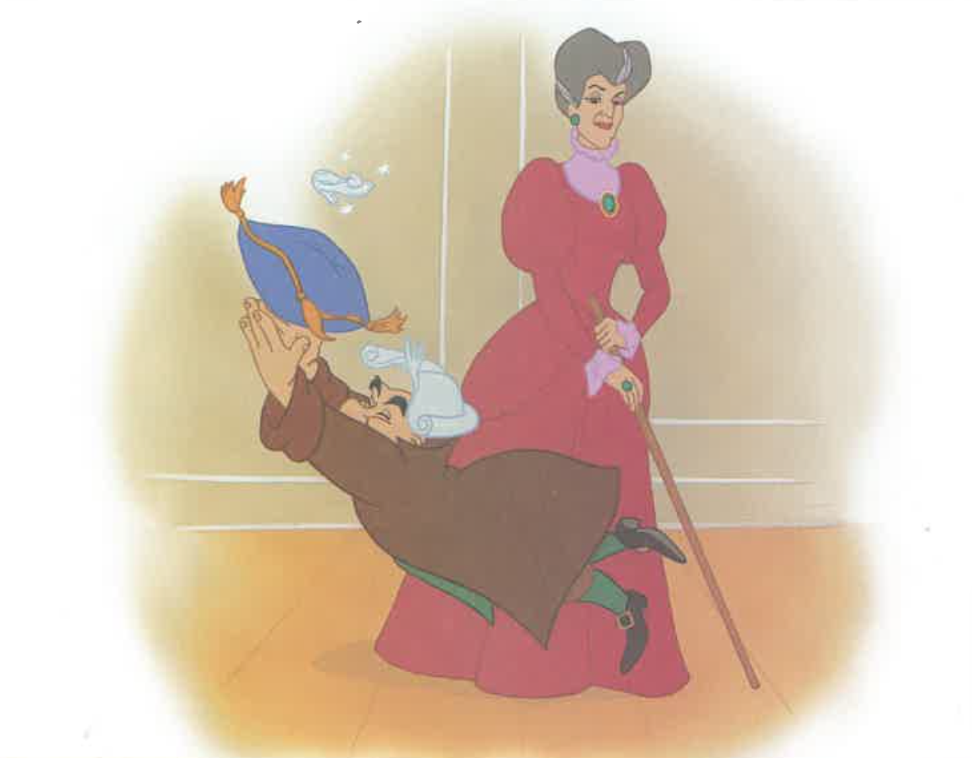

Slide 31
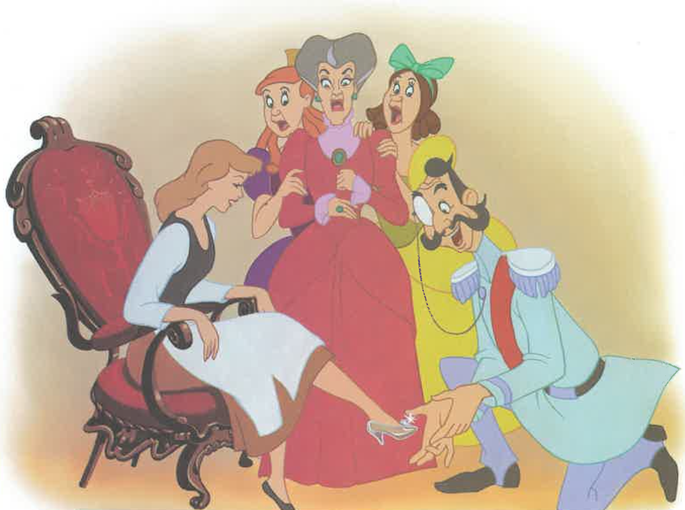

Slide 32
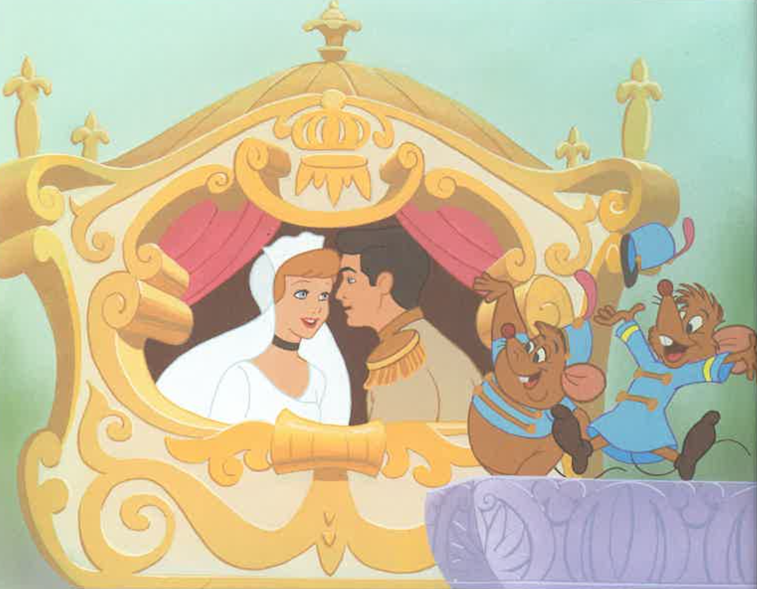

Slide 33
Notes:
Can you tell me the story of Cinderella?

