Slide 1
Phonological impairment in French-speaking children with SLI
Christophe Parisse¹ and Christelle Maillart²
¹MoDyCo, INSERM, CNRS-Paris Ouest Nanterre (France)
²University of Liège (Belgium)

Slide 2
Potential origins of SLI behaviour
grammatical deficit
memory deficit
limitation of working capacity
phonology – acoustics

Slide 3
Evidence for phonological deficit
phonological delay when children are compared with age-matched control children (Stoel-Gammon, 1989; Paul & Jennings, 1992 ; Rescorla & Ratner, 1996)
productions are quantatively different but qualitatively similar
productions are similar to young children’s productions

Slide 4
Strongest evidence for phonological deficit comes from comparison with MLU-matched children
if there are phonological deficits for the same language level, then phonology is a special difficulty for children with SLI

Slide 5
Previous results
SLI < MLU even taking into account their language delay
this was found for different languages (different phonology, different syntax)
  the details of the results obtained vary from one language to another
  Bortolini & Leonard (2000)
    English, Italian
  Owen, Dromi, Leonard (2001)
    Hebrew
  Aguilar–Medivilla , Sanz-Torrent & Serra-Raventos (2002)
    Spanish / Catalan

Slide 6
Goals of the study
Confirm that children with SLI show specific difficulties in phonology when compared with children with the same language level and confirm that this is a cross-language finding
Inquire whether there are specific phonological deficit/difficulties in French-speaking children with SLI
Confirm whether there is or not a developmental trend in the deficit (are errors qualitatively different and more common in older children?)
Notes:
Note 2: this means different from other languages
Note 3: the idea to test different age ranges comes from a previous study : Parisse & Le Normand (2002)

Slide 7
Participants
Matched by MLU (language match)
Age of control children corresponds to mean MLU age of children with SLI

Slide 8
Task
Spontaneous language
  free play situation for the younger children
  conversation with adult partner for the older children
Children can avoid forms that are difficult for them, so that results tend to be more difficult to obtain, but are also more reliable

Slide 9
Phonetic transcription
CHAT format
At least two persons checked all transcriptions
Transcriptions were corrected until 100% agreement was reached
Total utterances: 4158
Total words: 13312

Slide 10
Procedure
Utterance level
Word level
Syllable level
Phoneme level

Slide 11
Example of transcription
*CHI: sait pas nager (cannot swim)
%pho: se pa laʒe (child phonology)
%mod: se pa naʒe (adult phonological target)
Phonological errors

Slide 12
Automatic extension of coding schema
*CHI: cuisine (..) deux salons . •[% kitchen (.) two saloons]
%pho: kwizEn (..) ty zalo~
%mod: kwizin (..) d2 salo~
%syl: kwizin kwi.zin kwizen kwi.zen
%syl: d2 d2 ty ty
%syl: salô sa.lô zalô za.lô
*CHI: après la récré de dix heures +... •[after the ten o’clock break]
%pho: apE a ateeRe t@ ti z9R
%mod: apRE la RekRe d@ di z9R
%syl: apRe a.pRe ape a.pe
%syl: la la a a
%syl: RekRe Re.kRe ateeRe a.te.e.Re
%syl: d2 d2 t2 t2
%syl: di di ti ti
%syl: z2R z2R z2R z2R
Notes:
andyinterview

Slide 13
*CHI: la télé sur l' armoire hein@i . [% the tv on the sideboard]
%pho: la tele syR l aRmwAR e~
%mod: la tele syR l aRmwAR e~
%syl: la la la la
%syl: tele te.le tele te.le
%syl: syR syR syR syR
%syl: l l l l
%syl: aRmwAR aR.mwAR aRmwAR aR.mwAR
%syl: ê ê ê ê
*CHI: et la radio (.) sur l' armoire . [% and the radio on the sideboard]
%pho: e la RadjO (.) syR l aR::mwAR
%mod: e la RadjO (.) syR l aR::mwaR
%syl: e e e e
%syl: la la la la
%syl: Radjo Ra.djo Radjo Ra.djo
%syl: syR syR syR syR
%syl: l l l l
%syl: aRmwaR aR.mwaR aRmwAR aR.mwAR

Slide 14
*CHI: et la poubelle (.) de table (.) sur l' armoire . [% and the trash can (.) of table (.) on the sideboard]
%pho: e a pubEl (.) d@ tAp (.) syR l amwA
%mod: e la pubEl (.) d@ tabl (.) syR l aRmwaR
%syl: e e e e
%syl: la la a a
%syl: pubel pu.bel pubel pu.bel
%syl: d2 d2 d2 d2
%syl: tabl tabl tAp tAp
%syl: syR syR syR syR
%syl: l l l l
%syl: aRmwaR aR.mwaR amwA a.mwA
Notes:
sideboard

Slide 15
Utterance level
Age effect onky for both measures (p < .001)

Slide 16
Word level (correct adult target)
Age effect (p = .002), type effect (p = .02),
and interaction age x type (p = .009)

Slide 17
Syllable inventory
Green arrows: age effect – Blue arrows: type effect

Slide 18
% correct syllables
Green arrows: age effect – Blue arrows: type effect
Red circle: interaction age x type

Slide 19
Percentage of consonant correct
  Automatically computed (starting from syllable structure)
    PPC = number of correct consonants / (number of correct target consonants + number of omitted consonants + number of added consonants)

Slide 20
Percentage phonemes correct (PPC)
Age effect (p = .0001), type effect (p < .004)
interaction age x type (p = .02)

Slide 21
Percentage consonants correct (PCC)
Age effect (p = .0008), type effect (p = .02),
no interaction age x type

Slide 22
Percentage vowels correct (PVC)
Age effect (p < .0001), type effect (p < .0001),
interaction age x type (p = .002)

Slide 23
Discussion
Utterances ➔ age effect only
Words ➔ all effects
Syllables ➔ mostly age effect
Phonemes ➔ all effects

Slide 24
Special difficulties in phonology for children with SLI
Results for words were confirmed by measures on phonemes (and on syllables to a smaller extent)
Specific result for French children
  deficit on syllable structure was not important
  deficit for vowels as well as deficit for consonants

Slide 25
Developmental effect?
There was no difference between the two groups of younger children
There was an important difference between the two groups of older children
      Note: this was not a developmental study
Notes:
In previous study with the same children, we saw that chidlren caught up in lexical deficit and morphological deficit (but we probably were wrong to say that their phonetics was improving: this hs to be checked).

Slide 26
Children with SLI seem to develop phonological competence slower than control children
They appear as if they are stuck at a low level of phonological competence
A consequence is that children with SLI may have more problems when it becomes necessary to segment words into syntactic components

Slide 27
Follow up on the previous study
To understand the nature of the children’s problems and to test phonologically-based theories ➔ it is necessary to test the interplay between phonology and syntax
not only verbs (most theories – esp. grammatical – are tailored to the difficulties of children with SLI with the verbs)
➔ evaluate phonology and syntax for all word categories

Slide 28
Complexity as a factor
Does complexity (phonology and syntax) account for children difficulties?
Organisation of the current student
  Evaluate (theoretical) complexity for all syntactic categories
  Measure performances for all categories
  Compare theoretical complexity and children’s performances
  Check whether results in phonology are correlated with results in syntax
Notes:
parameters but could be another word (or variables, or domains)

Slide 29
Phonological complexity
Data was computed for this study using the database ‘Lexique’ and work about syllable complexity
‘Lexique’ database was limited to words attested in child directed speech
Complexity was automatically computed for each word and average complexity was computed for each syntactic category (using Paradis & Beland (2002) work about syllabic complexity)
1.21 determiners, 1.21 subject pronouns, 1.92 strong pronouns, 1.99 prepositions, 2.21 auxiliaries, 2.57 adverbs, 2.61 nouns, 2.66 unmarked verbs, 3.03 marked verbs
Four types of syntactic categories for phonological complexity

Slide 30
Syntactic complexity
 | Feature | Number of features | Value
Adverb | None | 0 | 10
Auxiliary verb | Tense, number(1/2), person | 2.5 | 2
Determiner | Gender, number | 2 | 4
Noun | None (number and gender for some nouns) | 0.5 | 8
Preposition | None | 0 | 10
Strong pronoun | Gender, person | 2 | 4
Subject pronoun | Gender, person | 2 | 4
Unmarked verb | Tense (non-pronounced), number (1/2) | 1.5 | 6
Marked verb | Tense (pronounced), number(1/2) | 1.5 | 6

Slide 31
Complexity for phonology and syntax
 | phono cpx | syntactic cpx
adverb | 5 | 10
determiner | 10 | 4
noun | 5 | 8
preposition | 7.5 | 10
strong pronoun | 7.5 | 4
subject pronoun | 10 | 4
marked verb | 5 | 6
auxiliary | 7.5 | 2
unmarked verb | 2.5 | 6
unmarked verb = present tense (1s, 2s, 3s, 3p) + imperative 2s
marked verb = mostly inf. and pp. (+ all other forms)

Slide 32
Methodology
Participants
  24 French-speaking children
    12 children with SLI (mean age: 7;7 ans, MLU: 3.82)
    12 control children (mean age: 4;0, MLU: 3.70)
Notes:
children with expressive and receptive troubles (severe cases)

Slide 33
Task
  spontaneous language production (semi-directed questions and answers)
  phonological transcription (CHAT)
  morphosyntactic tagging (CLAN, MOR & POST)
    3052 utterances (1474 SLI ; 1578 Ctrl)
    11702 words (5606 SLI ; 6096 Ctrl)

Slide 34
Example of transcription
*CHI: sait pas nager (cannot swim)
%pho: se pa laʒe (child phonology)
%mod: se pa naʒe (adult phonological target)
%mds: il se pa naʒe (adult target with syntactic correction)
Phonological errors
Syntactic errors

Slide 35
Morphosyntactic line was added automatically
*CHI: wah@i (.) un (.) grand (.) arbre avec (..) les trucs comme+ça .
%mor: co|wah@i det|un adj|grand n|arbre prep|avec det|les n|truc adv|comme+ça .
%pho: wa: (.) 9~ (.) gRa~ (.) da aEk (..) lE Ry gOmza
%mod: wa: (.) 9~ (.) gRa~ (.) aRbR avEk (..) lE tRyk komsa
%mds: wa: (.) 9~ (.) gRa~ (.) aRbR avEk (..) dE tRyk komsa
Target syntactic line was added manually
*CHI: joue des jeux +...
%mor: v|jouer det|des n|jeu +...
%pho: Zu tE Z2j
%mod: Zu dE Z2
%mds: (pro:subj|o~) Zu (prep|a) dE Z2
*CHI: elle travaille (.) mais <mon pa(pa)> [//] mon papa il travaille de la nuit (..) parce+que +...
%mor: pro:subj|elle v|travailler conj|mais det:poss|mon n|papa pro:subj|il v|travailler prep|de det|la n|nuit conj|parce+que +...
%pho: E tafa (.) mE <mo~ pa>[//] mo~ papa i tava d@ la myi (..) pat@
%mod: El tRavaj (.) mE <mo~ pa>[//] mo~ papa il tRavaj d@ la nyi (..) paRsk
%mds: El tRavaj (.) mE <mo~ pa>[//] mo~ papa il tRavaj {d@} la nyi (..) paRsk

Slide 36
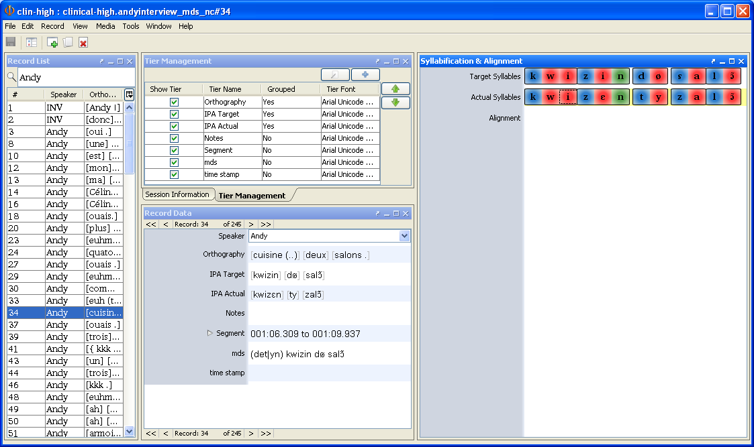
Phon version

Slide 37
Results – Phonological errors
 | adv | det | noun | prep | pro | p. sbj | verb non. | aux | verb mark
Sli | 67% | 89% | 62% | 81% | 69% | 73% | 56% | 92% | 48%
Ctr | 92% | 96% | 84% | 94% | 95% | 91% | 88% | 98% | 69%
p.= | .0003 | .018 | .0001 | .024 | .002 | .004 | .0001 | .15 (NS) | .025
Theory | 5 | 10 | 5 | 7.5 | 7.5 | 10 | 5 | 7.5 | 2.5
Large difference between the groups
At the same MLU level, phonology is weak for children with SLI (confirmed previous results)

Slide 38
Results – Syntactic errors
 | adv | det | nom | prep | pro | p. sbj | verb non. | aux | verb mark
Sli | 99% | 88% | 99% | 84% | 97% | 73% | 96% | 95% | 93%
Ctr | 99% | 95% | 100% | 94% | 96% | 81% | 97% | 99% | 95%
p.= | .92 NS | .005 | .095 NS | .0012 | .94 NS | .27 NS | .46 NS | .18 NS | .20 NS
Theory | 10 | 4 | 8 | 10 | 4 | 4 | 6 | 2 | 6
Not much difference between the groups
With the same MLU, significant differences were found for determiners and prepositions

Slide 39
Correlations between theoretical complexity and children’s results
 | phono cpx | syntax cpx
SLI phono | 0,79* | -0,34
CTR phono | 0,76* | -0,22
SLI syntax | -0,56 | 0,18
CTR syntax | -0,63 | 0,25

Slide 40
Discussion
Negative correlations
  do syntax and phonology behave differently?
Positive correlations
  strong link between phonological complexity and phonological errors
Not enough grammatical errors to obtain significant correlation measures?
Task to not sensitive enough to grammatical difficulties?

Slide 41
Missing elements
Some results are not explained by pure phonological theory
  determiner worse than subject pronouns and verbs worse than nouns (for phonology and syntax) but they have similar phonological complexity
  errors with prepositions
  results for adverbs and auxiliaries better than expected
  results for strong pronouns for SLI worse than expected
All syntactic errors do not reflect phonological complexity
  even if phonological complexity is even better tailored to the specificities of children’s productions

Slide 42
Future developments
Phonological complexity appears to be a cornerstone for all (phonological) theories about specific language impairment
  only phonological complexity predicts correctly the children’s errors
But…

Slide 43
… to be improved
If complexity works for phonology, why couldn’t it be the case for syntax
  maybe because we have a bad definition of syntactic complexity or of syntax (proposal: base on children’s specific productions, not on adult language)
Semantic/syntactic seems interesting
  because it could explain some results with prepositions, nouns/verbs, but needs to be better defined
Notes:
Proposal: the behavior of the parameters could be understood looking at children’s specific productions, not at adult language ➔ it would the development of the child’s system itself that would predict the child’s difficulties

Slide 44
Repetition study – different task
Correct
Mathieu et toi, vous allez jouer sur le tobbogan (Matthew and you, you are going to play on the slide).
13 (0.82)
La confiture de fraise, je la mange sur du pain (The strawberry jam, I’m eating it on a slice of bread).
12 (0.67)
Including one grammatical error (by substituting one word for another)
Marie et moi, vous allons jouer à la balançoire (number error: Mary and me, you are going to play on a swing)
13 (1.15)
Le miel du jardin, je la mange sur du pain (gender error: the honey from the garden, I’m eating her on a slice of bread).
12 (1.05)

Slide 45
Seven grammatical categories
Subject pronoun
Object pronoun
Auxiliary
Determiner
Preposition
Noun
Verb
70 correct utterances, 70 erroneous utterances
Children matched by comprehension level (ECOSSE)

Slide 46
Comparison between children with SLI and language level controls
Analysis bears on the correct, incorrect, or absent repetition of the target word in the utterances after the child’s repetition
Examples of incorrect repetition of target
Target: mes cousines préférées, elles apporteront des cadeaux.
Child: mes cousines préférées, ils apportent des cadeaux.
Target: quand j'étais petit, je ne saurai pas lacer mes chaussures.
Child: quand j'étais petit, je ne sais pas xx lacer mes chaussures.

Slide 47
 |  | Grammatical target |  |  | Ungrammatical target
Syntactic category | Subjects | No analysis | Target changed | Target reproduced | No analysis | Error corrected | Error reproduced
Subject pronoun | SLI | 3.1 | 3.1 | 3.8 | 2.6 | 6.2 | 1.1
 | Control | 1.1 | 2.5 | 6.4 | 1.3 | 5.3 | 3.4
Object Pronoun | SLI | 2.5 | 3.2 | 4.4 | 4.2 | 3.9 | 1.9
 | Control | 1.1 | 0.5 | 8.5 | 1.0 | 2.4 | 6.5
Auxiliary | SLI | 4.4 | 0.9 | 4.6 | 2.8 | 4.8 | 2.4
 | Control | 0.8 | 0.1 | 9.1 | 1.5 | 4.6 | 3.9
Determiner | SLI | 2.2 | 1.3 | 6.5 | 2.8 | 4.9 | 2.3
 | Control | 1.2 | 0.4 | 8.4 | 1.9 | 3.1 | 5.0
Preposition | SLI | 2.1 | 2.1 | 5.8 | 2.4 | 5.4 | 2.2
 | Control | 0.9 | 0.8 | 8.2 | 1.6 | 1.9 | 6.4
Noun | SLI | 1.4 | 0.6 | 8.1 | 2.9 | 2.1 | 4.9
 | Control | 0.9 | 0.0 | 9.1 | 2.1 | 1.0 | 6.9
Verb | SLI | 3.9 | 2.5 | 3.6 | 1.9 | 5.0 | 3.1
 | Control | 1.3 | 0.6 | 8.1 | 1.6 | 2.2 | 6.2

Slide 48
Spontaneous vs non spontaneous production
Is non-spontaneous production just ‘more difficult’?
With spontaneous production children are able to produce memorized (and non decomposed) forms
With non-spontaneous, they have to be creative and to decompose/recompose memorized material
  This could be where children with SLI have the most severe difficulties

Slide 49
Goal: Using PHON to analyse the cases of incorrect repetition – compare with other material
*REC: ce garçon n'est pas une menteuse il dit la vérité.
*CHI: ce garçon il est pas une menteuse il dit la vérité.
%com: Nom feminin erreur
%cod: . . 3 5
*REC: les camions orange mon frère les prend pour aller jouer.
*CHI: les camions orange i prend pour aller jouer.
%com: Proobj anaphore immédiate correct
%cod: . 4 . 4

Slide 50
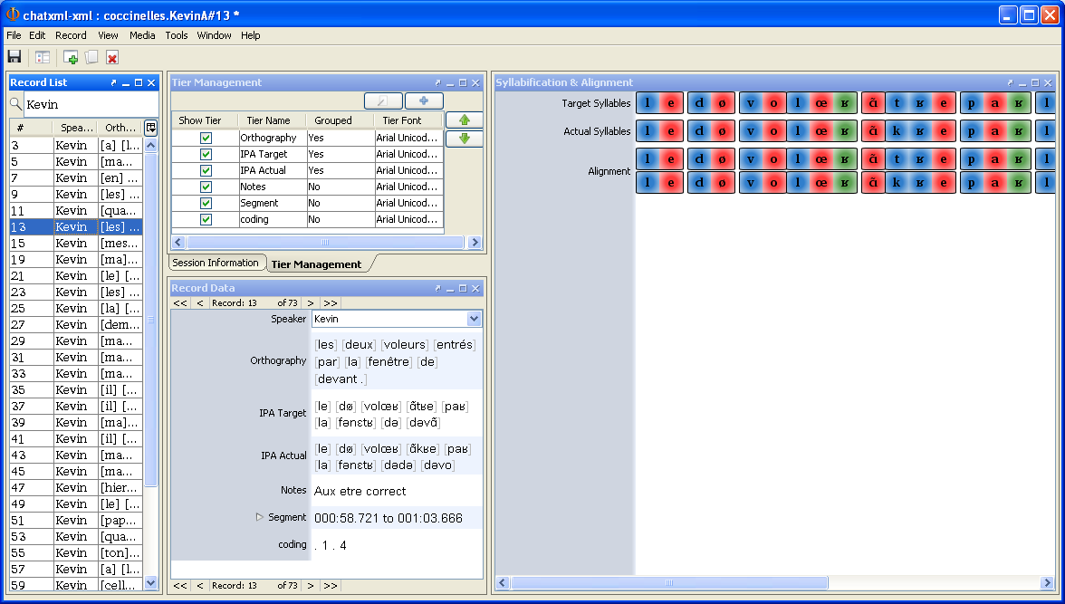
Phon version

