Slide 1


AI and Humans: Similarities and Differences
Brian MacWhinney
Carnegie Mellon University
1

Slide 2
Questions
Does AI pass the Turing Test?
Does it show consciousness? agency? intelligence?
Does it show that Chomsky was right? or wrong?
Can we use it as a model of language processing?
Can we use it to understand language development?
What are the similarities and differences? successes and failures? What is the way forward?

Slide 3

Turing 1950 => DeepSeek
ChatGPT/DeepSeek might have already passed the Turing Test, but only in limited domains and ways.
The goal posts have changed:
  Consciousness: the Graziano test
  AGI Artificial General Intelligence — Hinton, Altman
  agency will, selfishness: the HAL (Odyssey 2000) test, Hinton, Michio Kaku
  Huang (2024)/Linzen SAP tests and benchmarks
  Is prompting allowed within the Turing Test?
Once we have AGI, can we use it as our model for understanding humans?

Slide 4
Successes
ASR: Whisper, Multilingual, fine-tuning, complete acoustic analyses
NLP: translation, content analysis, cohesion, Universal Dependencies
ML and graph theory: language disorders, DementiaBank, PsychosisBank
genAI: chatbot, problem-solving, generativeAI
art, writing, programming, protein folding, navigation, war
vindication of Connectionism ??

Slide 5

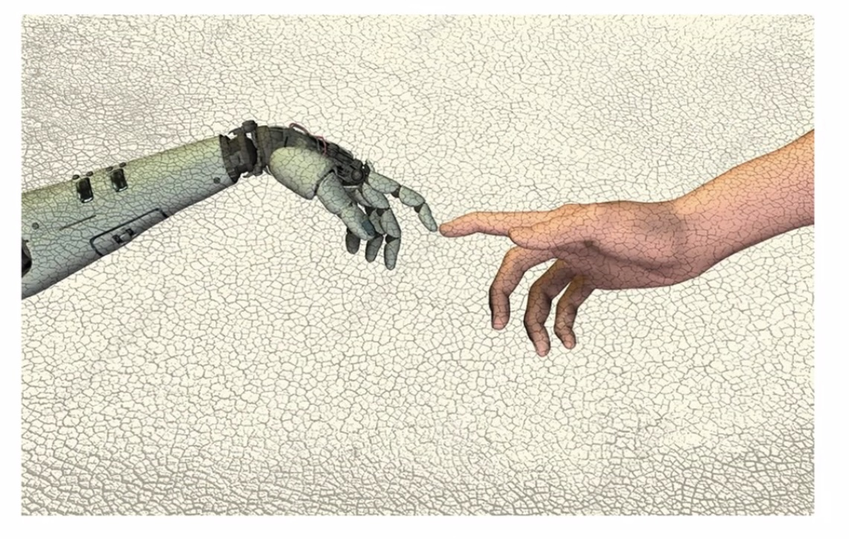
A New Source of Inspiration?

Slide 6

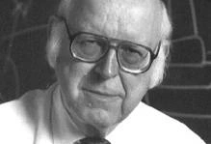


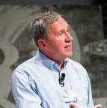
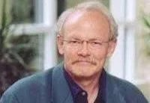
AI/ML/ASR/NLP at CMU
Herb Simon and Alan Newell with structured AI
Geoffrey Hinton, Jay McClelland, and Tom Mitchell with DLN and ML
Raj Reddy with early ASR

Slide 7
Early Failures
Hallucination, errors, not up-to-date
Getting stumped
Hiding knowledge from user
Not domain general, too much fine-tuning
Right for the wrong reasons

Slide 8
MS-Word vs LLMs
To better develop MS-Word, the strategy was to “fire a linguist”
However, to develop current AI, the opposite strategy seems to work, i.e. “hire a cognitive scientist”
Human intelligence is, after all, the gold standard
But changing computer algorithms based on insights and mechanisms from humans, neuroscience, and CogSci is not all that easy. But human intelligence is, to some degree, the gold standard

Slide 9
AI <vs> Humans
massive computing infrastructure <=> human brain weighs 3 pounds
massive energy consumption <=> millivolts
repeated scanning of trillion-word corpora <=> incremental exposure
meanings from vector extraction <=> grounded meaning
no body, no teacher <=> body, teacher, society

Slide 10
Why does AI do so well?
Both systems are exposed to and responsible for the full core of human language (and knowledge),
And there are some important mechanistic similarities
Eventually there will be more, hopefully.
Crucially: We can learn from both the successes and failures about how to make AI perform better and work better as a model

Slide 11
LLMs as Models
If changes to AI models make them align more with human data, the changes could tell us about how humans are operating.
We can perform lesions and ablations on models.
We can sample detailed aspects of the models: levels, vectors, changes over time.
Goldstein: fMRI and ECoG during 30 minute story; word embedding predicts brain activity and brain activity predicts word embeddings => roundtrip

Slide 12
Part 1: Similarities
Use of prediction
“Attention” encodes context
Levels are pre-wired, but their content emerges
Huge computational space
Reinforcement learning
Intermediate states
Emergent categories
Let’s looks at each of these in more detail

Slide 13
1. Prediction
Much like Elman’s (1998) RNN (recurrent neural net)
Kuperberg & Jaeger 2016 claim that humans do this too.
Schrimpf et al (2022): “unidirectional attention transformer models capture brain activity during language processing, because they focus on predicting the next word”

Slide 14
Prediction
Wehbe: context predicts MEG before word, then word predicts MEG after
Fedorenko: processing by the basal ganglia is like prediction by ANN, possible role of the cerebellum

Slide 15
Formulations
Berwick 1987: learning from failure to parse
Linck and Kroll: prediction is how language is learned
Pickering&Gambi: prediction-by-production (optional) and prediction-by-association (automatic)

Slide 16
But
Next word prediction is not as strong a predictor of reading time as it is for neural activity - so reading may involve more components
Surprisal doesn’t predict ambiguity processing - Huang(2024)
People are mostly working at integrating a mental model, predicting is fairly shallow.
If young children were to rely on prediction alone, it would be pretty frustrating. Instead they pick up units.

Slide 17
JEPA prediction - LeCun/Meta
Prediction has worked well for words, but fails for vision, because next saccade is not predictable.
JEPA predicts a representation of the future Sy from a
representation of the past and present Sx
The JEPA solution requires creation of an abstract world model to guide visual expectations
Technically, this requires energy-based models, regularized methods, and less reliance on RL

Slide 18
2. Context
Multi-level attention expands beyond the sentence to:
  the utterance block
  the paragraph or conversational turn
  the whole interaction
  previous interactions (requires memory)

Slide 19
3. Levels Architecture
LLMs are wired up with encoding levels separated by DNN learning
Somewhat similar to emergent levels in local areas in the brain: MacWhinney 2014, 2016.
Some architectures allow for recruitment of units, levels
AI systems have a huge number of parameters and multiple layers or levels (MacWhinney, 2015)

Slide 20
4. Huge computational space
GPT-3 Energy Consumption in MWh = 1,248 MWh
To train GPT-3 OpenAI used a supercomputer with over 285,000 CPU cores, 10,000 GPUs and 400 gigabits per second of network connectivity for each GPU server
CPT-4 costs 3x more than GPT-3 in regards to prompts
It was trained on 14 trillion words

Slide 21
the brain has a large space too
86 billion neurons
100 trillion connections
Cantlon & Piantadosi (2024) “size is all that matters”
but primate brains are already capable, i.e. we have just a “linearly scaled-up primate brain” (Herculano-Houzel 2012)
so structure must matter, as it does for LLM
what about microtubules?

Slide 22
5. Reinforcement Learning (RL)
DeepSeek claims that replacing backprop with RL led to improvement
RL requires a goal and children do have goals
RL can work along with prediction/integration
Jesperson: the best way to learn a language is to break it
Explore vs exploit - Allison Gopnik, Carol Dweck
But does explore have a clear a goal? Or does it rely on intermediate states?

Slide 23
6. Intermediate States
Chain of Thought (CoT): automatic, zero-shot, few-shot
Proving a theorem in Euclidean geometry
My programmer looking for a Safe solution for tokenizing in a Rust parser - 6 prompt stages, 40 pages long
Do LLMs build mental models from CoT?
Is this Kahnemann’s System 2, as opposed to mere prediction in System 1?

Slide 24
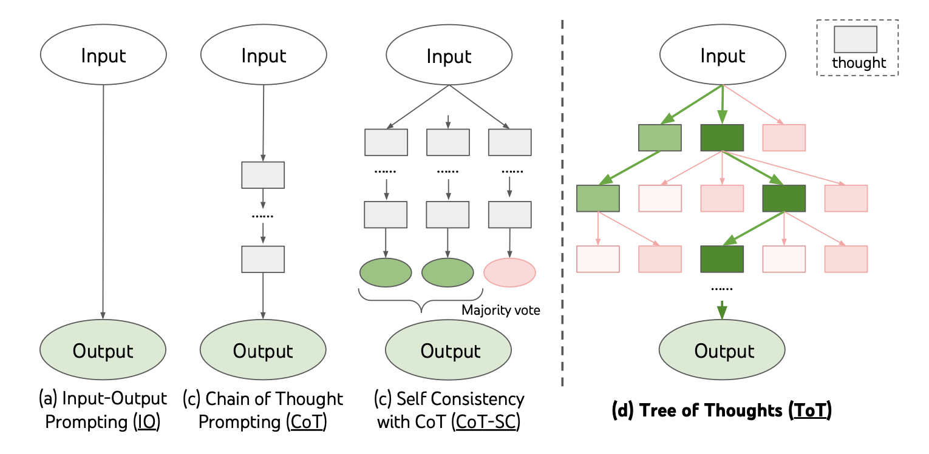
Tree of Thoughts (ToT)
Redo of classical search methods (very human)
Includes self-reflection (very human)

Slide 25
Mental models could yield
Serial dependencies in Dutch (addressing complexity)
Scope interpretation: every boy surrounded/climbed a tree
Inference results from 1980s; Zwaan/Glenberg embodied cognition
Understanding metaphors: Source/Target theory in metaphor research — Tom Griffiths
Bilingual linguistic relativity effects - weaker L2 models — ZhaoVanekMacWhinney (2025)

Slide 26
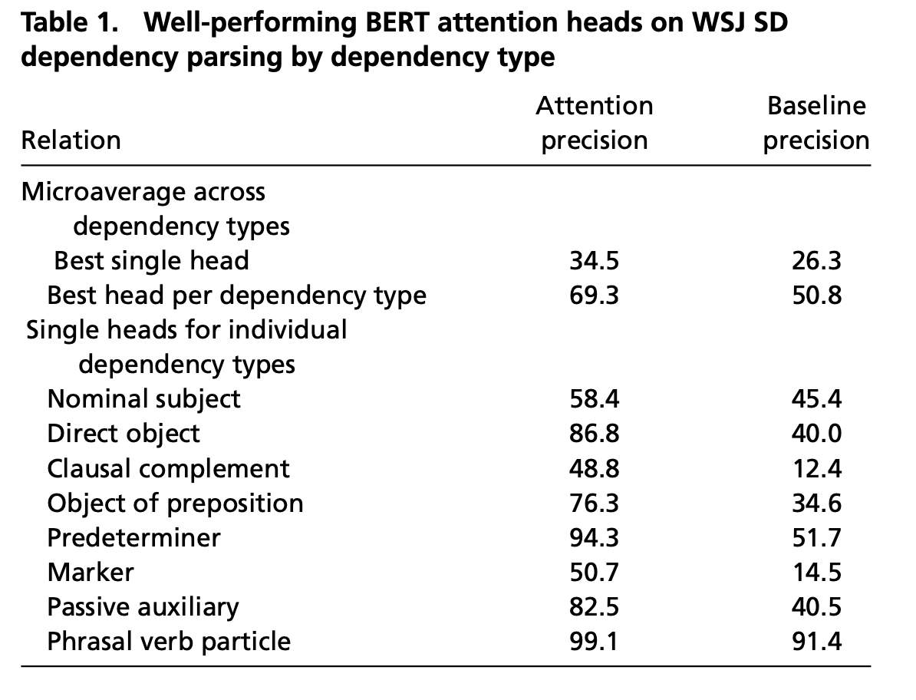
7. Emergent categories
Manning et al.: how often the head pays “attention” to the linguistically relevant word

Slide 27
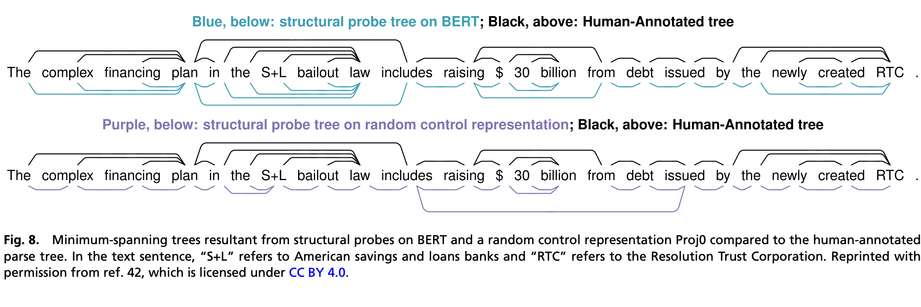
Tree structure

Slide 28
Other structures
Trees (Manning et al.): structural probes
Part of Speech (Köhn et al.): Models encode information necessary for predicting the part of speech of the next word
Morphology (Conneau et al.; Belinkov et al.): evaluated in translation autoencoders
Shain et al. Case roles, Complex clause types
Antonello & Huth: LLMs succeed not by prediction, but by learning structures
Does this rescue UG and symbolism?

Slide 29
Learnability
UG claims that non-learnability motivates innate parameters and principles
But LLMs learn without these
Chomsky: “LLMs are incapable of distinguishing the possible from the impossible”
However, Kallini et al. have demonstrated that LLMs struggle to learn impossible languages. The more impossible the worse.
Do LLMs extract trees? parts of speech? morphological patterns?

Slide 30
German gender
The category can be extracted through word2vec embedding
This then organizes lexical semantic space
Shared phonological and semantic cues within each gender category (Köpcke, 1996).
In processing, the article (der, die, das, etc.) expects the gender, but not necessarily the specific word
L2 German learners try to map L1 semantics onto this space and the fit can’t follow gender structures

Slide 31
Part 2: Differences
Humans use:
incremental learning
item-based learning
generality/compositionality
grounding / mental models / situational memory
avoiding overreliance on statistics
efficient storage mechanisms

Slide 32
1. incremental integration
Humans use a hippocampus to avoid catastrophic interference (Valiant); AI systems avoid this by having many passes over the data - highly inefficient
up to 3, toddlers are relying on basal ganglia, not declarative memory, limited lexicon
integration relies on match to memory — resonance, lexical engagement

Slide 33
vs. Full Storage Models
Statistical Learning - Saffran, Thiessen, Smith&Yu
Implicit Learning - Reber, Krashen
Radical exemplar learning - Ambridge
Batch learning - BERT, DNN, Mooney, Batchelder
Prediction and entropy reduction - Friston

Slide 34
2. item-based patterns (IBPs)
a predicate – either a free or bound morpheme,
related argument slots with feature specifications
the positions of the arguments vis a vis the predicate
the conceptual relation that holds between the predicate and each argument. — this is where MEANING comes in

Slide 35
Diagrammatically
relation**
more
X
position
argument
features/POS
predicate/operator
Short Form:
more + X
** relations derive from core operators in embodied cognition

Slide 36
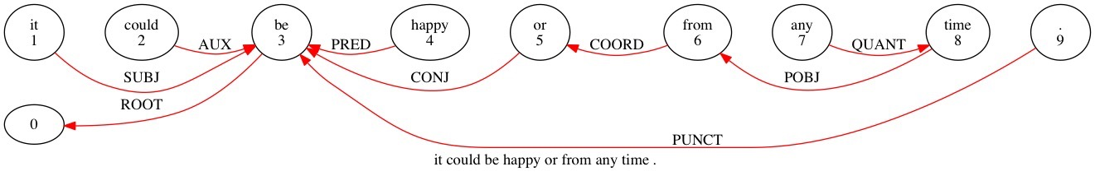
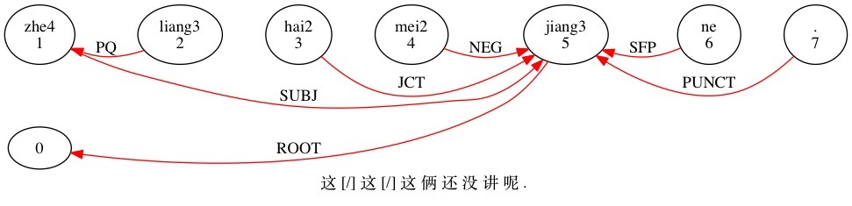
Dependency Grammar

Slide 37
Construction-based prediction
Words => IBPs
IBPs => FBPs feature based patterns
Constructions, MWE multiword expressions
As this process advances, the results become proceduralized — basal ganglia

Slide 38
3. Generality/Compositionality
Right for the wrong reason:
Ettinger: LLMs solve compositional tasks by reducing multi-step compositional reasoning into linearized subgraph matching, without necessarily developing systematic problem-solving skills.
But Sharma et al. were able to induce hierarchical structure if the right number of layers were chosen

Slide 39
4. Grounding and Mental Models (MMs)
Grounding is needed to construct MMs with links to the world.
LLMs need to have EXPERIENCES
Grounding includes: agent perspective, time/space location, deixis => RAG needs to build this
Children expand Common Ground through time, maybe AI can too.
AI systems can achieve this through sensory devices, locomotion, interaction (Sotopia - Hao Zhu) - Robotics

Slide 40
Meaning: Agenda and Attention
Attention is driven by what is meaningful to the child, not by environmental statistics
Agenda is an expression of Agency
Children display their agenda early on (Halliday, Werner&Kaplan, McCune, Slobin, Augustine)
Next, they realize that others can help in fleshing out their agenda.

Slide 41
5. Avoiding overreliance on statistics
can’t go outside domain
can’t go outside genre
seduced by statistics (Linzen)
cortical learning vs. hippocampal learning vs. procedural learning

Slide 42
Violations
Heuristic | Premise | Hypothesis
Lexical Overlap | The doctors visited the lawyer | The lawyer visited the doctors
Subsequence | The senator near the lawyer danced | The lawyer danced
Constituent | The lawyers resigned, or the artist slept | The artist slept

Slide 43
Natural Language Inference (McCoy 2019)
Heuristic | Supporting Cases | Contradicting Cases
Lexical Overlap | 2,158 | 261
Subsequence | 1,274 | 72
Constituent | 1,004 | 58

Slide 44
Why the errors?
“Statistical learners learn based on regularities in
their training sets. This process makes them vulnerable to adopting heuristics that are valid for
frequent cases but make errors on less frequent
ones.” (McCoy, Pavlick, Linzen, 2019: Right for the Wrong Reasons)
People can also be fooled (Ferreira), but they can recover.

Slide 45
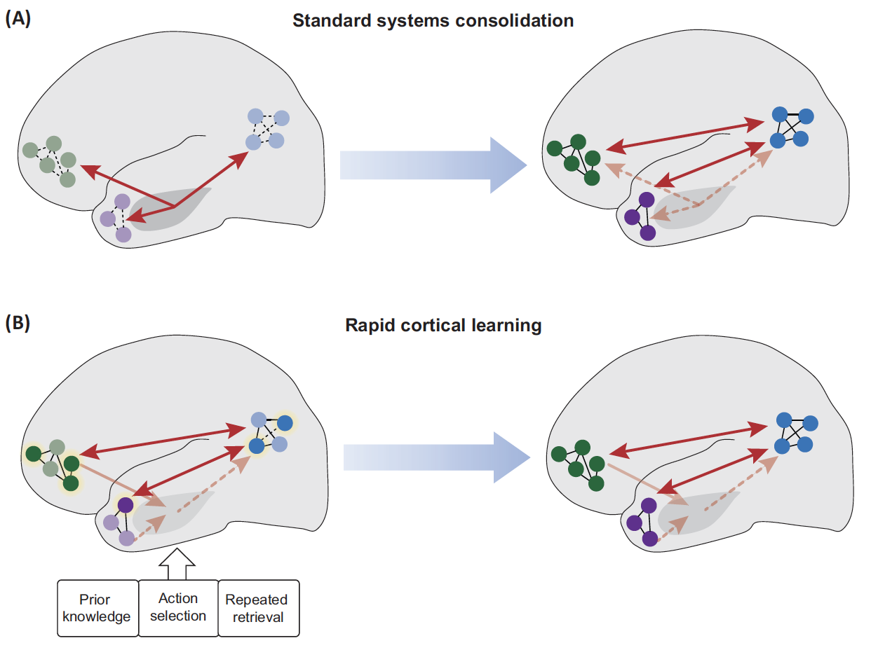
Cortical Learning as statistical

Slide 46
What is the mechanism?
Cortical consolidation depends on resonance within cortical hubs
Synaptic unmarking and synaptic remodeling for Hebbian learning (Hebscher et al, 2019)
The hippocampal trisynaptic pathway is not mature until about age 4 (Gómez&Edgin, 2016)
Early SL is cortical, not hippocampal
Early declarative memory is not tightly structured, but that is okay because declarative space is not yet crowded

Slide 47
Lexicon vs. SL
Lexical integration requires meaning
This avoids catastrophic interference (Valiant, CLS)
Words are invitations to categorization (Lupyan, Waxman, Whorf, Zhao & Vanek, Malt&Li)
Saffran et al SL (for word forms) doesn’t last more than a day
Studies show sensitivity to experienced words, but this is based on phonotactic match.
There is no evidence for a huge inventory of words waiting for a meaning in either L1 or L2 learning

Slide 48
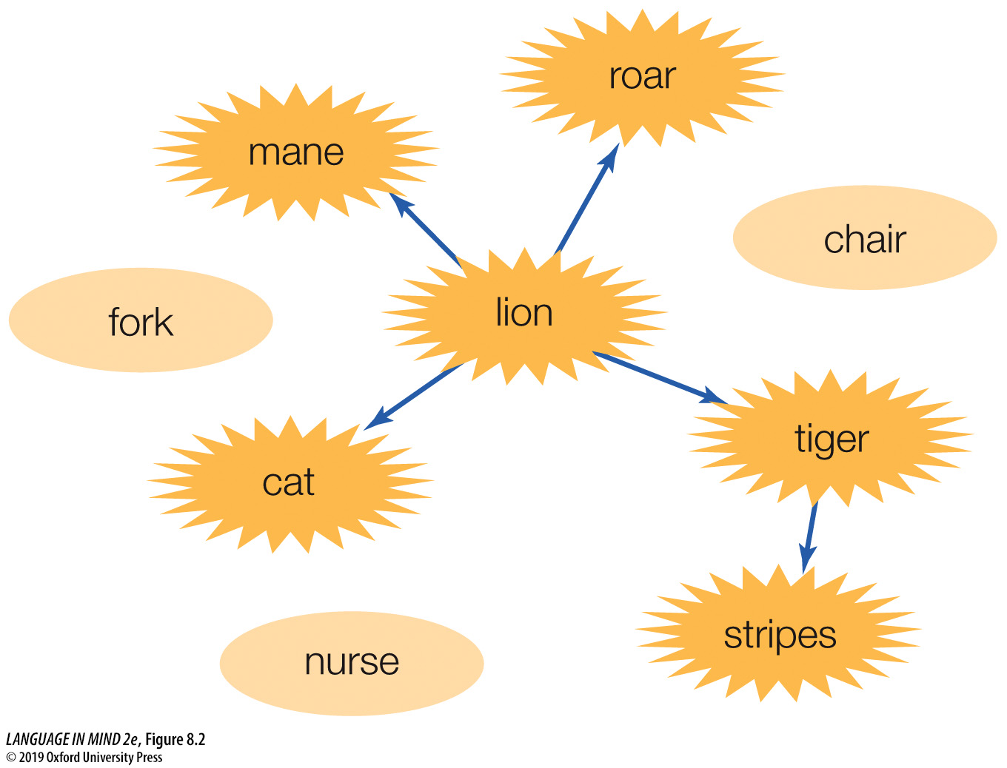
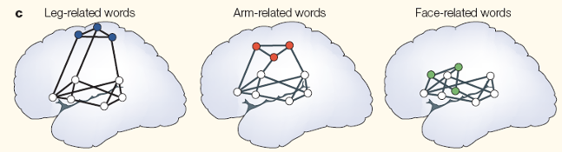
Words as Linkers
Perceptions/Actions
Constructions
Phonology
Other Words

Slide 49
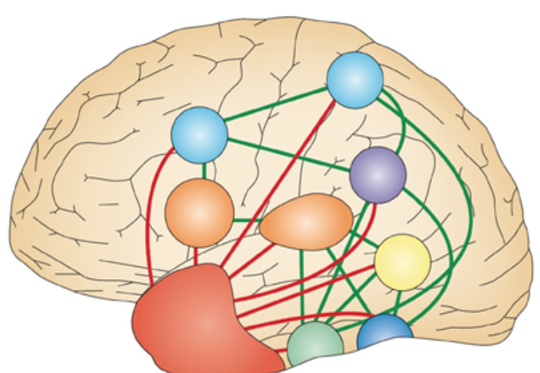
Hub-and-Spoke
ATL hub
spokes link to modalities

Slide 50
6. efficient implementation
spiking neural networks reduce energy cost
Valiant-type approaches to storage
neuromorphic hardware - Intel Loihi, IBM TrueNorth
STDP: spike-timing dependent plasticity

Slide 51
Part 3: What next?
Grounding: AI and Robotics
Mental Models: world model, model of the other, model for agency and goals
Memory: MMs and RAG
Incrementalism, Curriculum, Bootstrapping
Neuromorphic computing

Slide 52
1. Grounding - AI Robots
Rodney Brooks and behavior-based robotics
  Cambrian Intelligence: intelligence emerges from physical interaction with the world
  Cockroach robots with a minimal brain
Alvaro Moreno
  autonomy is a precondition for agency
  agency emerges for sensorimotor loops with goals
  much like Piaget

Slide 53
2. Mental Models
The 1980s debate about imagery vs. symbols is over
But how MMs work in humans is not yet clear
Need to construct models for planning
Model abstraction over development
Real-time creation of models requires “ignition” across pathways, inputs from space, vision, action, goals
Current AI models just hope for “abstraction”

Slide 54
3. MMs and RAG
retrieval augmented generation (RAG) as the next step
requires mental models
for it to work as a real conversational agent, it needs better memory storage for past interactions
the current solution is to freeze the LLM and to set up a separate set of memory layers to record information and parts of the interaction.

Slide 55
Mental models and RAGs
LangChain, Anthropic, GraphRAG, LightRAG
Knowledge graphs, chain of thought, tree of thought
Reflection (forcing LLM to generalize)
Weighting memories — recency, topicality, salience etc.
Re-ranking (bit like ACT-R)
Prompt caching
Contextual retrieval (Anthropic)
Generalization by levels, (as in the frontal lobe)
Dual-level retrieval: specifics, concepts

Slide 56
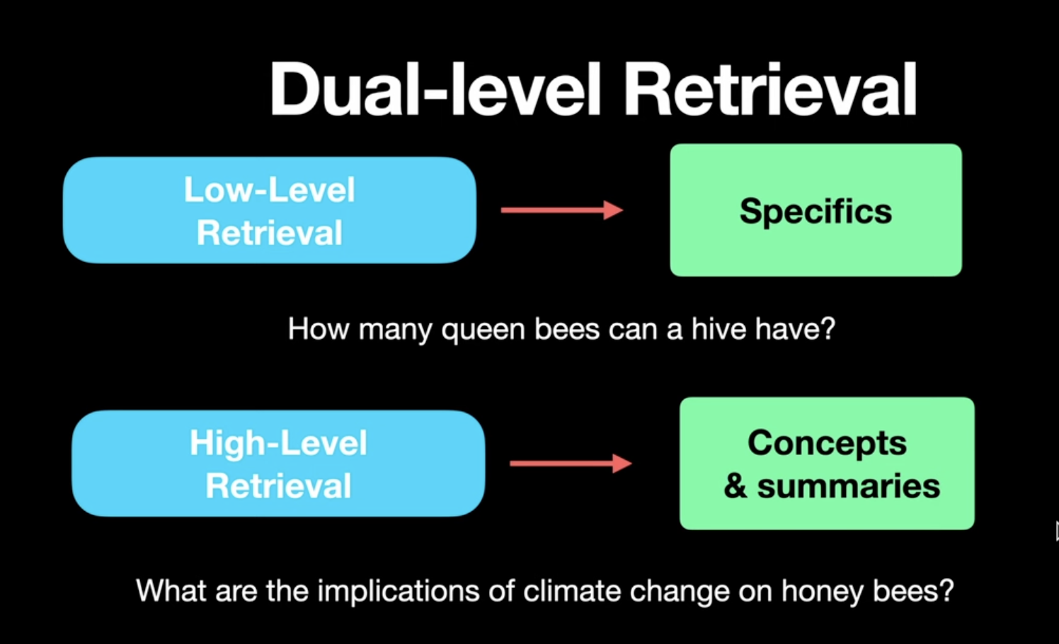
Levels of storage

Slide 57
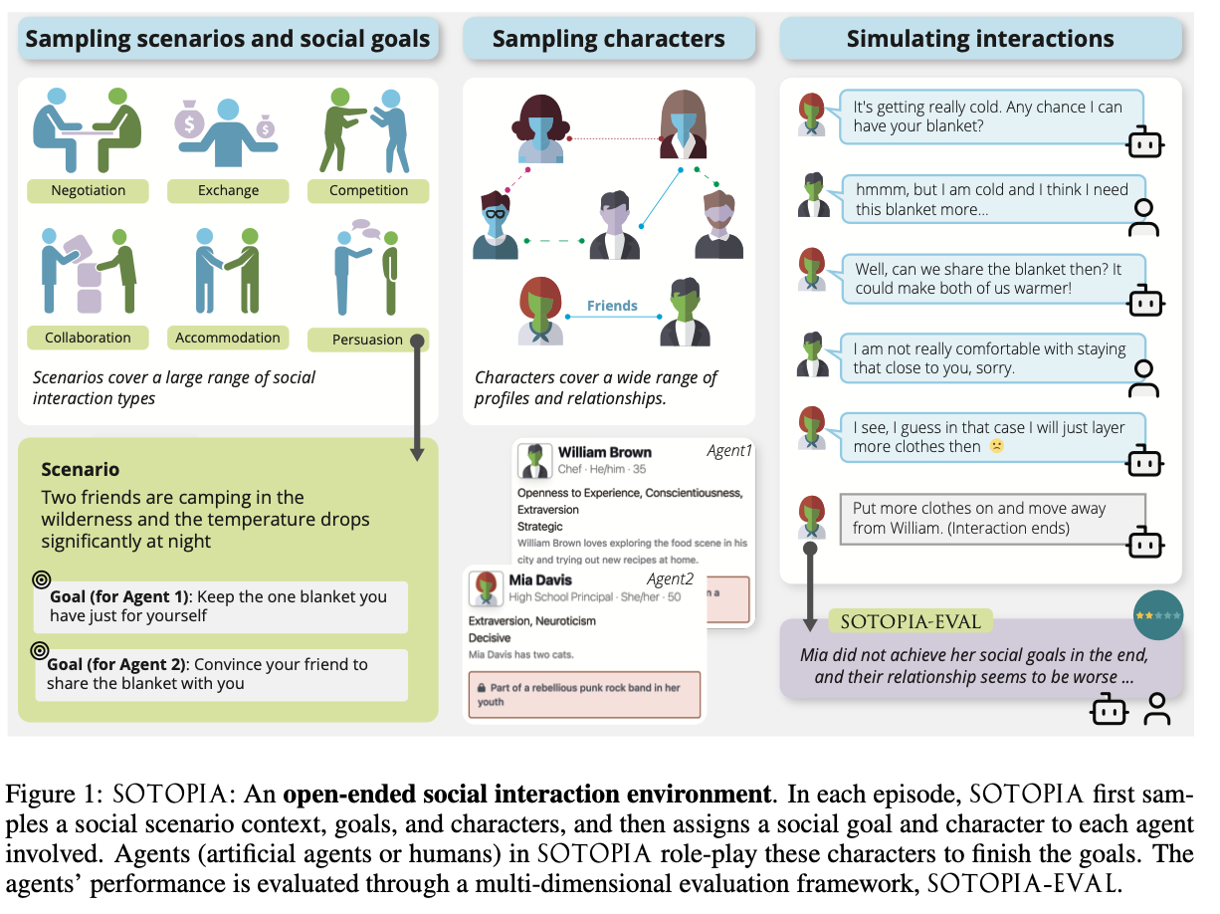
Social memory: Sotopia

Slide 58
4. Incrementalism
Current curriculum attempts don’t align with reality.
Xu points to use of expansions, RL, alignment
Need for a parent agent to be trained on the CHILDES database
Embeddings could be used to bootstrap process, but they would have to be richer

Slide 59
5. Neurally plausible architectures
How to replace back-propagation?
Tsvi Achler: neurally plausible models need (1) regulatory feedback, (2) excitation-inhibition balance, (3) homeostatic plasticity, and (4) biased competition to reduce training time and huge rehearsal
Peter Stratton: neurally plausible models should rely on SNNs spiking neural networks: When a neuron hears an incoming pattern of spikes that matches a pattern it knows, it responds with a spike of its own. Very Hebbian.

Slide 60
Neuromorphic computing
Loihi is a 60-mm2 chip fabricated in Intel’s 14-nm process that advances the state-of-the-art modeling of spiking neural networks in silicon. It integrates a wide range of novel features for the field, such as hierarchical connectivity, dendritic compartments, synaptic delays, and, most importantly, programmable synaptic learning rules. Running a spiking convolutional form of the Locally Competitive Algorithm, Loihi can solve LASSO optimization problems with over three orders of magnitude superior energy-delay product compared to conventional solvers running on a CPU isoprocess/voltage/area. This provides an unambiguous example of spike-based computation, outperforming all known conventional solutions.
IBM’s True North is a processor that contains 5.4 billion transistors that consumes only 70 milliwatts; most processors in personal computers contain about 1.4 billion transistors and require 35 watts or more.
— Davies, Srinivasan et al. 2024

