Slide 1





(Biological ?) Limits on Success in Second Language Learning
Brian MacWhinney
CMU

Slide 2
Science: 125 big questions
can the laws of Physics be unified?
are we alone in the Universe?
what is the biological basis of consciousness?
why do we sleep?
why do we dream?
why are there critical periods for language learning?

Slide 3
Consensus
After a certain age, second languages (and maybe first languages) cannot be acquired by “natural” methods. (Chomsky, Bley-Vroman, Paradis).
Werker (2005) “The evidence for critical periods is overwhelming”.
85% of CMU undergrads believe in the Critical Period Hypothesis (CPH) for second language learning (SLA).
Many (most?) SLA researchers accept the CPH.

Slide 4
So why is this still an open question?
Some adults acquire L2 fully (Bongaerts 1999)
There is no sharp drop-off (Hartshorne et al 2018)
Adults can learn words more quickly than children.
Crucially, we haven’t yet found any biological CP mechanism.

Slide 5
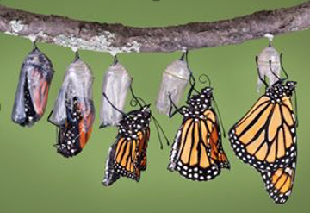
Critical Periods
Critical Periods play an important (but differing) role in embryology, neurobiology, ethology, and evolution.
They are crucial in embryology through epigenetic expression, but can also arise in later periods, as in tadpoles, larvae, cocoons, instars, etc.
For adult mammals, the most obvious critical period after infancy is the transition arising at puberty
However, puberty is about sex and risk seeking (Luna), not language.

Slide 6
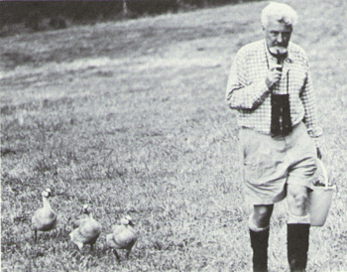
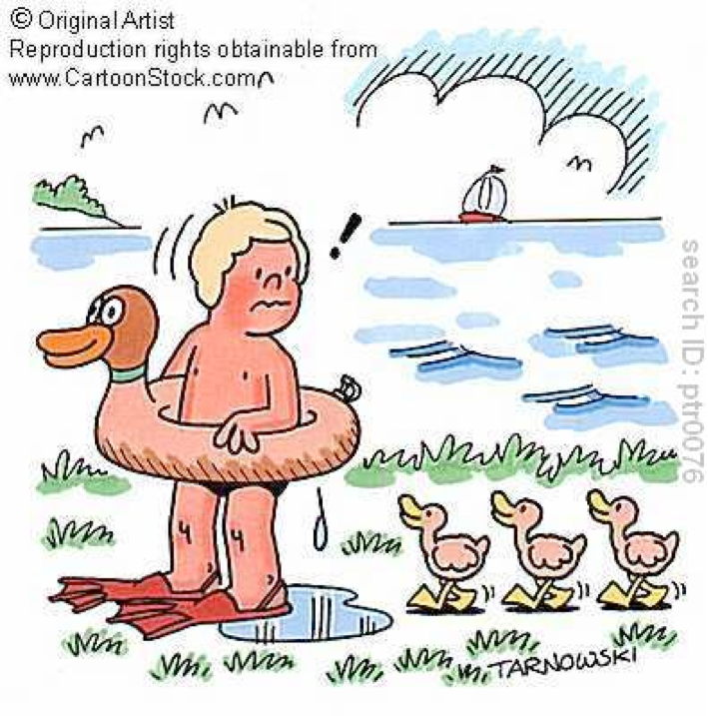
Is Language an Instinct?
Bee dance, cricket song as models
Lorenz and imprinting
Language as a Special Gift
  Deprivation, feral children
  Home signers, Nicaraguan signers, Bedouin signers
  Critical Period Hypothesis

Slide 7
Ten Pillars of UG
    UG Emergentism
    Sudden evolution of language -> Gradual evolution of language
    Simple genetic determination -> Complex genetic determination
    Speech is special -> Perceptual theory of audition
    ***Critical Period Hypothesis -> Age effects due to risk factors
    Language as clausal syntax -> Language involves all levels
    I-Language / E-Language -> I-language emerges from E-language
    Rules -> Cues and constructions
    Uniqueness of recursion -> Recursion emerges from action
    Modularity of mind -> Levels are not modules
    Poverty of the Stimulus -> The stimulus is complete
5

Slide 8
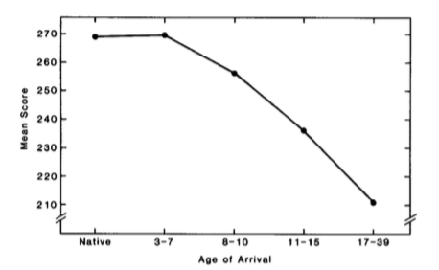
Sudden Drop or Gradual Loss?
Johnson & Newport (1989) and Hakuta et al (2003) show a smooth gradual decline in language learning attainment (LLA) across age of arrival (AoA). No sharp drop at puberty, although J&N say there is a “plateau”.
Educational level is just as important as AoA.

Slide 9
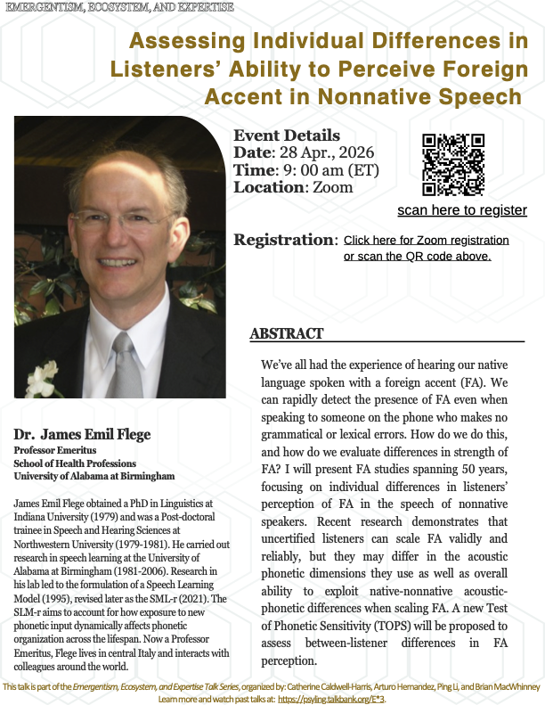
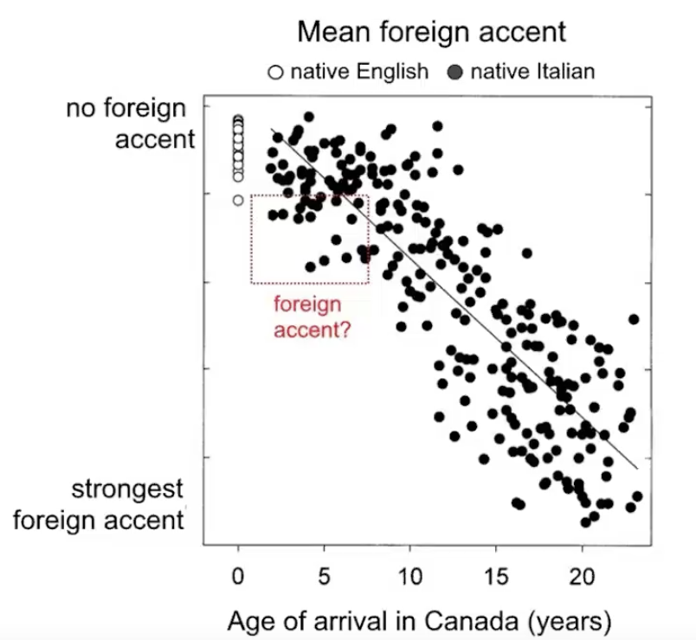
Flege Data
https://media.talkbank.org/open/E*3/Flege.mp4

Slide 10
Problems
The drop is not precipitous.
Critical periods apply to unitary abilities, like imprinting. Language is a complex of interrelated abilities. Each ability has its own set of age-related properties. (Werker cascade)
No genetic-physiological mechanism for a decline has been proposed.
Generative theory cannot reach consensus on whether UG is dead in adults.

Slide 11
Adult Success
Adult learners can achieve native speaker level competence after age 20 with 1) good instruction, 2) high exposure, 3) social support, and 4) high motivation.
Children benefit from all 4 of these.
Polyglots continue to acquire new languages throughout adulthood.
But: many adult learners do not reach native levels. Why?
And: adolescent learners often show retention of foreign accent.

Slide 12
By levels
Lexicon: Adults outperform children.
Pragmatics, Conversation: Adults do well.
Syntax: Mixed picture.
Morphology: Adults are weak.
Audition: Adults miss some contrasts.
Articulation: Adults fail to lose their (foreign) accents.

Slide 13
Proposed mechanisms
Chomsky | UG - perhaps a single gene
Lenneberg | Lateralization, Myelination
Pinker | Metabolic Decline
Paradis, Ullman, Segalowitz | Loss of Automaticity, Dopamine
Clahsen, Van Patten | Shallow Syntax
Hurford, Novak | Reproductive Advantage < Cost
Schumann | Limbic Support
PDP, Kuhl, DevLex | Entrenchment, Gangs
Hensch | PV cell windows

Slide 14
Problems with these accounts
A single gene: One gene for all the neural areas and processes involved? FoxP2? Biology doesn’t work that way.
Multiple genes: More likely, but no real evidence yet.
Lateralization: It begins at infancy, not at adolescence – Molfese, Neville
Myelination: White matter volume varies with exercise and time of day. There is no tight linkage to adolescence or language specific areas – (Raichle, Luna 2012, Engvig et al 2012, Posner et al. 2014, Takeuchi et al. 2010 etc.)

Slide 15
More problems
Metabolic Decline: Avi Karni shows that the elderly just need a nap to regain implicit learning ability (SRT, statistical learning)
Proceduralization:
  occurs in L2 learning – Presson, MacWhinney, Yoshimura, Davy.
  ELAN arises after six weeks of mini-Nihongo training – Friederici
  Basal ganglia supports extensive procedural flexibility – Stocco, Kotz, Dominey

Slide 16
More problems
Shallow Processing: It is true that learners often fail to attend to affixes and long-distance dependencies, but this can be trained. Demonstrations (Clahsen, Grüter, VanPatten) typically just illustrate cue validity effects.
Sexual Selection: People continue to reproduce past age 13. Males can reproduce into old age. 30,000 years ago, people began to survive and reproduce well past 30. Consider Genghis Khan.
Limbic Support: Schumann was probably onto something, but is it biological or social? Do older people have fewer emotions?
Entrenchment: This definitely occurs, but it is a general mechanism, not unique to the Special Gift.

Slide 17
Entrenchment?
Connectionist accounts depend on network dynamics, not gene expression.
In PDP (Seidenberg & Zevin 2006), entrenchment arises from attractor states. It suffers from catastrophic interference and saturation.
In SOFM (Li, Farkas, and MacWhinney) entrenchment arises from gang effects. There is no catastrophic interfence, but there is a loss of network fluidity.
Entrenchment is the mechanism underlying Kuhl’s Perceptual Magnet, Flege’s Speech Learning Model, and others.
Entrenchment need not and does not operate in a uniform way across linguistic levels. More on this later.

Slide 18
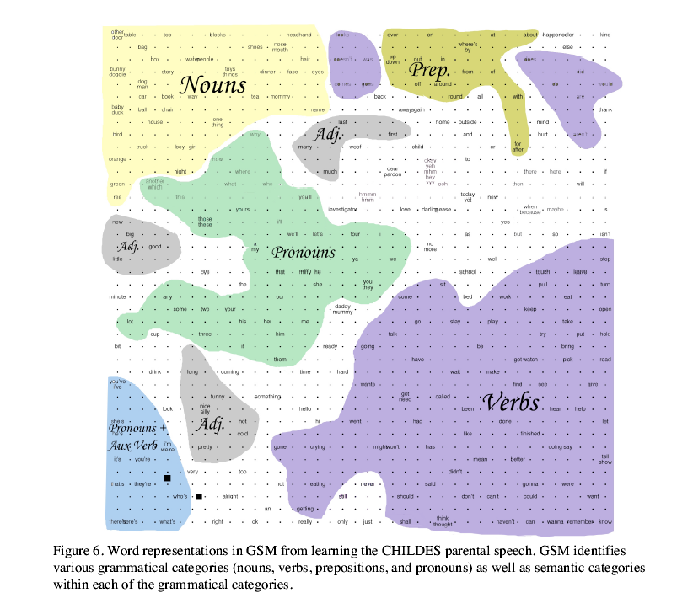
Lexical/Category Entrenchment
Li, Farkas, MacWhinney
  SOFM
  CHILDES Input
  Emergent POS entrenchment
  Clear gang effects

Slide 19
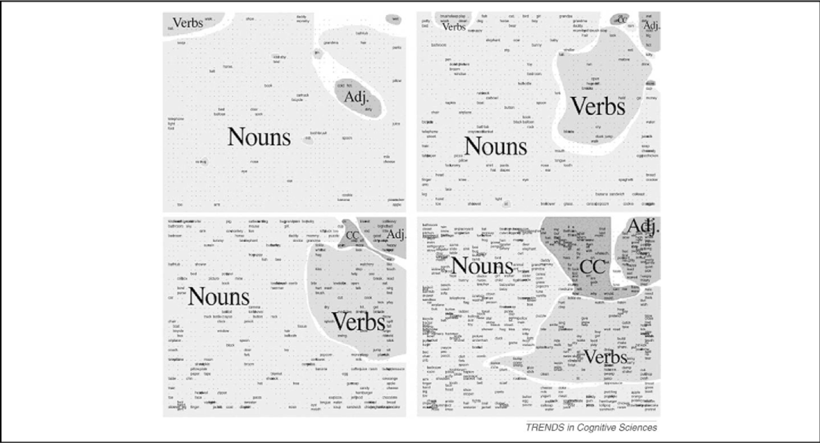
50, 100, 250, and 500 words

Slide 20
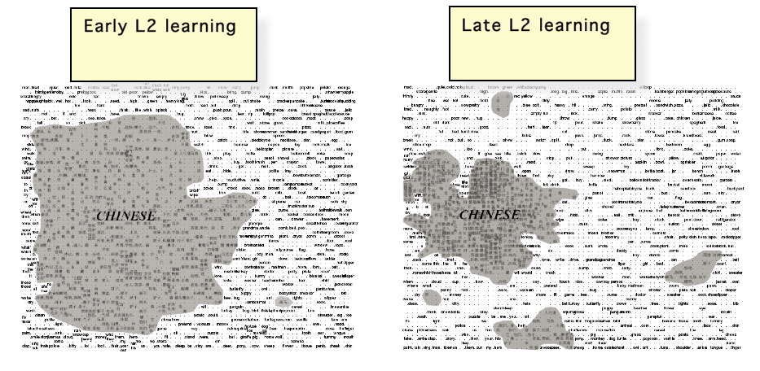
English first

Slide 21
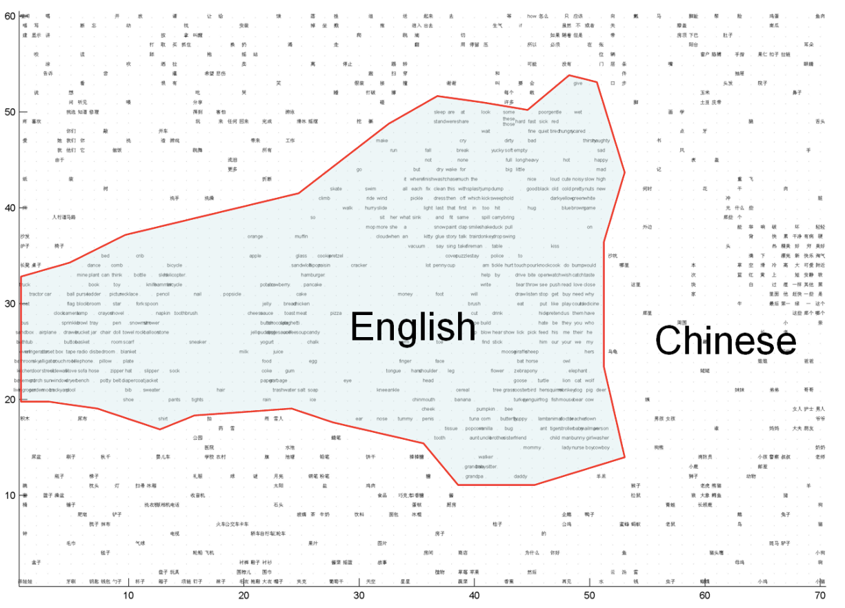
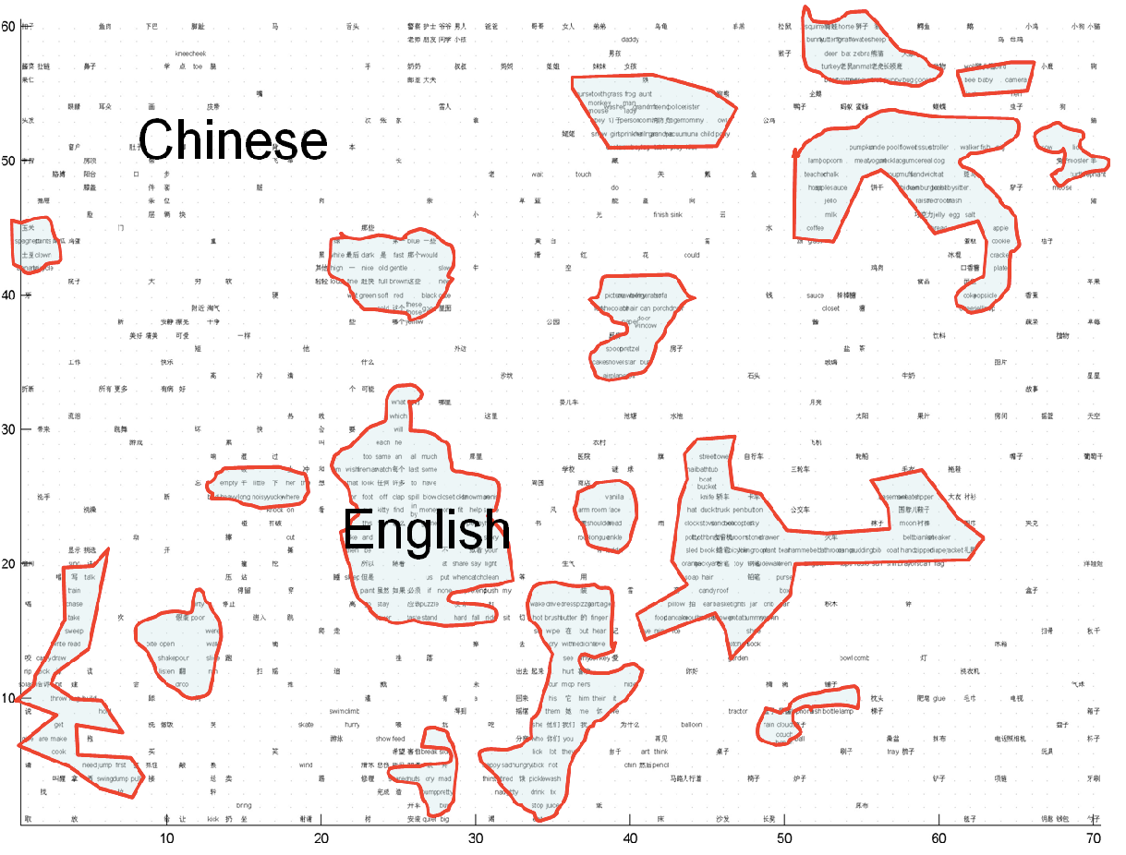
Chinese first
Early L2 learning Late L2 learning

Slide 22
Auditory Entrenchment
The Maintenance Theory (use it or lose it) doesn’t work, because 3-year-olds regain their ability to discriminate contrasts they haven’t been using.
Adults can hear all sorts of non-native contrasts: clicks, ejectives, retroflexes, tones, palatals.
Adult L2 learners can acquire MMN (75 msec brainstem) perception of L1 contrasts – Winkler et al. (1999); Kraus et al (1995)
Zhou (2011): Complete reversal of CP in mice through pink noise exposure

Slide 23
Articulatory Entrenchment
Bongaerts: With sufficient effort, adults can lose a native accent.
Strick (2006): Motor cortex has a mix of hard-wired and plastic neurons
Striate cortex maintains ability to combine actions.
L1 accent does not block effective use of L2.
“CP” effects for ballet, ice hockey, violin, golf …

Slide 24
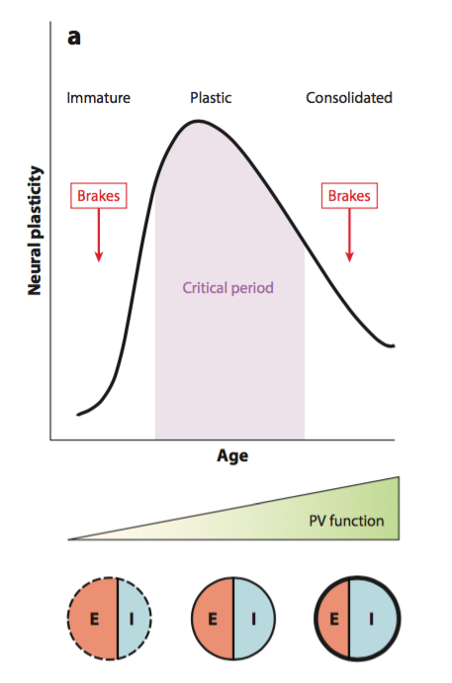
CP as a window- Werker & Hensch

Slide 25
Entrenchment through neurotransmitters
data comes from studies of V1 amblyopia - Hensch
relation to language is through extrapolation - Werker
immature period: excitation too strong for consolidation
opener: orthodenticle homeobox 2, BDNF act on PV (parvalbumin) GABA-circuit cells
closers: Lynx1 and myelin formation
epigenetic reopener: histone deacetylase inhibitors,
attentional reopener: 5-HT (serotonin), ACh, NE

Slide 26
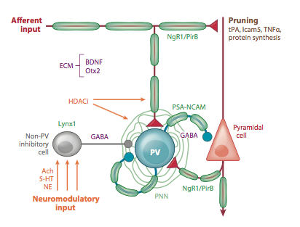
Controllers

Slide 27
Back to behavior
Given that
  Lynx1 is neuromodulated by attention
  GABAergic circuits are driven by pharmacologicals, epigenetics, and environment
  GABA circuits mature differently in different areas
  myelin is exceedingly plastic
Therefore, Critical Periods are unstable and reversible

Slide 28
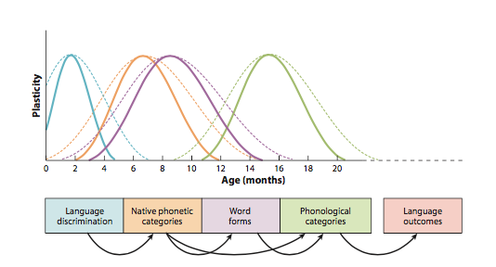
Werker - Cascading Sensitive Periods
Only for phonology?

Slide 29
Adoptee Attrition
International adoptees arriving before age 8 lose all use of their L1 (except perhaps some auditory categories), although they have had 6 full years to achieve entrenchment
Adult L2 learners who make no use of L2 show permastore 30 years later (Bahrick) and adult emigrants can’t lose their L1 even if they try (Schmidt 2010)
So, the trade-offs between entrenchment and plasticity must be operating in very complex ways
Alternative: Karmiloff-Smith Representational Redescription, Cleermans Mass Action, Kroll Dynamic Systems

Slide 30
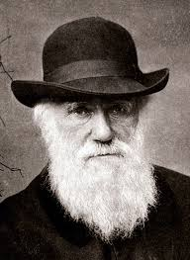
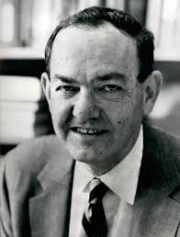
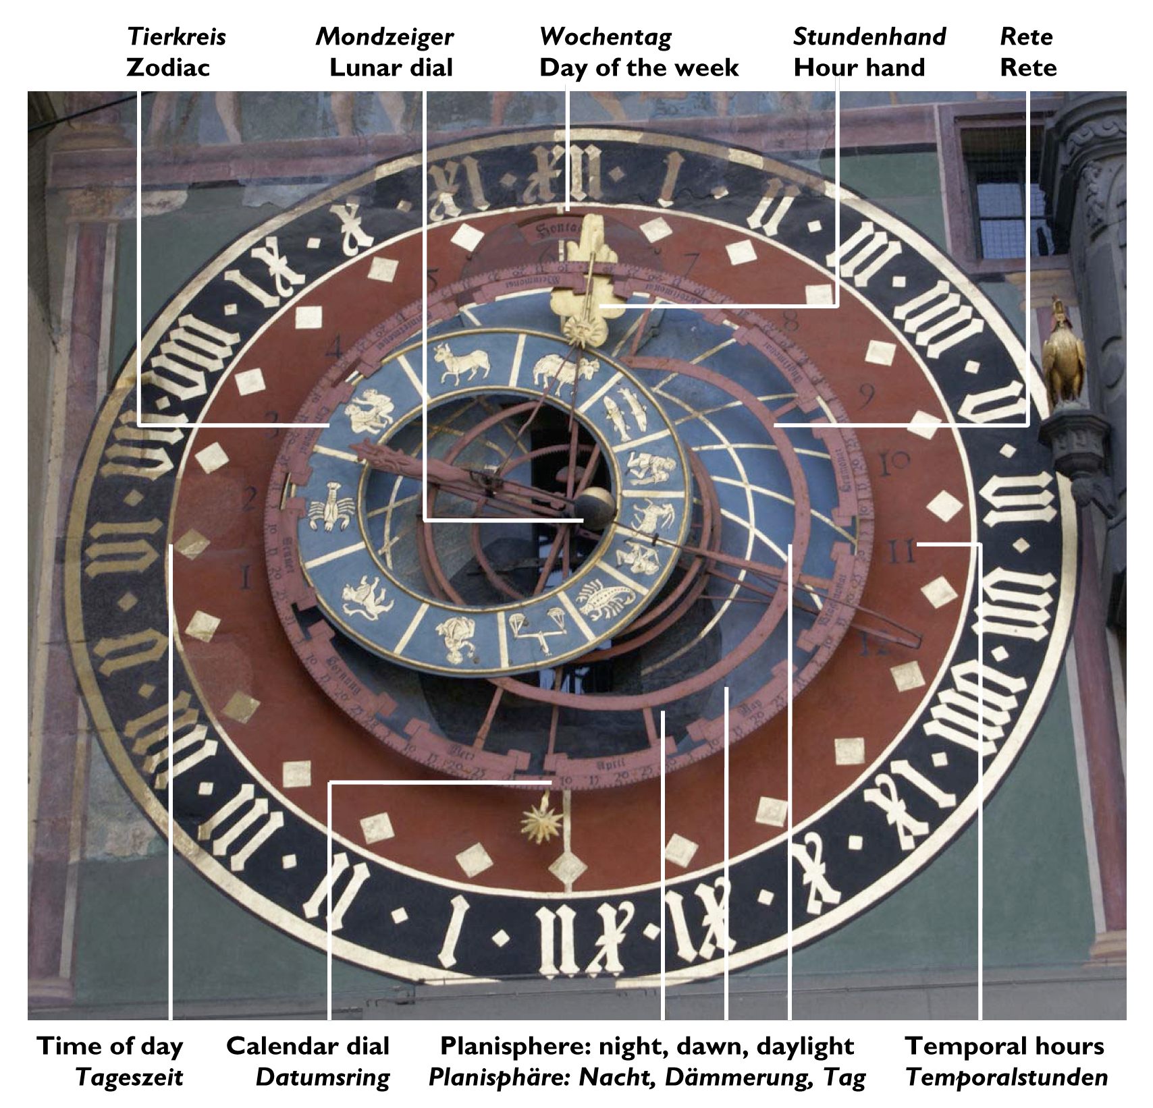
Emergentism as an alternative
Competition - classic Competition Model (Darwin)
Hierarchical Structure - linguistic levels (Simon)
Timeframes - the brain relies on this (MacWhinney)
The Unified Competition Model (UCM) is a specific version of Dynamic Systems Theory (DST)

Slide 31
Darwinism
Proliferation
Competition (biological and neuronal)
Selection: the phenotype is the locus of selection

Slide 32
Levels (Linguistics, Simon)
Subsystem | Area | Processes | Theory
Audition | Auditory Cortex | Extracting units | Statistical learning
Articulation | IFG, motor cortex | Targets, timing | Gating
Lexicon | STG,ATL | Sound to meaning | DevLex
Syntax | IFG | Slots, sequences | Item-based patterns
Mental Models | BA47, DLPFC, MTG | Deixis, Perspective | Perspective, Roles
Participation, Discourse | Social system | Topics, turn-taking | Conversation Analysis

Slide 33
Time/Process Frames
Processing (competition, transfer)
Consolidation (entrenchment, resonance, proceduralization)
Social diffusion (memetics, participation)
Evolutionary diffusion (genetic accomodation)

Slide 34
Cognitive Risks and Supports
 | Risks | Supports
1 | Entrenchment | Resonance
2 | Transfer, Parasitism | Decoupling
3 | Overanalysis | Chunking

Slide 35
Motivational Risks and Supports
 | Risks | Supports
4 | Isolation, Pride | Participation
5 | Opportunity Costs, Immediacy | Control
6 | Resource Scarcity | Create/Find

Slide 36
Children’s motivational supports
Dimension | Supports
Social support | full participation
Rewards | high immediacy, high utility
Resources | provided by caretakers

Slide 37
A fundamental difference?
UCM holds that all processes are available in both L1 and L2 acquisition.
  Body, voice, hearing, brain, group membership are common to adults and children
  The world is the same.
  The target language is the same.
Adults have greater exposure to risk factors and must compensiate by emphasizing support factors strategically.
There are differences, but they are not fundamental (Bley-Vroman revisions).

Slide 38
Risk #1: Entrenchment
Based on consolidation mechanisms
Varies by level
Reversible
Adoptees achieved entrenchment of L1, but still lost it after arrival.

Slide 39
Support #1: Resonance
Units that fire together, wire together
Resonance as recombination
Tolman-Eichenbaum Machine
Valiant/AI
li2
🦊
gou3
🐶
mao1
🐱
fox
dog
cat
狸
狗
猫
⺨

Slide 40
Two systems for recombination
Resonance: Episodic/declarative storage and recombination through hippocampal reentry - (Wittenberg, O’Reilly)
Chunking: Procedural recombination through basal ganglion selection (Verstynen, Dominey, Kotz)

Slide 41
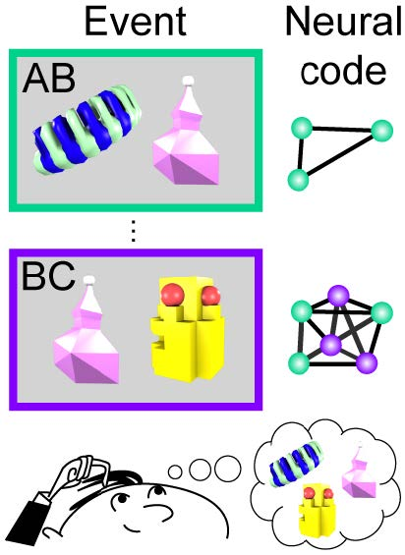
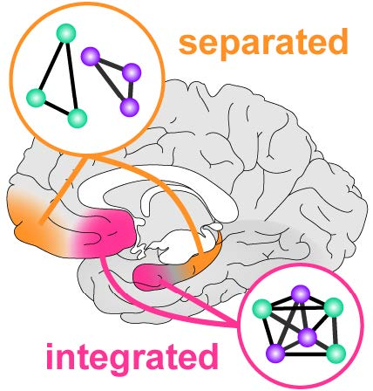
Recombination through resonance: Schichtling

Slide 42
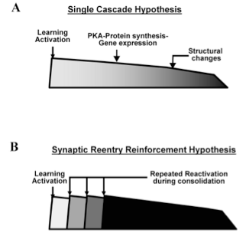
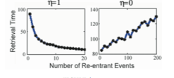
Neural Basis
Wittenburg et al. 2002

Slide 43

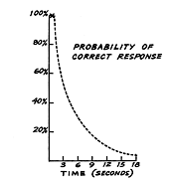
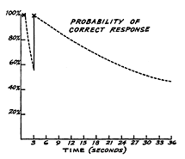

Graduated interval recall
Pimsleur 67

Slide 44
Resonance = Making Sense
CJK radicals – animals have fur radical
Stories for compounds: 相机 image-machine = camera
Spanish nouns ending in –o take el, un, su, le etc.
chevalier from caballero (cheval – caballo for horse)
Guangzhou is in Guangdong; Guangzhou and Hangzhou are capitals
Shanghai is on the sea
German compounds with “s” Liebestraum, Liebesbrief, liebeskrank, but not Pfeffer(s)kucken or Stadt(s)rat
reminiscent of, indicative of, but not apparent of
Final –e in make and cane makes the vowel long

Slide 45
Timescales for Consolidation
Gaskell, Davis – overnight consolidation
Decline in implicit learning in adulthood is erased by naps – Karni
Rats show retrograde amnesia for days
HM and others showed retrograde amnesia for weeks, even years (Squire TV study)
MTT model (Nadel et al, 2000) shows how the hippocampus supports continual consolidation across diverse timescales

Slide 46
Risk #2: Transfer
I often go ... / Je vais souvent …/ *Je souvent vais
Adv + V
V + Adv
speaking English:
competition
speaking French:
ADV 1st
ADV 2nd
Heavy Adv

Slide 47
What transfers?
Competition Model answer: Everything that can transfer will.
Some is positive (protective), some is negative (risk)
Unmarked patterns transfer; marked ones only with difficulty.
Semantics and perspective transfer smoothly (except for cultural differences – Pirahã, Japanese).
Phonology transfers, but not cleanly and there must be rearranging (basal ganglion) and readjustment.
Morphosyntax, IBP, FBP, and chunks cannot easily transfer.

Slide 48
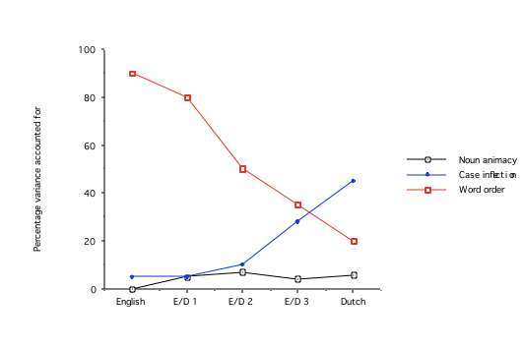
English Learners of Dutch
McDonald and MacWhinney (1989)

Slide 49
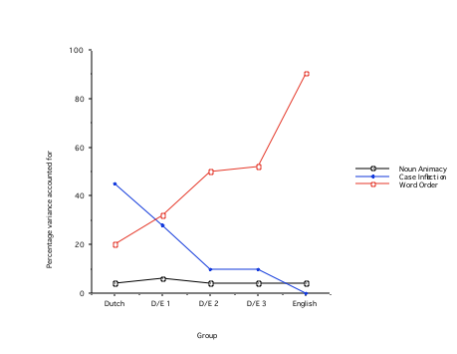
Dutch Learners of English

Slide 50
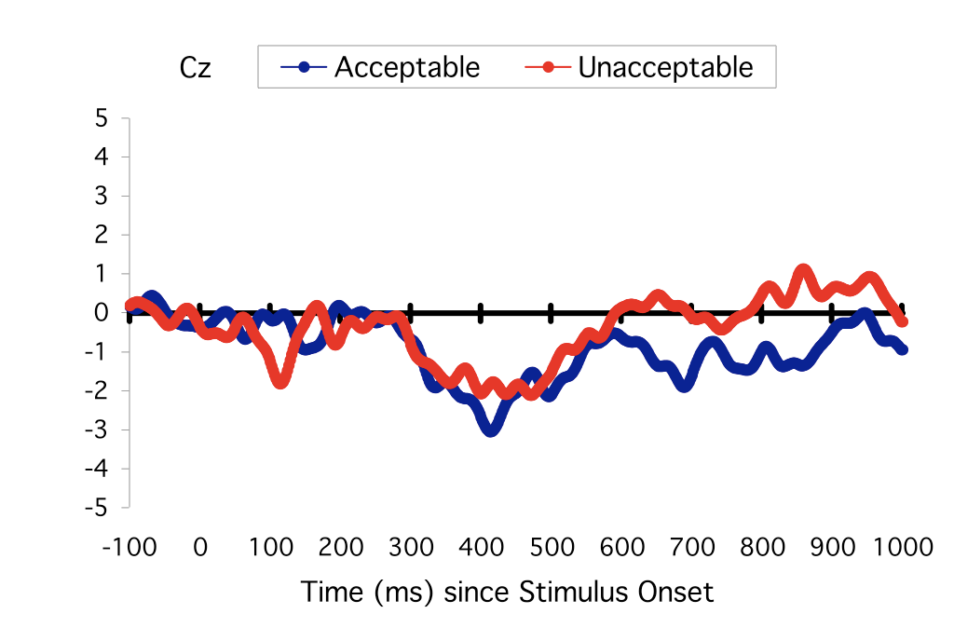
Tokowicz & MacWhinney 2005
L1 supports L2
Su abuela cocina/*cocinando muy bien.
Her aunt cooks /*cooking very well.
Further analysis in Tolentino & Tokowicz 2011

Slide 51
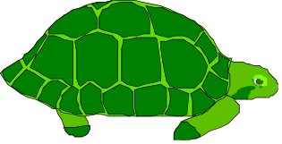
Transfer leads to Parasitism
Simultaneous Bilingualism
translation route
“turtle”
“tortuga”
LX
LY
balanced
direct route
Successive Bilingualism
L1
L2
dominates

Slide 52
Support #2: Decoupling
Parasitism can be mitigated by decoupling / internalization
  thinking in L2 (Vygotsky), L2 activates L2
  this works best for more advanced learners
  direct exposure, contextual learning
  Language Partner

Slide 53
Risk #3: Overanalysis
Instead of learning “schwimmen auf dem See”, adults just learn See = lake They ignore how dem marks case and gender and fits with auf.
Adults overuse analysis because it leads to quick success, despite long-term problems with failure to process and store morphological markings.
Instructional materials can make this worse.
Children pick up amalgams (MacWhinney 1978, Peters 1980).
Newport’s Less is More account makes the wrong predictions. Plaut and Rohde showed that Elman’s simulation was flawed.
Older adults (64 years) do worse than younger adults (34 years) at chunk-based learning in artificial grammar learning – Kürten et al (2012)

Slide 54
Support #3: Chunking
Chunks can arise from
  Whole phrase learning
  Proceduralization
Examples
  Phrases: por lo mucho que _, it reminds one of __
  Idioms, frozen forms
  Rhymes, poems
  Compounds: Donau_dampf_schiff_fahrts_gesellschaft(s_haupt_stellvertretender_kapitän)

Slide 55
Recombination through chunking
The proceduralization system uses reinforcement learning (dopamine) to form chunks in the striatum (Graybiel, 1998) .
These chunks are recombinatory patterns which are then used to “train” the cortex.
Chunking supports “the predictive brain”

Slide 56
Learning to skip steps
Time
Region 1
Region 2
Region 3
Routing
Operation 1
A representation
The same
representation
Routing
Operation 2
A transformed
representation
The transformed
representation
Notes:
Here is a time-flow of the imaginary task.
This is a situation that often happens in complex tasks

Slide 57
With practice
Time
Region 1
Region 2
Region 3
New routing
Operation
A representation
A representation that
has been processed
Notes:
Practice cuts the middle man.
New skills are more efficient because they get rid of intermediate steps.

Slide 58
Presson: Teaching with Time Pressure
Unified Model

Slide 59
Risk #4: Isolation across timeframes
Period | Support | Examples
Infancy | Full engagement, physical contact, repetition, guided noticing | Yip-Matthews Ornat, Yasmin Thai
Toddler | Parents and peers, welcoming of immigrants | MacWhinney, Hall, Danish
Primary | Schools, peers, parents, acceptance of immigrants, games | Literacy studies, Dresden, TCD
Secondary | Rejection of immigrants, gang formation, but … | Køge, Kreuzberg
Young Adult | Marriage, work, peer group – sex role bound | Missing data
Adult | Work-related, little support, formal schooling | ESF, Fossilization
11

Slide 60
Age Effects
Teenagers:
  Peer-group exclusion
  Immigrant group insulation
  Insufficient comprehensible input and output
Adults
  Role entrenchment; risk of embarrassment
  Ascendance of international English
  Work commitment

Slide 61
Lindsay’s Analysis
Listening to the Japanese babies in PhonBank was an eye-opener. Whereas in a conversation with a Japanese adult I am always struggling to keep up, I could understand absolutely everything that was being said to these children. It was, for me, a poignant demonstration of the differences between the language directed at children and the language directed at adults learning a second language.
Hiromi has “what’s this?” and “who’s this?” repeated to her over and over, for minutes on end, in multiple sessions, while her father point to illustrations in a book in front of them. If I had had this type of teaching, perhaps my learning might have resembled Hiromi’s.

Slide 62


Is 3rd Grade the Critical Period for Holding a Pencil?

Slide 63
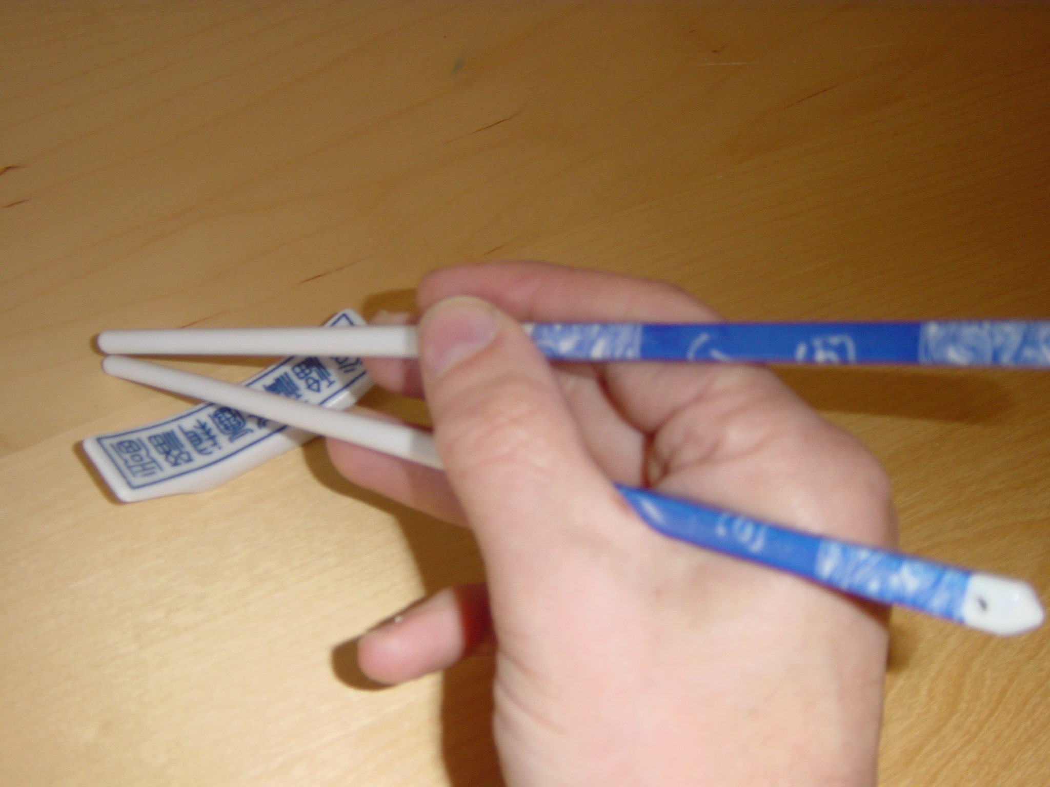
But what about Chopsticks?
Acquired at age 56

Slide 64
Confounded facts
“Critical periods” may be more social than neural.
Puberty locks in native-language peer groups.
Social effects may produce limbic effects.
Adulthood locks in social roles for immigrants.
Aging involves brain deterioration, but this is not unique to the “Special Gift”

Slide 65
Support #4: Participation
Identity Theory:
  ahány nyelv, annyi ember
  so many languages, that many people
  identifying with particular L2 members
extroversion/introversion
focus on form vs. focus on communication
group alignment: code-switching and language management

Slide 66
Risk #5: Opportunity Costs
For children, learning to communicate is the most important thing in their life
Children don’t have to go to meetings.
Children don’t have to answer email.
Children don’t have to file tax returns.
Children get immediate rewards; adults don’t.

Slide 67
time on task, lack of time
Children can devote 12 hours a day to language learning
Adults may only have 3 hours/week
So, L2 adult learning must be TIME-EFFICIENT
Most research has ignored this issue, but it is crucial.

Slide 68
Support #5: Executive Control
Inner Locus of Control: Adults have to overcome disappointment with low rewards and low immediacy.
Goal Hierarchy: Adults have to maintain the top level goal of achieving proficiency despite the barriers.
Opportunity Costs: Adults need to organize things so that conflicting demands don’t interfere.

Slide 69
Risk #6: Resources
It’s hard to learn Pirahã when there is no grammar and no dictionary.
Danish children can easily learn English from online chat and video games. It’s hard to use these to learn Danish.

Slide 70
Support #6: Find resources
Challenge yourself to master current materials
Maximize comprehensible input
Set goals for consistently moving up levels
Find and use materials just above your current level

Slide 71
Summary
 | Risks | Supports
1 | Entrenchment | Resonance
2 | Transfer | Decoupling
3 | Overanalysis | Chunking
4 | Isolation/Pride | Participation
5 | Costs, Rewards | Exec. Control
6 | Resource Scarcity | Create/Find

Slide 72
Emergentist Account
Complex systems (like language) involve
  Competition and Selection (Darwin)
  Levels of Structure (Linguistics and Simon)
  Time/Process Scales (MacWhinney)
The constraints operative across these dimensions shape the patterns of language learning across ages, languages, and learner types

Slide 73
In Conclusion
Together, the risks explain age-related effects.
Language learning is not easy, and life has many other demands.
None of the risks are biological, except for old age.
Even sensory entrenchment can be reversed.
The Emergentist account should replace the CPH.

Slide 74
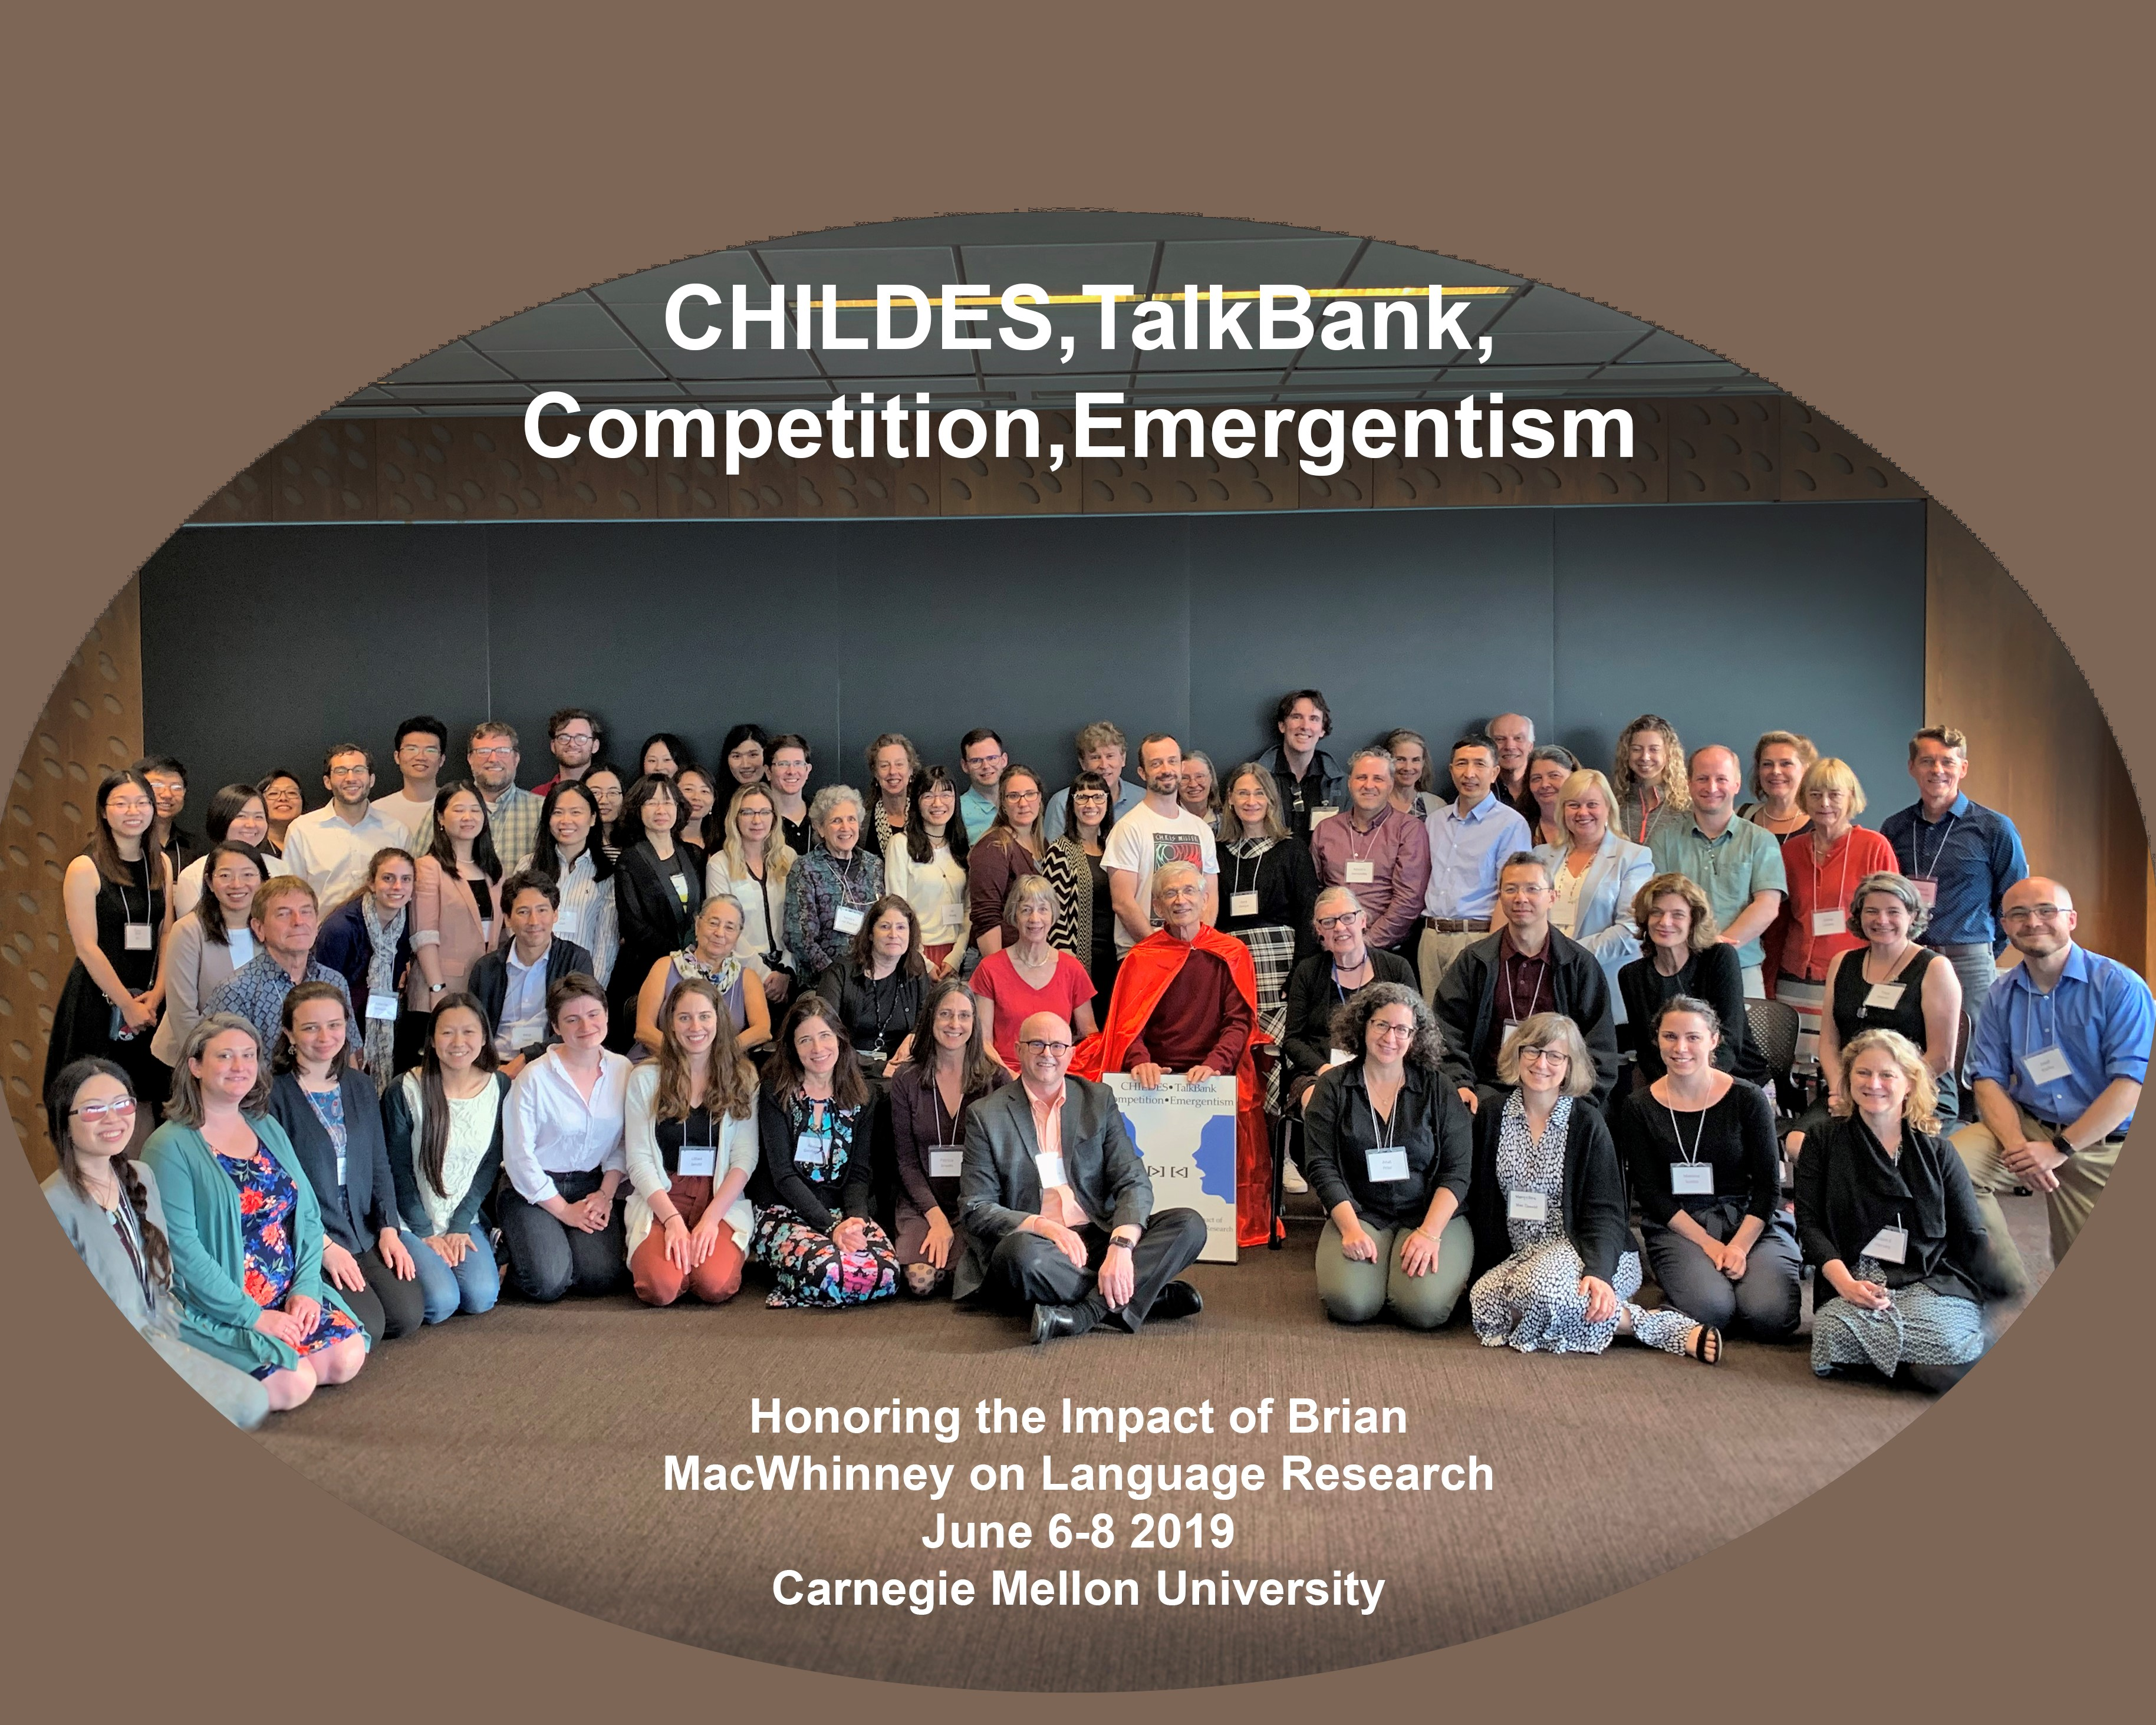
Thanks to all my colleagues

Slide 75
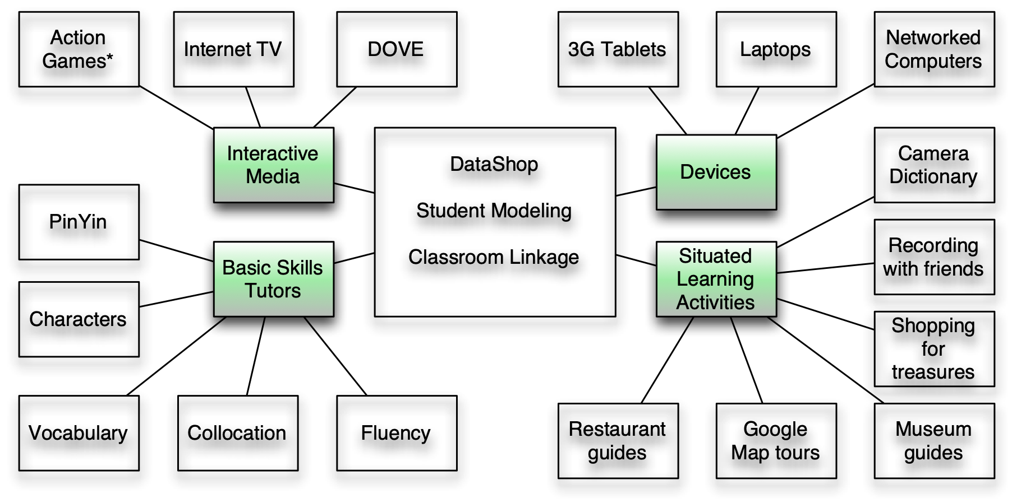
Language Partner and SLAWeb
2

