Slide 1
From the Competition Model to Emergentism
Brian MacWhinney
CMU - Psychology

Slide 2
Overview
Classic Competition Model (1982-1995)
Item-based patterns, Perspective, Cost
Unified Competition Model (1995-2017)
Emergentism: competition, levels, frames
Theory changes through extension, not replacement.

Slide 3
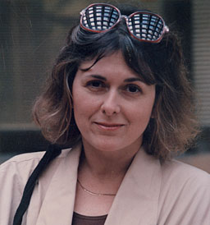
The Competition Model
"the forms of natural languages are created, governed, constrained, acquired, and used in the service of communicative functions." - 1984
1947-2003

Slide 4
Core Questions
Where does structure come from?
How does processing shape structure?
What are
  the constraints? the mechanisms?
  the levels? the timeframes?

Slide 5
First-generation functionalists
Tom Givon | Joan Bybee | Dan Slobin
Liz Bates | Elinor Ochs | Ron Langacker
Charles Fillmore | Leonard Talmy | Herb Clark
David McNeill | Joan Bresnan | Wallace Chafe
Robert Van Valin | Susumu Kuno | Adele Goldberg

Slide 6
Central Claim
Cue reliability predicts cue strength
  [p(function)|form] - comprehension
  [p(form)|function] - production
  Cue validity measured in corpora (TalkBank, COCA)
  Cue strength measured in experiments
  The mind mirrors the world (Brunswik)
  We all end up speaking language(s)

Slide 7
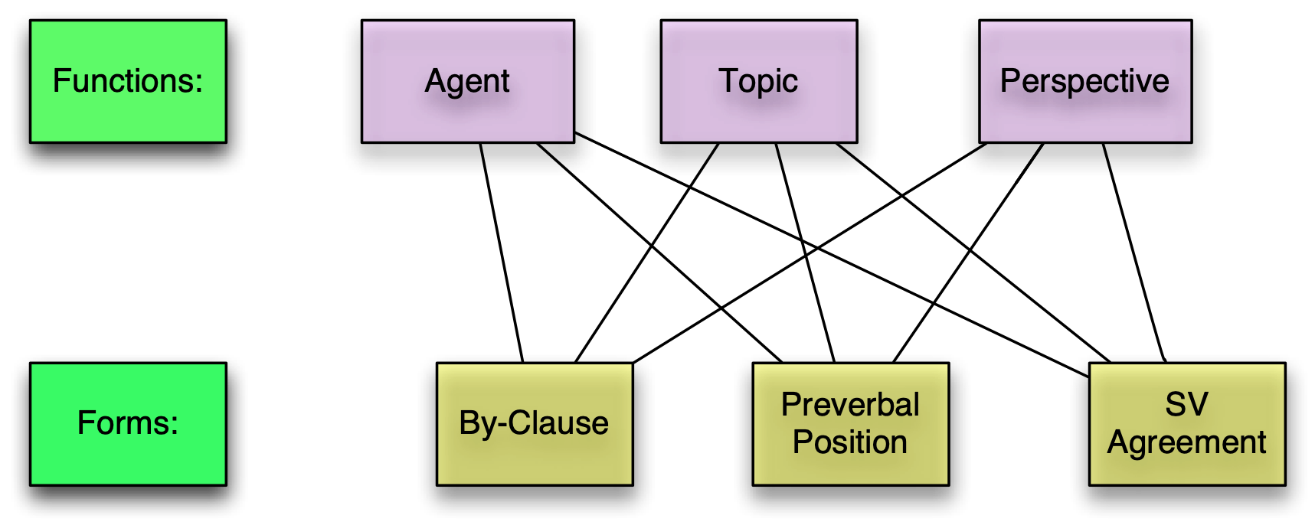
The Competition Model (1982- 1995)
142 studies
https://psyling.talkbank.org/guides/CM.html

Slide 8
Contributors
Antonella Devescovi, Arturo Hernandez, Ping Li, Jeff Sokolov, Michelle Kail, Csaba Pléh, Kerry Kilborn, Beverly Wulfeck, Janet McDonald, Patricia Brooks, Vera Kempe, Laura Morett, Nora Presson, Yuki Yoshimura, Anat Prior, Natasha Tokowicz, Helen Zhao, Sanako Mitsugi, Yoshi Sasaki, Julia Evans, Roman Taraban, Michael Matisko, Jared Leinbach, Edith Bavin, Cristina Caselli, Stan Smith, Yas Shirai, Roberta Corrigan, Antonella Devescovi, Sandra McNew and many others.

Slide 9
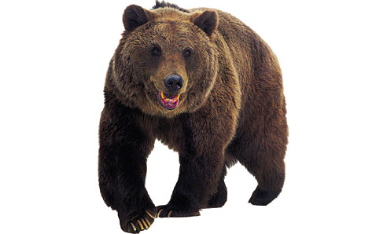

Competition Model Tests
WO (NNV, NVN, VNN)
Agreement (0, 1, 2)
Animacy (0, 1, 2)
Whodunit? (* is majority choice)
  The *tiger pushes the bear.
  The tiger the *bear pushes.
  Pushes the tiger the *bear.
  The bears the *eraser push.
  The bears the *eraser pushes.
  The *bear push the tigers.
  L'orso spingono le *tigri.

Slide 10
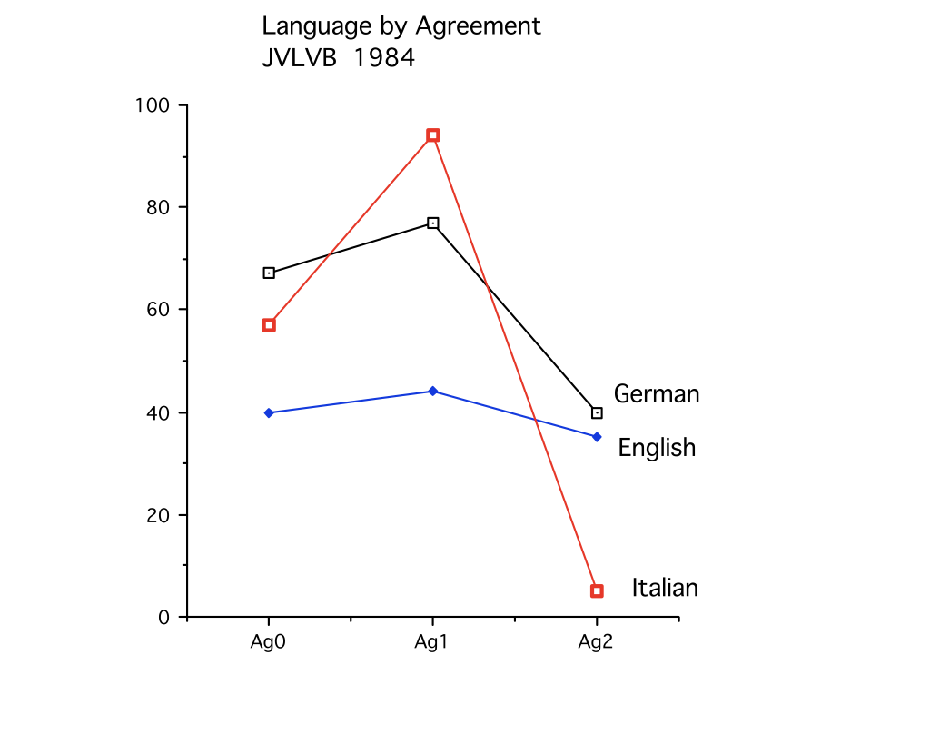
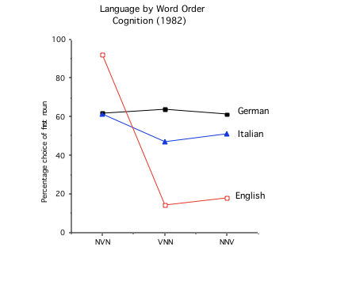
Strength measured in experiments

Slide 11

Competing Roles
The bear chases the tiger.
competition
cues
cues
bear - agent
tiger - agent
competition
competition
competition
cues
cues
bear - patient
tiger - patient

Slide 12
Cue Weights
The bear the *tigers chases.
“Tigers”-as-Agent
competes
“Bear”-as-Agent
Initial Position
SV agreement
preverbal position

Slide 13
Cues
Case Marking: many forms, many studies
Adjuncts: by-clause / MacDonald
SV Agreement – Italian/deVescovi
VO Agreement – Hungarian/ Pléh
Adj-Noun Agreement – Warlpiri / Bavin
Animacy, other noun features – German/Friederici
Implicit causality – English / McDonald
Honorifics – Japanese/Yoshimura
Stress, pauses (minor) – Italian/Bates
Switch reference – Navajo / not yet

Slide 14
Constraints
In Comprehension: Forms / Cues
In Production: Functions / Motives
Forms/Cues are constraints during comprehension
Functions/Motives are the constraints during production
Constraints serve to constrain choices
Constraints are embedded within Mechanisms

Slide 15
Sample choices in comprehension
Role assignment: Agent vs. Patient vs. Oblique
Coreference: local vs. distal vs. cataphoric
PP Attachment: verb vs. local
Scope: wide vs. narrow
Polysemy: 5 readings of “back”

Slide 16
Sample choices in production
English – give John the ball, give the ball to John
German case in PP – Dative vs Accusative
DOM differential object marking – Malchukov
Ergative marking: case, person, tense – Givon
Code-switching – Bangor corpus in BilingBank

Slide 17
Multiple Cues (Production)
animal vs. dog? ME, contrast, hierarchy, visibility
I gave John the book vs. I gave the book to John Bresnan - 8 cues
fuller vs. more full — Mondorf 21 cues
Can I talk now, or do I have to wait? – Schegloff, 5 cues
I start talking in English y termino en español – Poplack, 4 cue types

Slide 18
Methods
End of sentence choice
Online choice - joystick
Cross-modal priming
ERP
fMRI
Recall
Corpus Analysis
Collaborative Commentary
Motives in parent-child interactions

Slide 19

Models
Models are based on input from TalkBank corpora
Strengthx= ∑ cues-for-x ; Choice = Max (Strengthx)
MLE models - (McDonald and MacWhinney)
PDP (MacWhinney & Leinbach); Naive Bayes (Taraban)
SOFM (Li, Farkas, MacWhinney)
Universal Dependency (UD) Stanza Parsers

Slide 20
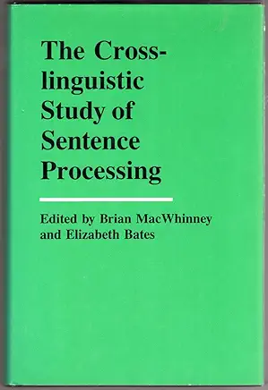
Findings - Adults
Cue strength is based on reliability
Individuals match group
Online responses based on strongest cue.
Final responses use cue summation - optimization
Choice r.t. fastest when cues all agree
Main effects and interactions always highly significant

Slide 21
Findings - Development
Children begin with the most available and detectable cue; adults do too (Matessa & Anderson)
But they are most consistent when these cues are configured as prototypes
Cue cost (agreement, long distance) impacts youngest learners most
Models (PDP, SOFM) capture course of development
Cue strengths shift from availability to reliability
L2 learners follow similar paths, but are impacted by transfer

Slide 22
Beyond Cues
Item-based patterns (IBP) and lexical specificity
Perspective-tracking
Cost analysis; Information bottleneck

Slide 23
1. Item-based patterns
MacWhinney (1976): item-based grammar
Tomasello (1992) : verb islands; Lieven usage-based
IBP => FBP Goldberg/Fillmore Construction Grammar

Slide 24
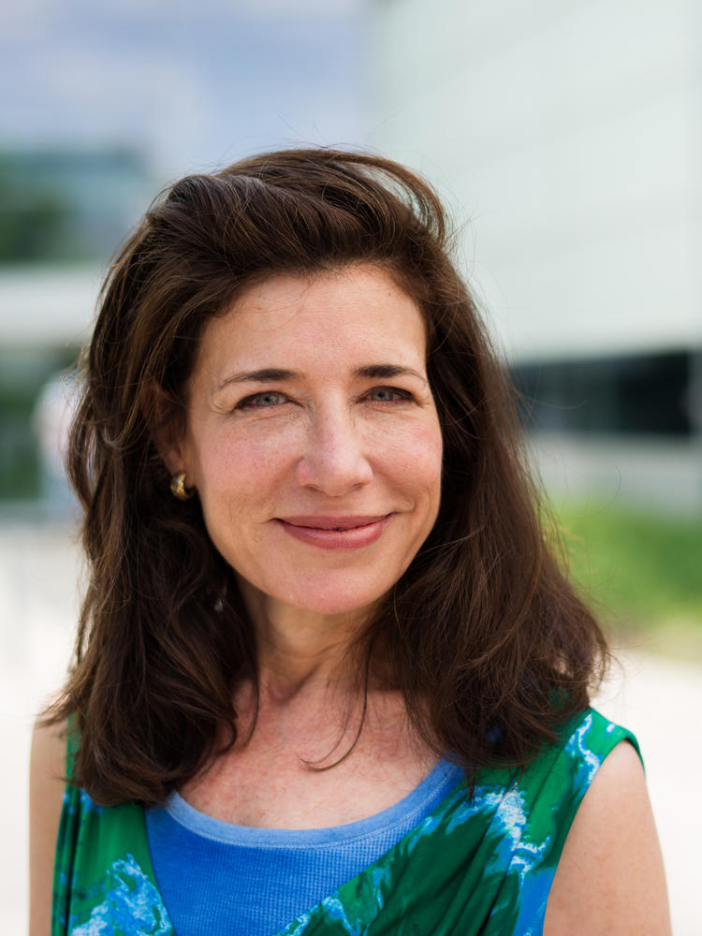

Lexical specificity
Most Competition Model experiments only used transitive actions with impact on Patient (hit, push, kiss)
Corrigan (1982, 1988, 2001): each verb carries unique causal expectations (Bowerman, Goldberg)
Word2Vec embedding analyses, much like DevLex

Slide 25
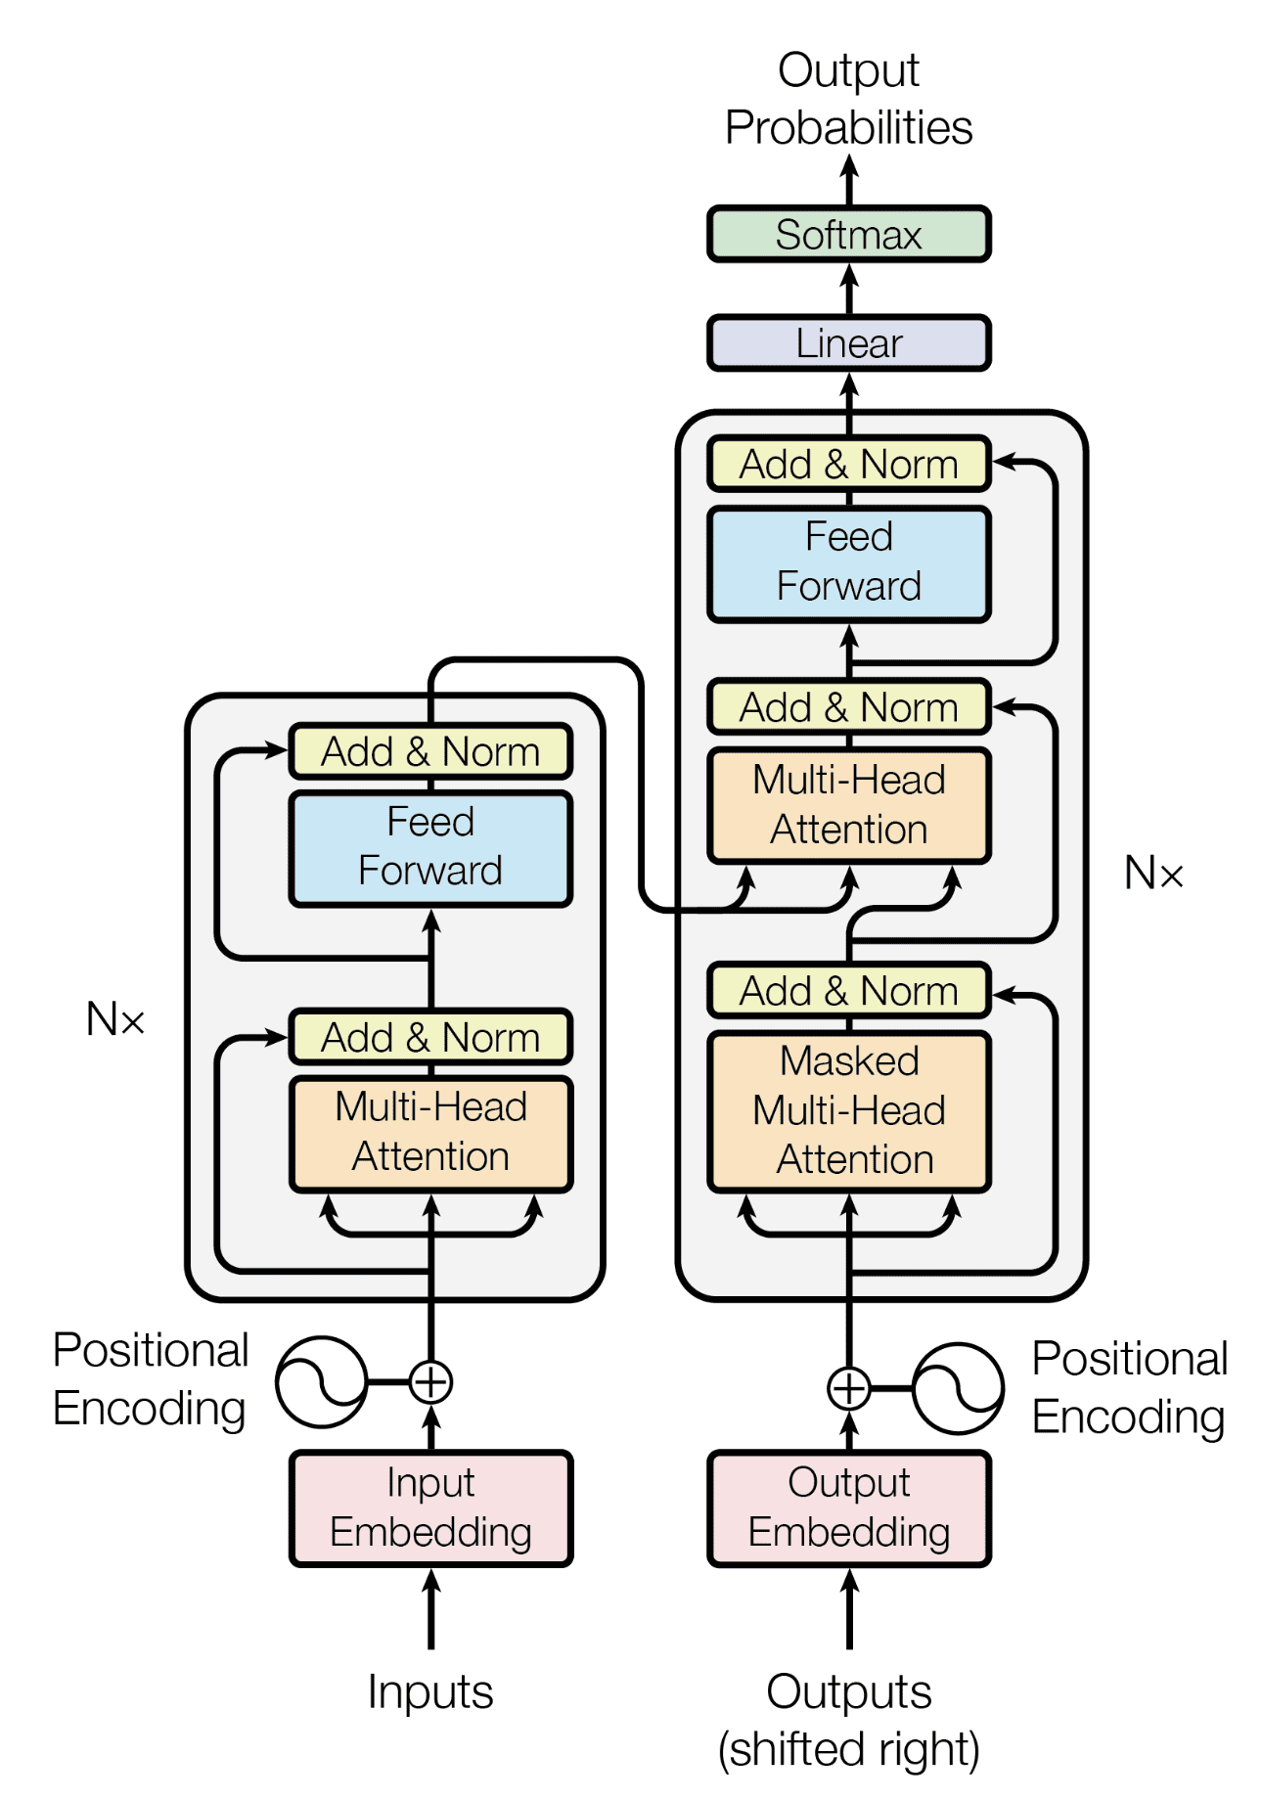
IBPs vs LLMs
Large language models (ChatGPT-4) acquire processing ability based on 300 billion words.
Children may hear 50 million words by age 5. Much less than what ChatGPT gets
Children learn relation of operator to head as they acquire the operator
Children can learn words on a single trial. They don’t just learn their co-occurrence frames. They also link them to their embodied meaning.
LLMs don’t have embodied meaning. Maybe computers will acquire meaning guidance some day.

Slide 26
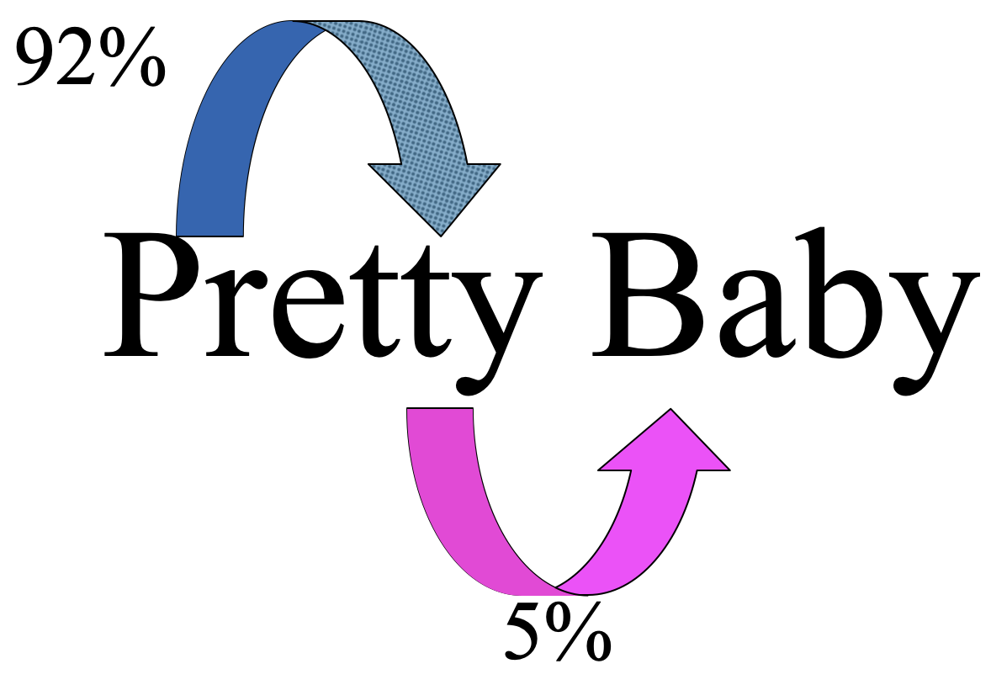

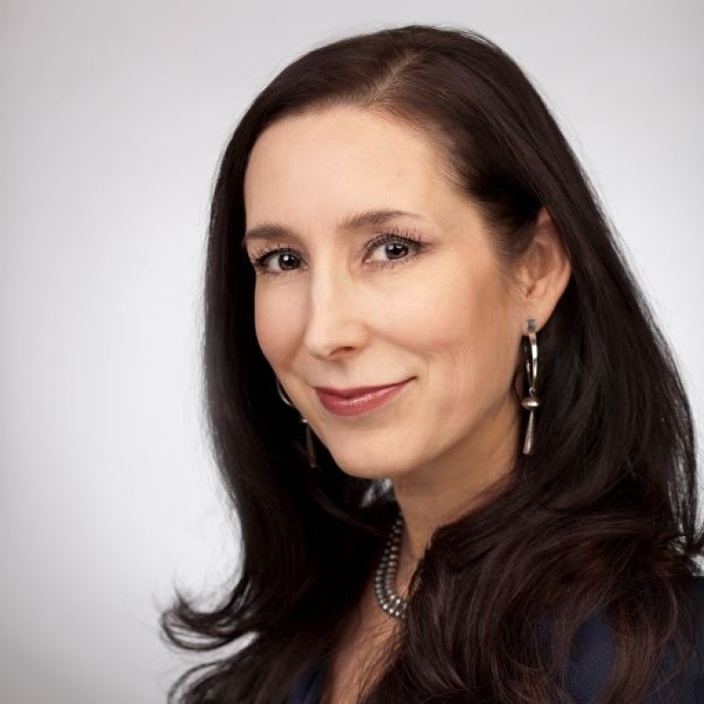
IBPs vs SL
golabu / tupiro / bidaku / padoti vs
piro-pa / ro-gola / daku-tu / bu-pado
Thiessen: statistical learning (SL) works well for phonotactics, because it is sensory/cortical
No clear demonstration of long-term effects of SL
Gomez: 3-year-olds pattern memory storage is weak because they do not have a mature hippocampus.

Slide 27
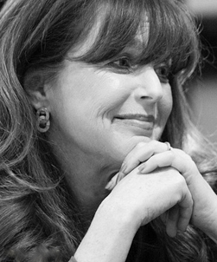

2. Perspective and Grammar
Starting Points - MacWhinney (1976) – we understand the world by projecting our own causal image
Structure building – Gernsbacher (1990)
Mental spaces: Barsalou, Fauconnier & Turner, Chafe
Grammatical constructions are used to mark, maintain, and shift perspective (passive, attachment, equi, topicalization, dislocation, theticals, etc.)
Ergative languages allow for perspective on non-Arg1 (O’Grady, 2014)
Universal role structure?

Slide 28
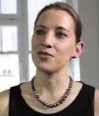
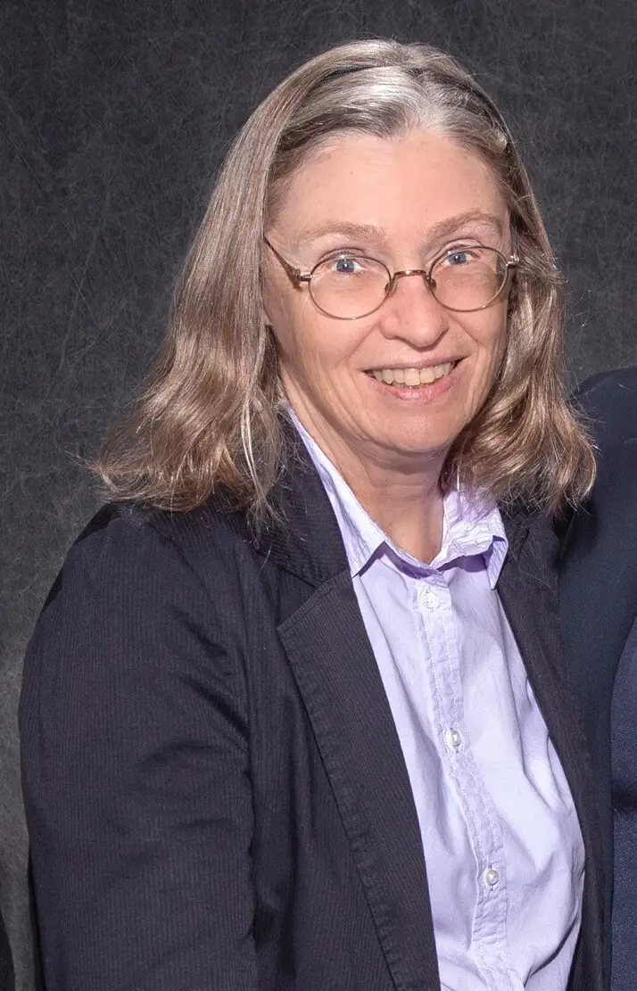
Perspective and processing
Perspective maintenance and switching incur a cost (Gibson, Hawkins, McDonald)
Perspective overrides local cues: McDonald & MacWhinney (1990)
Bornkessel-Schlesewsky & Schlesewsky (2014) AIM model assumes dorsal stream cascade of
  Actor => Subject => Topic

Slide 29

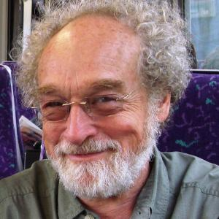
3. Costs
costs of clear articulation, full grammar, clear marking, perspective switching, agreement marking, reference binding
simple/easy vs complex/accurate
Gabelentz 1901; Slobin 1968; …

Slide 30
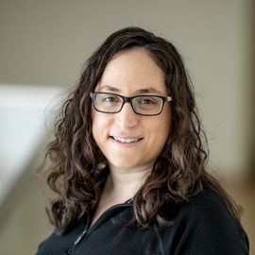
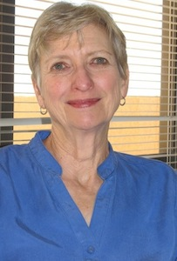
Information Bottleneck
Tishby, Zaslavsky, Kemp, Regier — objective functions for simplicity/accuracy tradeoff
Derived from Rate Distortion Theory
Applied to: color systems, kinship systems, case systems, pronouns, honorifics, tense/case, all sorts of “squishes”
Bybee: synchronic costs accumulate into diachronic constraints

Slide 31
Beyond L1
Is L2 acquisition “fundamentally different” (Bley-Vroman) from L1 acquisition, based on loss of UG? Critical Period?
Or is it “fundamentally similar” based on Competition Model constructs?
To deal with L2 learning, the model needs to examine:
  transfer
  entrenchment
  motivation, input
  fluency

Slide 32
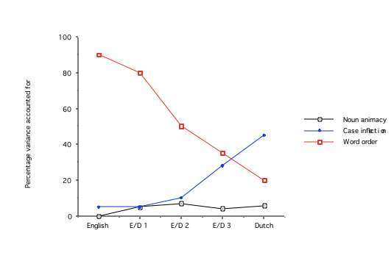
English L1, Dutch L2
Dissertations by Janet McDonald and Kerry Kilborn

Slide 33
eCALL Tutors
12 online tutors for study of L2 learning
French, Spanish, German, Mandarin, Cantonese
articles, case-marking, tones, conjugation, gender, verb separation, classifiers
corrective feedback is crucial, cues help too
simple cues work best, explicit cues retained longer
all tutors led to strong improvements

Slide 34
Cognitive Risks and Supports
 | Risks | Supports
1 | Entrenchment | Resonance
2 | Transfer, Parasitism | Decoupling
3 | Overanalysis | Proceduralization

Slide 35
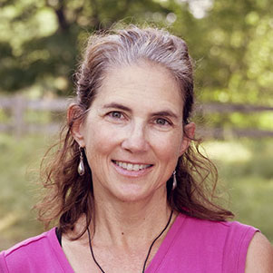
Motivational Risks and Supports
 | Risks | Supports
4 | Isolation, Pride | Participation
5 | Opportunity Costs | Exec Control
6 | Resource Scarcity | Create/Find
Caldwell-Harris, C. L., & MacWhinney, B. (2023). Age effects in second language acquisition: Expanding the emergentist account. Brain and Language, 241, 105269.

Slide 36
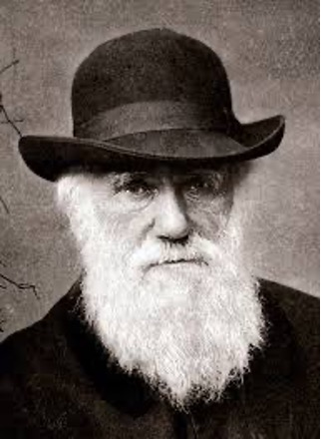
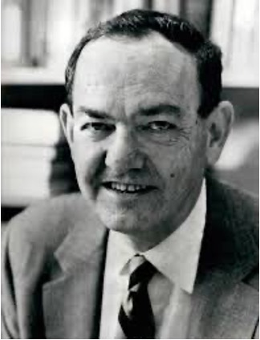
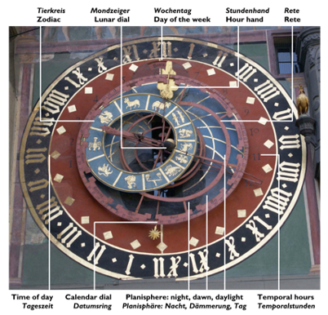
Emergentism
❖Competition - classic Competition Model (Darwin)
❖Hierarchical Structure - linguistic levels (Simon)
❖Timeframes – processes across time (MacWhinney)
The Unified Competition Model (UCM) is a specific version of Dynamic Systems Theory (DST)

Slide 37


Emergentism

Slide 38
Emergence: Classic Example
H + H + O => H2O
H2 and O2 are gases, but H2O is a liquid
Water's properties do not emerge from its components but from constraints on the molecular (quantum) level
Why? Dipole moments trigger Van der Waals bonding
Levels of water: steam, vapor, rain, rivers, lakes, freezing, salt water, glaciers, Gulf Stream

Slide 39
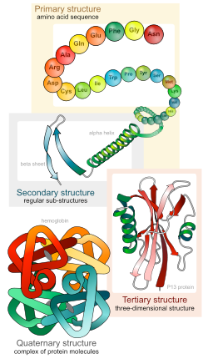
4 levels of protein folding
An example from Biology
  1. animo acid chain
  2. helices and sheets
  3. 3-D macro structure
  4. groupings of protein molecules

Slide 40
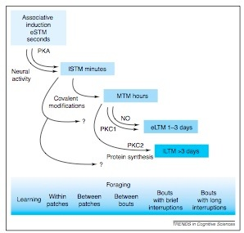
Timeframes in Bees

Slide 41

Neuroemergentism
Stan Dehaene – neural recycling
Mark Johnson – interactive specialization
Michael Anderson – neural reuse
Quartz & Sejnowski – plasticity
Arturo Hernandez – neuroemergentism
Constraints give rise to structure on levels

Slide 42
Neurolinguistic Levels, Constraints, and L2
Level | Area | L2 constraints
Audition | Auditory cortex | Still flexible
Articulation | IFG, motor cortex | Striate control, Outer layer of motor cortex
Lexicon | STG, ATG | Inherently expandable
Syntax | IFG | IBP => FBP, prediction
Mental Models | Dorsal cortex | New role configuration
Conversation | Social system | Topics, turn-taking

Slide 43
Levels above language
Groups: family, caste, clubs
Organizations: religion, business, army
Groups and organizations impose downward constraints on language:
  Special languages, code-switching
  Culture as narrative
  Globalization
  Reshaping of the planet

Slide 44
Mechanisms in4 Major Frame groups
Processing: direct competition, gating, embodied cognition, topological access, body constraints
Consolidation: Zipf, entrenchment, proceduralization, resonance, reinforcement, erosion, pruning
Diffusion: memesis, conformity, alignment, signaling
Epigenetic: linkage, induction, regulation, expression

Slide 45
Time/Process Frame Constraints
Age | Social | Cognitive | Neuro
Embryogenesis | Uterine Balance | Auditory | Proliferation
Infancy | Input, Autoinput | Stat Learning, DIVA | Cortical
Toddlerhood | Support, Scaffold | IBP, FBP | Hubs, Resonance
Childhood | Schooling, Groups | Literacy | Weak entrenchment
Adolescence | Immigrant Exclusion | Self-image | Consolidation
Adulthood | Work, Group identity | Resource Scarcity | Risks

Slide 46
Building the model
Corpora: External space-time-process frames show their effects in the moment. Multimedia is best
Sociolinguistics for tracking variation
Daylong tracking through ESM (Experience Tracking Method), VAS, and recording
Imaging to study consolidation
eCALL experiments to study learning,
Researcher-controlled Duolingo, open LENA

Slide 47
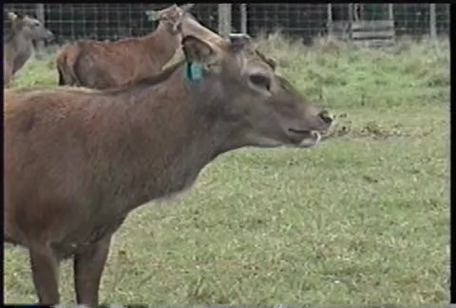
Emergentist accounts can be wrong
-- Cro-Magnon bent vocal tract

