Slide 1
The Emergence of Language Structure
Where does language come from?

Slide 2
Where does language come from?
Chomsky: Language comes from UG
Osgood (1971), Miller & Johnson-Laird (1976): Language comes from perception
MacWhinney & Bates Functionalism (1979): "The forms of natural languages are created, governed, constrained, acquired, and used in the service of communicative functions."

Slide 3



Emergentism
1999
2015
2014

Slide 4
10 Pillars of UG
Universal Base (Principles, Parameters, Modules)
Recursion (FLN, Merge)
Sudden Evolution of Language (Biolinguistics)
Simple Genetic Determination (FoxP2)
Rules vs. Cues (Stipulationism)
I-Language / E-Language (competence vs performance)
Speech is Special
Critical Periods
Modularity of Mind
Poverty of the Stimulus

Slide 5
10 emergentist approaches
Universal Base - questioned by Chafe, Levinson, reduced to Merge
Recursion - emerges diachronically - Givon, present in action - Steedman
Sudden Evolution of Language - gesture origin, 300,000 vocal
Simple Genetic Determination - many adaptations and reuse
Rules vs. Cues - PDP, LLMs, Competition Model
I-Language/E-Language - competence as input replay
Speech is Special - perceptual learning
Critical Periods - levels, constraints, and ages — Caldwell-Harris & MacWhinney
Modularity of Mind - Bates - modules are made, not born
Logical Problem - Pullum, MacWhinney

Slide 6
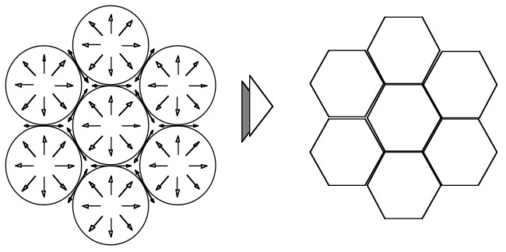
The basic idea
The basic idea
When honey droplets collect to form a new level, packing constraints create hexagons
It’s not magic, it’s mechanism

Slide 7
Principles of Emergentism
Competition – variation + constraints => selection
Levels – new mechanisms operate when combination creates new structural levels
Timeframes – mechanisms on levels create processes that configure structures across timeframes
Language structure emerges from competition governed by mechanisms within and across levels and timeframes

Slide 8
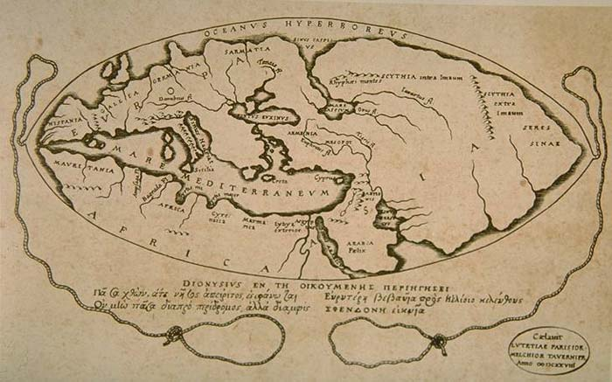
The pieces, the challenge
Emergentism is a roadmap of territories not yet fully integrated.
The pieces are the mechanisms, constraints, levels, and cycles.
We know a lot about these.
The challenge is putting it all together.

Slide 9
For SLA Theory
Accounts of L2 learning need to deal with the whole of language
Understanding L1 and L2 learning is fundamental to constructing the emergentist account
L2 learning has unique constraints based on the greater variability of L1s, learners, ages, methods, and goals.

Slide 10
1. Competition
Dobzhansky: “Nothing in Biology makes sense except in the light of evolution”
MacWhinney: “Nothing in language makes sense except in the light of competition”
Mechanisms = constraints on configurations
Motives are intentional/functional constraints

Slide 11
Example Competitions
Mondorf: 15 motives for clearer vs. more clear
Bresnan: 12 motives for double-object vs. periphrastic (give John the book vs. give the book to John)
Labov: 5 motives for fɔrti vs. fɔti in New York (store, floor, questioner, salesperson, syntax)
Hopper/Malchukov: 8 motives for differential object marking (DOM) crosslinguistically
          Lucía beso a Pedro vs Lucía besó el retrato.
MacWhinney & Bates: 6 competing motives for Subject assignment in 13 languages

Slide 12
More examples
16 cues to beer vs. pier (Lisker 1986)
8 motives for reduplication vs. simple form in Malay (Haiman 2015)
54 motives for the vs. a(n) vs. zero article (Zhao & MacWhinney, 2018)
12 motivations for selection of over (Brugman and Lakoff, 1989)
Systemic Functional Grammar (Halliday) describes many of these, but not processing, learning, or change

Slide 13
General competitions
Simplicity vs Expressivity: Gabelentz, Slobin
Costs and the Information Bottleneck - Zaslavsky objective function optimization
Assimilation vs. Faithfulness: OT
Affiliation vs. Dominance: Politeness, address terms, pronouns
Code-switching – affiliation, mot juste, matrix Poplack,
Speaker orientation vs. Listener orientation: CA recipient design
Ergative vs. Nominative: O’Grady arg1/arg2 analysis

Slide 14
Competition
Proliferation
  genes, neurons, memes, vowels, semantic fields, metaphors
Competition
  peaceful coexistence
  winner-take-all
  divide-the-spoils
  motivations
Selection
  fitness, reproduction
  horse races, strength

Slide 15
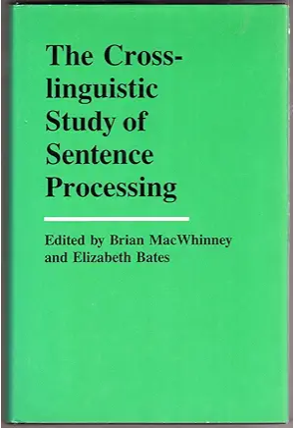
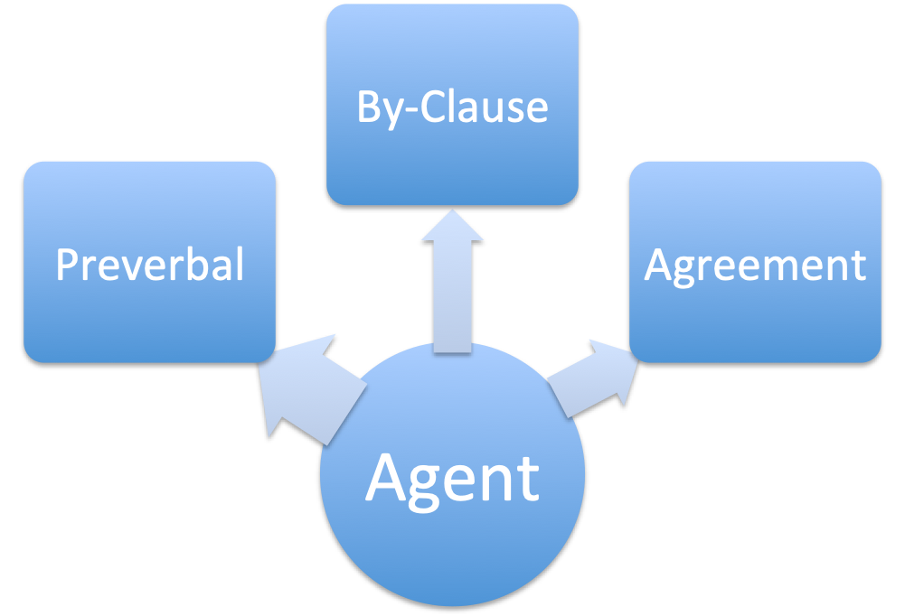
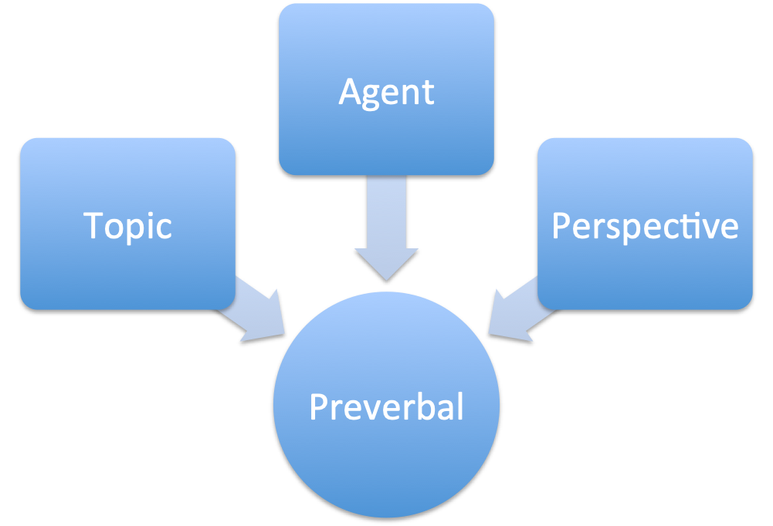
Competition Model
Forms compete for functions
Functions compete for forms

Slide 16
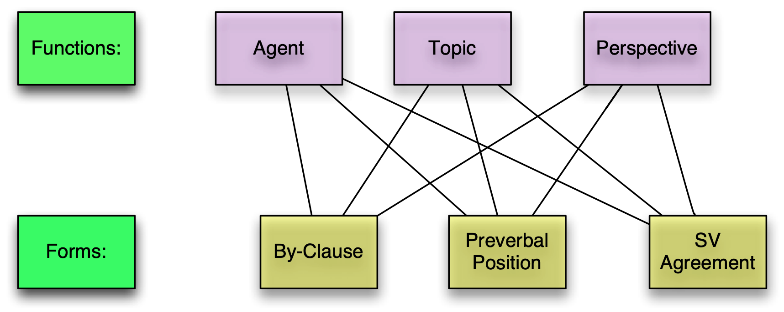
Competition Model (1982):
Functions compete for forms

Slide 17
Motives and Constraints
Constraints can arise from Physics, Biology, Society
Motives are intentional constraints
Other constraints derive from the nature of emergent levels — to be discussed
Language can express constraints and motives from many levels at once: You flip up that little temporal lobe Cognition and Instruction 2002

Slide 18
Evidence
Experiments measure cue strength - ANOVA / MLE
Corpora for cue validity
Crosslinguistic analysis
Imaging : ERP, Ping Li VR, Code-switching
TalkBank microgenetics

Slide 19
Findings
Final role assignment is based on summed cue strength
Online role assignment is based on single strongest cue
Decisions are fastest when all cues agree
Toddlers start learning with sentence prototypes
Development shifts to reliability and then conflict reliability
Cue strengths are initially transferred from L1 to L2
142 studies at https://psyling.talkbank.org/guides/CM.html

Slide 20
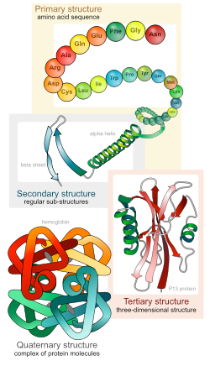
2. Levels --
Protein Folding
  1. animo acid chain
          picoseconds
  2. helices and sheets
          microseconds
  3. 3-D macro structure
          milliseconds
  4. protein molecule complex

Slide 21
Mechanisms on levels
Emergence of secondary structure from properties of hydroxyl bonds, Van der Wals forces
Emergence in tertiary structure through helper proteins
Each protein has a function in some larger metabolic pathway past Level 4
Each biochemical cycle is shaped through evolution
30

Slide 22
Mechanisms and levels for water
Level | Mechanism | Emergence
Atom | Valency | Tetrahedron
Molecule | Polarity | Liquid
Liquid | Solvency | Salt Water
Solid | Temperature | Lattice
Lake | Solid is lighter | Bottom doesn’t freeze
Planet | Ice at Poles | Ocean currents
 | Saturation | Clouds, Rain

Slide 23
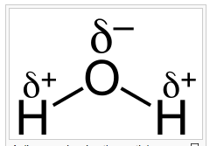
Water
O is strongly negative and attracts electrons from H. Resultant dipole leads to hydrogen bonding
Cooling of bonds allows ice to float and lakes not to freeze over.
The fact that ice floats allows life to survive the winter in lakes.
Salt rejection from ice produces the ocean currents
Water evaporates up to form clouds

Slide 24
Levels in Language
Gestures combine to make syllables
Syllables combine to make morphemes
Features combine to make meanings/concepts
Meanings link to morphemes
Morphemes combine to make words
Words combine to make clauses
Clauses combine to make utterances
Utterances combine to make conversations or narratives
Narratives combine to make cultures

Slide 25
Levels of Language
Subsystem | Area | Processes | Theory
Audition | STG, IPG | Extracting phonemes | Statistical learning
Articulation | BA44, motor cortex | Targets, timing | Resonance, gating
Lexicon | STG RH coding | Phonology to meaning | DevLex
Syntax | BA45,47 | Slots, sequences | Item-based patterns
Mental Models | BA47, DLPFC, MTG | Deixis, Perspective | Perspective, Roles
Participation | Social system | Topics, turn-taking | Conversation Analysis

Slide 26
Audition
Basic apparatus is cross-species
Tonotopic organization
Vocalization/audition loop — Piaget DIVA
Statistical (cortical) learning for phonotactics
Early perceptual magnet, but then tuning by lexicon
Speaker/dialect adaptation
Dual route: dorsal to motor, ventral to lexicon
Auditory cortex connections are complex

Slide 27
Articulation
Recent phylogenetically — Macneilage
Last synapse before spinal cord, but there are
Two sets of motor cortex neurons, one is flexible
Flexible control by striatal system
Gestures linked into syllables
Disfluency based on competition - Nozari vs Roelofs
Flege-Bohn Revised Speech Learning Model

Slide 28
Lexicon
Primates have concepts and gestures, but phonology opened up the system
Embodied learning with social support — Tomasello, Smith
Hub-and-spoke embodied organization based on learning in the hippocampal-based declarative system — DevLex
Operator/nucleus or predicate/argument organization based on item-based pattern (IBP) learning — MacWhinney 1975/2016
FBP feature-based pattern learning — Construction Grammar
L2 learners excel in lexical acquisition

Slide 29
Morphology
Constraints from articulation feed back to lexicon - OT
Vowel harmony, assimilations, stress patterns
Lexical groups: DevLex and SOFMs

Slide 30
  Syntax
Now or never: Christiansen Chater
Linearity limits possible cue types
O’Grady: Syntactic Carpentry
MacWhinney: IBP, cue strength, perspective shifting
Chomsky: MERGE

Slide 31
Fast and slow processing
Statistical learning only clearly supports phonotactics in early childhood
LLMs learn through self-supervised processing of huge amounts of text
Humans may do some of this, but they also use item-based embodied small-trial learning based on meaning
LLM-type system runs as an automaton. Meaning system runs as a backup.

Slide 32
Mental Models
Perspective Framing
  structure building: Gernsbacher
  starting points: MacWhinney, Bornkessel-Schlesewsky
Space/Time framing for mental model
Deixis, anaphora framing
Much of this level could be universal?
Thetic intrusions / conversational constructions

Slide 33
Attention
As much as possible, all these processes operate without attention, but
When there is conflict, attention comes into play
And we can use attention to focus on each different level
This means that we are using attention in different forms
L2 learning could be implicit, but it can’t be without attention

Slide 34
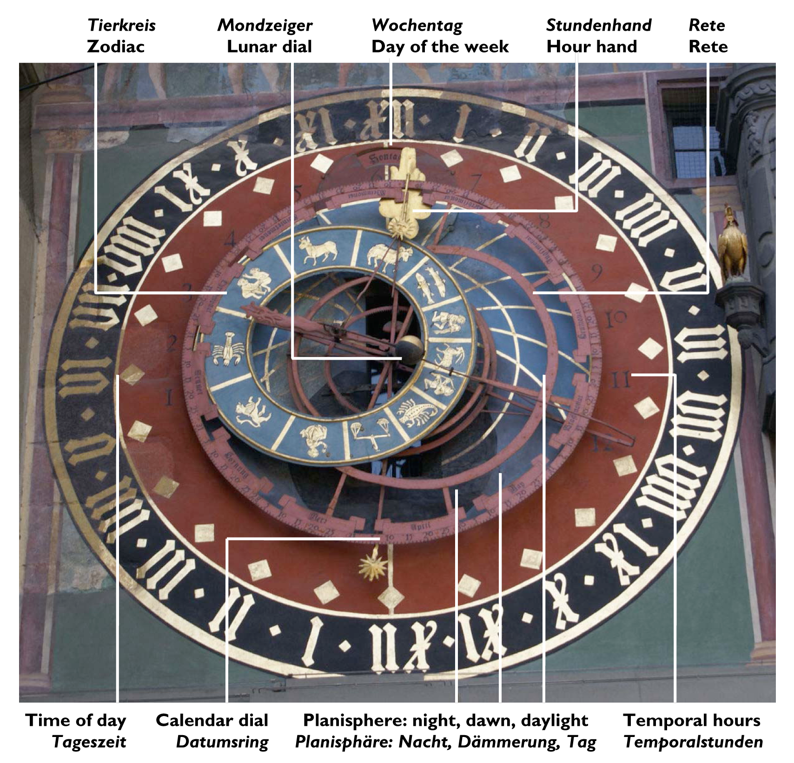
3. Timeframes/Process Frames

Slide 35
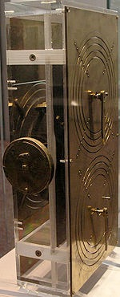
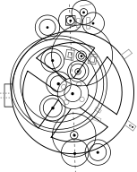
The Antikythera – Greece 150BC

Slide 36
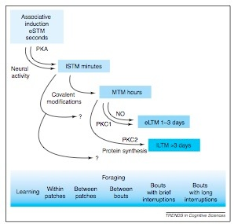
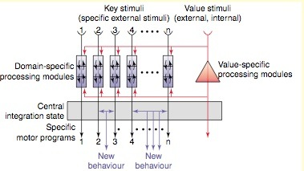
Timeframes in Bees

Slide 37
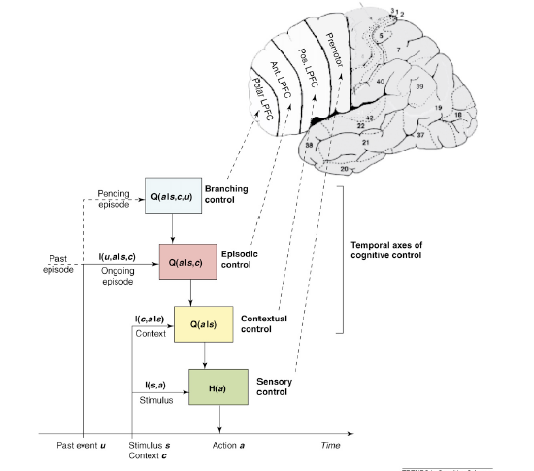
Cascade Control - Koechlin
Momennejad and Haynes: aFPC encodes
prospective memory: what, whether, and when

Slide 38
Process Groups
Evolution and Body
Evolution and Brain
Development
Processing
Consolidation
Social - Language Change

Slide 39
1. Evolution and the Body
A Unique Niche: bipedalism, manual dexterity, social cohesiveness, neoteny
Birth canal, spinal cord, vocal tract, teeth, muscles, cranium, circulatory system, retain opposing thumb, expansion of intercostals

Slide 40
2. Evolution and the Brain
Expansion of brain in homo erectus, initially parietal
New functions from old forms, language from gesture, perspective from cooperation
Neoteny: slow entrenchment (Lenneberg), but shift at puberty
Coevolution of language, body, sociality, and cognition
Language as an continuing evolving system (Deacon, Givon) – evidence from Sumerian, even German
Creoles don't arise from a Bioprogram. They are just the easiest first steps in language creation, given constraints.

Slide 41
3. Development
Development is about
  first, new functions from old forms
  then, new forms for old functions
Phenotypic adaptation - West-Eberhard
Plasticity - Quartz & Sejnowski

Slide 42
Developmental Neuroemergentism
Reuse - Michael Anderson (2010)
  new functions from old forms - massive redeployment
  66% of areas play a role in at least 3 tasks
Cultural Recycling - Dehaene (2007)
  exaptation (old form, new function) during lifetime
  left VWFA for reading
  Broca's for ASL
Developmental specialization: Mark Johnson: ConSpec and ConLearn

Slide 43
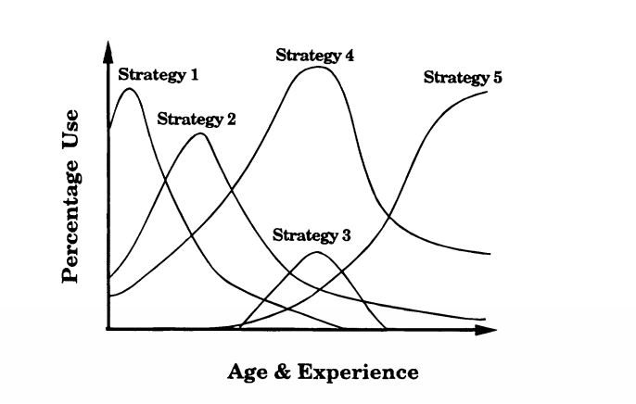
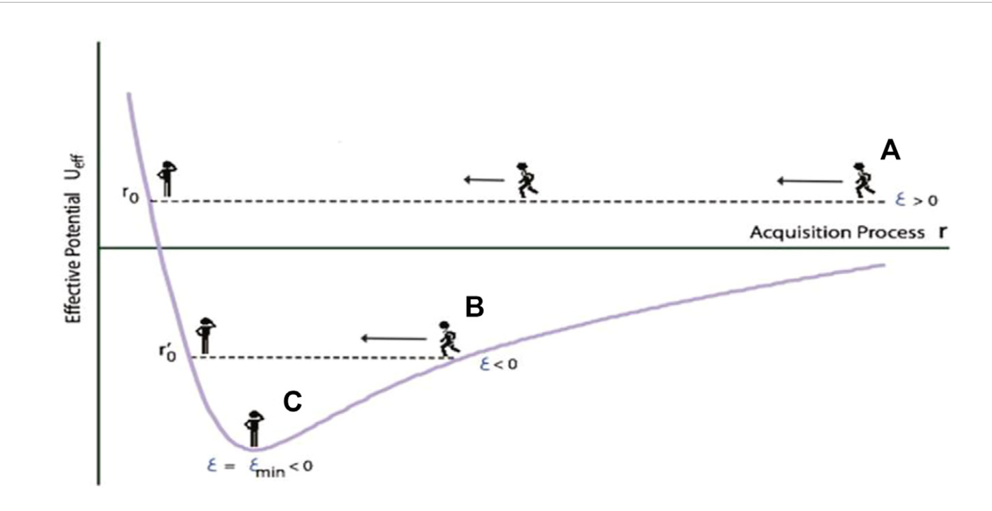
Waves, Cascades, Levels — Siegler, Han

Slide 44
4. Processing - Mechanisms
Lexicon: Gang effects, fan effects
Lexical basis – item-based patterns
Immediacy of processing
Clustering (MacWhinney) or MERGE (Chomsky)
Horse races/ Dual-route /Rote-Combination-Analogy
Decision thresholds/DDM/gating — Dell, Roelofs, Ratcliff, Grossberg
Gesture - Speech Linkage — McNeill, Kita, Goodwin, SEEG

Slide 45
Long-term vs. short-term
McDonald and MacWhinney (1997): perspective maintains across compound sentence, whereas pronouns show quick shift
Bornkessel-Schlesewsky & Bornkessel: perspective/prominence has longer temporal duration in EEG, crosslinguistically

Slide 46
5. Consolidation - Mechanisms
Hebbian learning, back-propagation (Plaut), chunking (Anderson), binding (Reder), Bayesian learning (Kemp), sequence/distributional learning (Thiessen), reinforcement learning (Verstynnen), prospective memory, entrenchment, resonance
All are relevant to language.
All of these mechanisms serve as constraints, but in different ways in different task configurations on different levels

Slide 47
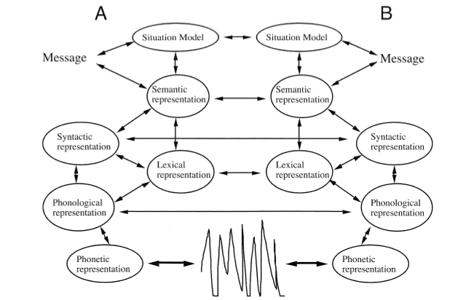
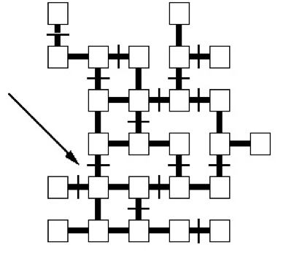
6. Social Constraints -Alignment
CA: alignment for turn projection, topic sharing, perspective, gaze, posture
Social referencing, imitation, entrainment — John Bargh
Common ground — H. Clark, E. Clark
Perspective theory — MacWhinney
Alignment for concept identification — Goldstone’s ABSURDIST

Slide 48
Language Change
The "glossogenetic" timeframes boil down to social frames
Labov and the Northern Cities Shift, loss of prestige for New York, return of prestige in the new millenium
Best to view language change as shaped through a competition of erosion (contrary to adiabatic principle) and memetics.

Slide 49
Code-switching
Fundamental competition between two languages
During a cascade of conceptualization, formulation, lexicalization, gating, and articulation
Constraints/Motives:
  affiliation, solidarity, identification
  culture-dependent conceptualization
  motives for switching
  matrix sentence constraint
  mot juste, attrition, forgetting

Slide 50
Unified Competition Model
Risk Factors | Protective Factors
Entrenchment | Resonance
Transfer, Parasitism | Decoupling
Overanalysis | Chunking, Proceduralization
Pattern recognition | Aptitude
Reward immediacy | Executive control
L1 identity | L2 acceptance
Isolation | Participation

Slide 51
Corpora
All of the space-time-process frames must show their effects and be conditioned in actual moments in time and space.
  We can capture The Moment and The Place for the bodily, processing, and social constraints/motives in multimodal longitudinal corpora. Hence TalkBank.org
However, consolidation is only visible through experiments and neuroimaging.
We can only barely see evolution in real time in Drosophila. we have to infer it.
5/22/04
5

Slide 52
Falsification
Conceptualizations cannot be falsified, but specific implementations can be.
Liberman: evolution of articulation based on descent of larynx in Cro-Magnon
Alternative: descent of larynx and sexual selection

Slide 53
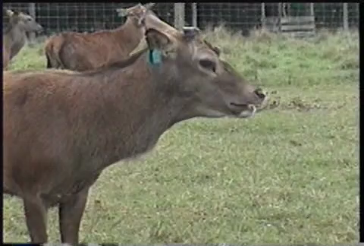
Emergentist accounts can be wrong

Slide 54
The challenge: fitting the pieces together
Cascade control: executive control of action levels as in code-switching
Consolidation levels: fast learning links to input, slow links to generalization with inputs through resonance
Proceduralization levels: Fluency studies => SLI, L1, stuttering, L2, Aphasia, Dell, DIVA, Levelt
Gating of lexicon by syntax: 4 levels of speech errors
Diachronic accumulation of processing biases
Memetic diffusion links to affiliation, identification
Evolutionary wheels link to adaptive success of variations in the phenotype

