Slide 1
  Item-based Patterns
  and the LPLA
Lecture 6a

Slide 2
What is an IBP?
a predicate – either a free or bound morpheme,
related argument slots with feature specifications
the positions of the arguments vis a vis the predicate
the conceptual relation that holds between the predicate and each argument.

Slide 3

An example
more + X (more cookie, more milk)
  identity of the predicate = more
  position of the argument = after
  relation between predicate and argument = recurrence
  features of argument = substance, possibly action

Slide 4
Diagrammatically
relation**
more
X
position
argument
features/POS
predicate/operator
Short Form:
more + X
** relations derive from core operators in embodied cognition

Slide 5
Emergent Combinations
cookie =
  “would you please open the cupboard door and bring me down a cookie”
want ##### cookie
want # cookie
want cookie
Nim Chimpsky, Washoe, Sara, Lana

Slide 6
Clustering
my + X
little + X
  my little dolly
X + go (this goes)
where + X
  Where this goes?
  Where goes this?
  Where does this go?

Slide 7
No movement
Bresnan 1982
  Mary has braids. *Braids are had by Mary.
  Tim lacks energy. *Energy is lacked by Tim
  The suit fits Tom. *Tom is fit by the suit.
Questions
  Aren’t I invited? *I aren’t invited.
  John may be coming. *May John be coming?
Kuczaj 1978 — wh and aux learned one by one

Slide 8
Algorithms, Probabilities, and Competition
Some aspects of language seem fundamentally algorithmic — recursion, dependency, unification/merge, IBPs
Other aspects seem fuzzy — POS, competition, semantic extension
Language is full of competition (Unified Competition Model)
Can these 3 forces coexist?

Slide 9
Implications for 7 debates:
Rules vs Probabilities
LPLA: APNE (negative evidence)
LPLA: APPE (positive evidence)
Language evolution: sudden or gradual
Critical Periods and Fundamental Differences
The relation between ATL and Broca’s area
Semantic bootstrapping (assumed)

Slide 10
Early Formulations
1966 Braine – Positional patterns in MLS (ALS, ALL)
1968 Braine – Child Pivot Grammar
1971 Bloom – Why not pivot grammar?
1971 Braine – Sieve Model
1975 MacWhinney – item-based patterns (IBP)
1976 MacWhinney – superimposition
1982 MacWhiney — feature-based patterns (FBP), clustering

Slide 11
More recent formulations
1987 – Langacker’s sieve model
1990 – Tomasello's “Verb Islands”
1995 onward – Rise of Usage-based Linguistics
2006 – Hierarchical Bayesian Models: Perfors, Kemp
2009 – Bannard & Lieven’s PCFG based on formulas
2009 – Hierarchical Prediction Network: Bod
2014 – MacWhinney’s restatement
N.B. All of this has focused on L1

Slide 12
Related Frameworks
1987 – Langacker sieve model
1990 – Tomasello “Verb Islands”
2001 – Recycling: Lieven, Dabrowska, colleagues
2006 – Hierarchical Bayesian Models: Perfors, Kemp
2009 – Bannard & Lieven PCFG based on formulas
2009 – Hierarchical Prediction Network: Bod
N.B. All of this has been only about L1

Slide 13
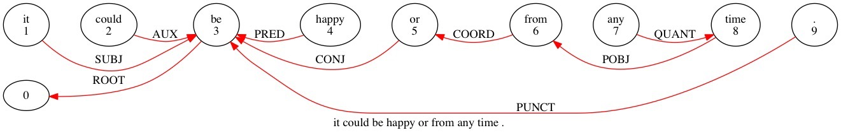
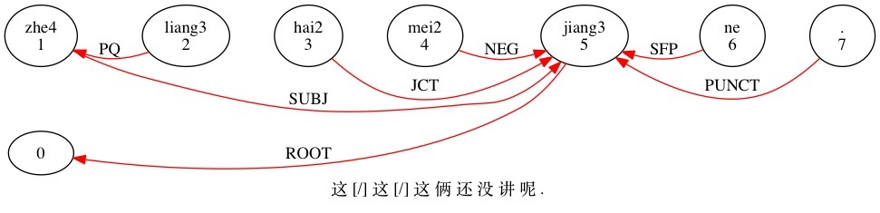
Dependency Grammar

Slide 14
Diagrammatically
relation**
more
X
position
argument
features/POS
predicate/operator
Short Form:
more + X
** relations derive from operators in embodied cognition

Slide 15
IBP and predicate learning
When the child learns “cookie” or “byebye” they are not predicates, but complete statements (Einwortsätze).
When the child learns “nice” in the phrase “nice cookie”, there is an unknown (nice) extracted from the phrase that includes the known (cookie) (MacWhinney 1978).
The predicate acquires its meaning, relation, and position AT THE TIME OF LEARNING.
So, IBP learning is directly linked to the learning of the meaning of predicates.

Slide 16
Generative Power of IBP
MacWhinney (1975) used IBPs to generate 90% of Zoli’s first 1000 utterances. No evidence of overgeneration.
Lieven, Pine, & Baldwin (1997) and Dabrowska & Lieven (2005) show good recall, but poor precision, because they didn’t limit their model to items with detailed frames. (Wintner 2010)
Adult frames support IBP induction
  See the nice __ Want a __
Adult variation sets induce IBPs (Waterfall)
  Do you want the cookie? Do you want it? (Harris, 1951)

Slide 17
Conservatism of IBP
Pine & Lieven (1997) show that the fillers for “a”+X and “the”+X are initially not the same. Kuczaj (1978) found same for wh-words.
Tomasello (1992): in the 2-year-old, verbs are limited to particular frames and constructions with little evidence of FBP.
Tomasello & Brooks (1999) show that 3-year-olds do not generalize transitives to intransitives

Slide 18
Feature-based Patterns (FBP)
Generalization of the predicate creates two generalized slots: ADJ + X
The first pattern to show this clearly is the adjective/modifier in English, because of high reliability and availability (Competition Model prediction)
French/Spanish modifier are slower, because of inconsistency. Hungarian is unclear, because of copula deletion.

Slide 19
FBP Generalization
knows: nice + X, big + X, looks
hears: is nice, is big
extracts: IBP is + ___ (Adj class)
Hears: doggie is mean
adds: mean to Adj class
hears: mean doggie
applies: nice + X, big + X
extracts: Adj +X
Other routes are possible and all operate cooperatively to extract FBPs
26

Slide 20
An example
[must (+ tense, +pres, +obl, +intent)] + go, come, eat [action, state]
[can (+tense, +pres, +pot, +intent)] + go, come, eat [action, state]
[will (+tense, +fut, +intent)] + go, come, eat [action, state]
Superimposition yields ----->
(+intent, +tense) + V
Eventually
+tense + V
27

Slide 21
IBP ⇒ FBP: Superimposition
Braine 1971, MacWhinney 1976, Langacker 1987, Saxton 1997, Dabrowska 2014
More milk, more cookies, more soap => more + X (generalization of IBP argument slot)
More milk, some milk, no milk, less milk => QN + X (predicate/operator generalization -> phrase-structure rule)

Slide 22
FBP ⇒ Global Patterns
Hungarian/Chinese topics
  kislány # szép. (girl # pretty.)
Topic + comment can start as item-based and then be generalized, just like Adj + N
Four year-olds show FBP
  They correct VSO in Ahktar (1997), but not earlier
  Causative generalization in Tomasello & Brooks (1999)
Adj + N early in English, Topic + Comment early in Chinese

Slide 23
Discontinuities
He is coming
  V + -ing (suffixation) => V’
  is + V (Aux + (V-ing) ) => V’’
  he + V’’ (S + V’’)
Is he coming? IBP centered on is(q)
  is(q) + (NP) + V + -ing
Eventually
  AUX + (NP) + V + -ing

Slide 24
Patterns of clustering
Predicate can be a free or bound morpheme
Repeated clustering:
((((my + brother) + ’s) + (friend))+ ’s) + car
    but not in Pirahã
Arguments of the argument:
die(pl) Mädchen koch-en(pl)
  das(sg) Mädchen koch-t(sg)

Slide 25
Myth #1: Whole Sentences
Children parse whole sentences and link to whole scenes, perhaps through batch learning.
Actually: Children piece together fragments. Batch learning fails to appreciate the roles of
  The growing lexicon
  Partial understandings
  Clusters of dependency relations
  Parental fine-tuning

Slide 26
Myth #2: no single words
Children don’t hear single word utterances.
Actually: 23% of the utterances directed at 12-month-olds are single word utterances (Brent corpus).
40% are 2- and 3-word utterances
freq +s"*MOT:" +u +re +d4 +y +.cha
wdlen +t*MOT +re +u *.cha
cooccur +x2w -x2w +t*MOT +u *.cha

Slide 27
Myth #3: its all comprehension
Comprehension vastly precedes production. Children fully parse lots of whole sentences.
Actually: Demonstrations of greatly advanced comprehension are flawed. Typically, comprehension only precedes production step by step. Exceptions: Einstein, paraplegics. But they have covert production.
Models that try to match adult input are missing the point. It is better to base models on the child’s output.

Slide 28
Myth #4: statistical learning
Statistical learning is important for phonotactics, but
Children rely on the lexicon and item-based patterns to crack the code, as emphasized in current models (Monaghan, Rytting, Blanchard).

Slide 29
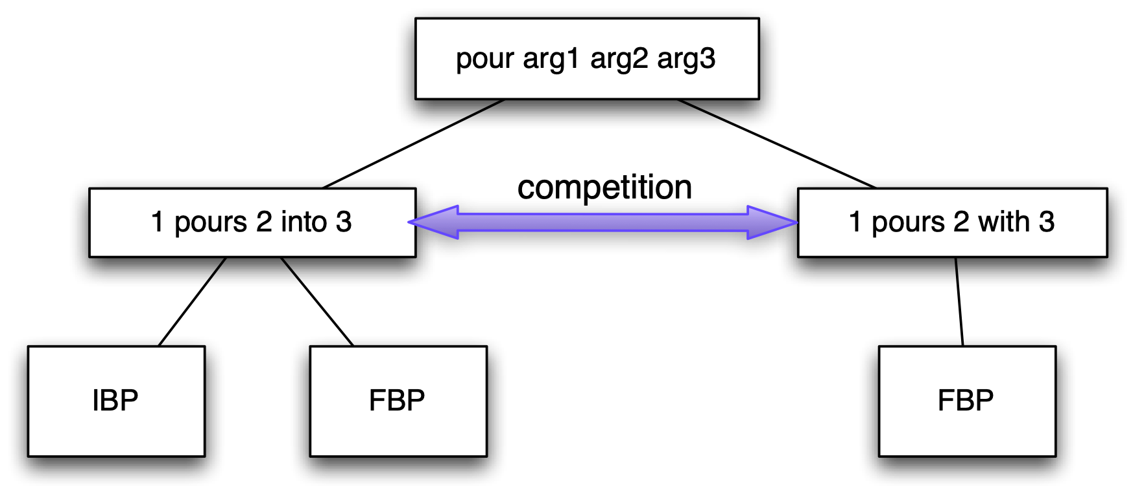
Competition
IBPs coexist with and compete with FBPs - Bowerman, Ambridge, Goldberg
Pour water into the tub. *Pour the tub with water.

Slide 30
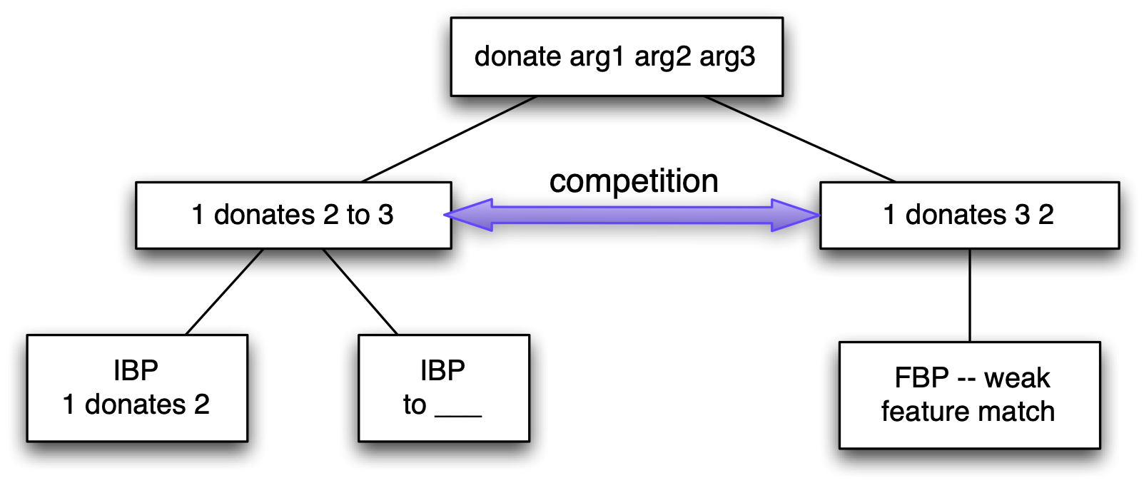
*Donating the library the book

Slide 31
Competition
Other names for competition
  Blocking -- Baker 1970
  Uniqueness -- Pinker 1984
  Mutual exclusivity -- Markman 1986
  Semantic mapping -- Anderson 1978
Competition includes conservatism, probabilism, and indirect neg evidence

Slide 32
Issue #1: Rules vs cues
Algorithms: IBPs emphasize recursion and the combinatorial nature of thought
Probabilities: But POS categories and relations are based on probabilistic learning (coming up next)
Competition: On top of all of this is competition between and among IBPs and FBPs
Answer: all are involved

Slide 33
Issue #2: APNE
Competition resolves the Argument from Poverty of Negative Evidence (APNE): there is only one way to say “goed” and it is “went” - benign exceptions
Chomsky, Braine, Wang and others refer to “implicit negative evidence”
APNE is not the strongest part of the LPLA
But we can still worry about the Argument from the Poverty of Positive Evidence APPE (Crain)

Slide 34
Issue #3: APPE
The boy who is smoking is crazy.
Ia the boy who is smoking crazy?
*Is the boy who smoking is crazy?
S
NP
VP
the boy
is
crazy
who
is
smoking

Slide 35
Constraints
The AUX of the relative clause must move from INFL across the CP and COMP of the relative clause (around “man”).
But the Head Movement Constraint (HMC) blocks this (Ross, 1969).
No such barriers exist in the main clause.
Also, movement of AUX would leave a gap that violates the Empty Category Principle (ECP) in the relative clause.

Slide 36
Emergentist View
HMC is the pragmatic freezing of given information.
ECP is driven by parsing expectations against the sequence “the boy who smoking”
ECP violations can be viewed as unfilled item-based slots.
But more importantly, there IS positive evidence

Slide 37
Chomsky (1980)
The child’s acquisition of language is “hopelessly underdetermined by the fragmentary evidence available.”
Degeneracy of input
Lack of positive evidence
Lack of negative evidence

Slide 38
IBPs and Structural Dependency
Item-based learning for AUX (will, is, can)
  Is the dog coming? is + (NP) + V
  Can you come? can + (NP) + V
Item-based learning for COP
  Is Billy your friend? Is + (NP) + PredN
  Was he your friend? Was + (NP) + PredN
Generalization across TENSE
Eventual FBPs
  AUX + (NP) + V
  COP + (NP) + NP

Slide 39
The Input
Pullum and Scholz (2002) found that 1% of the Wall Street Journal (WSJ) corpus has positive evidence. Most is of the different AUX type. So there is a huge amount of positive input. Or is there?

Slide 40
Evidence from CHILDES
A search of the English CHILDES database (3 million utterances) by Lewis and Elman (2001) found only one “exact match” utterance in the input to Adam.
MacWhinney also found one in the input in the Hall corpus.

Slide 41
No evidence, no production
So there is no positive evidence of exactly this type.
But there is also no production, so how can we know that children follow the constraint?

Slide 42
Experimental Evidence
Crain and Nakayama (1987): Ask Jabba if [the boy who is watching Mickey] is happy?
Children (3-5) never moved the AUX of the relative, although they did other strange things
But the procedure gives the children the relative as a frozen unit.
  “the boy who is watching Mickey”
  There is a fundamental pragmatic fact about relative clause freezing that the structural analyses are ignoring, but …
Still, let us grant that children have some sense of this constraint by age 4. Is there really no input?

Slide 43
But what can count as positive evidence?
Same AUX: Is the man who is next in line coming?
Different AUX: Will the man who is next in line _ come?
Fronted WH: Where is the boy who is smiling?
Item-based (is, will)?
Or class-based (AUX)?
This is crucial for evaluating a data-driven (usage-based) account.

Slide 44
Two other major sources
Double AUX, Sub, WH
  Which is the dog [that is clawing at the door]?
  There are dozens of sentences of this type in the database.
  They show the relative clause staying intact.
  Elman and Lewis’s parser hates: the dog that clawing
Single AUX, Sub, WH
  Where is [the dog that you like]?
  There are hundreds of these.
  They also illustrate keeping the subordinate clause frozen

Slide 45
The biggest source
You can learn from just main clauses
  Is the baby happy?
  Lightfoot (1986, 1997) degree-zero learnability
  Main clause movement is demonstrated.
  Subclause movement is not illustrated.
  Conservatism: If something is not illustrated, it is not legal.

Slide 46
Another Example - Kimball 1973
Kids hear
    It rains.
    It may rain.
    It may have rained.
    It may be raining.
But never
    It may have been raining.
So, there is no positive evidence

Slide 47
But a CHILDES search found
27 might have been
5 may have been
24 could have been
15 should have been
70 would have been

Slide 48
So ...
We can learn: modal + “have_been”
There is really no shortage of positive evidence on this.
Kimball’s mistake was to only search for “may have been” since there were only 5 of these.
Again, learning mechanisms have to be given a little bit of power. We have to allow for extraction of IBPs and then FBPs, along with clustering.

Slide 49
Is this error-free learning?
There are definitely errors.
There is definitely positive evidence.
But it is true that errors seem to be relatively scarce.
So, this is “low error” learning.
We will return to this later.

Slide 50
Binding conditions
Devilliers, Roeper, and Vainikka 1990
  When did the boy say he hurt himself?
  When did the boy say how he hurt himself?
  Who did the boy ask what to throw?
Young children can’t understand #3.
Children will associate “when” with “hurt” in #1 more than #2, but this understanding grows with age
Therefore binding seems to be learned.

Slide 51
Perhaps … But …
Perhaps De Villiers et al. are saying that what is UG is the ability to identify and utilize the structure.
Perhaps learning is just a matter of identifying triggers (Sakas, Buttery)
But the relevant structural details can be expressed in terms of grammatical relations and IBPs.

Slide 52
Movement constraints
Who did John believe __ kissed his buddy?
* Who did John believe the man that kissed __ arrived
* Who did pictures of ___ surprise you?
* What did you see a happy ___ ?
* What did you stand between the wall and ___ ?

Slide 53
Data from Seth (3-4)
What am I cooking on a hot __ ? (stove)
What are we gonna look for some __ ? (houses)
What is this a funny __ , Dad?
What are we gonna push number __ ? (9)
Where did you pin this on my __ ? (robe)
What are you shaking all the __ ? (batter and milk)
What is this medicine for my __ ? (cold)

Slide 54
Yes, Virginia, there is structure
Movement formulated in terms of valency relations (GRs), not position (crucial assumption).
Single AUX sentences teach the basic pattern.
Double AUX sentences show that the choice must be based on the AUX - V valency relation.
For WH, the rule is WH - AUX - (NP) - V.

Slide 55
Yes, it involves Recursion
MacWhinney (1982, 1987) emphasizes the fact that heads in valency relations (item-based patterns) can themselves be complex clusters (X-bar theory).
Clustering implements recursion.
Here, the whole relative clause is an NP which is not a part of the AUX + (NP) + V pattern that is learned.
Freezing of RC blocks extraction (pragmatic effect)

Slide 56
Issue #4: What is Recursion?
Clustering produces embeddings and X-bar
Psychological minimum is
  Head-based clustering (in a buffer or memory)
  Repeated application to cluster heads - missing in Pirahã
  Operates in real time from “left to right” - O’Grady

Slide 57
What is recursion?
  S -> NP + VP
  NP -> det + (Adj) + N (S)
  Relativization: The boy who climbed the tree…
  Complementation: He wanted to climb the tree.
  Possessive strings: My friend’s father’s sister’s …
  direct recursion: combination, merge
  tail recursion: iteration
  embedding: rare

Slide 58
Combination
the + dog => the dog (still a noun)
dependency grammar
combinatorial grammar, merge
X-bar theory, headedness, clustering
(almost) everyone agrees about this

Slide 59
Iteration
the napkin on the plate on the table in the room
a big red India rubber ball
tea-pourer + maker => tea-pourer-maker
Jane’s father’s brother’s neighbor’s bike
Bill thinks that John knows that Mary hopes ….
This is the farmer sowing his corn, that kept the cock that crow'd in the morn, that waked the priest all shaven and shorn, … the house that Jack built.

Slide 60
Center Embedding
The mouse the cat the dog chased bit ran.

Slide 61
Iteration, Recursion, Anaphora
  W and X and Y and Z
  (W and (X and (Y and (Z)))
  (W, (X, (Y, (and Z)))
  The man who smokes climbed a hill.
  That man, he smokes. That man climbed a hill.

Slide 62
Recursion vs circularity
Defining Ancestor:
  Base: my parent’s are my ancestors
  Expansion: the parents of my ancestors are also my ancestors
  Termination condition
Recursive definition vs circular definition
  Definition of recursion (see recursion).

Slide 63
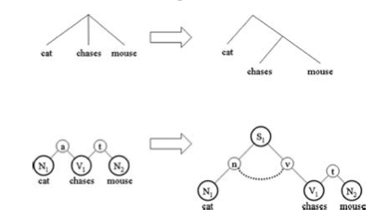
Recursion, Roles, and Binding

Slide 64
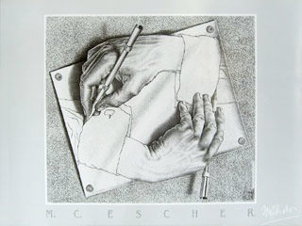
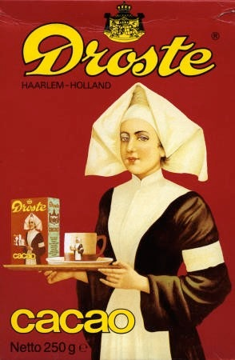
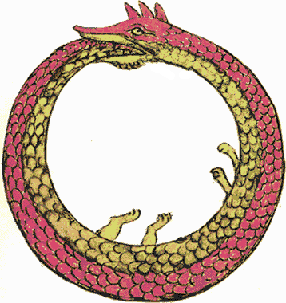
Self-embedding

Slide 65
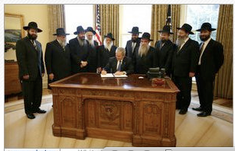
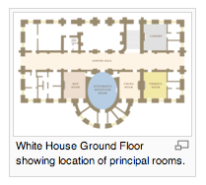
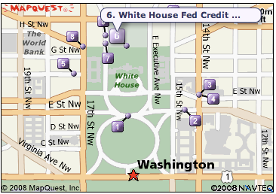
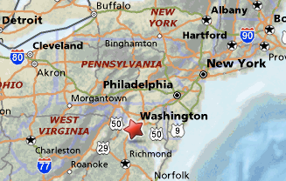
Spatial Zooming
Fractals
Spatial embedding
Cycles, catalysis

Slide 66
Recursion and Imagery
Frontal-temporal connections support spatial imagery for action planning (Steedman), navigation, and tools making.
Integrated frontal function constructs group relations: kinship, reciprocals, hierarchy.
Competence grammars are seldom proposed as Performance grammars

Slide 67
Recursive Rewrite System
  Non-terminals = classes
  Terminals = words in classes
  Non-terminals expand as terminals
  Constituent Structure combination
  Constituent Structure order (or non-configurational)
  Rule cycle
  The stack
  Iteration
  Termination condition

Slide 68
Building Clusters
The graceful dog
  “the” sets up workspace for NP
  “graceful” added to image
  “el perro gracioso” puts image first
Perspective shifts
  The dog that chased the cat stole the bread.
  The cat the dog chased stole the bread.

Slide 69
Storage Methods
Crossing: Sean and Bill drank Guiness and Coors, respectively.
Coreference: John climbed Everest in 1995 and Bill did it in 1998.
Embedding in sentence or discourse:
  The policeman the mayor called arrested Bill.
  That policeman, the mayor called him, that man arrested Bill.

Slide 70
Is recursion the FLN?
  Yes, but it takes the full coordination of six systems and their subcomponents to support recursion.
  These systems evolved over 6 million years or more.
  Core aspects of recursion were prepared before language.
  FLN is based on six million years in a special niche for a bipedal social climber.

Slide 71
Issue #5: Critical Period for L2 learning?
Complete formulaic multiword expressions (FMWEs) ,
  you don’t say
  I couldn’t have said that better myself.
MWEs with slots:
    Would you mind if I had some ___
    Können Sie mir vielleicht ____ geben?
Transfer of L1 IBP to L2: more + ____ => más + ____
Transfer of L1 FBP to L2: ADV + V => *souvent vais
Using Legos like children

Slide 72
MWEs vs IBPs
Carlos (Eskildsen, 2015) shows this competition:
  Where are you from?
  What they are doing?
  What do you say?
  You can say like this.

Slide 73
IBPs give rise to FBPs
Carlos (Eskildsen, 2015): What is, where is, whose is, what are => elimination of missing do-support over time
Why are you V-ing (*why you V-ing) is the last to change
This is the same pattern observed for children by Kuczaj (1978).

Slide 74
L2 can mix IBP and MWE
Eskildsen: I can Verb may derive from puedo Verb
Can I Verb may derive from puedo Verb?
Carlos’s expands the MWE can you write Noun? to other forms.
Bardovi-Harlig: I am going to write about NP arises after initial productivity of going to Verb

Slide 75
L2 learning traps
MWEs are highly contextually sensitive and often not that generalizable.
Learners are deceived by L2 FBPs that partially resemble L1, such as French adjective placement.
They can also be deceived by L1 FBPs that partially match L2 FBPs.
  French adverb placement
  German “Important is to know”
Cautious L2 learners will test this out by transferring IBPs and not FBPs — Pienemann Swedish learners of German

Slide 76
Issue #6: ATL and Broca, neuronal assumptions
Resonant topology - retinotopic, tonotopic
Two-phase activation
  Cohort activation
  Winner take all
  Learning adjustment
Preference for local connections
Widespread lateral inhibitions

Slide 77
Production
ATL as the Hub, STG as the phonological controller, distributed cognition (Martin, Just & Mitchell, Lambon Ralph), Broca’s as activator
Broca’s (pars opercularis/BA44) controls clustering (substitution, unification) by gating ATL through FBP
ATL gates production through STG to dorsal stream, relies on IBP and compounding
Timing: Firing of three areas must occur in just-in-time (JIT) incremental synchrony

Slide 78
Comprehension
Ventral path from STG to ATL activates IBPs
Broca’s (pars opercularis/BA44) controls clustering/recursion (substitution, unification)
Frontal areas build up mental models and adjudicate competition

Slide 79
The brain’s solutions
All areas (ATL, STG, BA44) use topological mapping, as in DevLex.
Area connectivity patterns are established during neurogenesis.
Resonant processing links patterns across areas.
Gating and timing can be facilitated by chunking and proceduralization (ACC, striatum)

Slide 80
Conclusions
Competition resolves the APNE
The generalization of IBP to FBP resolves the APPE
The processor uses probabilities, recursion, and competition in coordination
Recursion relies on clustering and mental model construction

