Slide 1
The Emergence of Grammar from Perspective
Lecture 13a
1

Slide 2
Basic Idea
The Emergentist Program (MacWhinney & O’Grady, 2016) holds that patterns arise from constraints operating on structural levels. This includes human language and grammar.
For grammar, these constraints involve:
  now-or-never processing (Christiansen & Chater)
  the flow of perspective for the construction and expression of mental models
This view is in accord with the theory of Embodied Cognition across timeframes

Slide 3
Roots of Embodied Cognition
Philosophy: The Stoics, Augustine, Schopenhauer, Spinoza, Kant, Heidegger, Vico, Prinz
Psychologists: Freud, James, Vygotsky, Barsalou
Neurologists: Damasio, Rizzolatti, Graziano, ….
Educators: Herbart, Pestalozzi, Dewey, Montesorri
Artists: Stanislavski, Orff, Kodaly, Dalcroze
Linguists: Cognitive Linguistics, CMT

Slide 4
We all realize that
Language is used to convey ideas (Pickering & Garrod)
We think in terms mental models
Mental models make use of embodied imagery
People take a human actor point-of-view on the world
Conversation works to align mental models (Goldstone)
Language is designed to facilitate this

Slide 5
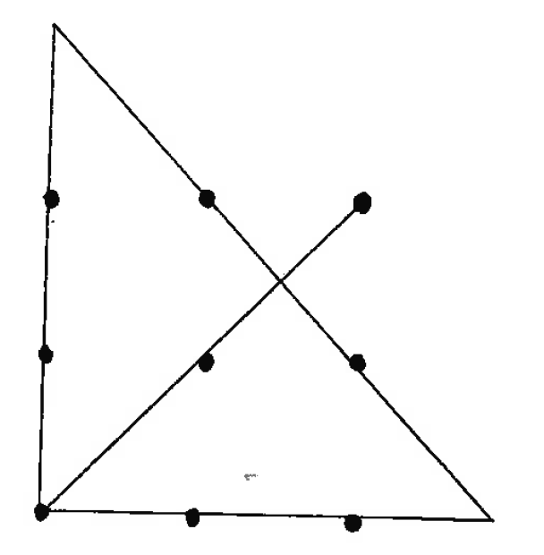
But we haven’t connected the dots
Mental models are constructed in real time
The human point-of-view has to act through real time during speaking and listening
Therefore, language must support a DYNAMIC construction of mental models from a point-of-view

Slide 6
But
Linguists may be unhappy because they think this means there is no grammar. But grammar arises from the proceduralization of processing (Givon)
Cognitive Psychologists may be unhappy because mental models seem to invoke homunculi. But there is much evidence from neuroscience about how images and perspective are constructed
Social Psychologists might think this predicts changes in stereotypes. This is not the primary effect, but it could be a result.
Neuroscientists are pretty happy. But they need better methods to track dynamic processing.

Slide 7
Projection Mechanisms
Body Image – Damasio, Ramachandran
Body Image Matching – Meltzoff, Decety
Localization – Klatzky, Profitt
Mirror Neurons – Rizzolatti, Gallese
Empathy – Adolphs, Pelphrey, Maturana
Imagery – Kosslyn
Mental Models – Chafe, Langacker, Johnson-Laird
Perspective Tracking – MacWhinney
9

Slide 8
2. Identification and Mapping
Imitation and identification require “mapping” of body image
Johansson point-light displays (see YouTube examples)
Johnson (1998), Meltzoff and Moore, Csibra et al.
    Eyes and movement trigger identification
    Identification is basic, not cue-driven
Mapping to other
    Birds “have no hands” (Menn)
    Child looks for its tail. (Mervis)
    Child opens mouth for scissors (Fincham)

Slide 9
3. Localization
Where am I?
Position in world – egocentric, allocentric, geocentric
The adults in the picture are facing away from us, with the children behind them. —Cantrall
Tracking facing and position of the body
Imagined movements of the body.
Tracking position while blind-folded.

Slide 10
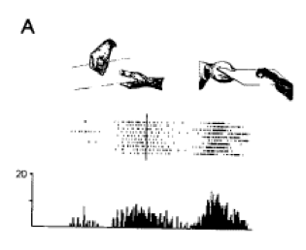
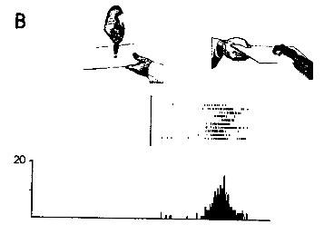
4. Mirror Neurons
E grasps M grasps
E with pliers M grasps

Slide 11
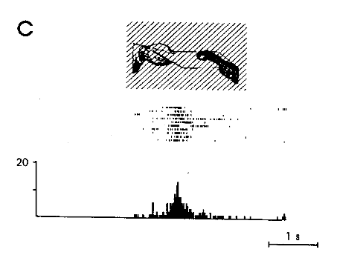
Monkey grasps in dark

Slide 12
5. Empathy
Watching people fall, we also feel fear.
Watching people cry, we also feel sad.
Decety, Adolph have tracked the emotion to the amygdala
Pelphrey has tracked the social matching in the superior temporal.
26

Slide 13
6. Imagery
Animals dream and have images.
Freud’s primary processes trigger images.
Day-dreaming and resting state all involve sequences of images
Imagery relies on the perception-action cycle.
40% of people report little mental imagery, but don’t they dream?
27

Slide 14
Perception-Action Cycle
When we perceive actions, we activate the same brain structures we use to produce the actions.
When we imagine actions, we activate the same motor areas we use.
When we recognize objects, we do this through our actions on them. Gibson. Two paths.
28

Slide 15
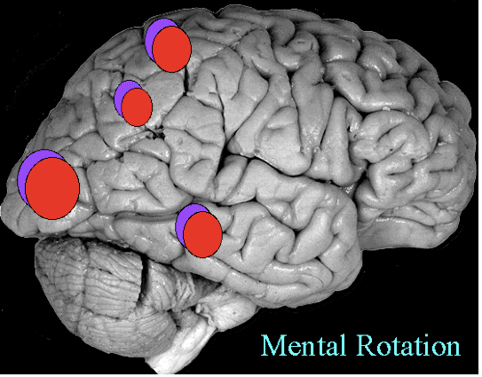

Dorsal (Enactive), Ventral (Depictive)
enactive
depictive

Slide 16
Language coding to the body
Features: articulation, movements, limbs, senses
Words
  Banana
  Navajo table and chair
  Verbs – give, walk, talk, push, run
  Big schemas – promise, gravity, a certiorari
Linkers - deixis, anaphora
Phrases - (my (little doll))
Clauses - grammar
Discourse - characters on stage
But “promise” is already a whole discourse

Slide 17
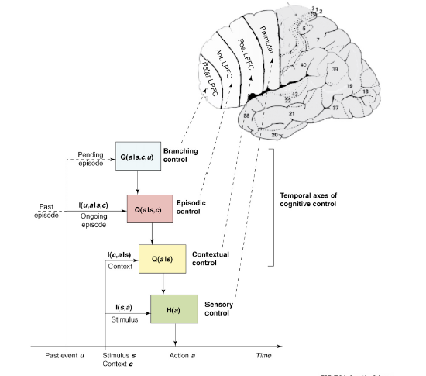
7. Mental Models
Summerfield & Koechlin:
Frontal control across timeframes
And the pSTS (posterior superior temporal sulcus) processes animacy
This can be based on linkage to constructions with grammatical roles

Slide 18
8. The Human Perspective
When we act, we have
  A stance (balanced, sitting, stretched)
  A spatial position (in front, behind)
  A temporal flow (repeat, single, end)
  Goals and plans (push, open, turn, fall)
  Emotions (always present)
  A social position (giver, brother, trust)
All of these actions situate us in a human perspective
32

Slide 19
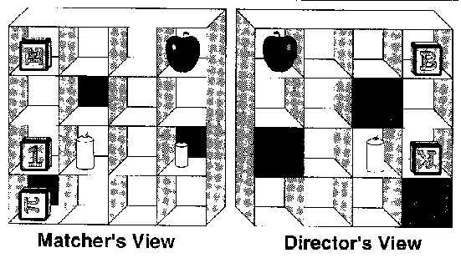
Put the bottom block below the apple

Slide 20
Theory of Mind (ToM)
O wad some Pow'r the giftie gie us; To see oursels as ithers see us. — Robbie Burns
Would that the gift some power would give us to see ourselves as others see us — Robert Burns

Slide 21
Cognitive Assumptions
Speaker and listener share mental models.
These models depend on temporal, spatial, and causal linkages.
Links are structured by perspective tracking.
Specific neuronal projection systems keep these cognitive simulations separate from direct perception and action.
The primary function of grammatical devices is to mark perspective tracking.

Slide 22
Psycholinguistic Assumptions
Incrementalism (Sedivy, O’Grady, Gibson)
Direct mapping (Competition Model, Word Grammar)
Load reduction (Gibson, MacWhinney), maintenance of referents, attachments, assignments
Starting Points or First mention (MacWhinney, Gernsbacher)
Slot-filling (Kempen, Hauser LAG)
Competition and Cues (MacWhinney, McDonald)
34

Slide 23
Perspective Tracking
Start of new primary perspective
Maintenance of primary perspective
Drift to a secondary perspective. This shows the relation between perspective and Attention
Linkage: return or link to primary perspective
Shift: Start of new perspective
Delay of primary perspective based on cues to wait
Implicit Perspective from previous discourse or situation
35

Slide 24
Constructions coding Perspective
Passive Adverbialization
Double Object Attachment
Relativization Dislocation
Appositive Clefting
Ergative/Absolutive Topicalization
Conflation Possessive
Comparison Ellipsis, Zero
Complementation/Equi Coordination

Slide 25
MacWhinney & Pleh 1987
Type # switches
SS: The dog that chased the cat kicked the horse. 0
OS: The dog chased the cat that kicked the horse. 1-
OO: The dog chased the cat the horse kicked. 1+
SO: The dog the cat chased kicked the horse. 2
SS > OS = OO > SO
The dog the cat the boy liked chased snarled. 4+
(dog -> cat -> boy -> cat -> dog)

Slide 26
Perspective and Case
Traxler, Mak, Diessel, Bornkessel-Schlesewsky all show that Animacy (prominence, perspective) interacts with case in garden paths and relative clause processing
Prominence/Perspective plays a large role in German
In Turkish, differential object marking (DOM) is driven by Animacy = Perspective
Navajo, Lummi, Awtuw all treat Animacy as central

Slide 27
Constructions as procedures
Emergent grammar (Hopper) becomes proceduralized (Givon)
Proceduralization doesn’t require full perspective taking at each point
As with phonological erosion (Bybee), it doesn’t require erosion at each time

Slide 28
Causal Roles and Perspectives
Predicates are directly grounded
Case is routinized perspective
  Arg1 – Starting point initial perspective or starting point
  Arg2 – Recipient of attention Drift
  Arg3 – External perspective, also with Drift
Grammar arises to encode perspective starts, drifts, shifts, delays, and linkages
Constructions serve to package these relations

Slide 29
Case and Agreement - O’Grady
      All languages have perspective (Arg1) and theme (Arg2).
      They differ on how they expand from a base
      Accusative takes Arg1 as base, marks Arg2 with case.
      Agreement is with Arg1 to allow dropping
      Ergative takes Arg2 as base, marks Arg1
      Often this is because the perspective is obvious (Dubois)
      Agreement can be with either base or Arg1
      The agreement trigger can be either first argument or base argument. In accusative languages they are the same. In ergative they can be split by person and tense.

Slide 30
Split ergativity
In Indo-Aryan, only the perfective is ergative, because the involvement of Arg1 is lessened
Moreover, this is more likely in the 3rd person where perspective is weaker than 1st or 2nd person

Slide 31
Case and Attention
I packed my things.
I packed the suitcase.
I packed my things into the suitcase.
I packed the suitcase with my things.
40

Slide 32
Perspectival Dimensions
Causal action is central, other systems are overlays.
Space – three systems
Time/Aspect – three systems, Aktionsart
Empathy – your beloved cat
Evidentiality – *you are sick (Japanese)
Metaphor – stocks tumbled
62

Slide 33
Perspectival Empathy Domains
The bicyclist appears to have escaped injury
Did the bicyclist appear to have escaped injury?
The reporter said that the bicyclist appeared to have escaped injury.
The reporter asked if the bicyclist appeared to have escaped injury.
John said that Marco hates Sarah’s beloved cousin.
The adults in the picture are facing away from us, with the children hidden behind them. (Cantrall)

Slide 34
Ambiguity
Tim saw the Grand Canyon flying to New York. (Drift vs Shift)
Visiting relatives can be a nuisance. (Start vs Implicit)
The women discussed the dogs on the beach. (Drift vs Shift)
Although John always jogs, a mile seems long. (Drift vs Shift)
The horse raced past the barn fell. (Implicit vs Maintenance)

Slide 35
Aspect
Internal perspectives (Aktionsart) on actions
  Terminative: He stopped chopping.
  Inceptive: He began chopping.
  Iterative: He kept on chopping.
External perspectives involve Reichenbach relative location theory
He had been chopping, when there was a sudden noise.
He chopped until he was called to dinner.

Slide 36
Scope
Every boy climbed a tree. - standard and inverse
Everyone surrounded a dog. - unambiguous
Many arrows didn’t hit the target.
The target wasn’t hit by many arrows.
Three students read two books.
Two books were read by three students.
Every man who owns a Porsche loves it.
44

Slide 37
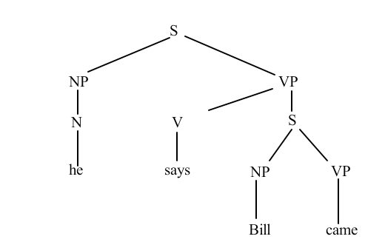
C-Command

Slide 38
C-command
Bill says he came.
He says Bill came.
Bill says Bill came.
He says he came.

Slide 39
C-command as Perspective
Starting points must be referentially committed (MacWhinney, 1977)
Pronouns immediately seek their referents
  McDonald and MacWhinney (1996)
    Mary criticized Billi, because hei ...
    Maryi amazed Bill, because shei …
Perspective flows to referents online

Slide 40
Backgrounding
Cueing commitment delay:
  After hei came, Johni drank three beers.
  Near himi, Johni saw a snake.
Starting point shouldn’t be alone in the background:
  *Near Johni, hei saw a snake.
  Near John, Bill saw a snake.
  ?Near John’si computer desk, hei placed a printer.
  After John arrived to the bar, he ordered a beer.
48

Slide 41
Introduction in the Background
While Ruth argued with the mani, hei cooked dinner.
*While Ruth argued with a mani, hei cooked dinner.
49

Slide 42
Reflexives maintain Perspective
Igori hid the book behind himi/himselfi.
Johni kicked *himi/himselfi.
Johni ignored the oil on himi/*himselfi.
Johni heard a story about ?himi/himselfi.
Maxi told a story about *himi/himselfi.
I did it myself . (no c-command relevant)

Slide 43
Tense and maintenance
*Shei jumped inside the car, when Debrai saw a large man lurking in the shadows.
Shei was jumping inside the car, when Debrai saw a large man lurking in the shadows.
51

Slide 44
Linkage blocked
Jessie stole a photo of *her/herself out of the archives.
Jessie stole me a photo of her/*herself out of the archives.
Anna hid a snapshot of *her/herself under the linoleum.
Lucie talked about the operation on *her/herself.
Lucie talked about the operation on her/herself that Dr. Edward performed.

Slide 45
Clitic Assimilation
    Why do you want to go?
    Why do you wanna go?
    Who(m) do you want to go?
    * Who(m) do you wanna go?

Slide 46
An emergentist alternative
Many of these assignments (attachments, roles, scopes) work to minimize processing distance (O’Grady, Hawkins)
They also work to assign perspective
In fact, c-command reflects this too
Perspective provides a fuller explanation of why the structures and positions have their shape

Slide 47
An example
A cyclone hammered the Bangladesh coast Monday with the force of "hundreds of demons" leveling entire villages of mud and thatch huts, flooding crops, and killing at least six people.
Three men and two children were crushed under collapsed buildings or hit by flying pieces of tin roofs in the southern port of Chittagong. One man died in Teknaf, about 110 miles down the coast, when he was blown off his roof, while trying to secure it.
The storm roared in from the Bay of Bengal with wind gusts of 125 mph, forcing a half-million people to flee their huts and huddle in concrete shelters. Many power and telephone lines were down, so a full account of casualties and damage was not available.
54

Slide 48
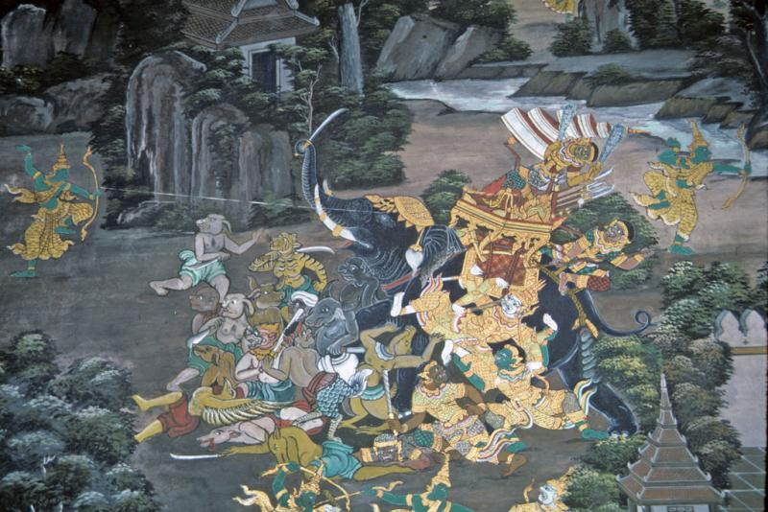
The force of hundreds of demons

Slide 49
Frames
Cyclone - Coast - Monday
Demons
Killing
Leveling
Chittagong - 5 people
Teknak - Man on Roof
die
blown
secure
Results
PowerDown
NoReports
VagueStory

Slide 50
Conclusions
The brain provides mechanisms to implement imagery and perspective construction.
Language then capitalizes on this system to build stories.
These stories are retained as mental models and cultural themes.
The forms of grammar emerge from the need to track perspective through these stories.

