Slide 1


TalkBank: Domains and Methods
Brian MacWhinney
Carnegie Mellon University
1

Slide 2
TalkBank
world’s largest open-access database for spoken language
12,000 published papers
29,663 registered users (in 10 months)
9 TB of media, 50 million words
14 areas
32 languages

Slide 3
TalkBank Principles
Focus on spoken language
Data-sharing / Open Science / Replicability
CHAT transcript format across all corpora and all banks
Alignment across linguistic levels
Transcripts linked to media on file, utterance, and word level
Programs to support researchers, students, and clinicians
Modern software: Python, ASR, AI, JavaScript
Survivability – deployment outside of CMU

Slide 4
Example Studies
ASR for people with disabilities or differences – Gates, NIH, Google
Aphasia and gesture
Automatic diagnosis of phonological disorder
Learning of geometry through knowledge expansion
LLM language learning -- BabyLLM
Development as Preference Management - PLAY
TBI and returning to work as a part of the protocol
UG vs. usage-based models of L1 learning
Recovery from stuttering, parental recasts
Measuring L2 CALF (complexity, accuracy, lexicon, fluency)
HomeBank data on maternal but not paternal pitch

Slide 5
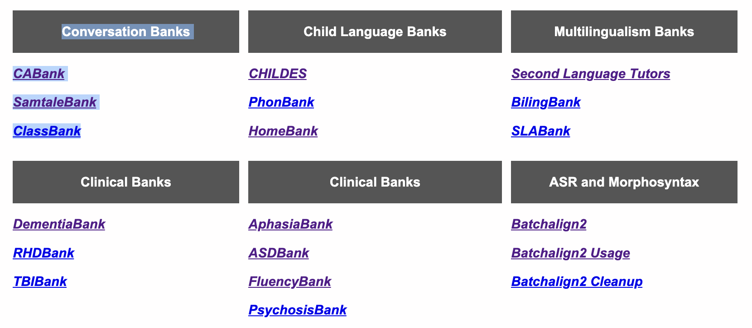
14 Domains

Slide 6
For the 14 domains
Transcripts all in CHAT format, mostly linked to media
Most are tagged for morphology and syntax by UD
Most are openly available
Clinical banks require easy-to-get membership
HomeBank and PsychosisBank require vetted membership
6 clinical, 4 child, 4 other

Slide 7
Clinical #1: DementiaBank
The global challenge of dementia diagnosis
DementiaBank as the only publicly available language data on dementia GrandRounds
Now includes Mandarin, Greek and new Lanzi data
300 MCI/AD and 200 controls with Cookie Theft
Over 400 labs using this corpus to create methods for AD detection: Universities (25 countries), Pharma, Google, Samsung, Apple, Pfizer etc.

Slide 8
Challenges
  ADReSS 2020 Interspeech - Frontiers
  ADReSSo 2021 Interspeech – audio only
  ADReSS-M ICASSP – Multilingual, Greek English
  TAUKADIAL-2024 – Chinese and English
  W3PHIAI-22 Data Hackallenge with Toolkit
  DrivenData Dementia 2024
  DrivenData Child Language 2025
  170 entries

Slide 9
Clinical #2: AphasiaBank
Protocol – 520 sessions, 422 participants, 322 control
LLM and ML for diagnosis and classification
EVAL for automatic analysis
Analyses: lexicon, grammar, gesture, cohesion, fluency, AoS, phonology
Grand Rounds and Examples
MRI images from OpenNeuro for USC corpora
Script repetition training (evaluation in progress)
AoS and motor speech (in progress)

Slide 10
Who has Shared
THANK YOU!
Adler Aphasia Center University of Arizona Austrian Academy of Sciences
Aphasia Center of West Texas University of California, San Diego Higashi-Yamato Hospital, Japan
Aphasia Center of California University of Central Florida Hungarian Academy of Science
Arizona State University University of Kansas Max-Planck Institute, Germany
Boston University University of Kentucky Nanjing Med. Univ. Hospital, China
Duquesne University University of Massachusetts, Amherst Suvag Polyclinic, Croatia
East Carolina University University of New Hampshire University of Athens
Emerson College University of New Mexico University of Macedonia, Greece
InteRACT University of Redlands University of Nova Gorica, Italy
Kathryn Garrett, Pittsburgh, PA University of South Carolina University of Oviedo, Spain
Montclair State University Lucian Blaga University of Sibiu, Romania
Northwestern University University of Valencia, Spain
Snyder Center for Aphasia Life Enhancement University of Zagreb, Croatia
Stroke Aphasia Recovery Program
Stroke Comeback Center
Texas Christian University
Triangle Aphasia Project

Slide 11
Clinical #3: TBIBank
Uses the AphasiaBank Protocol and free interview
58 participants with TBI at 3, 6, 9, 12, and 24 months after injury
All linked to video, all analyzed for morphosyntax and coreference
Grand Rounds by Leanne Togher and Elise Bogart from Sydney
All Australian!
Analyses using CC and focus on returning to work

Slide 12
Clinical #4: RHDBank
Uses the AphasiaBank protocol and additional tasks
Grand Rounds
TBI, RHD, and PsychosisBank focus on issues with discourse, cognition, communication, not just grammar or phonology
For this, Collaborative Commentary (CC) and a tagging system is ideal
The Clinical banks have Grand Rounds linked to CC

Slide 13
Clinical #5: PsychosisBank
Large English corpus from Lena Palaniyappan (400 participants)
Corpus from Sunny Tang in NYC with more marked psychosis
Standard protocol with personal narrative, health narrative, picture descriptions, dream reports, and story recall
Computational analysis group works on LLMs, graphs, TLI analysis, vocal features

Slide 14
Clinical #6: ASDBank
English (8), French (2), Mandarin, Greek, Dutch corpora
Video and audio are important
However, sharing of media has been restricted

Slide 15
Child #1: CHILDES
Began in 1984
Openly available, all aligned if there is media
28 languages all in UD format, including Mandarin, Cantonese, Korean, Thai, Japanese
158 corpora – cross-sectional, longitudinal, narrative, disorders, and bilinguals
Used in 8250 studies
Automatic profiling through KidEval

Slide 16
Child #2: Phon
Processed through Phon (download from phon.ca)
Phonological level transcription in IPA
Automatic insertion of target, hand entry of child
Automatic syllabification
All major current profiling analyses supported (PCC, etc.)

Slide 17
Child #3: HomeBank
Daylong recordings in the home
Most were collected by LENA
*.its files were converted to CHAT
Audio is being recognized by ASR. Results are remarkably good for adults. Children are often prelingual.
Public, Password, and Secure access

Slide 18
Child #4: FluencyBank
18 corpora, mostly from English, one French, one German
AWS: adjusted and accepting
Precise coding and time alignment facilitate analysis
For children, the issues are:
  Who recovers and who doesn’t and why?
  What is the role of parental input, recasting?
For adults, the issues relate to therapy, strategies, identity, group acceptance

Slide 19
Multilingualism #1: BilingBank
Code-switching: Miami and Eppler
Sociolinguistics: Brazilian Russian, Istrian Italian/Croatian
Other corpora focus on bilingual experience: Turks in Denmark, Greeks in France, Japanese in Columbia

Slide 20
Multilingualism #2: SLABank
10 L2s with a focus on English, Spanish, French, and Mandarin
Most linked to audio or video and all analyzed by UD
Great target for CALF analysis (complexity, accuracy, lexical richness, and fluency) all based on use of the CLAN program.

Slide 21
CA #1: SamtaleBank
Excellent CA coding of interactions in Danish
CA coding implements all the features of Jeffersonian coding
Most are linked to video
Conversations with 1, 2, 3, and 4 speakers
Also radio and telephone conversations.

Slide 22
CA #2: ClassBank
All in English except for TIMMS-Math/Science
Corpora all link to CA and Discourse theory papers
Full year corpus from Rick Lehrer on quilts and symmetry
Group analysis of the APT corpus in Collaborative Commentary (CC) – later slide

Slide 23
CA #3: CABank
Everything else
CallHome, CallFriend, SCOTUS, MICASE, SBCSAE, CABNC, Goodwin, Watergate, Newport Beach, Sakura, SLX, CORAAL
New corpus: ATC Air Traffic Control
LangBank: Mambila, Nahuatl, Mixtec, Mopan, Hakka, Yiddish, Yucatec, Istriot
And many more

Slide 24
Methods
ASR
Benchmarking
UD
Measures / CLAN
CC
TalkBankDB
Phon
IRB, Authentication
Outreach

Slide 25

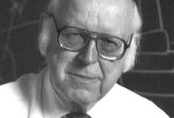

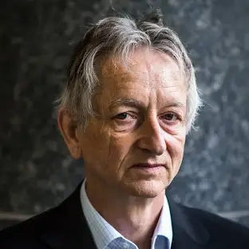
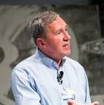
The Rise of AI/ML/ASR/NLP
Herb Simon and Alan Newell with structured AI
Geoffrey Hinton and Tom Mitchell with DLN and ML
Raj Reddy with early ASR

Slide 26
New World
These changes transform the nature of the CHILDES/TalkBank databases
The changes are still very much in progress: glass is half-full/half-empty
AI/ML needs LOTS of data; hence TalkBank
TalkBank has become a lot more central to technological progress than we would have ever thought

Slide 27
Holy Grails
Models/systems that learn language like children
Models that align with the brain – or not
Systems to diagnose dementia, psychosis, IQ
Systems to track progress in L2 or loss in dementia
Systems to help in language learning
Systems to solve all our problems

Slide 28
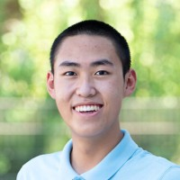
Method #1: ASR
Batchalign2 program from github
ASR: transcribed by Whisper/Rev-AI
FA forced alignment with wav2vec
Good analysis of daylong LENA audio
Benchmarking: lots of .05 WER, but not all of course
First version published in Liu & MacWhinney (2023) JSLHR

Slide 29
ASR through Batchalign
Python program open-source/downloadable from https://github.com/talkbank
Four basic functions
  transcribe (ASR)
  morphotag (UD)
  align (times)
  benchmarking
Uses either Whisper (OpenAI) or Rev-AI
Rev-AI $.02/minute; non-storage option; faster and better than Whisper
Web Service alternative: https://whisper.talkbank.org

Slide 30
Tokenization/Alignment
ASR produces a stream of words with time stamps.
CHAT/CHILDES needs utterances.
Houjun used MICASE, Pittsburgh Super Computing, and HuggingFace programs (PyTorch, etc.) to train a transformer for utterance tokenization in English.
Tokenizers for other languages are being developed by HuggingFace AI community using TalkBank data such as CallHome (German, French, etc.) – great OpenScience
Tencent does better than Rev-AI for Mandarin.

Slide 31
Cleanup
Instructions at https:/talkbank.org
Specific assignments (MOT, CHI, FAT) through CLAN ROLES program
Further role correction using keystrokes during playback
Tokenization cleanup with periods and FIXIT

Slide 32
ASR for HomeBank
10-hour San Joaquin corpus
Each day ran in 54 minutes on M2 Mac using Whisper
MOT is accurate, but baby’s cries are missing ➔ fine-tuning needed
*MOT: hi [/] hi good morning . •145740_147780•
*MOT: sweet pea . •147780_148400•
*MOT: how are you . •148400_150060•
*MOT: good morning sweet pea . •150060_154400•
*MOT: good . •154400_155240•

Slide 33
Open-Source!
Ranyuliao based entirely on Talkbank software
MISL.ai is building assessment of narrative development based on TalkBank tools and then users contribute to TalkBank
whisper.talkbank.org for web service

Slide 34
Method #2: Benchmarking
.017 WER (Word Error Rate) on TED Talks
.053 WER on ENNI 4-year-old DLD recording
.06 WER for most 7-10 Mandarin story telling
Varieties being evaluated: TED, Psychosis, RHD, TBI, MCI, CallHome, ENNI, MacWhinney, SanJoaquin, Class-APT, AWS, CORALL, Lego, CWS, Anomia, Broca, Wernicke
What ASR can’t do well: Rescorla 2-year-olds, Sekali, Pawley’s
Projects from Buffalo AI, MindAI, Gates/DrivenData

Slide 35
Method #3: UD
Universal Dependencies (UD): International project with over 200 language tree banks
DNN/NLP: morphotag in Batchalign uses Stanford’s Stanza
Described in Liu & MacWhinney (2024) Language Development Research
Evaluation: 98% correct links in 3 Eve transcripts
Native language scripts – deromanization
Supports cross-linguistic comparisons including profiling
Fine-tuning for Cantonese, Thai/Dai

Slide 36
UD
210 languages and more coming
Some have only small training sets, some are quite large
Related languages training effort – train on Hindi, extend to
Universal Part of Speech categories
Semi-universal Feature set
Universal dependency relations set

Slide 37
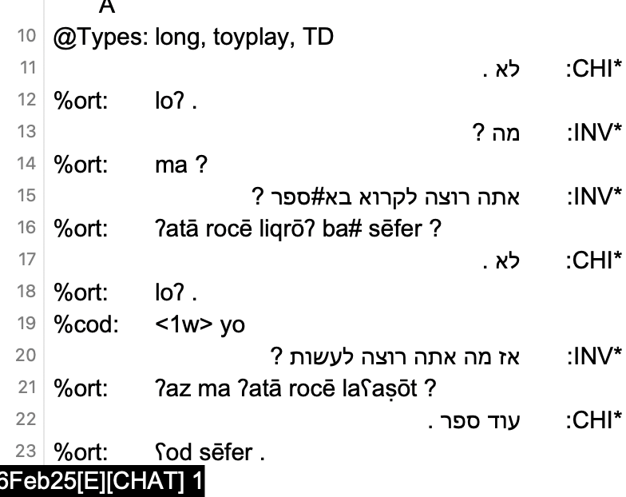
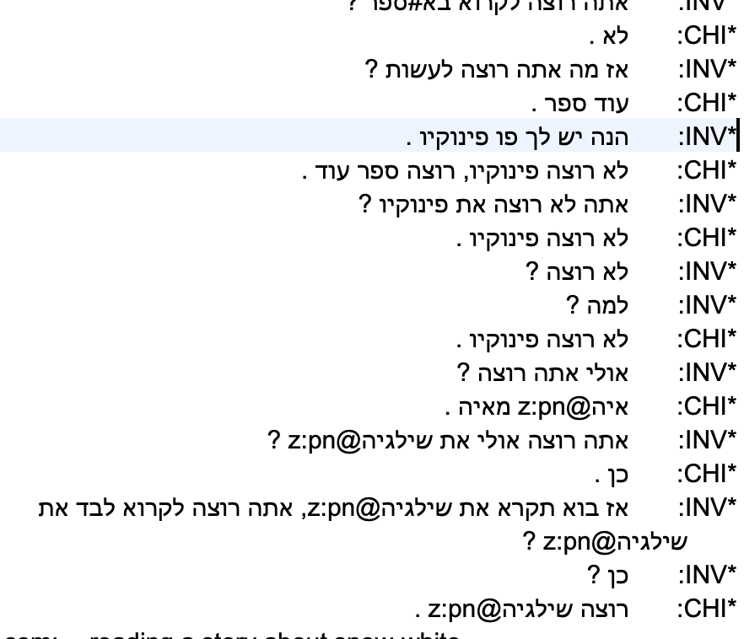
Right-to-Left in CLAN editor

Slide 38
Languages Tagged in CHILDES
We have used UD now for CHILDES data in these 25 languages: Irish, Welsh, Cantonese, Mandarin, Dutch, Afrikaans, Korean, English, French, German, Japanese, Catalan, Spanish, Romanian, Italian, Portuguese, Danish, Swedish, Icelandic, Norwegian, Turkish, Croatian, Czech, Polish, Serbian, and Slovenian.
UD in Batchalign also works for bilingual transcripts, if they are annotated by CHAT rules.
UD doesn’t yet work for CHILDES romanizations in Hebrew, Arabic, Russian, and Bulgarian.
Thai, and Japanese – problems with word tokenization
If we have good audio, we can just start over with ASR and then apply UD

Slide 39
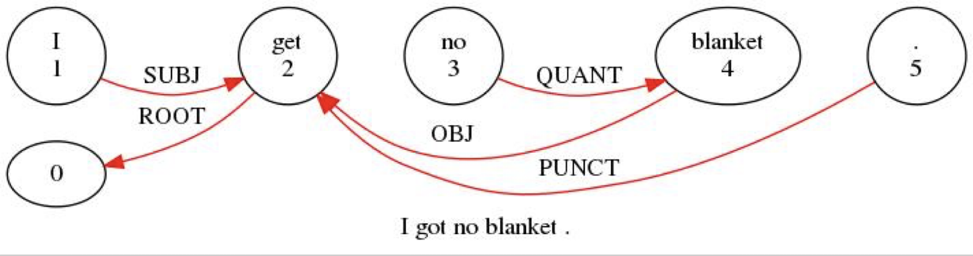
Triple-click on %gra line

Slide 40
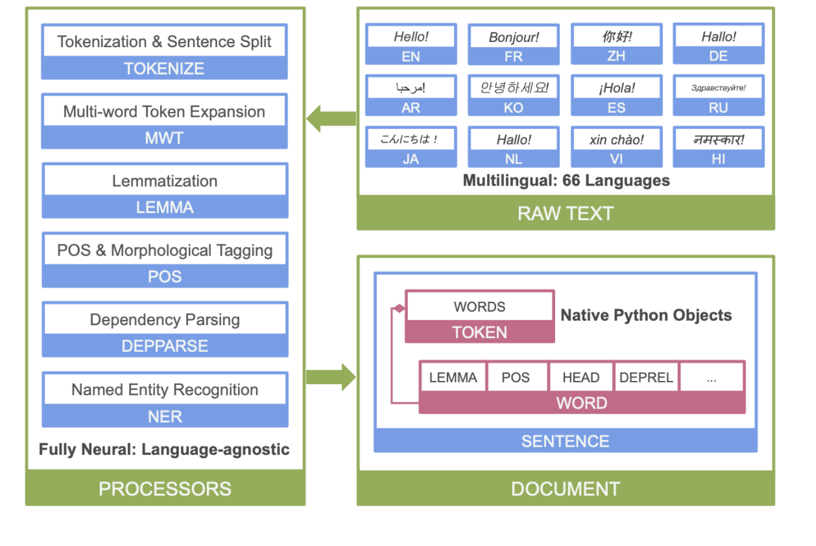
Stanza Structure

Slide 41
Method #4: Measures/CLAN
Fluency: FluCalc, %wor line, cross-tier computation
Coreference: new higher accuracy system
CIU: content informative units, graph analysis NetworkX
Profiling: Eval, KidEval, DSS, IPSyn, QPA, *LARSP
Comparison databases, s.d. levels
Complete computation of CALF (complexity, accuracy, lexical diversity, fluency)

Slide 42
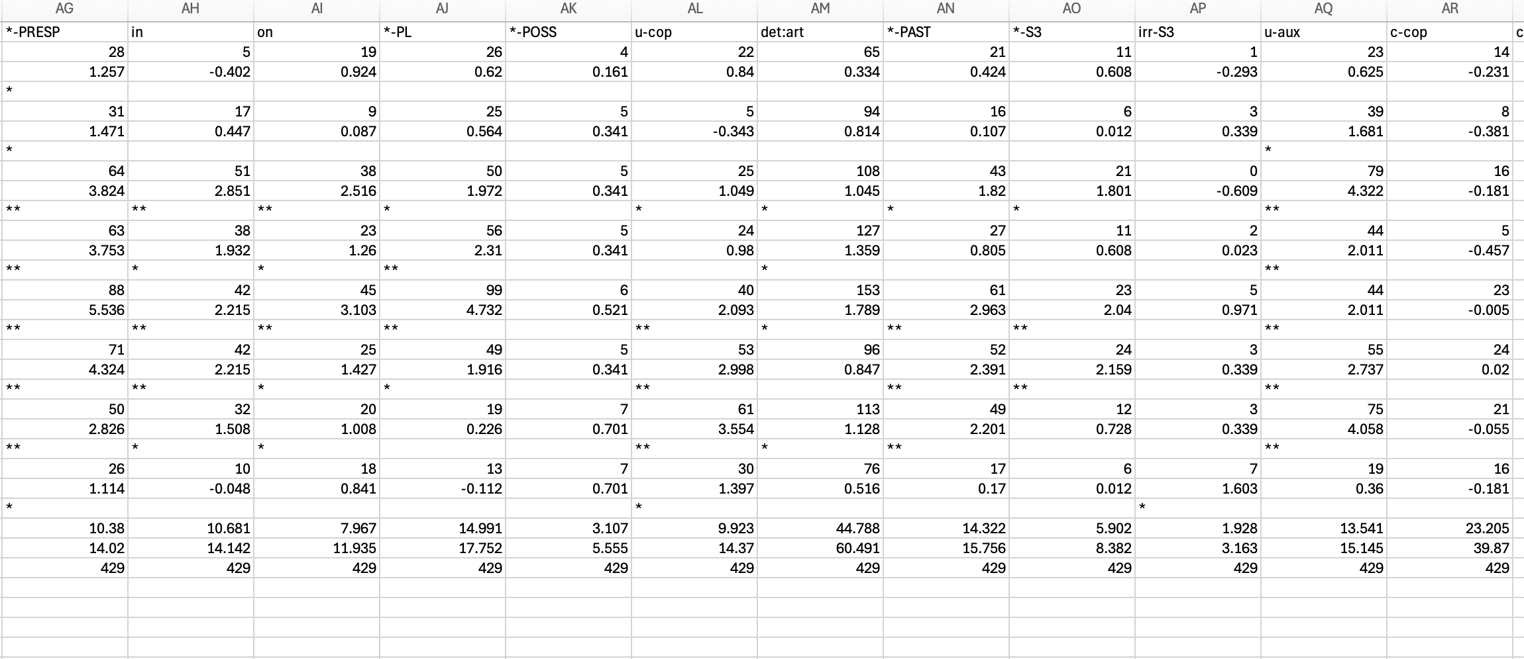
KidEval – Eve 2;0-2;4
kideval 02*.cha +LinkAge +lengu +t*CHI: +dtoyplay~"2;-2;5"

Slide 43
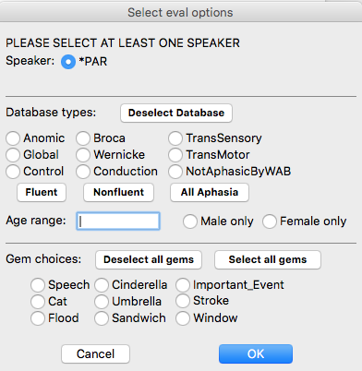
Choices for Comparison Group

Slide 44
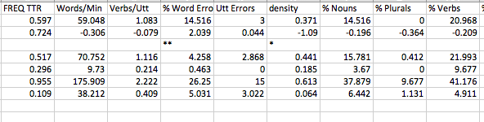
Spreadsheet Output

Slide 45
CLAN
CLAN relies on CHAT: everything in one consistent, verifiable format for all 14 databases
CLAN Editor: Unicode for all languages, even right-to-left
20 Corpus search commands
6 profiling commands
14 format conversion commands

Slide 46

Method #5: TalkBankDB
Under construction – fixed in June
Searches based on database, corpus, child, age, gender, type,
Computation downloaded to client, file download
API for Python, R
Type/token, CQL, n-grams, graphs
Cross-tier analyses

Slide 47
TalkBankDB
Browse Manual
Select: AphasiaBank/English
Click to open any transcript in TBB
Tabs for utterances, participants, types, tokens, CQL
Download all utterances – 26432 rows in Excel
3-grams => lots of “I don’t know”
CQL: adjective + stroke => WordSketch
R API and package to pull directly

Slide 48
TalkBankDB
https://talkbank.org/DB
Select: CHILDES, Eng-NA, Brown, Eve, all
Click to go to any transcript
Tabs for utterances, participants, types, tokens, CQL
Download all utterances – 26432 rows in Excel
3-grams => I want some 39 times

Slide 49
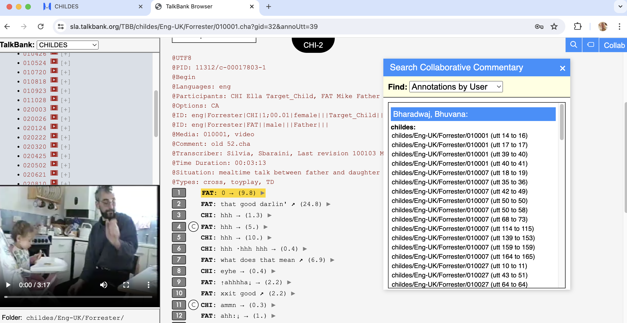
Method #6: Collaborative Commentary

Slide 50
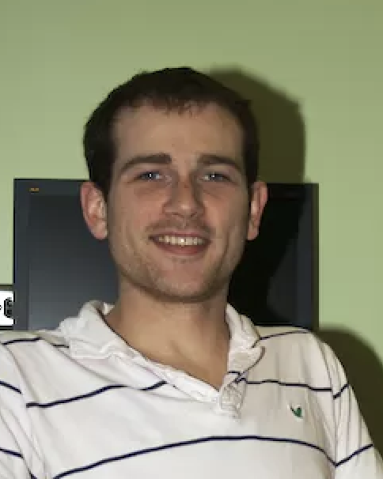
Method #7: Phon
Phon 4-alpha now available
It has complete PHON <-> CHAT compatibility
In other words, PHON is now in CHAT
2025: TalkBankDB will support all of UD and Phon
This will allow full cross-tier analyses

Slide 51
Method #8: Authorization, IRB
Open Science, Open Data
Open Publishing
Ground Rules, informed consent, deidentification
Infrastructure protection – CMU Cloud
Levels of access, authorization system
Citation requirement, embargo, archiving

Slide 52
Informed Consent
Consent forms should not have exclusionary language such as "These data will only be made available to Professor XYZ and her laboratory” or “these data will be destroyed after X years”. If the consent forms says "These data will only be made available to qualified researchers," then inclusion in TalkBank should be allowed by all IRBs including GDPR, because access to TalkBank is password protected and informed consent is given.

Slide 53
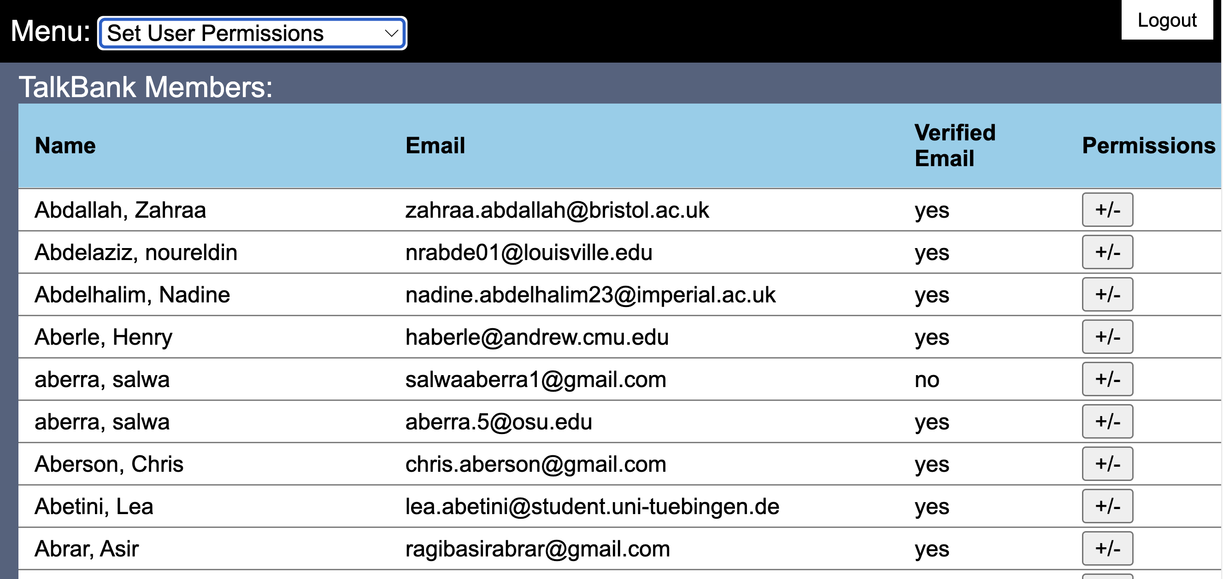
Authorization System

Slide 54
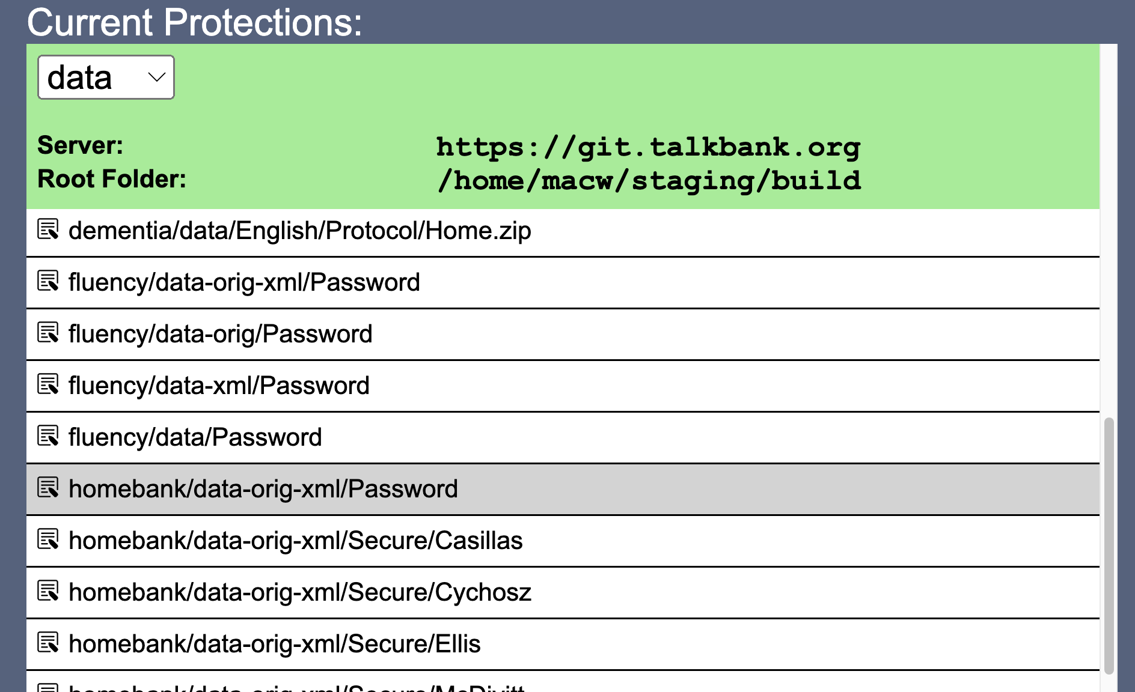
Protecting Media

Slide 55
Levels
Basic password protection: We can now study usage to detect incorrect access
Access can be controlled by membership levels: students must be supervised by faculty
Vetting of membership for HomeBank and PsychosisBank
Contributor control for most sensitive material
Embargo, Archiving

Slide 56
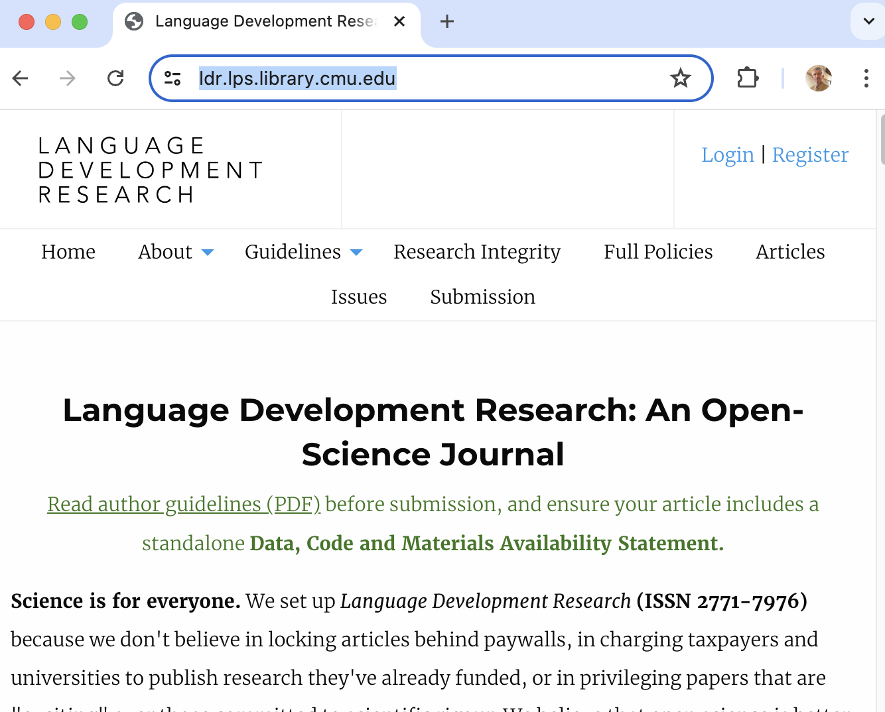
Open Publishing

Slide 57
Method #9: Outreach
Tutorials at https://talkbank.org/screencasts
Online manuals, documentation
Workshops, plenaries, Zoom
Google Groups lists
IASCL Newsletter – Angel Chan
Advisory Board
New initiatives

Slide 58
The Future
International deployment of TalkBank at multiple sites through dockerization
Data: multilingual, multimodal, diverse, longitudinal
Daylong and ESM (experience sampling method) data
Child language learning as the new Turing Test
Aligning with the brain
AI for understanding development and remediation

Slide 59

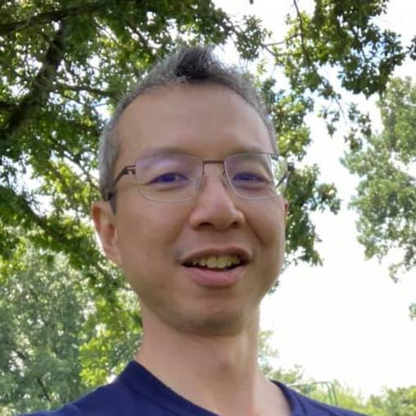



Thanks
John Kowalski: CC, DB, Auth
Franklin Chen: Cross-Tier, deploy
Greg Hedlund: Phon
Houjun Liu: Batchalign
Leonid Spektor: CLAN
Nan Bernstein Ratner: Fluency, Measures

