Slide 1


TalkBank Resources for Studying SLA
Brian MacWhinney
Carnegie Mellon University
1

Slide 2
TalkBank
world’s largest open-access database for spoken language
12,000 published papers
29,663 registered users (in 10 months)
9 TB of media, 50 million words
14 areas
32 languages

Slide 3
TalkBank Principles
Focus on spoken language
Data-sharing / Open Science / Replicability
CHAT transcript format across all corpora and all banks
Alignment across linguistic levels
Transcripts linked to media on file, utterance, and word level
Programs to support researchers, students, and clinicians
Modern software: Python, ASR, AI, JavaScript
Survivability – deployment outside of CMU

Slide 4
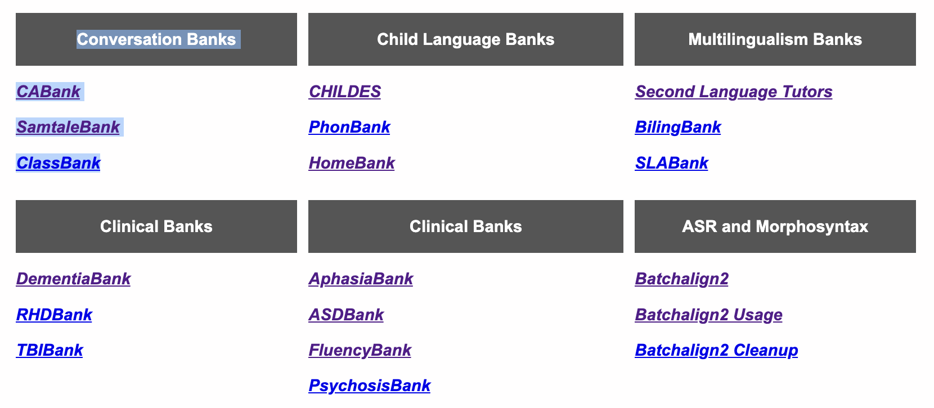
14 Domains

Slide 5
SLA-relevant domains
SLABank
BilingBank
CHILDES (Biling section)
PhonBank and Phon (Biling section)

Slide 6
SLABank
10 L2s with a focus on English, Spanish, French, and Mandarin. Index page
Tracy-Ventura, Köylü, &MacWhinney planned intro to SLA and TalkBank book
Southampton databases such as LangSnap and SPLLOC
Most linked to audio or video and all analyzed by UD
Nebrija-CAO presentations 06-11 11-00
Can be analyzed for CALF (complexity, accuracy, lexical richness, and fluency) using the CLAN program.

Slide 7
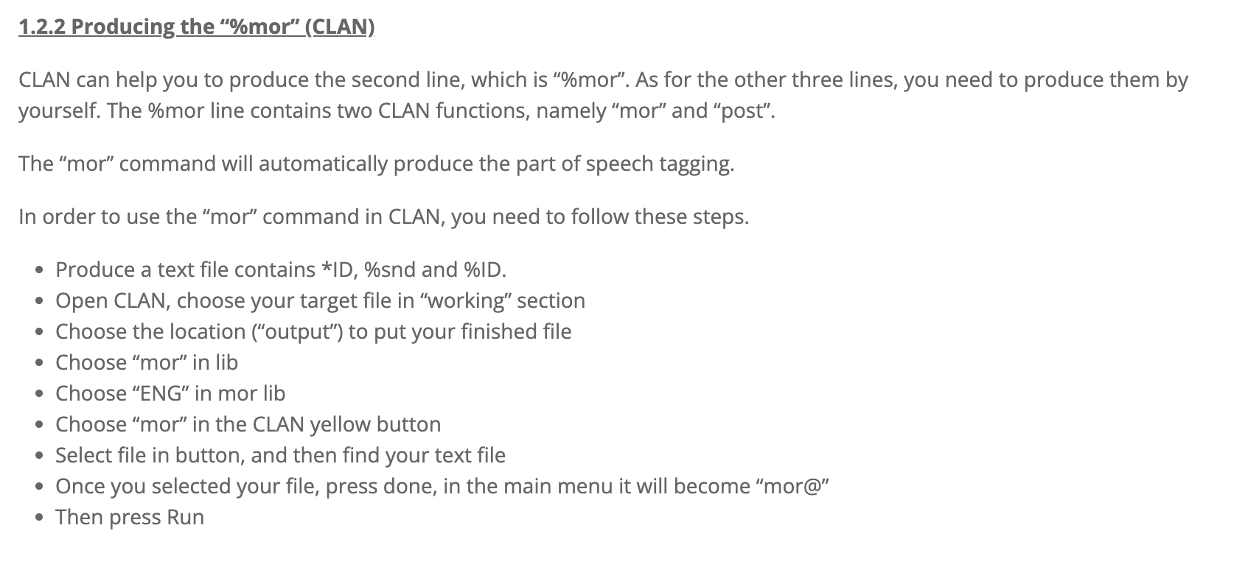
CALF – Bui & Skehan
Online tools uses CHAT format and MOR
However, things are now more automatic, except for error coding
Also, running on the desktop provides more control.

Slide 8
BilingBank
Code-switching: Miami and Eppler
Sociolinguistics: Brazilian Russian, Istrian Italian/Croatian
Other corpora focus on bilingual experience: Turks in Denmark, Greeks in France, Japanese in Columbia

Slide 9
CHILDES – Biling
Simultaneous acquisition, such as
  Yip Matthews : 8 children
  Leo: English, Mandarin, Cantonese
  Twins English-Spanish
Immigrant acquisition, such as
  Ionin Russian-English
  CHCC - Heritage

Slide 10
PhonBank - Biling
Child corpora such as Japanese-English
Or older learners such as VYSA
Processed through Phon (download from phon.ca)
Phonological level transcription in IPA
Automatic insertion of target, hand entry of learner
Automatic syllabification
All major current profiling analyses supported (PCC, etc.)

Slide 11
Methods
ASR
UD
Measures / CLAN
CC
TalkBankDB
Phon
IRB, Authentication
Outreach

Slide 12
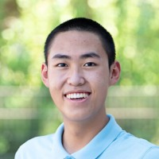
Method #1: ASR
Batchalign2 program from github
ASR: transcribed by Whisper/Rev-AI
FA forced alignment with wav2vec
Good analysis of daylong LENA audio
Benchmarking: lots of .05 WER, but not all of course
First version in Liu & MacWhinney (2023) JSLHR
Update in Liu & MacWhinney (2024) LDR

Slide 13
ASR through Batchalign
Python program open-source/downloadable from https://github.com/talkbank/batchalign2
Four basic functions
  transcribe (ASR)
  morphotag (UD)
  align (times)
  benchmarking
Uses either Whisper (OpenAI) or Rev-AI and Tencent for Cantonese
Rev-AI $.02/minute; non-storage option; faster and better than Whisper
Web Service alternative: https://whisper.talkbank.org

Slide 14
Tokenization/Alignment
ASR produces a stream of words with time stamps.
CHAT/CHILDES needs utterances.
Houjun used MICASE, Pittsburgh Super Computing, and HuggingFace programs (PyTorch, etc.) to train a transformer for utterance tokenization in English.
Tokenizers for other languages are being developed by HuggingFace AI community using TalkBank data such as CallHome (German, French, etc.) – great OpenScience

Slide 15
Method #2: UD
Universal Dependencies (UD): International project with over 200 language tree banks
DNN/NLP: morphotag in Batchalign uses Stanford’s Stanza
Described in Liu & MacWhinney (2024) Language Development Research
Evaluation: 98% correct links in 3 Eve transcripts
Native language scripts – deromanization
Supports cross-linguistic comparisons including profiling
Fine-tuning for Cantonese, Thai/Dai

Slide 16
UD
210 languages and more coming
Some have only small training sets, some are quite large
Related languages training effort – train on Hindi, extend to
Universal Part of Speech categories
Semi-universal Feature set
Universal dependency relations set

Slide 17
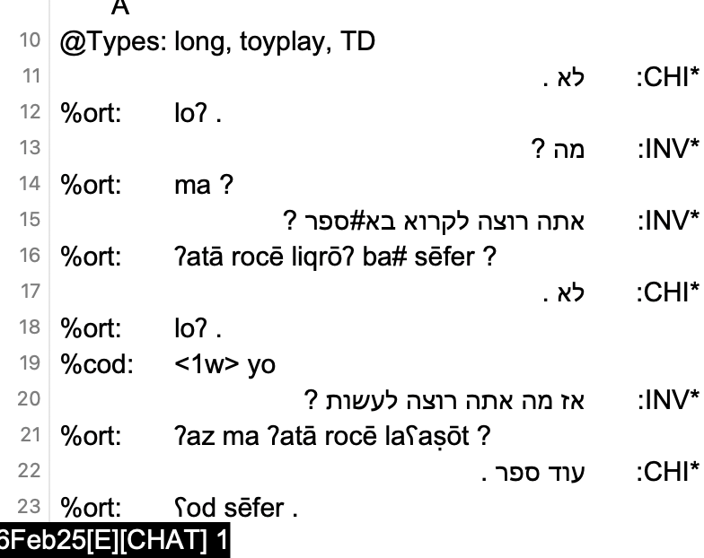
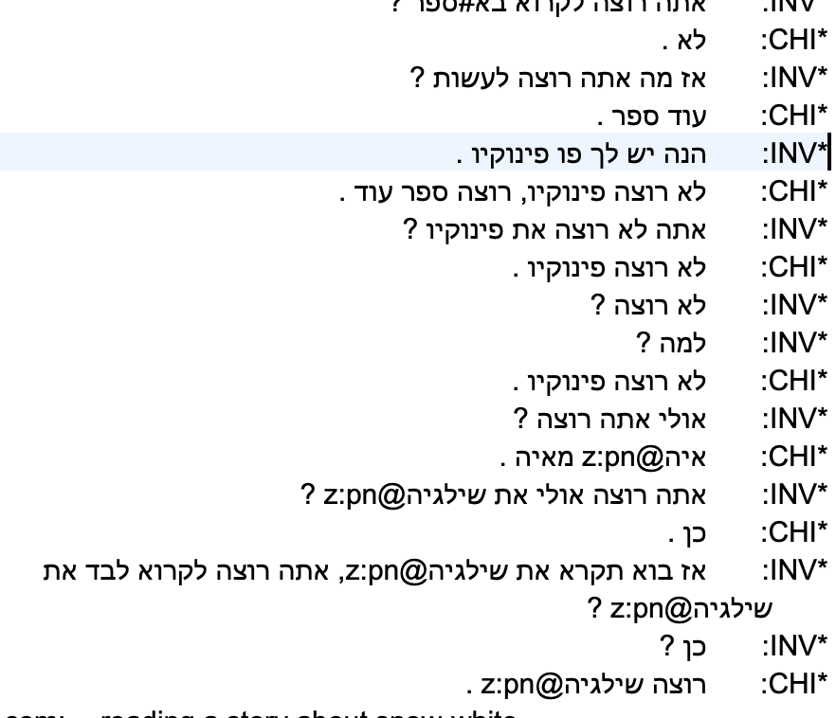
Right-to-Left in CLAN editor

Slide 18
Languages Tagged in CHILDES
We have used UD now for CHILDES data in these 25 languages: Irish, Welsh, Cantonese, Mandarin, Dutch, Afrikaans, Korean, English, French, German, Japanese, Catalan, Spanish, Romanian, Italian, Portuguese, Danish, Swedish, Icelandic, Norwegian, Turkish, Croatian, Czech, Polish, Serbian, and Slovenian.
UD in Batchalign also works for bilingual transcripts, if they are annotated by CHAT rules.
UD doesn’t yet work for CHILDES romanizations in Hebrew, Arabic, Russian, and Bulgarian.
Thai, and Japanese – problems with word tokenization
If we have good audio, we can just start over with ASR and then apply UD

Slide 19
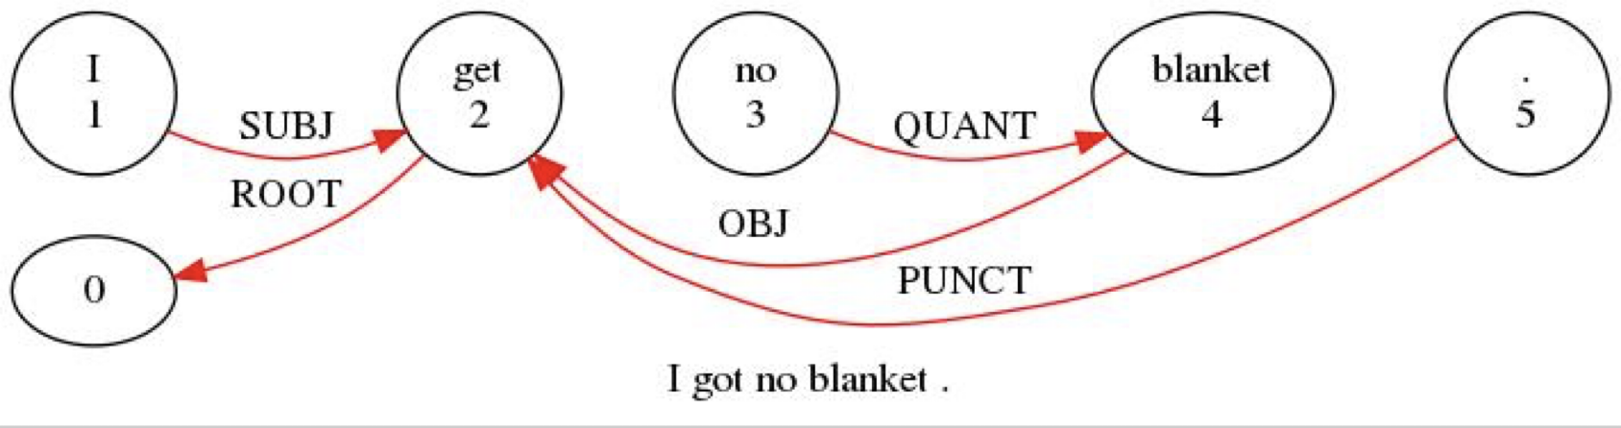
Triple-click on %gra line

Slide 20
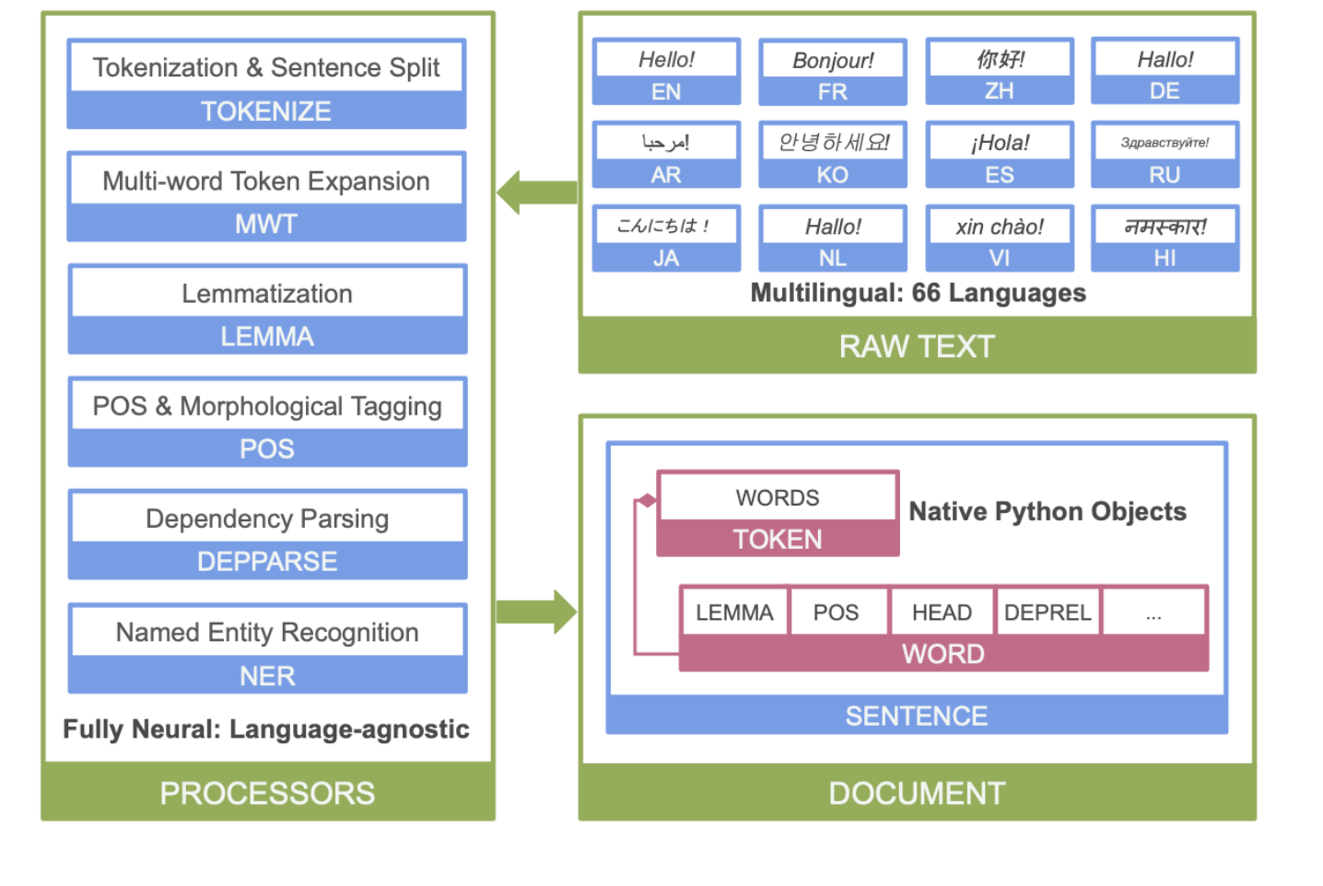
Stanza Structure

Slide 21
Method #3: Measures/CLAN
Fluency: FluCalc, %wor line, cross-tier computation
Coreference: new higher accuracy system
CIU: content informative units, graph analysis NetworkX
Profiling: Eval, KidEval, DSS, IPSyn, QPA, *LARSP
Comparison databases, s.d. levels
Complete computation of CALF (complexity, accuracy, lexical diversity, fluency) but error tagging by hand

Slide 22
CLAN
CLAN relies on CHAT: everything in one consistent, verifiable format for all 14 databases
CLAN Editor: Unicode for all languages, even right-to-left
20 Corpus search commands
6 profiling commands
14 format conversion commands

Slide 23
Method #4: TalkBankDB
Searches based on database, corpus, child, age, gender, type,
Computation downloaded to client, file download
API for Python, R
Type/token, CQL, n-grams, graphs
Cross-tier analyses

Slide 24
TalkBankDB at https://talkbank.org/DB
Browse Manual
Select: AphasiaBank/English
Click to open any transcript in TBB
Tabs for utterances, participants, types, tokens, CQL
Download all utterances – 26432 rows in Excel
3-grams => lots of “I don’t know”
CQL: adjective + stroke => WordSketch
R API and package to pull directly

Slide 25
TalkBankDB
https://talkbank.org/DB
Select: CHILDES, Eng-NA, Brown, Eve, all
Click to go to any transcript
Tabs for utterances, participants, types, tokens, CQL
Download all utterances – 26432 rows in Excel
3-grams => I want some 39 times

Slide 26
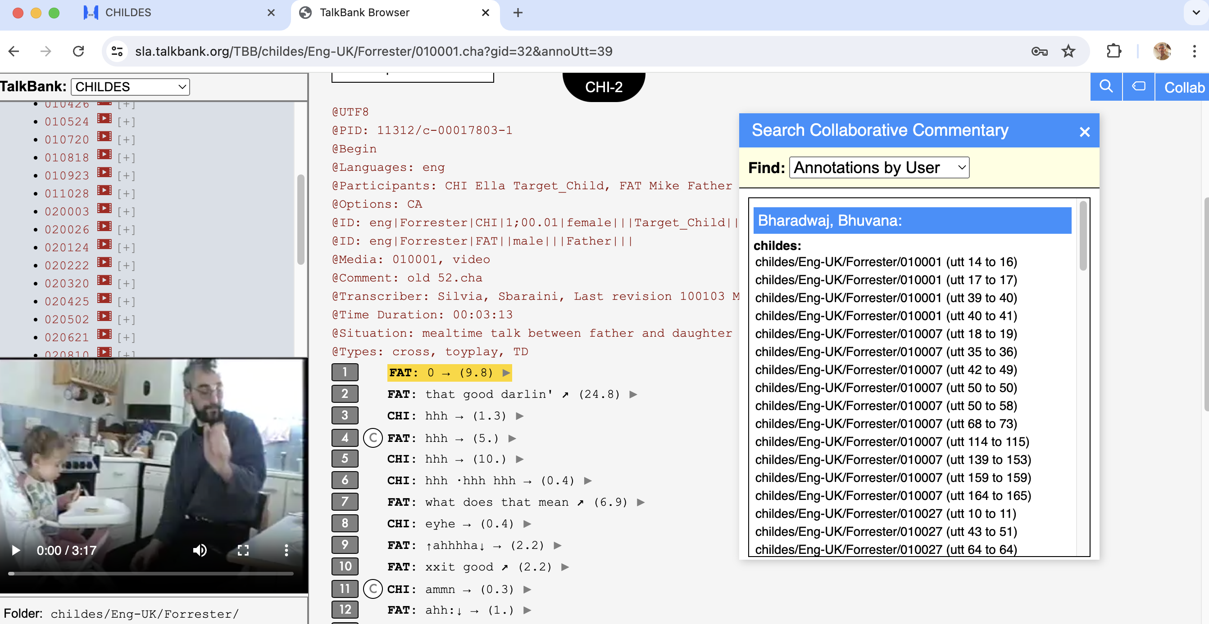
Method #5: Collaborative Commentary

Slide 27
TBB to CC
Start at https://talkbank.org
Go to AphasiaBank, Browsable Database
(or go directly to sla.talkbank.org/TBB)
Read instructions (once)
Pick a transcript: Aphasia/Adler / adler06a
Go to line 6, play, stop
Enter Collaborative Commentary

Slide 28
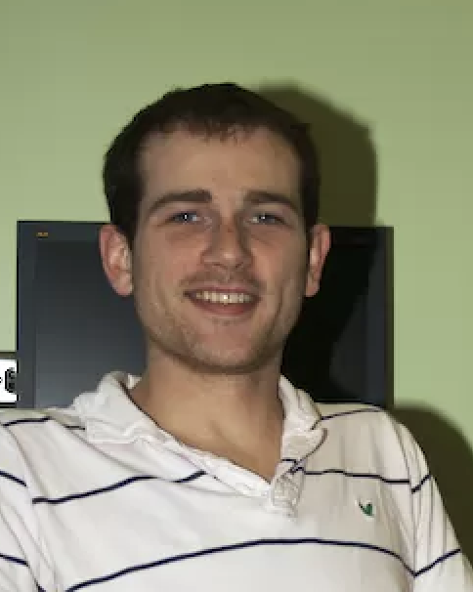
Method #6: Phon
Phon 4-alpha now available
It has complete PHON <-> CHAT compatibility
In other words, PHON is now CHAT
2025: TalkBankDB will support all of UD and Phon
This will allow full cross-tier analyses

Slide 29
Method #7: Authorization, IRB
Open Science, Open Data
Open Publishing
Ground Rules, informed consent, deidentification
Infrastructure protection – CMU Cloud
Levels of access, authorization system
Citation requirement, embargo, archiving

Slide 30
Informed Consent
Consent forms should not have exclusionary language such as "These data will only be made available to Professor XYZ and her laboratory” or “these data will be destroyed after X years”. If the consent forms says "These data will only be made available to qualified researchers," then inclusion in TalkBank should be allowed by all IRBs including GDPR, because access to TalkBank is password protected and informed consent is given.

Slide 31
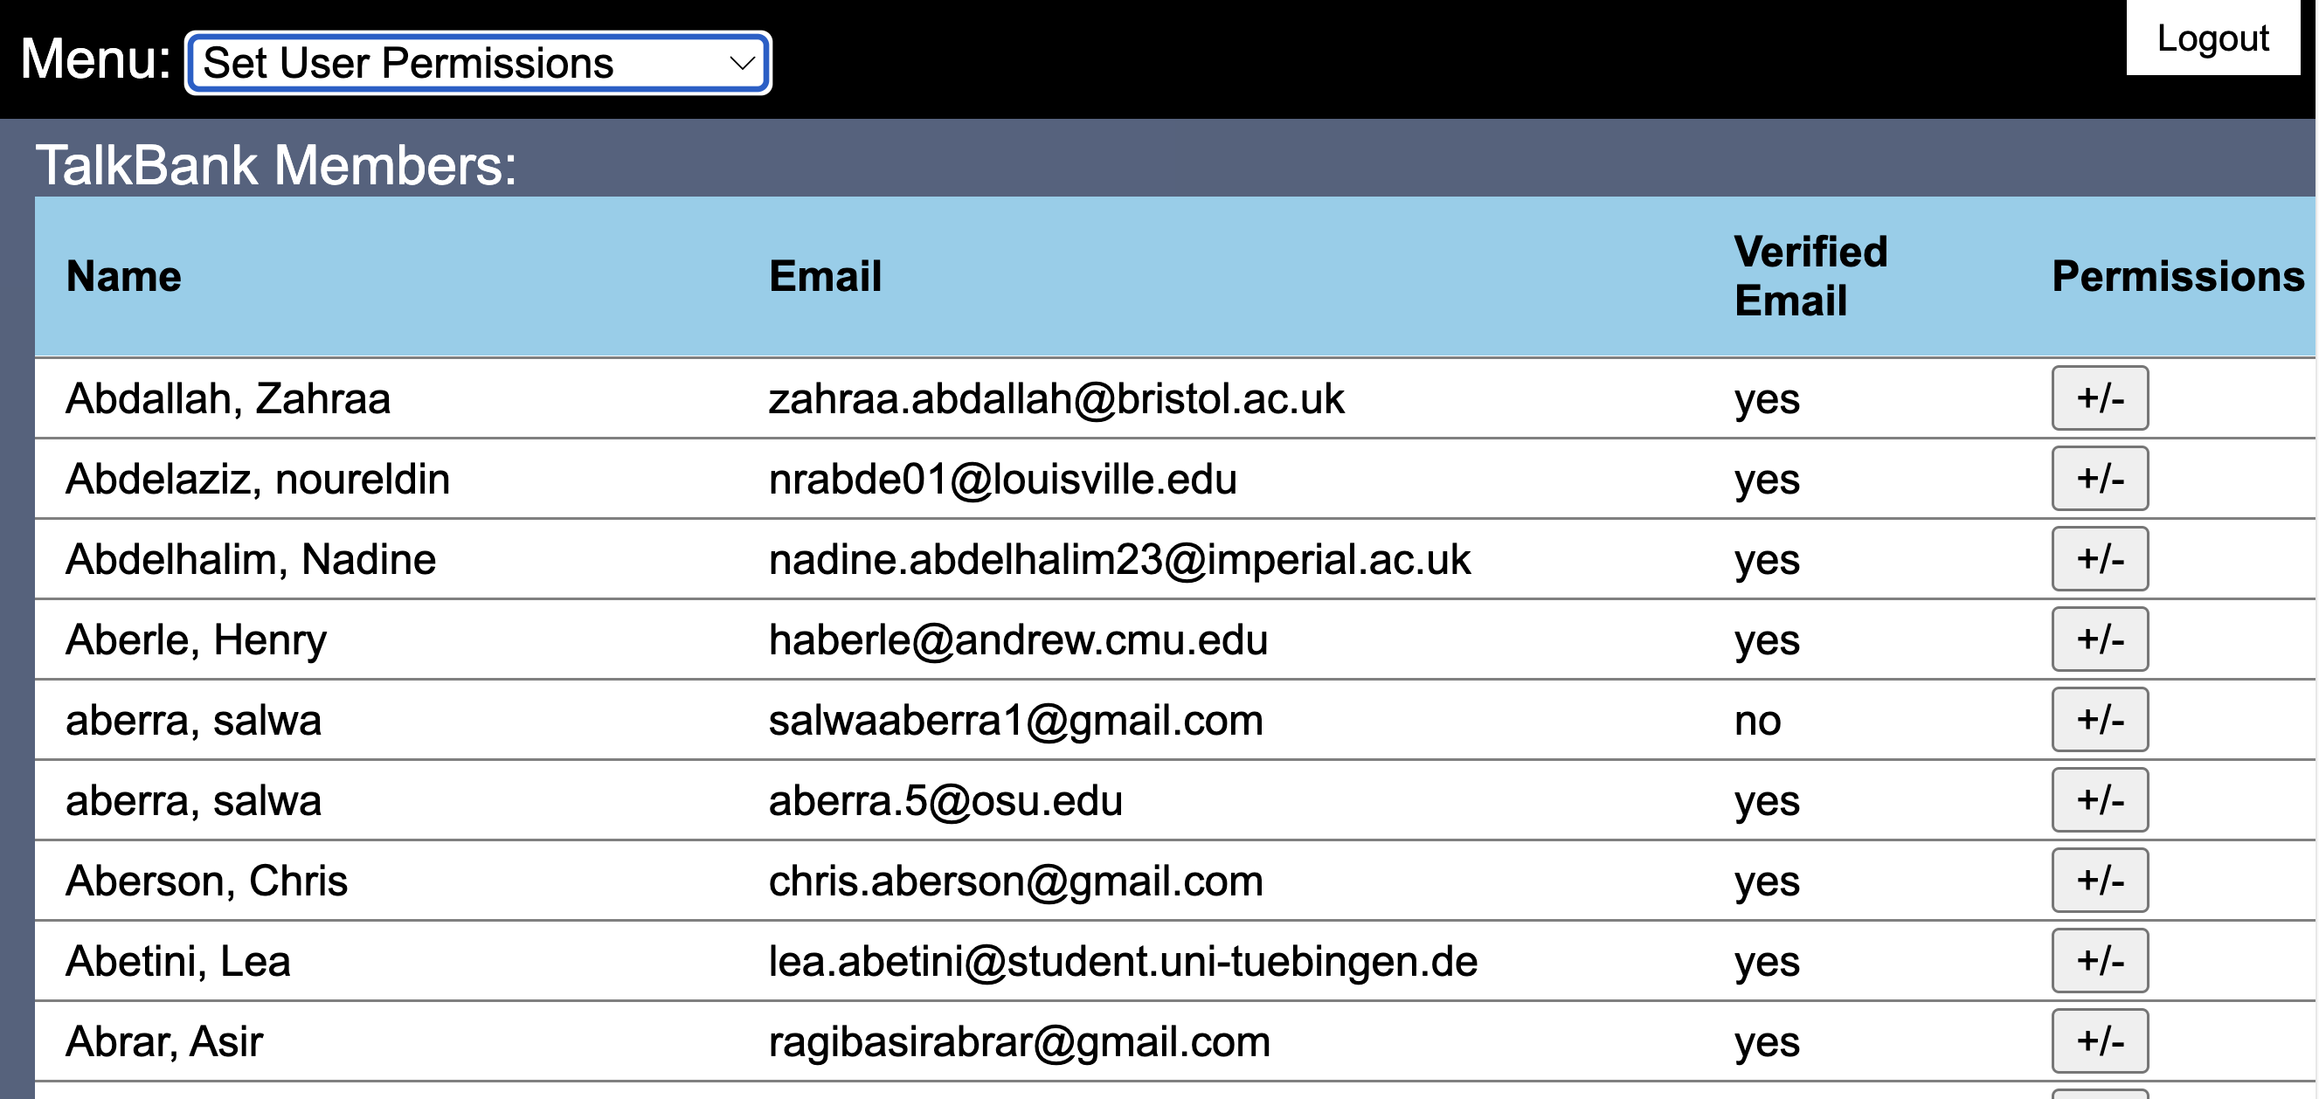
Authorization System

Slide 32
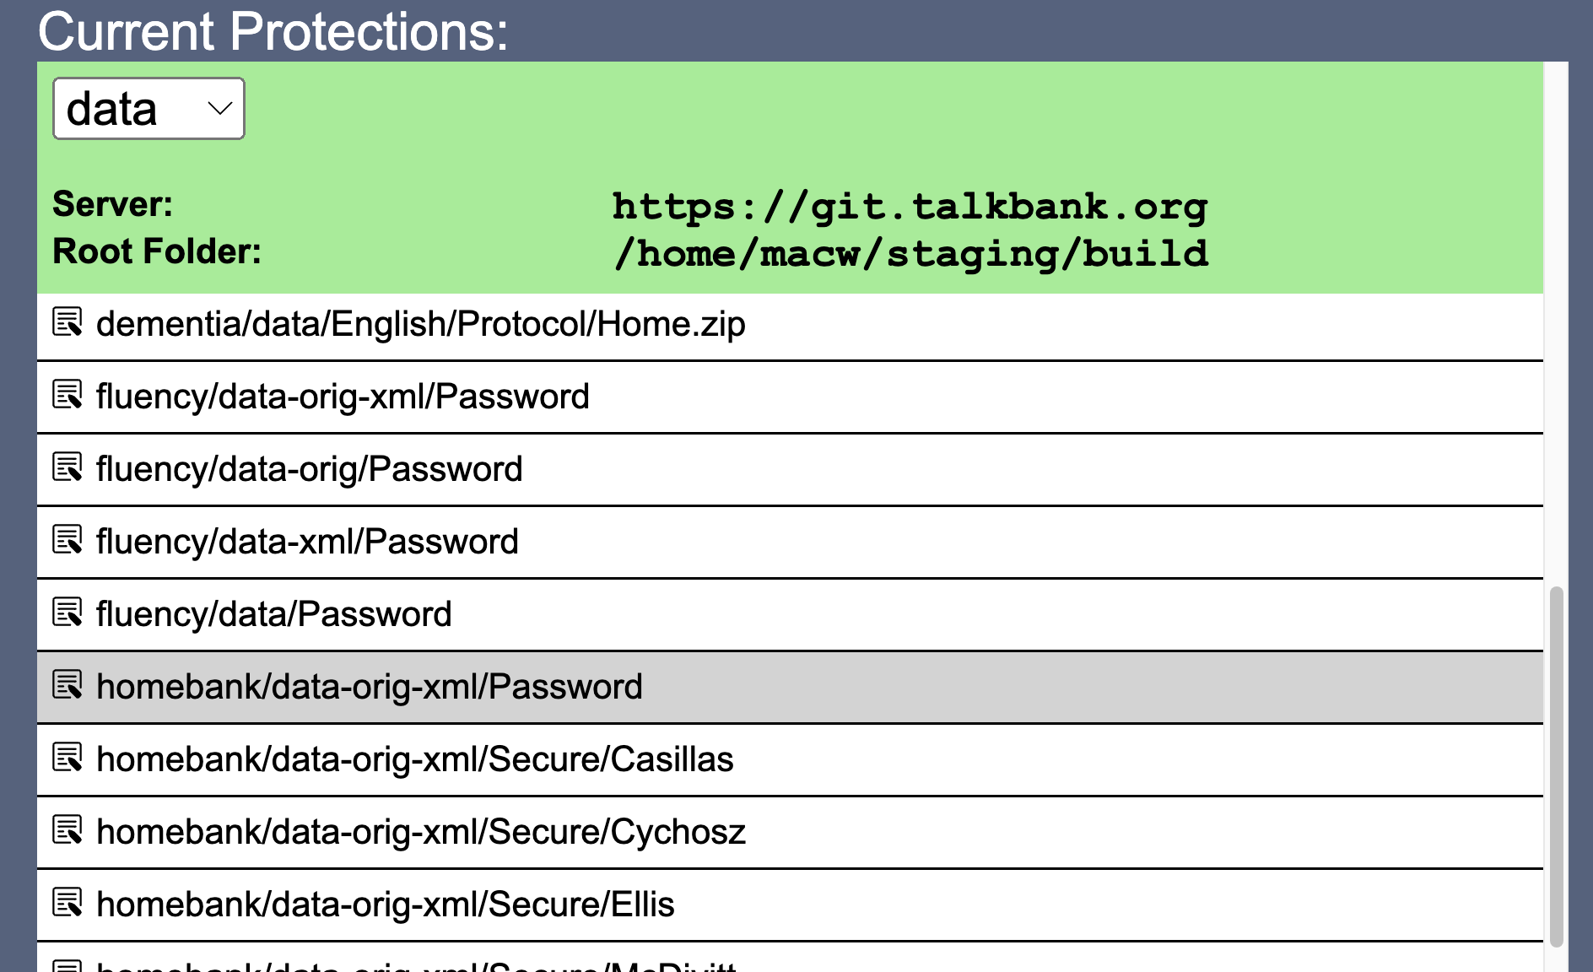
Protecting Media

Slide 33
Levels
Basic password protection: We can now study usage to detect incorrect access
Access can be controlled by membership levels: students must be supervised by faculty
Vetting of membership for HomeBank and PsychosisBank
Contributor control for most sensitive material
Embargo, Archiving

Slide 34
Method #8: Outreach
Tutorials at https://talkbank.org/screencasts
Online manuals, documentation
Workshops, plenaries, Zoom
Google Groups lists
IASCL Newsletter – Angel Chan
Advisory Board
New initiatives

Slide 35
The Future
International deployment of TalkBank at multiple sites through dockerization
Data: multilingual, multimodal, diverse, longitudinal
Daylong and ESM (experience sampling method) data
Child language learning as the new Turing Test
Aligning with the brain
AI for understanding development and remediation

Slide 36
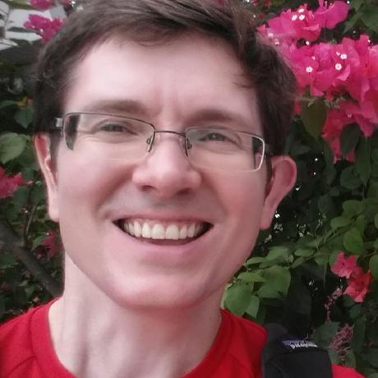
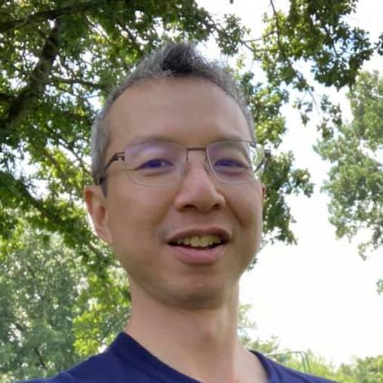
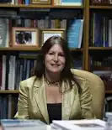


Thanks
John Kowalski: CC, DB, Auth
Franklin Chen: Cross-Tier, deploy
Greg Hedlund: Phon
Houjun Liu: Batchalign
Leonid Spektor: CLAN
Nan Bernstein Ratner: Fluency, Measures

