Slide 1


TalkBank: Tools, Data, and AI
Brian MacWhinney
Carnegie Mellon University
macw@cmu.edu
https://talkbank.org

Slide 2
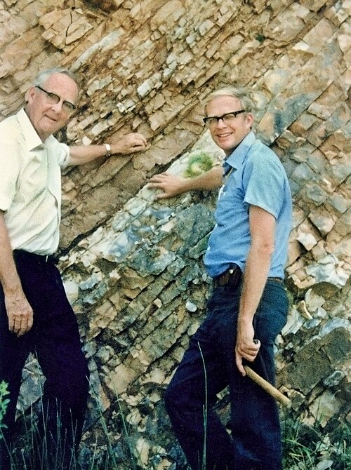
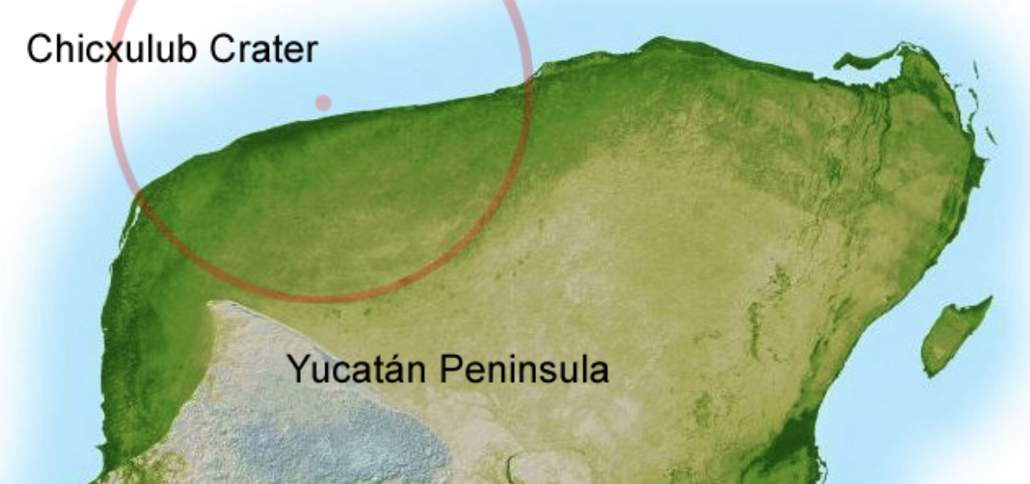
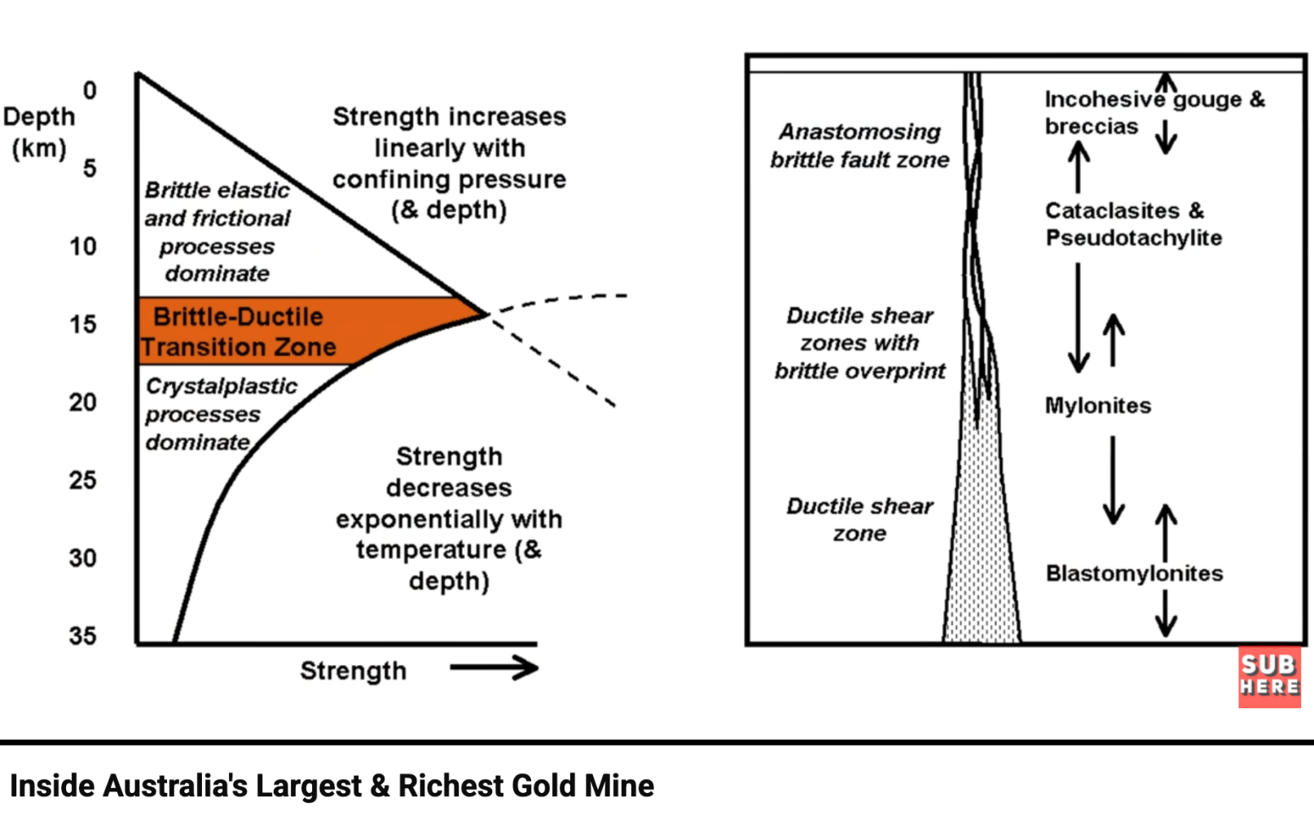
Records in the Rocks
What killed the dinosaurs?
Iridium at K-Pg boundary
The crater in the Yucatan
The Boddington Gold Mine
A confluence of events and constraints across 200 million years

Slide 3
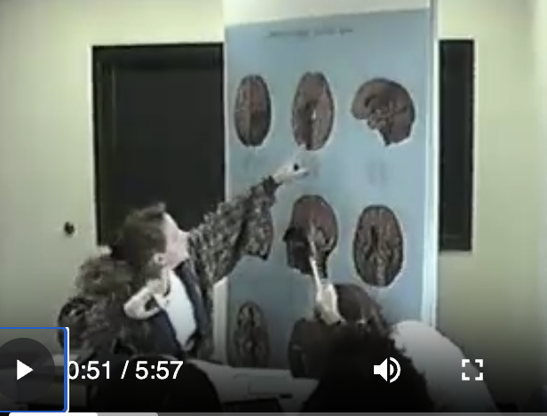
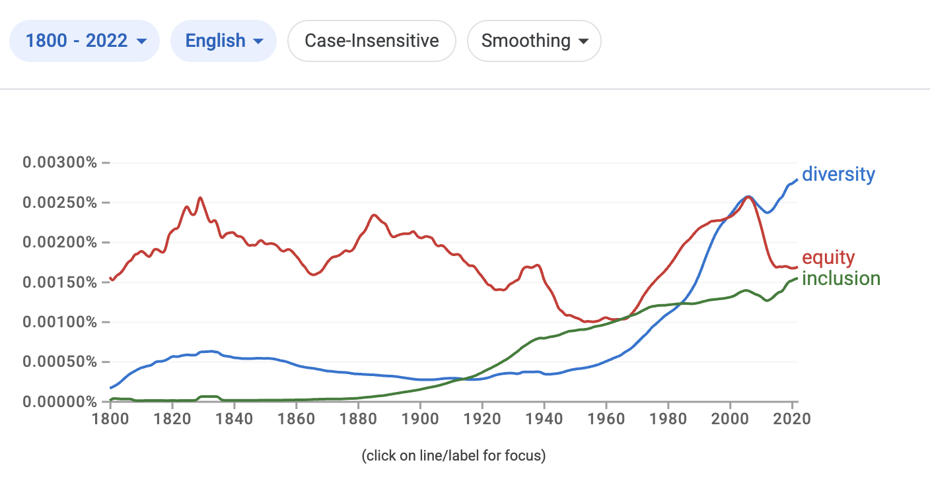
Records in the Words
Where is the hippocampus?
It’s right up here.
You just flip up that little temporal lobe
Tracking DEI with
Google n-gram

Slide 4
From CHILDES to TalkBank
1984 – Catherine Snow, MacArthur, and Concord
1985-1995 CLAN, MOR, many corpora, Web
2005 – TalkBank with 5 new areas
Currently: 14 new areas, ASR, UD, AI, and a new world
Goal: to create Records in the Words open to study and replication

Slide 5
TalkBank Status
14,000 published papers
50,000 registered users
9 TB of media, 50 million words
100,000 transcript files
14 areas
32 languages

Slide 6
Claude / Models / Data
AI/ML needs LOTS of data; TalkBank provides it
TalkBank has become a lot more central to technological progress than we would have ever thought
Claude and GPT5 are reshaping TalkBank data, analysis, and infrastructure

Slide 7
TalkBank Principles
Focus on spoken language
Data-sharing / Open Science / Replicability
Single transcript format across all corpora and all banks
Alignment across linguistic levels
Transcripts linked one-to-one to media
Programs to support researchers, students, and clinicians
Modern software: Python, Rust, ASR, AI, JSON
Survivability – deployment outside of CMU

Slide 8
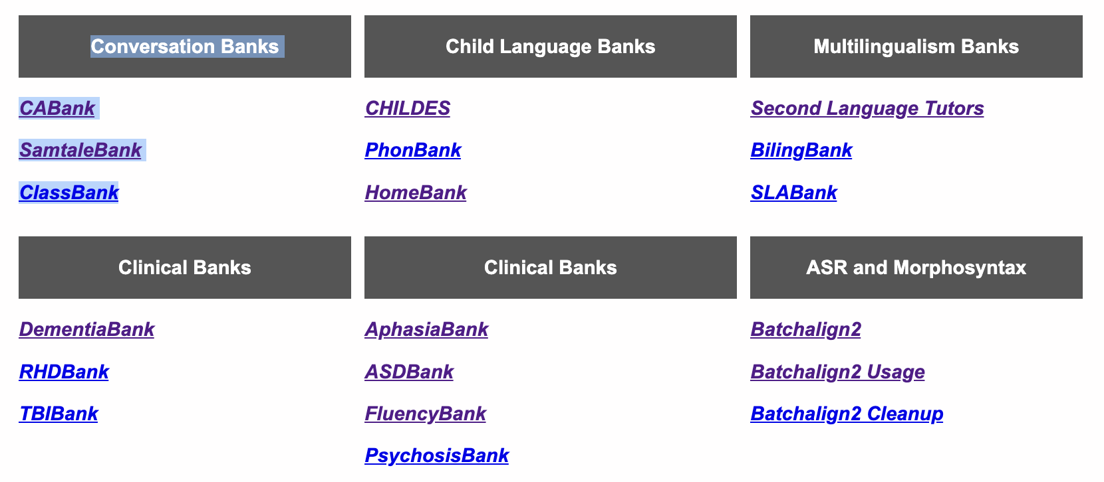
14 Areas

Slide 9
Example Studies
ASR for people with disabilities or differences – Gates, NIH, Google
Aphasia and gesture -Brielle Stark at Indiana
Automatic diagnosis of phonological disorder – PhonBank, Yvan Rose at Memorial Newfoundland
Learning of geometry through knowledge expansion – ClassBank, Rich Lehrer at Vanderbilt
LLM language learning – BabyLLM Alex Warstadt UCSD, Marvin Lavechin Paris
Development as Preference Management – PLAY Catherine Tamis-LeMonda at NYU
TBI and returning to work as a part of the protocol – Elise Elbourn at Sydney
UG vs. usage-based models of L1 learning – Elena Lieven at Manchester, MPI
Recovery from stuttering, parental recasts – Nan Bernstein Ratner at Maryland
Measuring L2 CALF (complexity, accuracy, lexicon, fluency) – Nicole Tracy-Ventura at Oklahoma
HomeBank data on maternal but not paternal pitch -- Mark VanDam at Western Washington

Slide 10
15 Tools
ASR Automatic SpeechRecognition | Tokenization, Diarization | Forced Alignment
SRT, Word Naming | CLAN Editor | Universal Dependencies
Measures – KidEval, Flucalc, RefVals | TalkBankDB | TalkBank Browser
Collaborative Commentary | AI Structuring | IRB, Authentication
Fleet Deployment | Internationalization | Benchmarking

Slide 11
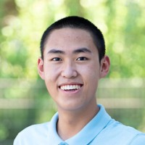
Tool #1: ASR
https://github.com/TalkBank/batchalign2
Created by Houjun Liu
ASR: transcribed by Rev-AI/Whisper
Cantonese and Mandarin use FunAudio
Works for 24 languages in TalkBank, but not Sesotho, Berber, Jamaican, or Quechua
Good analysis of 16-hour LENA audio
Early version described in Liu & MacWhinney (2023) JSLHR

Slide 12
Tool #2: Tokenization/Diarization
ASR produces a stream of words with time stamps.
CHAT/CHILDES needs utterances. This requires diarization. Houjun built a diarizer for English. The HuggingFace diarizer community is building ones for other languages, using TalkBank. Claude is helping.
Diarization includes speaker identification. For child language this is a major issue and the current focus of the DrivenData/Gates challenge based fully on CHILDES data.

Slide 13
Tool #3: Forced Alignment
Used for transcripts that have not yet been linked to their audio or video media
State-of-the-art method designed by Houjun Liu using wav2vec, fuzzy matching, and batch slicing
If transcripts are full and accurate with minimal overlap and if recordings are clean, the results are perfect.
Results include time values for utterances and words.

Slide 14
An example with %wor
*CHI: 有 收费站 . 39684_41706
%mor: verb|有-Inf-S noun|收费站-Acc .
%gra: 1|0|ROOT 2|1|OBJ 3|1|PUNCT
%wor: 有 39684_41025 收费站 41025_41706 .
*MOT: 这 是 收费站 啊 ! 41726_45531
%mor: pron|这-Int-S1 aux|是-Inf-S noun|收费站 part|啊 !
%gra: 1|3|NSUBJ 2|3|COP 3|0|ROOT 4|3|DISCOURSE 5|3|PUNCT
%wor: 这 41726_41786 是 41786_41866 收费站 41866_44930 啊 44930_45531 !

Slide 15
Tool #4: SRT and Naming
Sentence Repetition Task (SRT) is a good test of proficiency
It can also be used to measure and characterize apraxia
Automatic analysis by comparing script with productions using Batchalign’s compare command
Current work on automatic scoring of word and non-word naming

Slide 16
Tool #5: CLAN editor
The editor is now used primarily to clean up ASR output and to review interactions, although this can also be in the TalkBank Browser.
Because ASR is linked to the audio, it is easy to playback, verify, reassign, and resegment.
After cleanup, re-running align fixes alignment.
Editor includes checking and even Right-To-Left

Slide 17
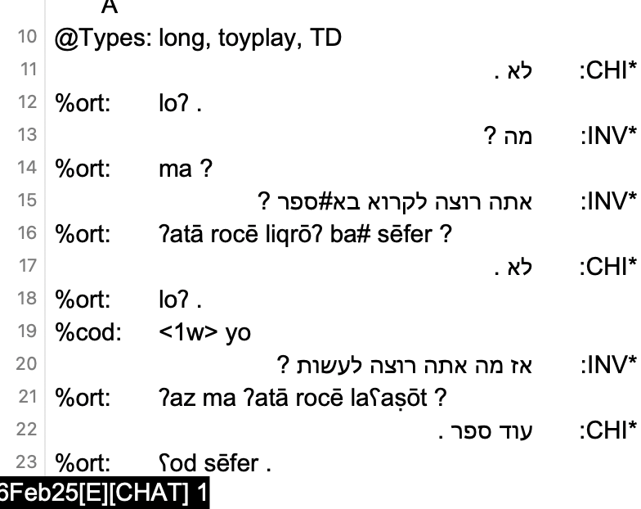
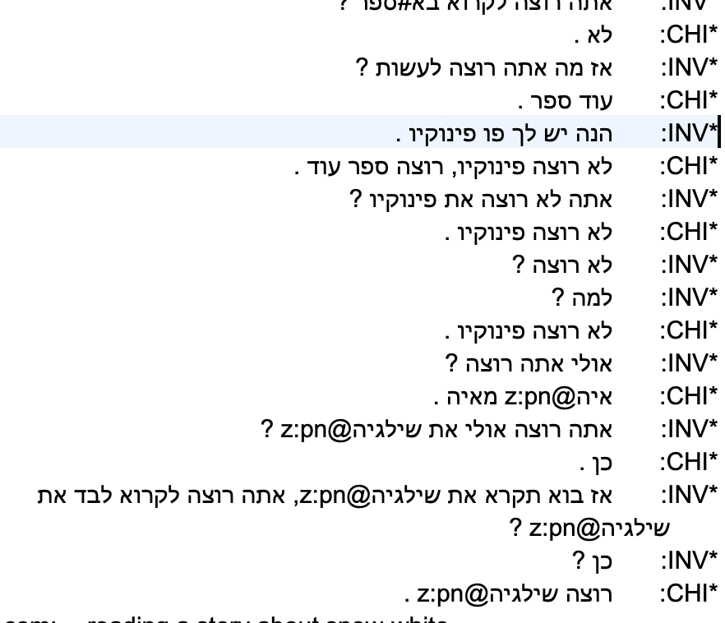
Right-to-Left in CLAN editor

Slide 18
Tool #6: UD
Universal Dependencies (UD): International project with over 210 language tree banks. Stanford Stanza project uses DNN
Liu & MacWhinney (2024) Language Development Research
Evaluation: 98% correct links in 3 Eve transcripts
Requires native language scripts – deromanization
Universal Part of Speech categories
Semi-universal Feature set
Universal dependency relations
Permits cross-language comparisons

Slide 19
Languages Tagged in CHILDES
We have tagged these 25 languages: Irish, Welsh, Cantonese, Mandarin, Dutch, Afrikaans, Korean, English, French, German, Japanese, Catalan, Spanish, Romanian, Italian, Portuguese, Danish, Swedish, Icelandic, Norwegian, Turkish, Croatian, Czech, Polish, Serbian, and Slovenian.
UD in Batchalign also works for bilingual transcripts, if they are annotated by CHAT rules.
Thai, and Japanese – problems with word tokenization
If we have good audio, we can just start over with ASR and then apply UD

Slide 20
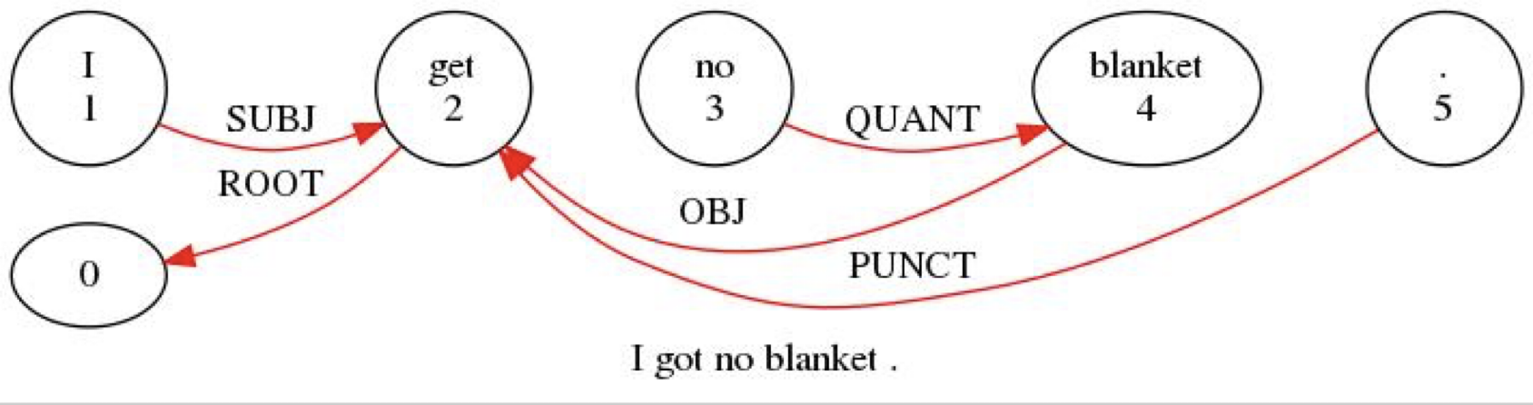
Triple-click on %gra line

Slide 21
Tool #7: Measures
Fluency: FluCalc, %wor line, cross-tier computation
Coreference: new higher accuracy system
CIU: content informative units, graph analysis NetworkX
Acoustic: OpenSMILE, AVQI
SRT Sentence Repetition Task: compare
Profiling: Eval, KidEval, DSS, IPSyn, QPA
Comparison databases, s.d. levels
For L2 work, complete computation of CALF (complexity, accuracy, lexical diversity, fluency)

Slide 22
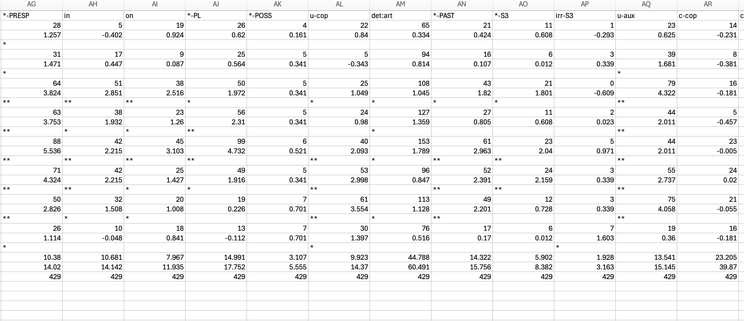
KidEval – Eve 2;0-2;4
kideval 02*.cha +LinkAge +lengu +t*CHI: +dtoyplay~"2;-2;5"

Slide 23
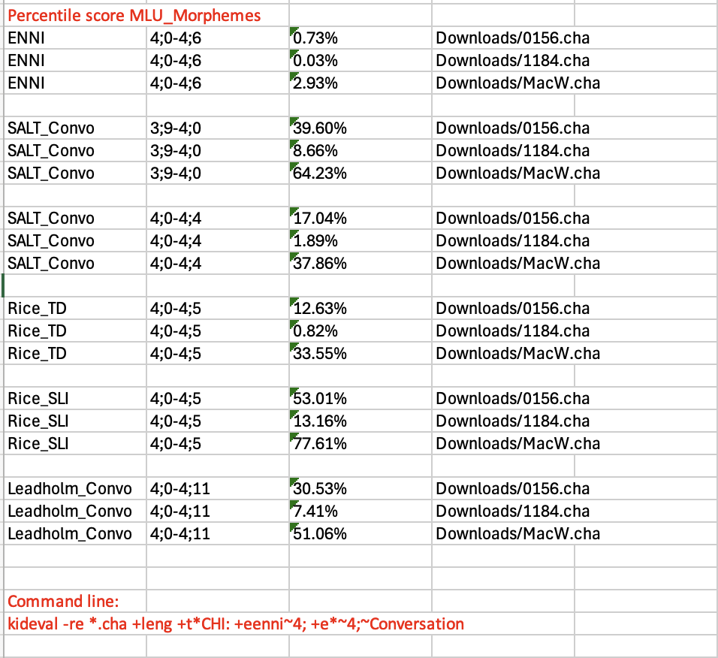
RefVals
If multiple .cha files are analyzed at once, KIDEVAL will output a score for each .cha file, for each dataset, labeled with the filename. For example, this call analyzed three .cha files and compared the children to six dataset age bins:

Slide 24
Tool #8: TalkBankDB
Searches based on database, corpus, child, age, gender, type,
Results downloaded to client in spreadsheet
Or file download
Currently integrating CLAN
Type/token, CQL, n-grams, graphs
Cross-tier analyses

Slide 25
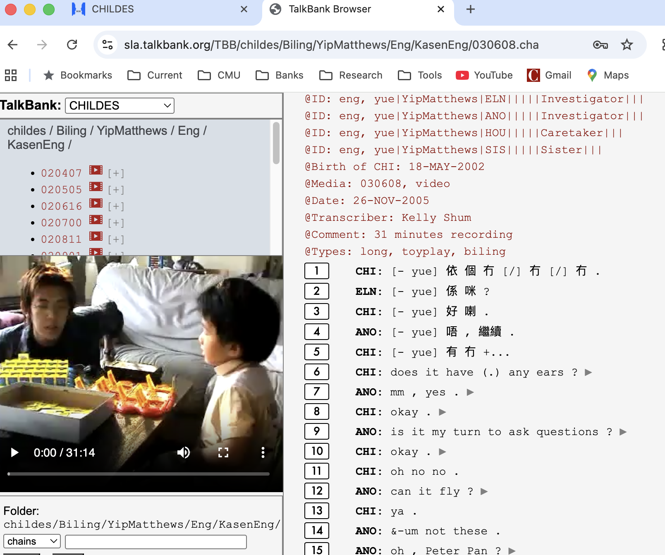
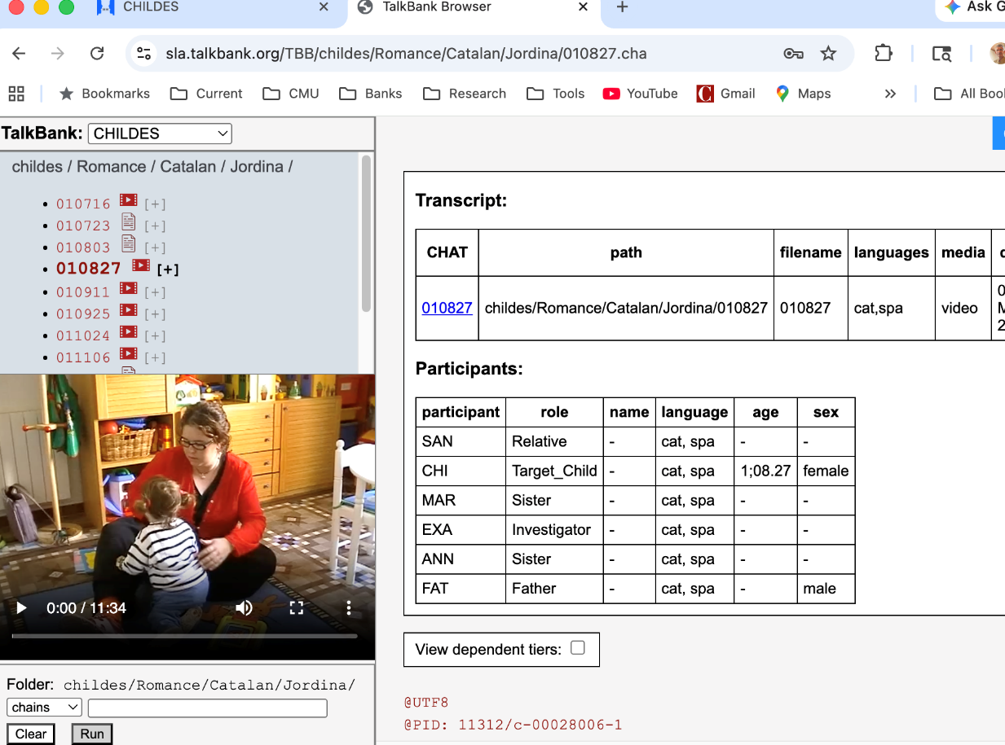
Tool #9: TalkBank Browser

Slide 26
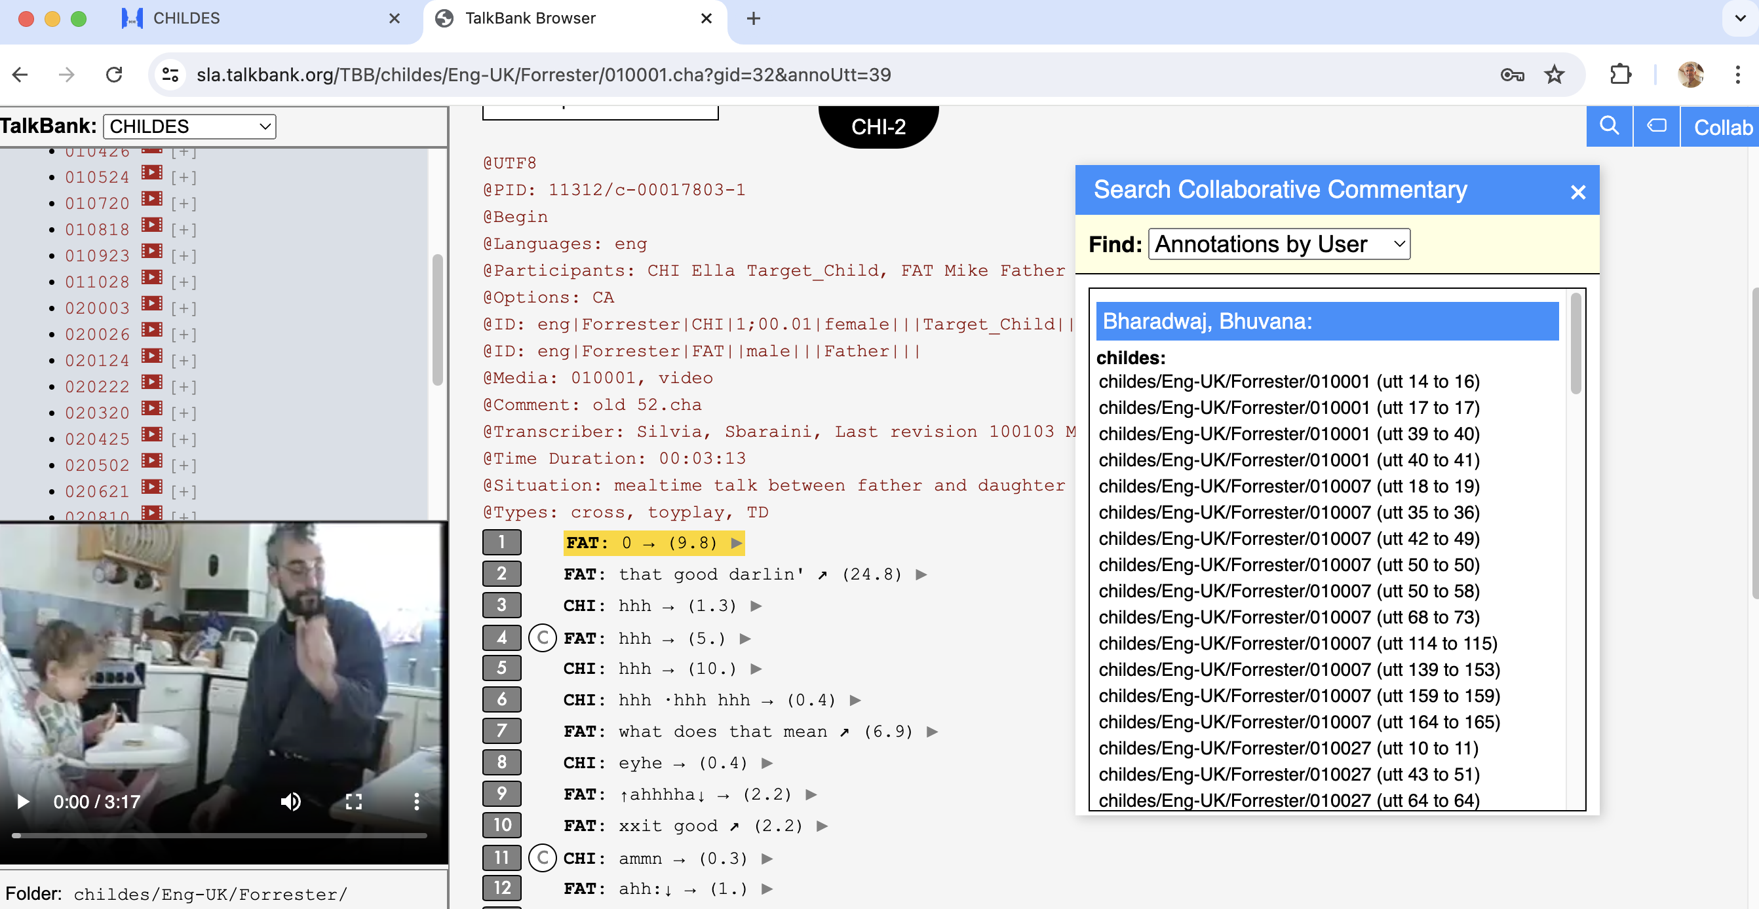
Tool #10: Collaborative Commentary

Slide 27
Browsable Database Example
Start at https://talkbank.org
Go to AphasiaBank, Browsable Database
(or go directly to sla.talkbank.org/TBB)
Read instructions (once)
Pick a transcript: Aphasia/Adler / adler06a
Go to line 6, play, stop
Enter Collaborative Commentary

Slide 28
Tool #11: AI restructuring
Complete redo of the TalkBank infrastructure, using Claude to debug commands, restructure Git repositories, debug connections through TailScale and system deployment across machines
Claude digested all of Batchalign, CLAN code, TalkBank data, Stanza code, the manuals, along with lots of guidance from Franklin Chen, while using its vast knowledge of programming and language (Cantonese segmentation, deromanization, and Romance morphology).
Claude has created new versions of CLAN and CLAN editor. Done in days what took decades to build

Slide 29
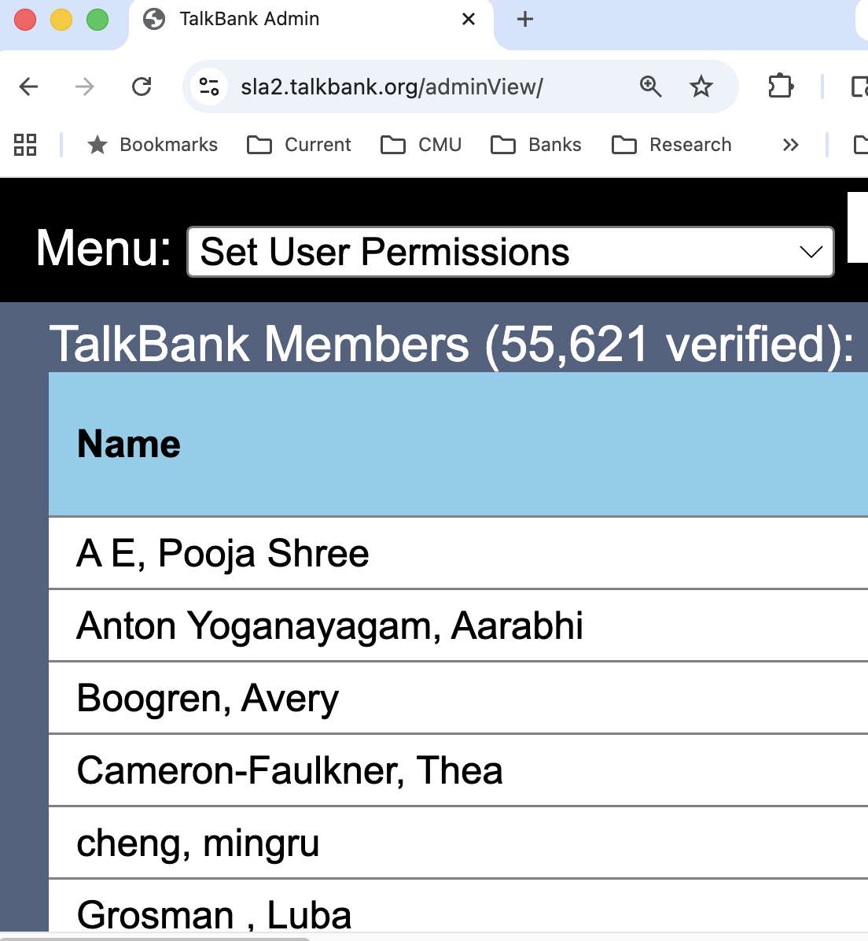
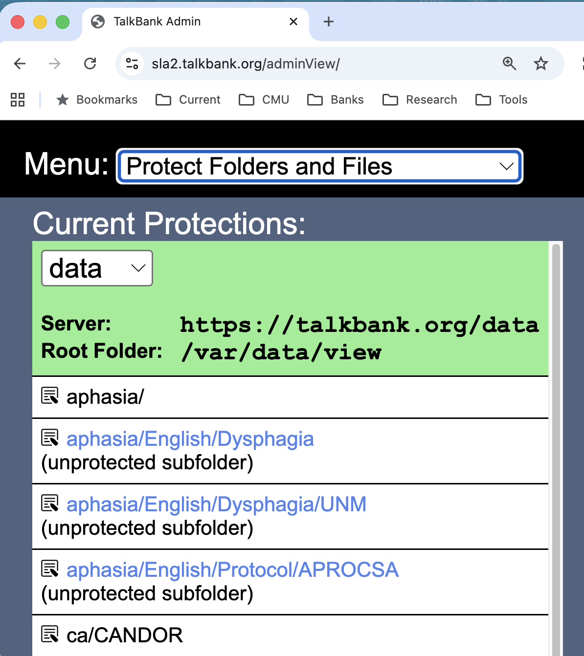
Tool #12: Authorization, IRB

Slide 30
Access Levels
Basic password protection: We can track usage to detect incorrect access
Access can be controlled by membership levels: students must be supervised by faculty
Vetting of membership for HomeBank and PsychosisBank
Contributor control for most sensitive material
Embargo, Archiving

Slide 31
Informed Consent
Consent forms should not have exclusionary language such as "These data will only be made available to Professor XYZ and her laboratory” or “these data will be destroyed after X years”. If the consent forms says "These data will only be made available to qualified researchers," then inclusion in TalkBank should be allowed by all IRBs including GDPR, because access to TalkBank is password protected and informed consent is given.

Slide 32
Tool #13: Fleet Deployment
PyInfra: central controller to all TalkBank machines, reads current code for deployment from GitHub
GitHub: stores deployment code
TailScale: peer-to-peer VPN from GitHub
launchd: keeps programs running on MacOS
NFS: allows machines to read media from central server
macOS Keychain: holds API keys for outside services

Slide 33
Tool #14: Internationalization
PyInfra fully deploys to PolyU and Shanghai machines: all of TalkBank in ~/0tb/data (repos), ~/0tb/web (repos), and ~/media(NFS)
PolyU machines can push and pull the data from GitHub repositories, using: tb status, tb pull, tb check, and chatter
System uses CMU computing resources through Batchalign3
Updating 110,000+ files (relying on caching) takes seconds.
When ready, PolyU can set up a fully parallel site

Slide 34
Tool #15: Benchmarking
.017 WER (Word Error Rate) on TED Talks
.053 WER on ENNI 4-year-old DLD recording
.06 WER for most 7-10 Mandarin story telling
Varieties being evaluated: TED, Psychosis, RHD, TBI, MCI, CallHome, ENNI, MacWhinney, SanJoaquin, Class-APT, AWS, CORALL, Lego, CWS, Anomia, Broca, Wernicke
What ASR can’t do well: Rescorla 2-year-olds, Sekali (noisy), Pawley’s (jargon)
Projects from Buffalo AI, MindAI, Gates for better child ASR

Slide 35
Child #1: CHILDES
Began in 1984
Openly available, all aligned if there is media
28 languages all in UD format, including Mandarin, Cantonese, Korean, Thai, Japanese
158 corpora – cross-sectional, longitudinal, narrative, disorders, bilinguals,
Used in 8250 studies
Automatic profiling through KidEval

Slide 36
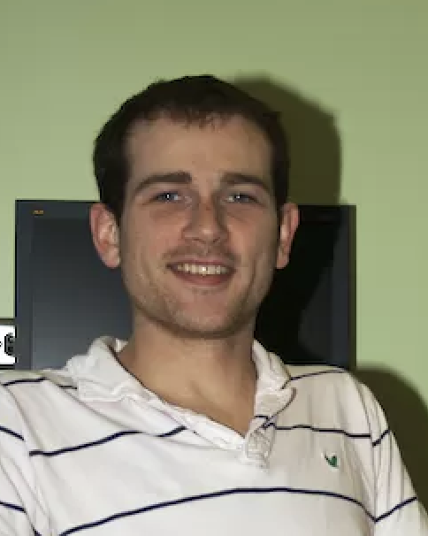

Child #2: PhonBank
Processed through Phon (download from phon.ca)
Phonological level transcription in IPA
Automatic insertion of target, hand entry of child
Automatic syllabification
All major current profiling analyses supported (PCC, etc.)
Yvan Rose & Greg Hedlund

Slide 37
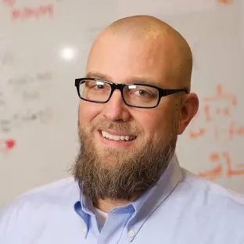
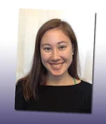
Child #3: HomeBank
Daylong LENA recordings in the home
Audio is being recognized by ASR. Results are remarkably good for adults. Children are often prelingual.
Public, Password, and Secure access
Mark VanDam and Anne Warlaumont

Slide 38
ASR for HomeBank
10-hour San Joaquin – Public
Runs in 54 minutes on M2 Mac using Whisper
MOT is accurate, but baby’s cries are missing ➔ fine-tuning needed
*MOT: hi [/] hi good morning . •145740_147780•
*MOT: sweet pea . •147780_148400•
*MOT: how are you . •148400_150060•
*MOT: good morning sweet pea . •150060_154400•
*MOT: good . •154400_155240•

Slide 39
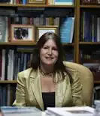
Child #4: FluencyBank
18 corpora, mostly from English, one French, one German
Precise coding and time alignment facilitate analysis
For children, the issues are:
  Who recovers and who doesn’t and why?
  What is the role of parental input, recasting?
For adults, the issues relate to therapy, strategies, identity, group acceptance
Nan Bernstein Ratner - Maryland

Slide 40
Child #5: ASDBank
English (8), French (2), Mandarin, Greek, Dutch corpora
Video and audio are important
Media access is restricted, but possible

Slide 41
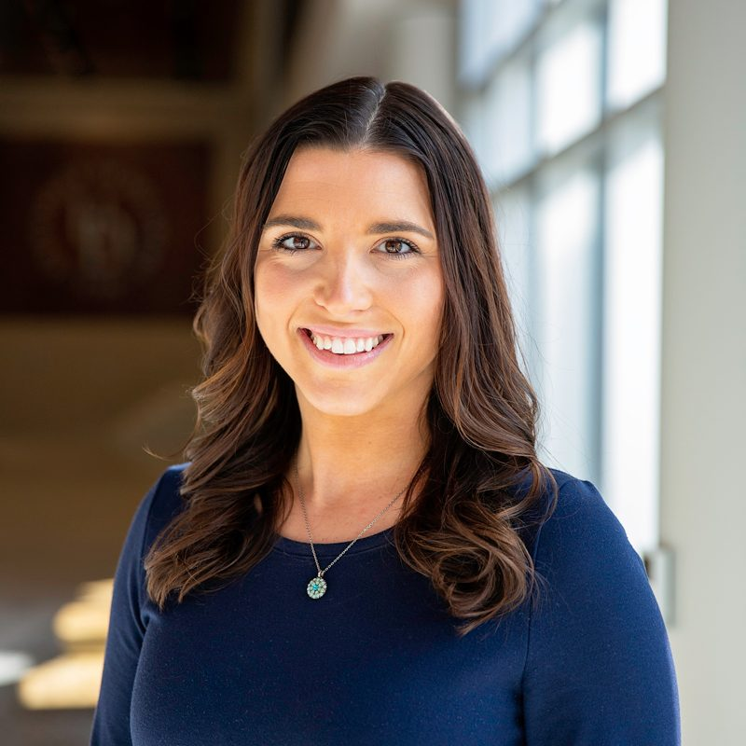
Clinical #1: DementiaBank
The global challenge of dementia diagnosis
Pitt corpus as the only publicly available language data
300 MCI/AD and 200 controls with Cookie Theft
Over 400 computer science labs using the Pitt corpus to create methods for AD detection.
Alyssa Lanzi’s new longitudinal data

Slide 42
Challenges
  ADReSS 2020 Interspeech - Frontiers
  ADReSSo 2021 Interspeech – audio only
  ADReSS-M ICASSP – Multilingual, Greek English
  TAUKADIAL-2024 – Chinese and English
  W3PHIAI-22 Data Hackallenge with Toolkit
  DrivenData Dementia 2024
  DrivenData Child Language 2025
  170 entries

Slide 43
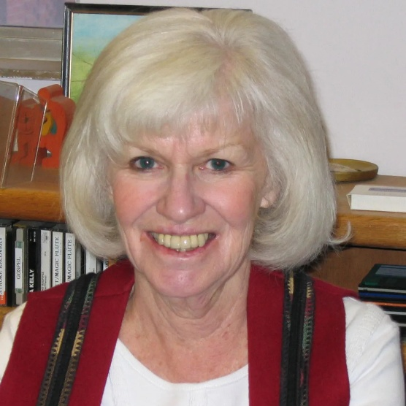
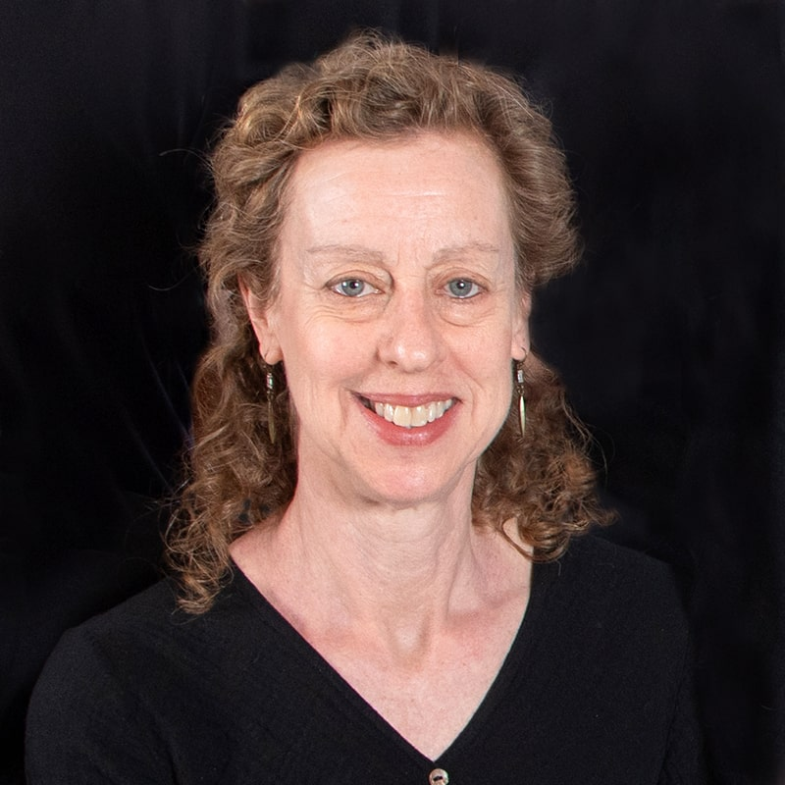
Clinical #2: AphasiaBank
Protocol – 520 sessions, 422 participants, 322 control
LLM and ML for diagnosis and classification
EVAL for automatic analysis
Analyses: lexicon, grammar, gesture, cohesion, fluency, AoS, phonology
Grand Rounds
Script training (evaluation in progress)
AoS and motor speech (in progress)
Audrey Holland and Davida Fromm

Slide 44
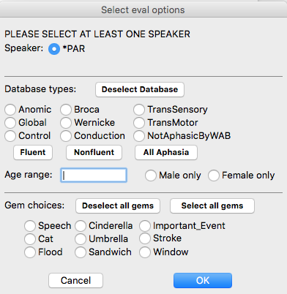
Choices for Comparison Group

Slide 45
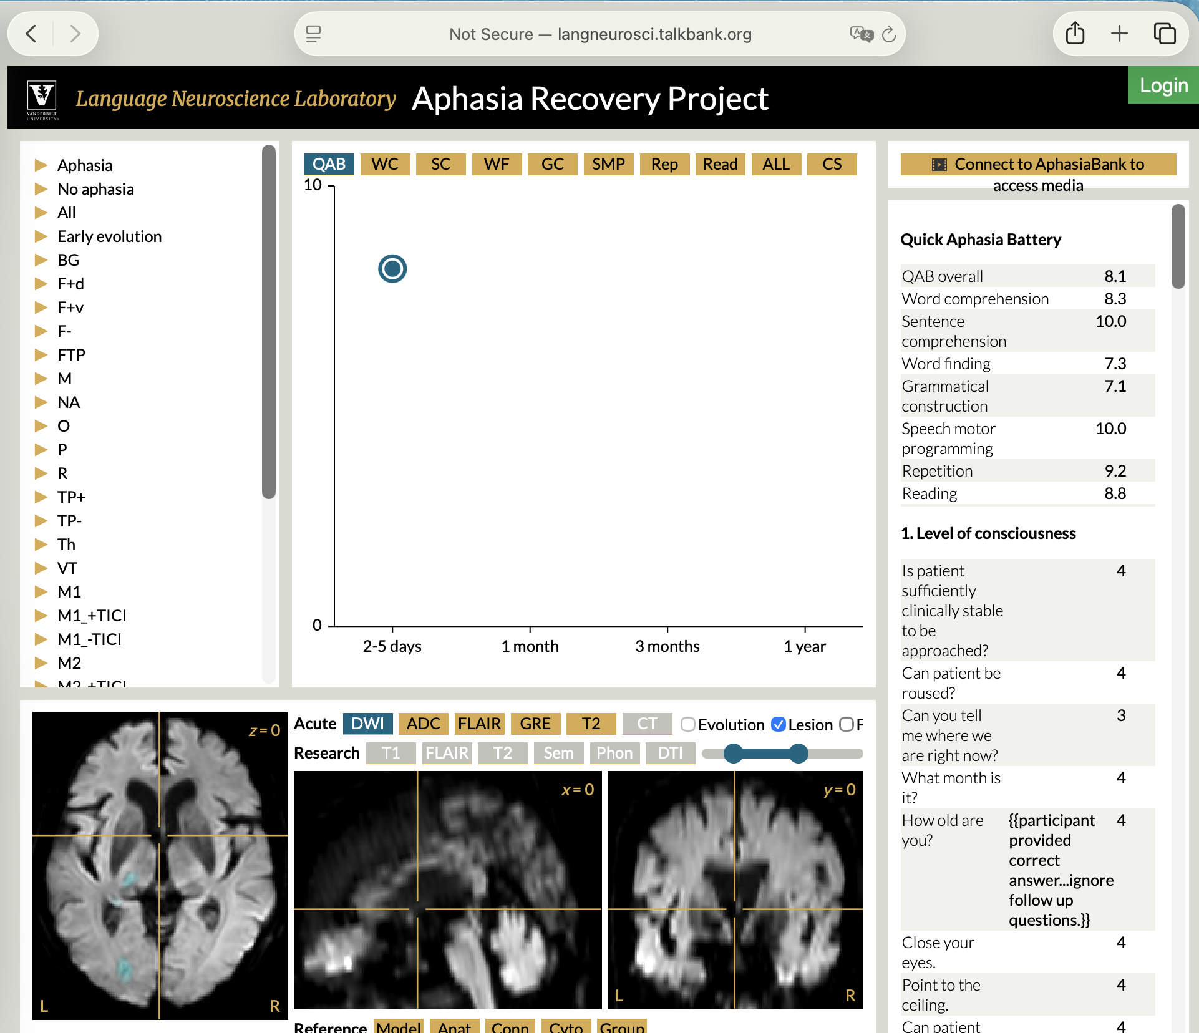

Scans Online
Stephen Wilson, Queensland

Slide 46
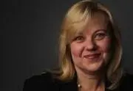

Clinical #3: TBIBank
Uses the AphasiaBank Protocol and free interview
58 participants with TBI at 3, 6, 9, 12, and 24 months after injury
All linked to video, all analyzed for morphosyntax and coreference
Analyses using CC and focus on returning to work
Leanne Togher and Elise Bogart from Sydney

Slide 47
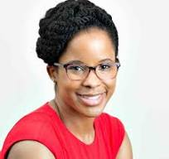
Clinical #4: RHDBank
Uses the AphasiaBank protocol and additional tasks
TBI, RHD, and PsychosisBank focus on issues with discourse, cognition, communication, not just grammar or phonology
Collaborative Commentary (CC) and Grand Rounds linked to CC
Jamila Minga

Slide 48
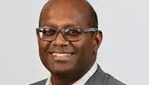
Clinical #5: PsychosisBank
Large English corpus from Lena Palaniyappan (400 participants)
Standard protocol with personal narrative, health narrative, picture descriptions, dream reports, and story recall
Computational analysis group works on LLMs, graphs, TLI analysis, vocal features

Slide 49
Multilingualism #1: BilingBank
Code-switching: Miami and Eppler
Sociolinguistics: Brazilian Russian, Istrian Italian/Croatian
Other corpora focus on bilingual experience: Turks in Denmark, Greeks in France, Japanese in Columbia
Batchalign can transcribe, align, and morphotag bilingual and even trilingual recordings

Slide 50

Multilingualism #2: SLABank
10 L2s with a focus on English, Spanish, French, and Mandarin
Most linked to audio or video and all analyzed by UD
Great target for CALF analysis (complexity, accuracy, lexical richness, and fluency) all based on use of TalkBank programs.
Nicole Tracy-Ventura - Oklahoma

Slide 51

CA #1: SamtaleBank
Excellent CA coding of interactions in Danish
CA coding implements all the features of Jeffersonian coding
Most are linked to video
Johannes Wagner, SDU
Conversations with 1, 2, 3, and 4 speakers
Also radio and telephone conversations.

Slide 52
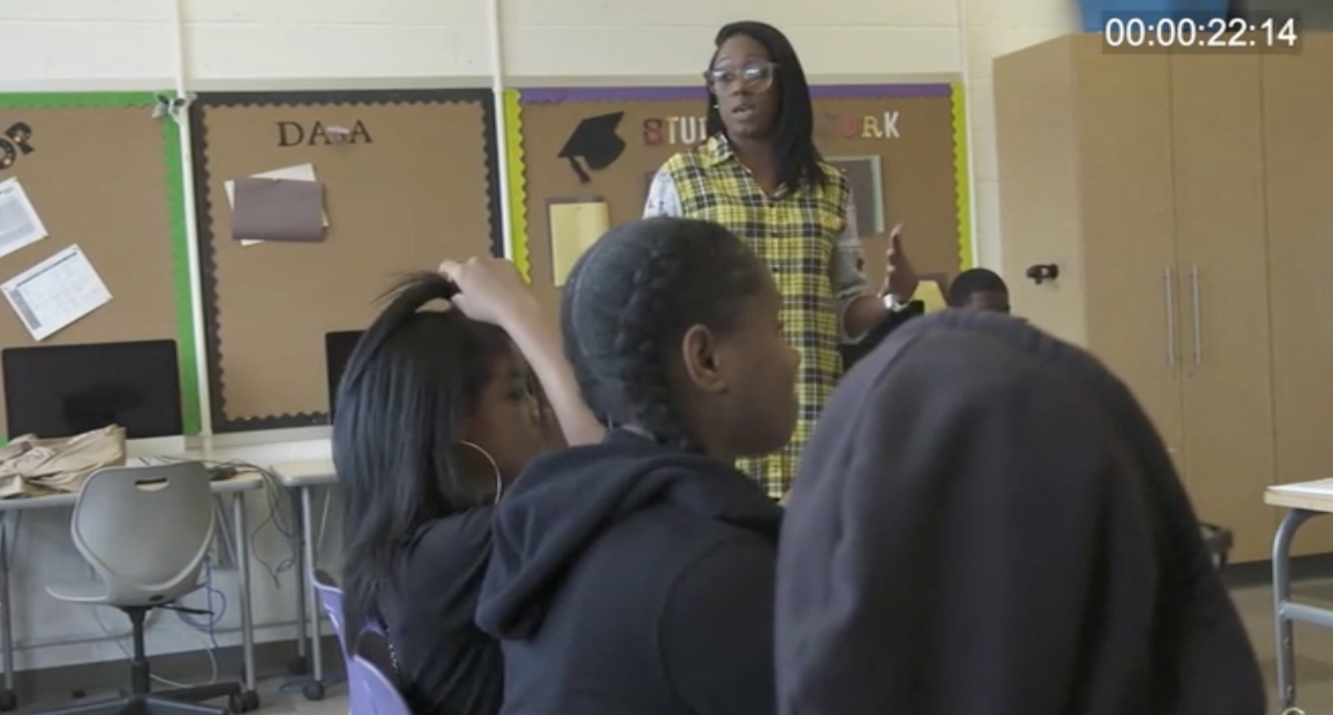
CA #2: ClassBank
All in English except for TIMMS-Math/Science
Corpora all link to CA and Discourse theory papers
Full year corpus of 2nd Grade Geometry from Rick Lehrer
Group analysis of the APT corpus in CC

Slide 53
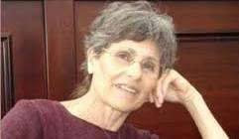
CA #3: CABank
CallHome, CallFriend, SCOTUS, MICASE, SBCSAE, CABNC, Goodwin, Watergate, Newport Beach, Sakura, SLX, CORAAL
LangBank: Mambila, Nahuatl, Mixtec, Mopan, Hakka, Yiddish, Yucatec, Istriot
And many more
Gail Jefferson

Slide 54
Outreach
Tutorial Screencasts
Online manuals, documentation
Workshops, plenaries, Zoom
Google Groups lists
IASCL Newsletter – Angel Chan
Advisory Board
New initiatives

Slide 55
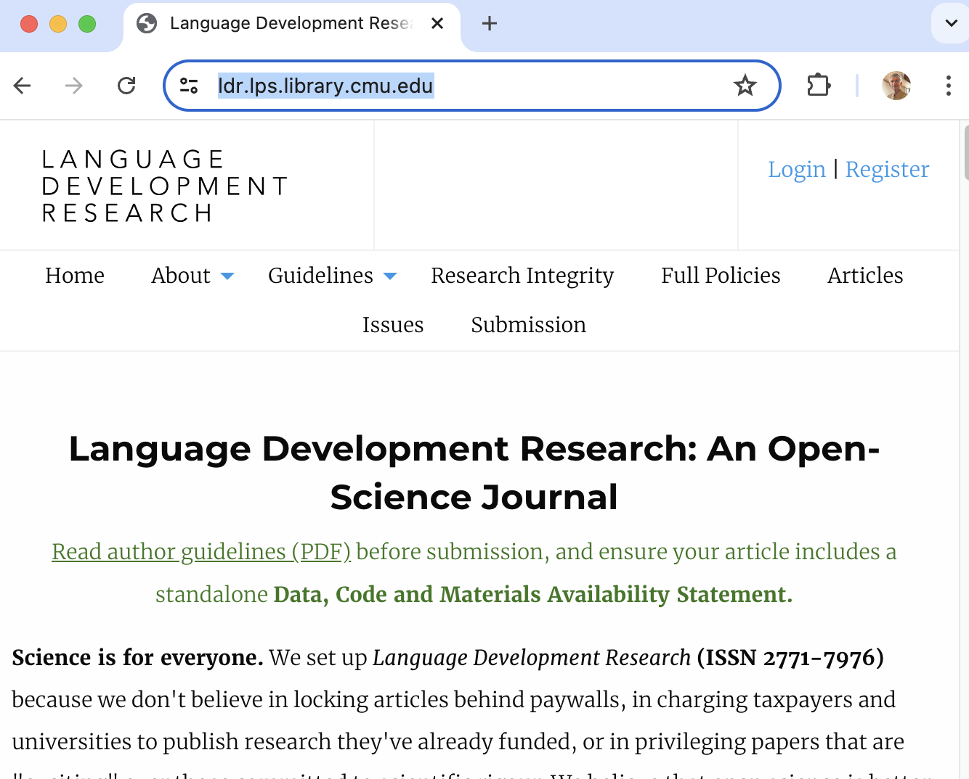
Open Publishing

Slide 56
The Future
International deployment of TalkBank at multiple sites through dockerization
Data: multilingual, multimodal, diverse, longitudinal
Daylong and ESM (experience sampling method) data
Child language learning as the new Turing Test
Aligning with the brain
AI for understanding development and remediation

Slide 57
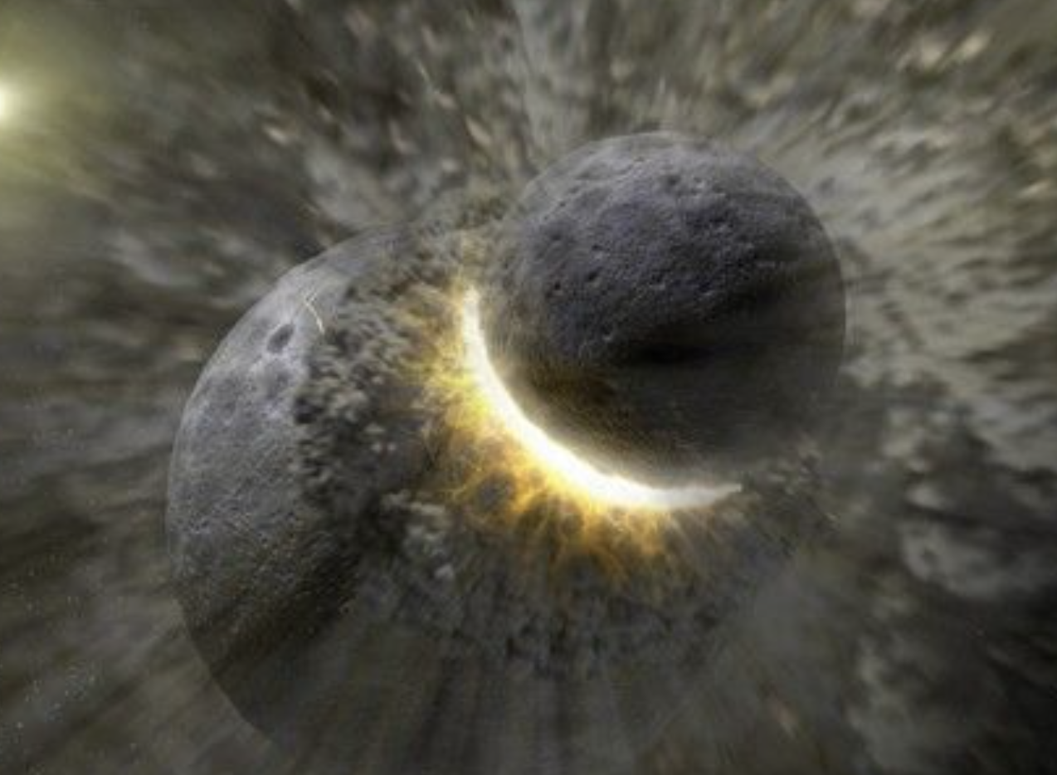
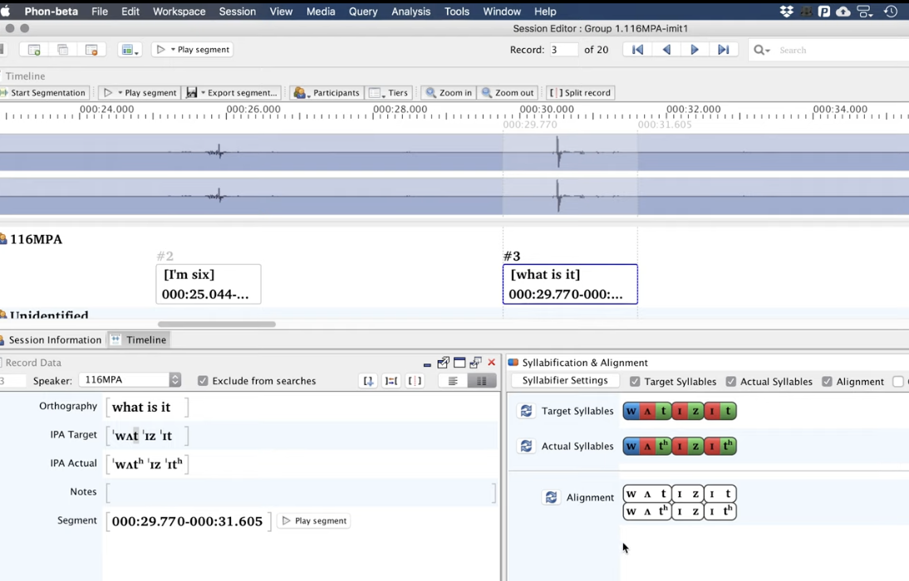
Stories of the Rocks and Words
Theios and Earth 4.5 billion years ago
Phon and Syllables

Slide 58
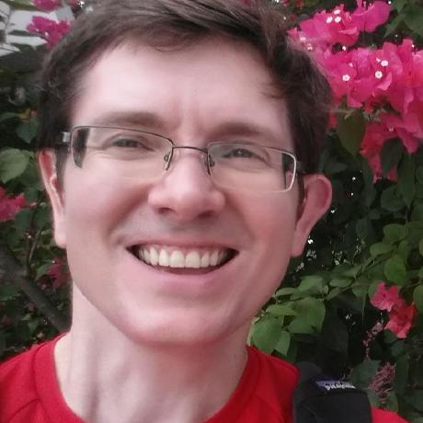
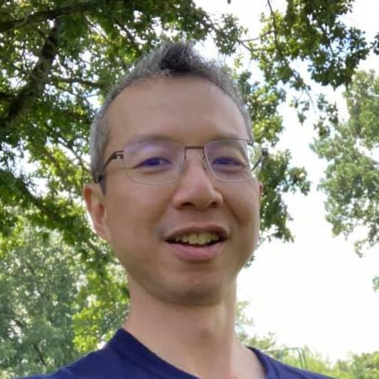


Programmers
John Kowalski: CC, DB, Auth
Franklin Chen: Cross-Tier, deploy
Greg Hedlund: Phon
Houjun Liu: Batchalign
Leonid Spektor: CLAN

