Slide 1

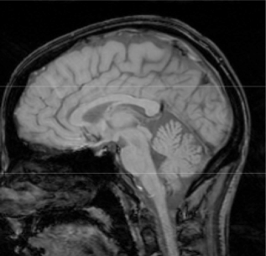
Language in children with early brain injuries: behavioral and imaging evidence of plasticity
Brian MacWhinney, CMU
Heidi Feldman, Pitt
Kelley Sacco, CMU
Notes:
Thanks. Special to come to Chicago. Reference to Huttenlochers, Reference to Susan G-M.
My topic today is language in children with neurological injuries. The neural basis of language remains an area of intense scientific study in part because language is a uniquely human facility, and therefore the organization of language in the human brain gets at core issues of
Language function is also of great interest to all who work with children. Language
Greatly expands our capacities
Enables communication about present, past or future events and emotions
Increases the scope of learning about concepts and ideas
Supports cognitive processes, such as memory and categorization
Contributes to control of behavior

Slide 2
Outline
Preformation/Emergentism -- Seven theories
Development of language in preschool children with early unilateral brain injuries
Performance at school age
  Formal measures
  Sentence comprehension strategies
  Information processing tasks
fMRI to uncover patterns of reorganization of language

Slide 3
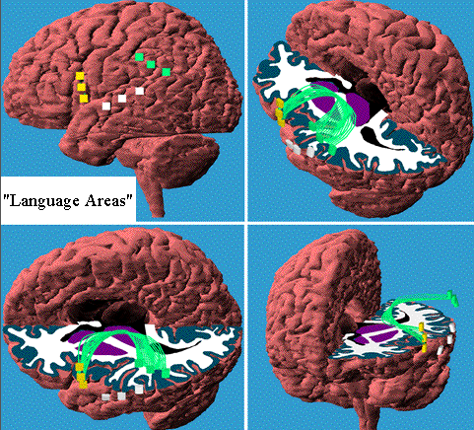
Classic theory:
Language modules in adult brain
Front
R
Front
L
L
Back
Back
Notes:
Language in the adult brain is localized to two discrete and highly specialized areas of the LH and the connections between those areas.
Here is a schematic of the human brain.

Slide 4
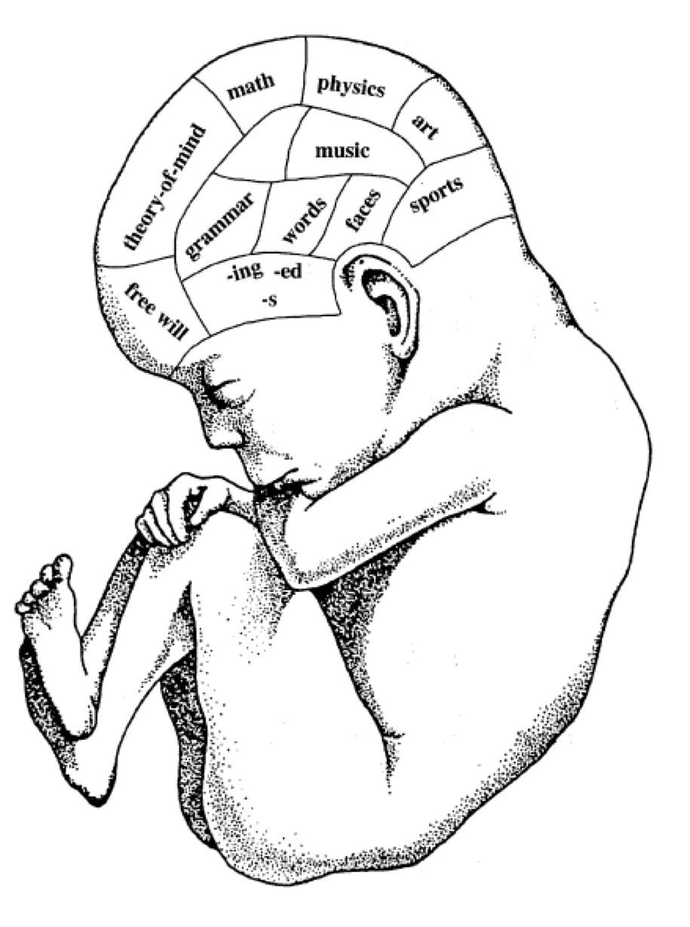
Modules from birth?

Slide 5

A toolkit
Notes:
Highly differentiated instrument, comprised of many discrete and highly specialized tools.

Slide 6
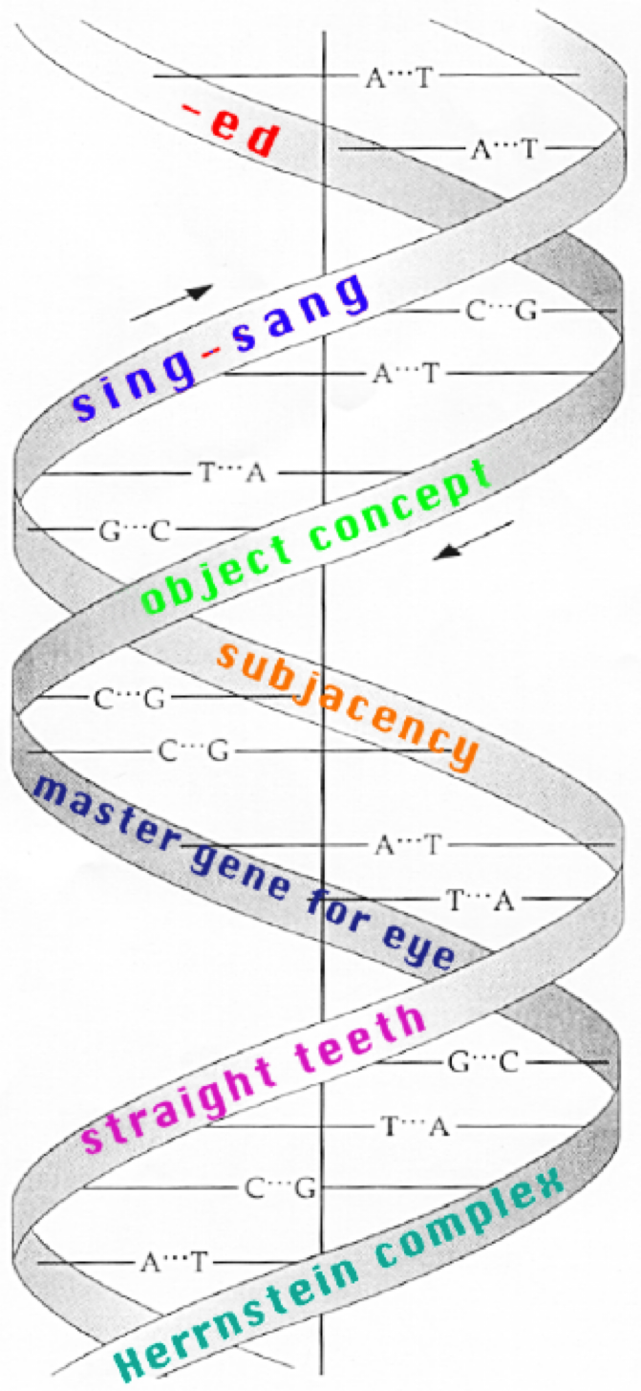
A Gene for the Past Tense?

Slide 7
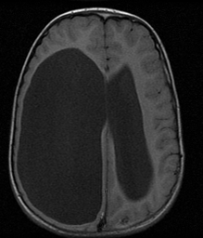
Achilles’ Heel of Modularity: a child with marked hydrocephalus and normal language

Slide 8
Alternative theory:
Emergentism
Language areas not highly circumscribed nor highly specialized, though LH dominant
  RH becomes activated for various components or levels of difficulty
  After injury, recovery may be possible with training
Notes:
New experimental methods that assess the neural substrate of language in awake and processing individuals have revolutionized the classic theory.

Slide 9
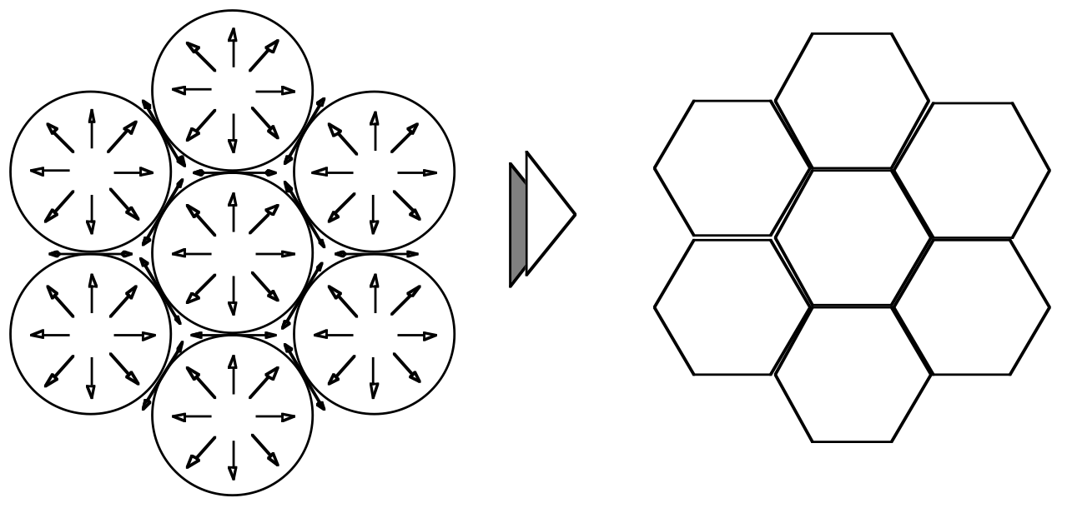
Structure in Honeycombs

Slide 10
What happens if early damage?

Slide 11
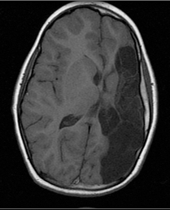
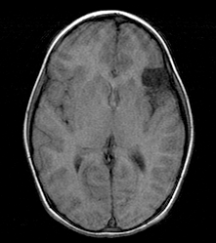
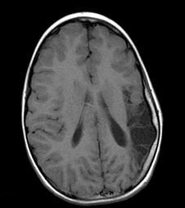
Children with early brain injury
Front
R
L
R
L
R
L
Back

Slide 12
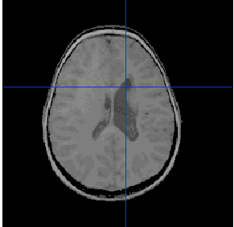
MRI scans of PVH

Slide 13

Child with early brain injury

Slide 14
Seven observed patterns
1. Preferential language sparing
2. Cognitive crowding
3. Hemispheric equipotentiality

Slide 15
4. Contralateral recruitment
5. Local recruitment
6. White matter commitment
7. Late rigidity

Slide 16
Lack of direct evidence
No direct evidence of crowding
No direct evidence of use of contralateral homologs
Unclear evidence on equipotentiality
No direct evidence of local recruitment
No direct evidence on actual organization

Slide 17
Open Developmental Questions
Initial delay -> catchup -> final parity? OR
Sparing -> cognitive crowding -> decline in late acquisitions (math, reading)
Exactly how does brain reorganize?

Slide 18
Language development in children with early brain injuries
(Feldman, Holland, Kemp, Janosky, 1992)
To describe the changes over time in language skills of young children learning language
Multiple observations of parent-child communication
  Lexicon—Number of words
  Syntax—MLU and IPSYN
Compare children with unilateral LH and RH damage to children developing typically

Slide 19
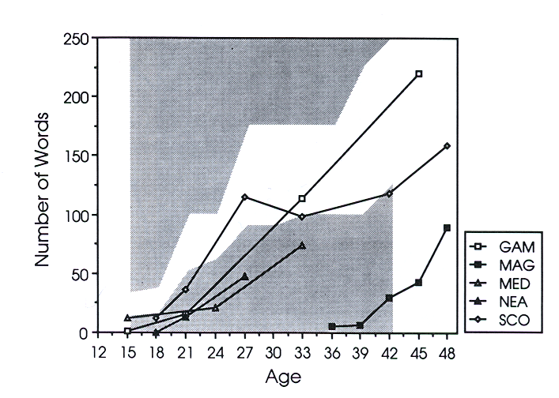
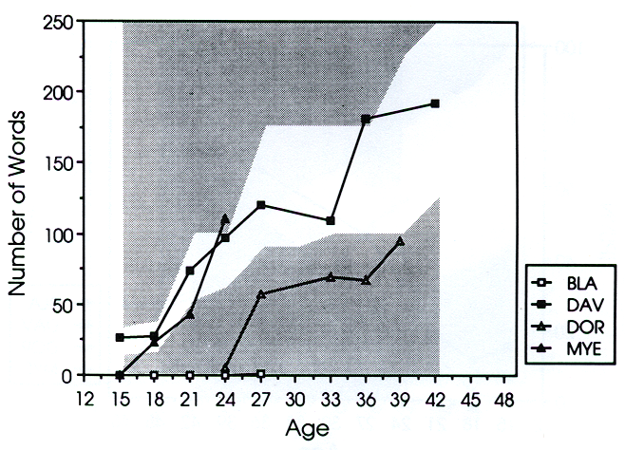
Vocabulary growth
LH injury
RH injury

Slide 20
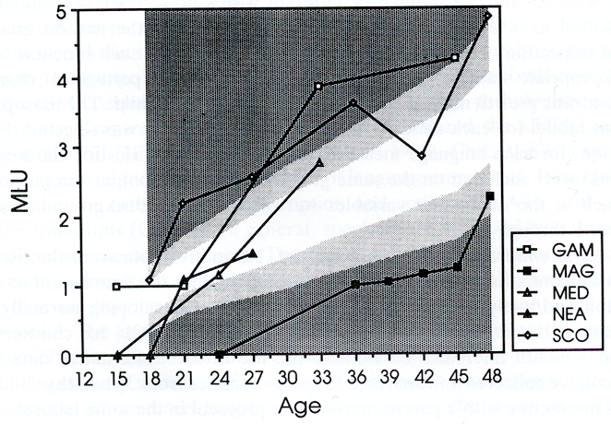
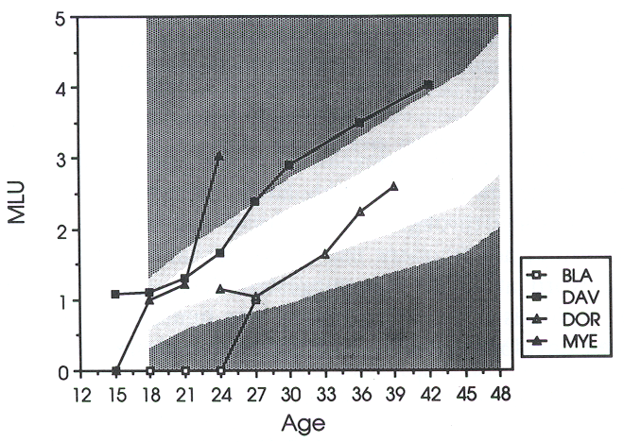
Average sentence length
LH injury
RH injury

Slide 21
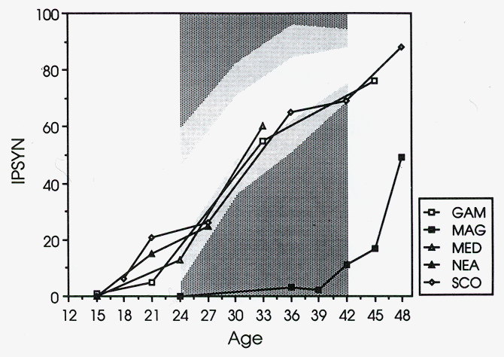
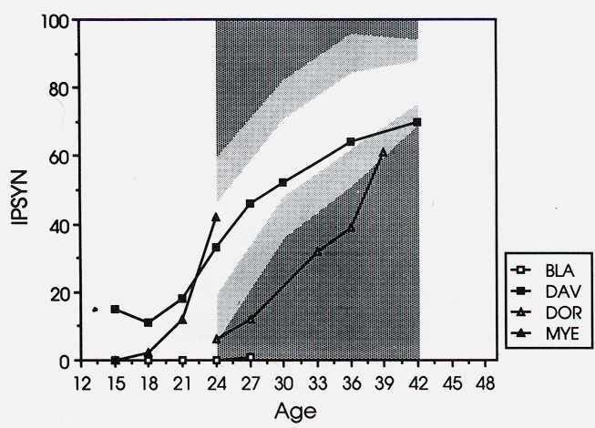
Grammatical complexity
LH injury
RH injury

Slide 22
Summary and Questions
Children with early brain injuries may show initial delays and then near normal rates of development
Suggests takes longer to organize the damaged system
Issues
  What are the best measures to assess early language in these children? Types versus tokens, competence versus performance
  Would larger sample reveal greater difference?
  What happens as the children reach school age?

Slide 23
Formal testing at school age
(MacWhinney, Feldman, Sacco, Valdez-Perez, 2000)
Goal: to determine how children with early brain injuries perform on formal measures at ages 6 to 10 years
Measures
  Non-verbal intelligence test (Leiter International Performance Scales)
  Receptive vocabulary (PPVT-R)
  Language Functions (CELF-R)

Slide 24
Formal Testing Results

Slide 25
Formal Language Measures

Slide 26
Sentence comprehension study
(Feldman, MacWhinney, Sacco, in press)
Goal: to determine the cues children use to determine the agent of the action in sentence-comprehension
  Syntax is area of alleged weakness in many studies of children with acquired injuries
  Functional tasks better than judgments
  To isolate sentence comprehension strategies, need task with minimal other processing demands: simple input, no memory load, and non-verbal (pointing response)

Slide 27
Task
On-line “who done it?” task
  Sentences were simple
    Varied by word order: NVN, VNN, and NNV
    Nouns were animate or inanimate
    No intonation cues
  Words and picture stimuli presented simultaneously on computer screen
  Child indicates the agent by pointing to the appropriate picture
  Yields accuracy and reaction time

Slide 28
Stimuli
NVN-AA The cat kissed the bear.
NNV-AI The lion the pencil watched.
VNN-IA Hugged the block the camel.

Slide 29
Typical development results
3-4 year olds decide on the basis of animacy
5-6 year olds choose first noun in NVN
7-8 year olds choose first noun in NVN and second noun in VNN
9-10 year olds choose second noun in NNV, adult pattern
(Von Bergen et al, 1996)

Slide 30
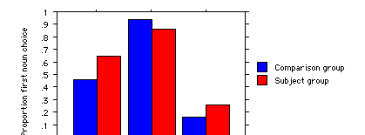

First noun choice
Main effect of word order p<.001
Main effect of group p=.058
Interaction of word order X group p = .027

Slide 31
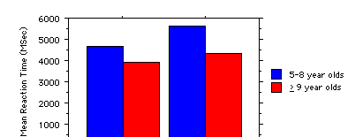

Reaction Time
Main effect of word order p < .001
Main effect of age p=.037

Slide 32
Parameter estimates
 | Controls |  | Subjects
 | Younger (n=82) | Older (n=59) | Younger (n=7) | Older (n=5)
Animacy | .5891 | .5782 | .5598 | .5374
NVN | .9242 | .9720 | .8131 | 1.000
VNN | .1955 | .0967 | .2460 | .1891
NNV | .4746 | .4428 | .6428 | .6684

Slide 33
Children with RH damage
N = 3
2 children were delayed
The only child of the 15 subjects to show mature strategy on the NNV was one with RH PVH

Slide 34
Summary
Unexpected developmental delays in children with LH and RH brain injuries in sentence comprehension strategies
Variability in performance across the group
Would be useful to assess children > age 12 years

Slide 35
Developmental course after early brain injury

Slide 36
Information processing tasks
(Feldman, MacWhinney, Sacco, Valdez-Perez, 2000)
Goal: to identify specific patterns of impairment as a function of lesion location as source of language and sentence comprehension profiles
Tasks—computerized tasks
  Picture naming, number naming, word repetition
  Also, digit span task
Measures—accuracy and reaction time
Data analysis—profiled subjects’ scores in comparison to scores to 150 children at appropriate grade for age

Slide 37
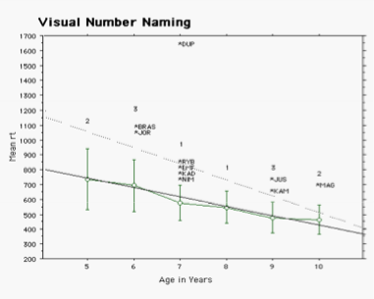
Results
Out of range:
Ss 10/20
Cs 12/150
Notes:
12 / 150 outside range 8%
10 / 20 or 50%

Slide 38
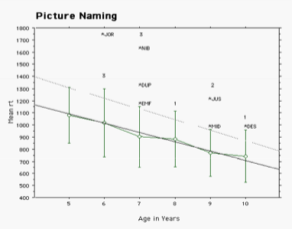
Results
Out of range
Ss 7/20
Cs 10/150

Slide 39
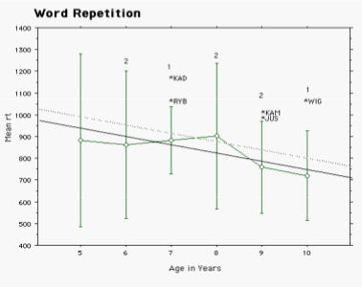
Results
Out of range:
Ss 5/20
Cs 7/150
Notes:
7 / 150 outside range = 5%
5/20 with BD = 25%

Slide 40
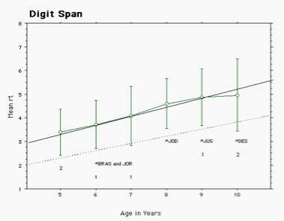
Results
Out of range
Ss 5/20
Cs 7/150

Slide 41
Children’s net outlier scores
-8+ -7 -6 -5 -4 -3 -2 -1 0 1 2 3 4 5 6

Slide 42
Language Sparing
Focal lesions kids didn’t do poorly overall
All scored within 95% confidence interval from the normal mean on at least half of the tests

Slide 43
Language Deficit
Children with the lowest scores were usually the focal lesion kids
Each focal lesion child had at least one test for which they scored significantly below normal

Slide 44
Summary
No highly specific pattern associated with lesion location
In general, children with brain injury perform simple information processing tasks more slowly than peers
Suggestion that children with LHD have selective difficulty in naming
Need for larger sample and more language-related tasks

Slide 45
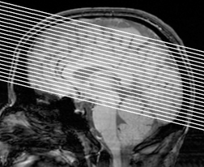
How is the brain organized to serve language in children?

Slide 46
fMRI: assesses function through hemodynamic consequences
zzz
I’m up!!
Inactive state
Active state
Notes:
Increases in regional brain activity lead to increased blood flow to the region
Increase flow of oxygenated blood is greater than oxygen consumption
In active area greater concentration of oxygenated blood in venous bed
Oxygenated blood has different magnetic susceptibility than deoxygenated blood
MR signal intensity increases in areas of increased flow: BOLD

Slide 47
Uses of fMRI
Basic question: Where is a specific operation performed in the brain?
Measures
  Identity of brain regions involved: Region of interest
  Magnitude of activity in those regions
  Spatial extent of activation
  Correlations among activity in brain regions

Slide 48
Brain activation during sentence comprehension
(Booth, MacWhinney, Thulborn, Sacco, Voyvodic, Feldman, 2000)
Goals:
  Describe developmental differences in brain activation during sentence comprehension
  Describe functional organization of sentence processing in children with early brain injury
Hypotheses:
  LH activation in adults and children
  RH activation in children with LHD

Slide 49
Methods
Subjects
  A: 20-28 year old right handed (n=5)
  C-NN: 9-12 year old right-handed (n=7)
  C-BI: 9-12 year old (n=6)
    3 LH stroke
    2 LH periventricular hemorrhage
    1 RH stroke

Slide 50
Sentence comprehension task
Auditory presentation of 3 sentence types
  CVP: The cat chased the rabbit and enjoyed the hunt.
  SR: The principal that tripped the janitor used the phone to call home.
  OR: The pig that the dog followed ate the trash in the street.
Comprehension test after each presentation
  T/F: The principal used the phone to call home. (T)
  T/F: The dog ate the trash in the street. (F)

Slide 51
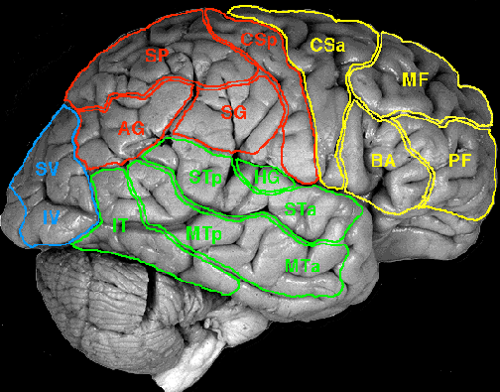
Analysis: 17 ROI

Slide 52
Results: Percent errors
Sentence Types
Participants
CVP
SR
OR
Adults
11%
7%
18%
Children
36%
32%
36%
Children with brain injury
42%
51%
42%

Slide 53
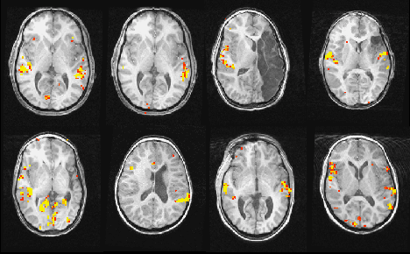
Results sentence processing
Adults
Children
SJ
BR
Left
Right
MK
MM
GM
DK

Slide 54
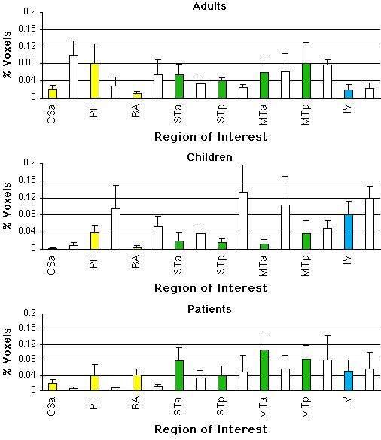
Results by ROI
Colored bars RH
Open bars LH

Slide 55
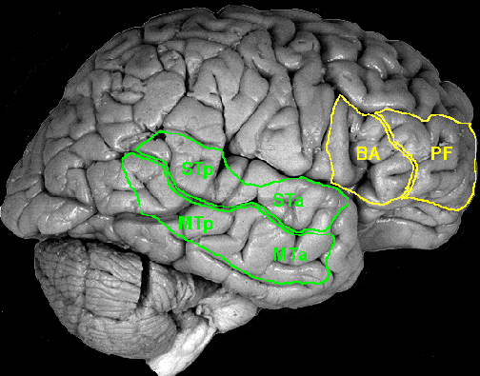
Network for sentence comprehension

Slide 56
Summary
Activation patterns for sentence comprehension show developmental change
  Greater levels of activation in adults
  Bilateral activation in adults
Children with brain injuries show more errors than do children and adults
Children with LH injuries show shift to increased RH activations

Slide 57
Verb generation and mental rotation
Verb generation
  Presentation of pictures of common objects
  Instruction: “Say to yourself as many actions as you can do to or with each object presented”
Mental rotation
  Presentation of 2,G at 0⁰, 135⁰, 180⁰, and 225⁰
  Decision about direction of letter/number
Rest for both conditions
    Presentation of cross

Slide 58
Post-acquisition SPM99 processing:
Adult and Children groups
Steps in individual Analyses
Realignment
Co-registration
Smooth to
FWHM 3 x voxel
Inspection and
Comparisons
Steps in group analyses
Smooth to
FWHM 3 x voxel
Normalized
Analyses

Slide 59
Post-acquisition processing –
Children-BI
Case study approach
Smooth to
FWHM 3 x voxel
Realignment
Co-registration
Inspection and
Comparisons

Slide 60
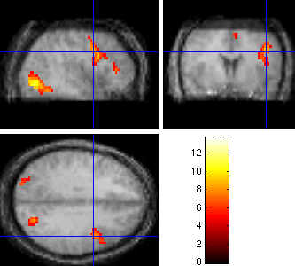
Verb generation - adults
L
L

Slide 61
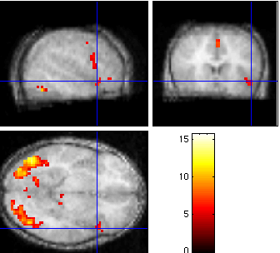
Verb generation -- children
L
L

Slide 62

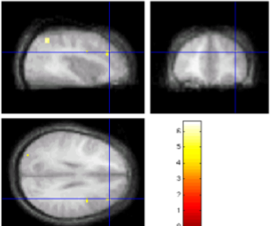
Adults minus children

Slide 63
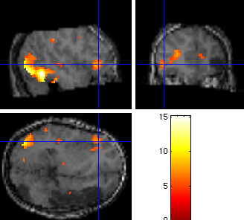
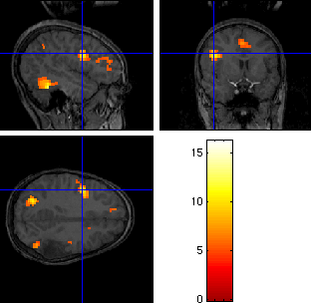
Verb generation—children with LH stroke
R
L
R

Slide 64
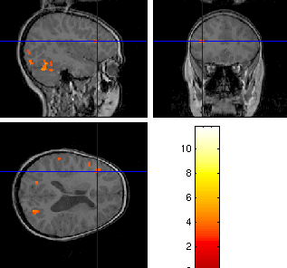
Verb generation – children with L-PVH

Slide 65
Laterality index

Slide 66
Proportion of anterior activation

Slide 67








Mental Rotation Stimuli
Targets
Distractors

Slide 68
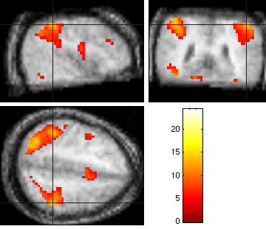
Mental rotation - adults

Slide 69
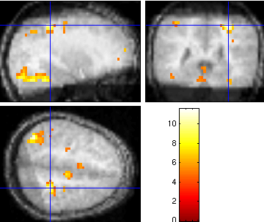
Mental rotation -- children

Slide 70
Laterality index

Slide 71
Proportion of anterior activation

Slide 72
Overall summary
Development of children with early brain injury favors developmental specialization view; language areas not completely predetermined
Integrity of the entire brain supports launching language development
  Children with RH damage often show initial delays
  Consistent with ERP data (Mills and Neville)
  RH remains available for language tasks under normal circumstances
  RH can serve language if LH damaged
  Effects of reorganized language minimally apparent in functional tasks such as conversation

Slide 73

Summary
Alternate brain organizations may not be as effective as typical brain organizations for language processing
  Children with brain injuries have lower scores on formal testing
  Children with brain injuries have subtle delays under demanding circumstances
  Children with brain injuries are slower at information processing

Slide 74
Summary
fMRI suggests intriguing possibility of multiple reorganization patterns
  L stroke had strong R anterior activations
  L PVH had R laterality but minimal anterior activation
  All may result in information processing inefficiencies
Calls for systematic, larger imaging study
  Correlations with behavioral data
  Variations as a function of lesion, age, and performance level

Slide 75

Thank you.

