Slide 1
RHDBank
Discourse Tasks
Participants with RHD

Slide 2
These instructions explain how to administer the discourse tasks of the RHDBank protocol and include the detailed script for examiners to follow.
Allow ample time for as full a response as each participant can provide using this protocol script. However, also pay attention to the maximum time recommended for each prompt and task. If the participant is still talking once that time period has elapsed, bring that task to an end by saying:
“I'm going to stop you there so we can move on to the next item.”
To facilitate transcription, the examiner's speech, including verbal encouragers, should be kept to a minimum. Use nonverbal encouragers (e.g., head nods, facial expressions, eye contact) instead of verbal encouragers (e.g., “I see”, “mhm”, “yeah”) whenever possible. Try not to talk at the same time as the participant.

Slide 3
Start with a preliminary unrecorded conversation for social exchanges, signing consent forms, explaining about recording the session, answering any questions, and so forth.
BEGIN RECORDING
If your institution requires it, record the following preamble about informed consent, then lead in to the first recorded protocol item (Stroke Story). If not, go straight to the Stroke Story.
Investigator: "This participant has signed an informed consent form. These data can be used for ______________ (specify: research, teaching, or any purpose). These data are not to be used for ____________ (specify any restrictions)."

Slide 4
FREE SPEECH

Slide 5
A. STROKE STORY and COPING (~ 1 minute)
1. “I’m going to be asking you to do some talking. How is your speech? How have things been going when you are talking with others?" (~ 1 minute)
If no response in approximately 10 seconds, prompt:
“Do you have any problems communicating with others?”

Slide 6
2. "Do other people -- like your family or your doctor -- think you have a problem with your talking?" (~ 1 minute)
If no response in approximately 10 seconds, prompt:
“Do other people say your speech is any different than it used to be?”

Slide 7
3. “Do you remember when you had your stroke?” (~ 4 minutes)
If yes, “Please tell me about it.”
If no, “Well, how about your first memories after the stroke.
What can you tell me about that?”
If no response in approximately 10 seconds, prompt:
“Try to tell me about the day you had your stroke.”

Slide 8
4. "Tell me about your recovery. What kinds of things have you done to try to get better since your stroke?” (~ 4 minutes)
If no response in approximately 10 seconds, prompt:
“Tell me about any changes you’ve needed to make in your daily life.”

Slide 9
“Now I’m going to ask you to do a few more things where you need to talk.”
B. FIRST ENCOUNTER (~ 5 minutes)
Instructions to Student (done prior to session):
“This is not an interview. Converse as you would with anyone you have met for the first time. Allow the partner to initiate topics.”
Instructions to Participants:
"I'd like you to meet one of my students. (If being administered by a student clinician, say: “I'd like you to meet another student here.") I don't think you've met her/him before. This is a chance for you to get to know each other. This is not an interview, so s/he doesn’t have a list of questions to ask you. See what you can get to know about her/him."
<Suggestion: Minimize the screen during the conversation.>

Slide 10
PICTURE DESCRIPTIONS
“Now let’s look at some pictures …”

Slide 11
Picture #1

Slide 12
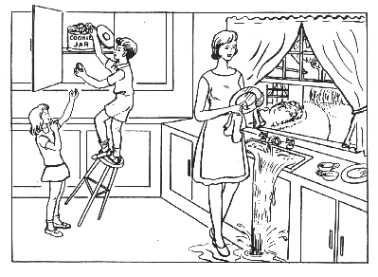
Notes:
Present picture #1 (Cookie Theft) (~ 3 minutes)
“Here is a picture. Tell me everything you see going on in this picture.”
If no response in 10 seconds, give second prompt:
“Take a look (point to picture if possible) and tell me what’s happening in the picture.”
If fewer than 2 utterances, give third prompt:
“Anything else you can tell me about the picture?”

Slide 13
Picture #2

Slide 14
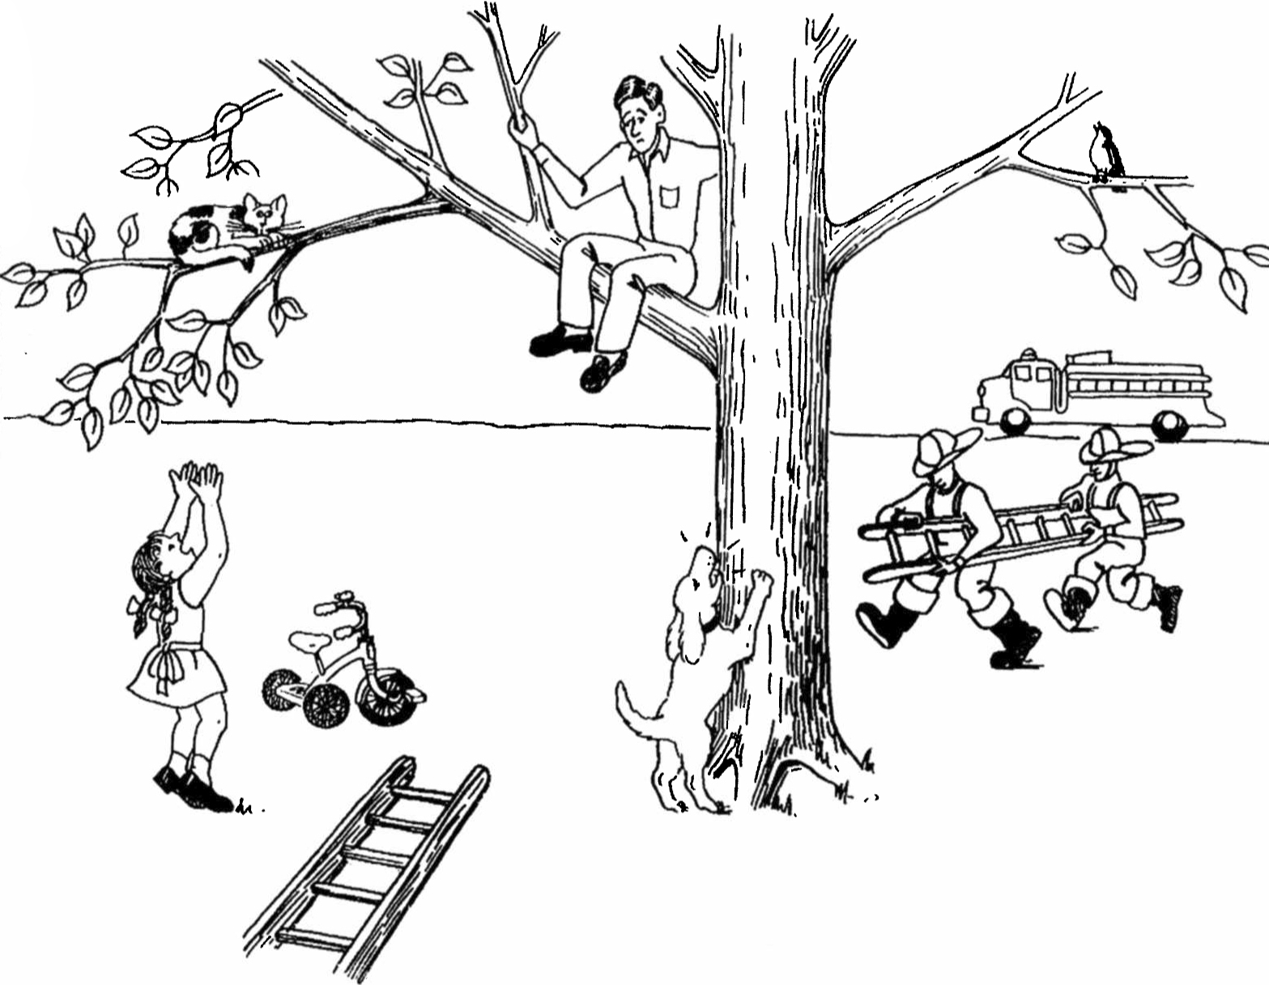
Notes:
Present Picture #2 (Cat Rescue) (~ 3 minutes)
“Here is another picture. Look at everything that’s happening and then tell me a story about what you see. Tell me the story with a beginning, a middle, and an end.”
If no response in 10 seconds, give second prompt:
“Take a look (point to picture) and tell me any part of the story.”
If fewer than 2 utterances, give third prompt:
“Anything else you can tell me about the story?”

Slide 15
Story Narrative

Slide 16

Notes:
CINDERELLA (~ 5 minutes)
“I’m going to ask you to tell a story. Have you ever heard the story of Cinderella? (Make note of answer for demographic data. If answer is no, ask participant to tell a fairy tale s/he knows.)
Do you remember much about it? Take a look through the pictures from the story book. They might remind you of how it goes. Then, after you finish looking at the pictures, you can tell me the story in your own words.”
After participant looks through all the pictures, remove the book or the pictures and prompt:
“Now tell me as much of the story of Cinderella as you can. You can use any details you know about the story, as well as the pictures you just looked at.”
If participant gives a response of fewer than three utterances, or seems to falter, allow 10
seconds, then prompt:
“What happened next?” or “Go on.”
Continue until participant concludes story or has clearly finished. HOWEVER, if the participant is still telling the story after 5 minutes have elapsed, then prompt:
“Sorry to interrupt, but please try to finish up with the rest of the details of the story so we can get to the other things we still have to do.”
If the participant does not finish after 1 more minute, then prompt:
"Okay, just tell me how the story ends. We have to move on."

Slide 17
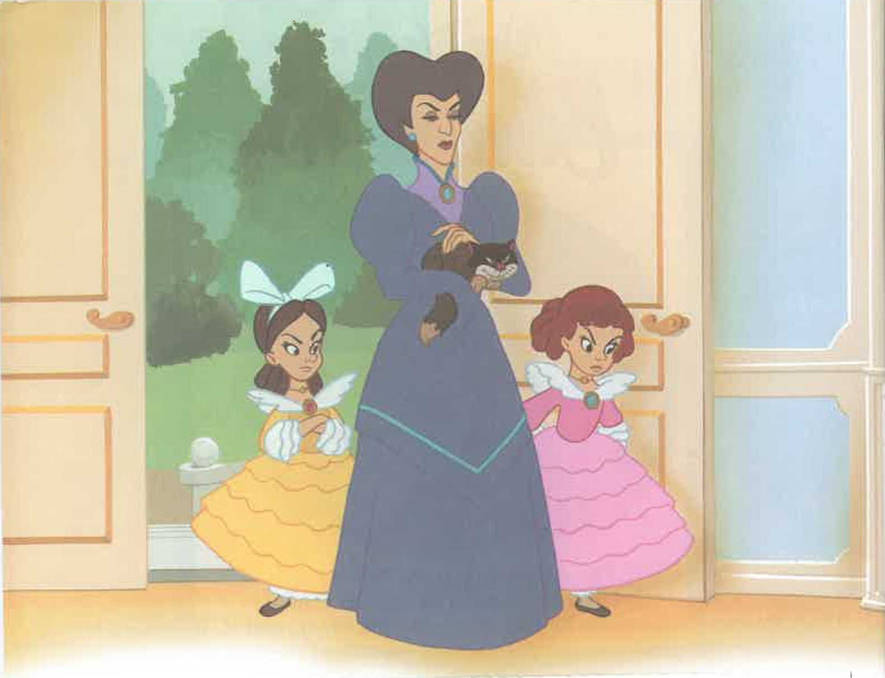

Slide 18
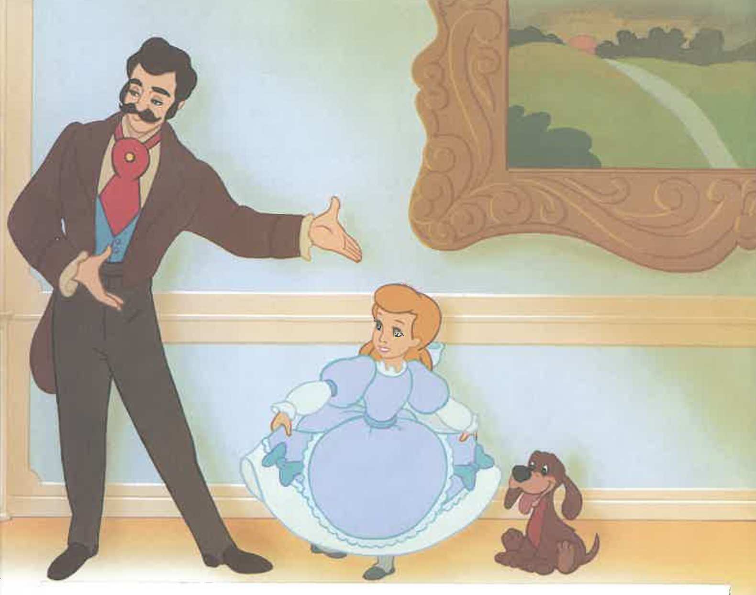

Slide 19
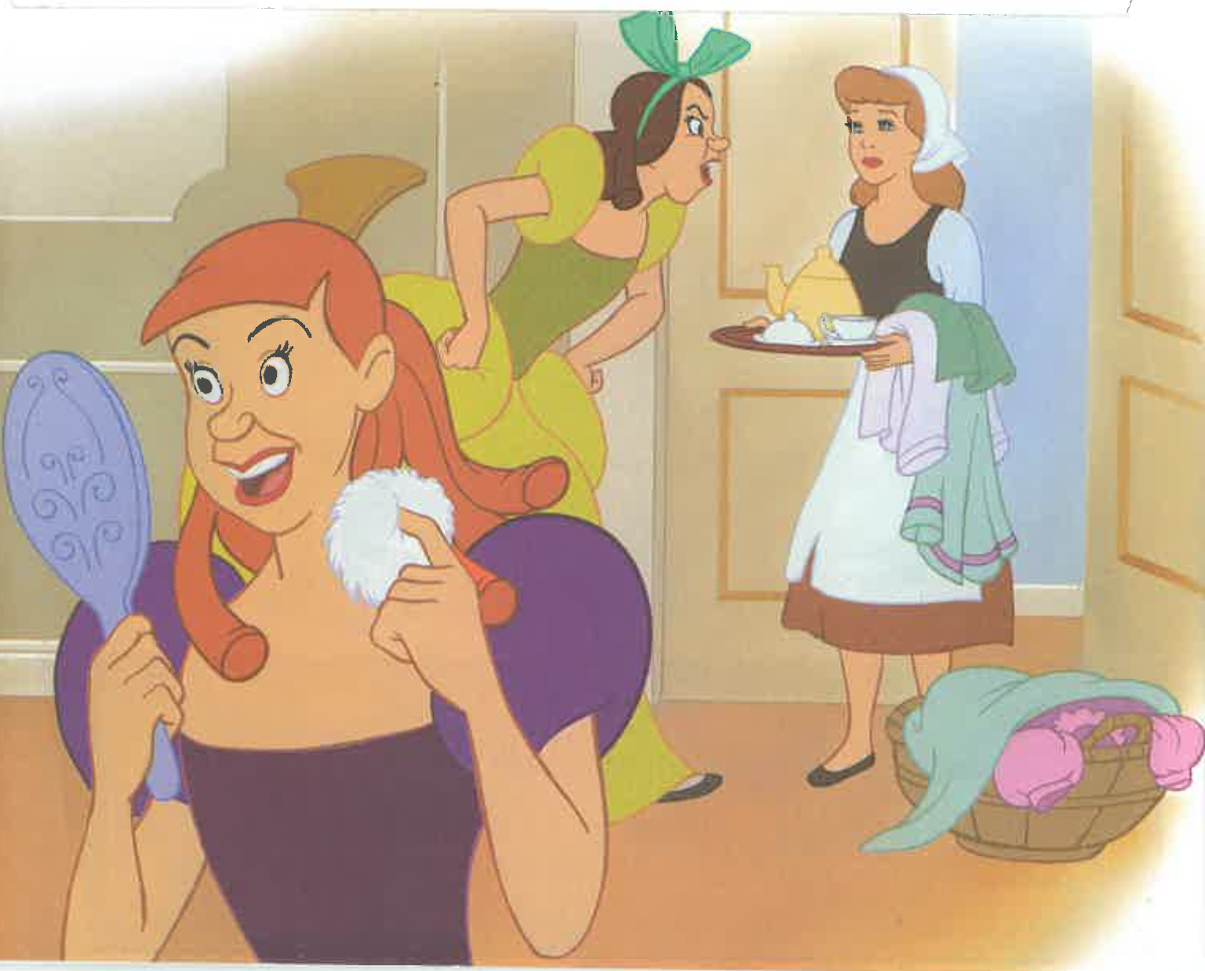

Slide 20
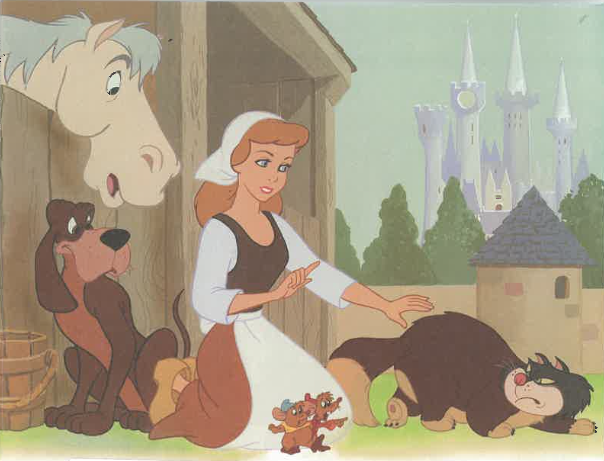

Slide 21
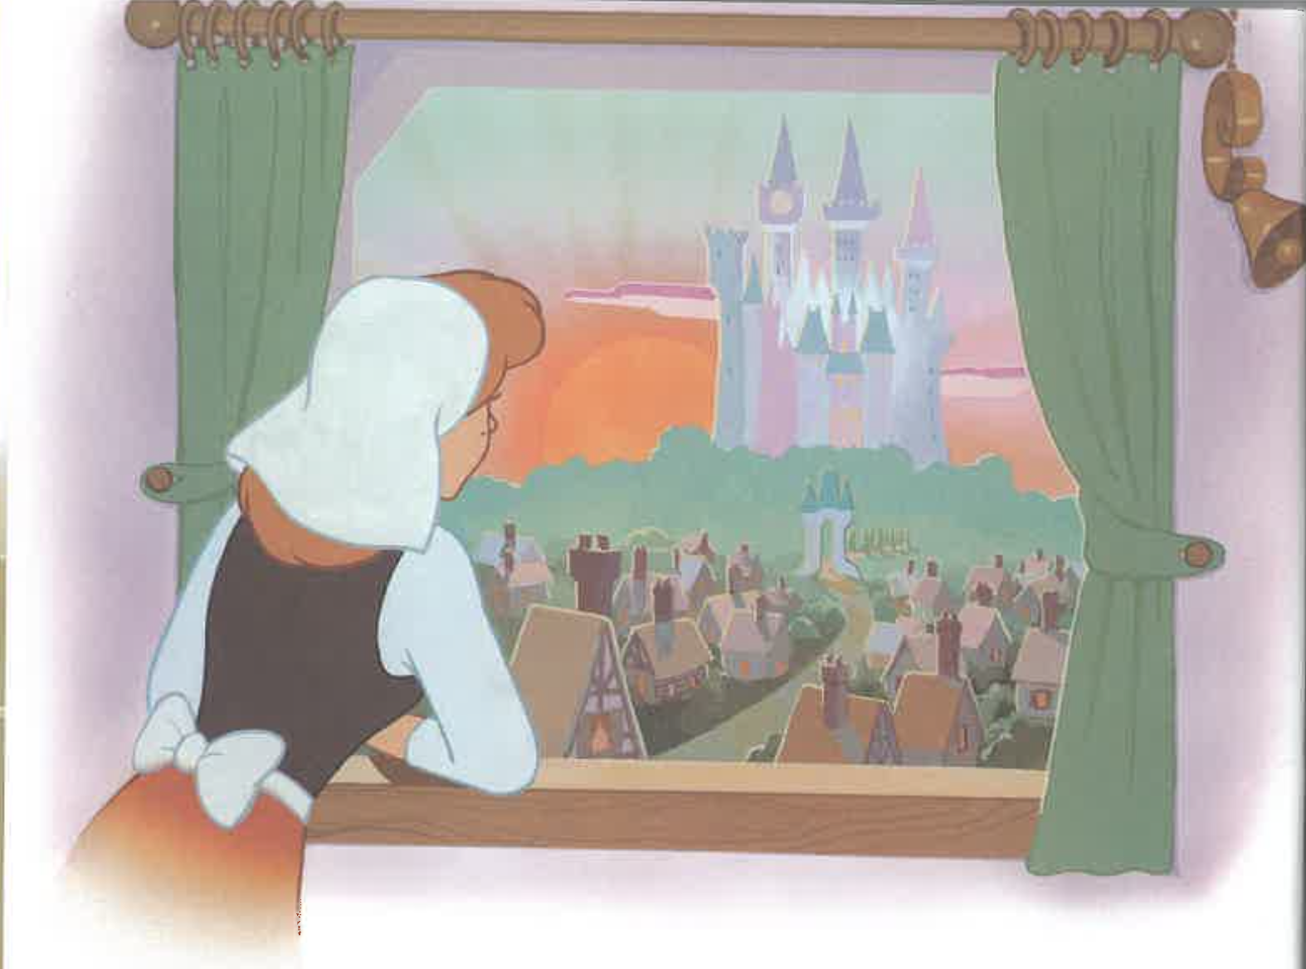

Slide 22
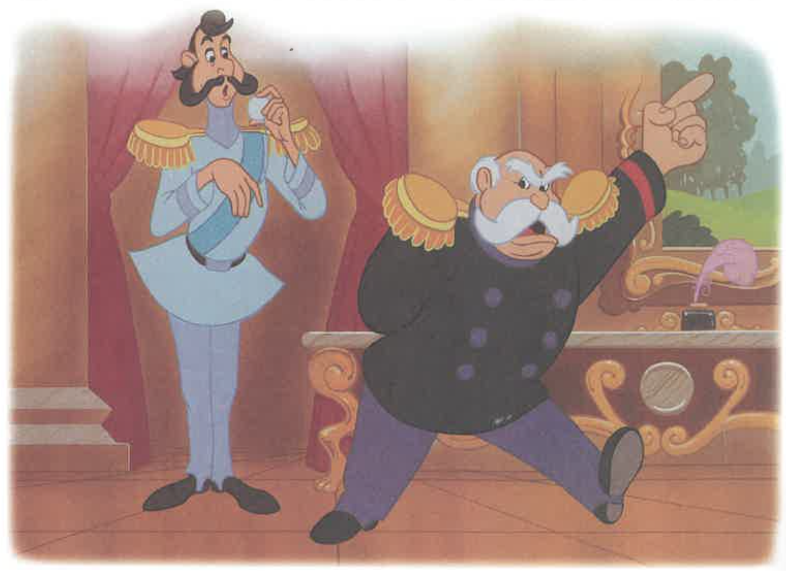

Slide 23
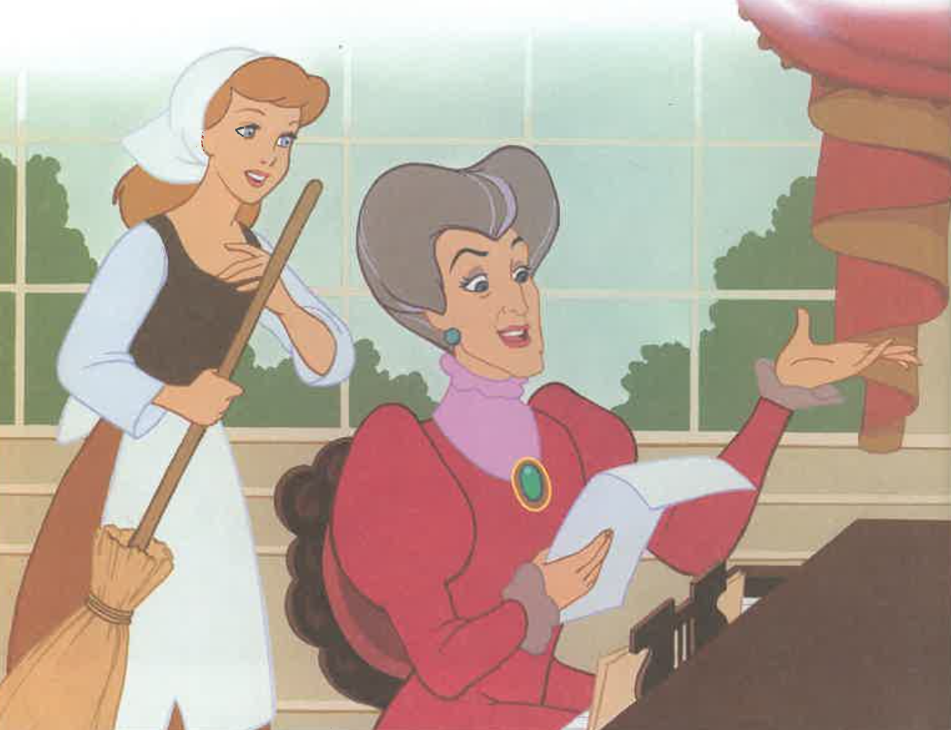

Slide 24
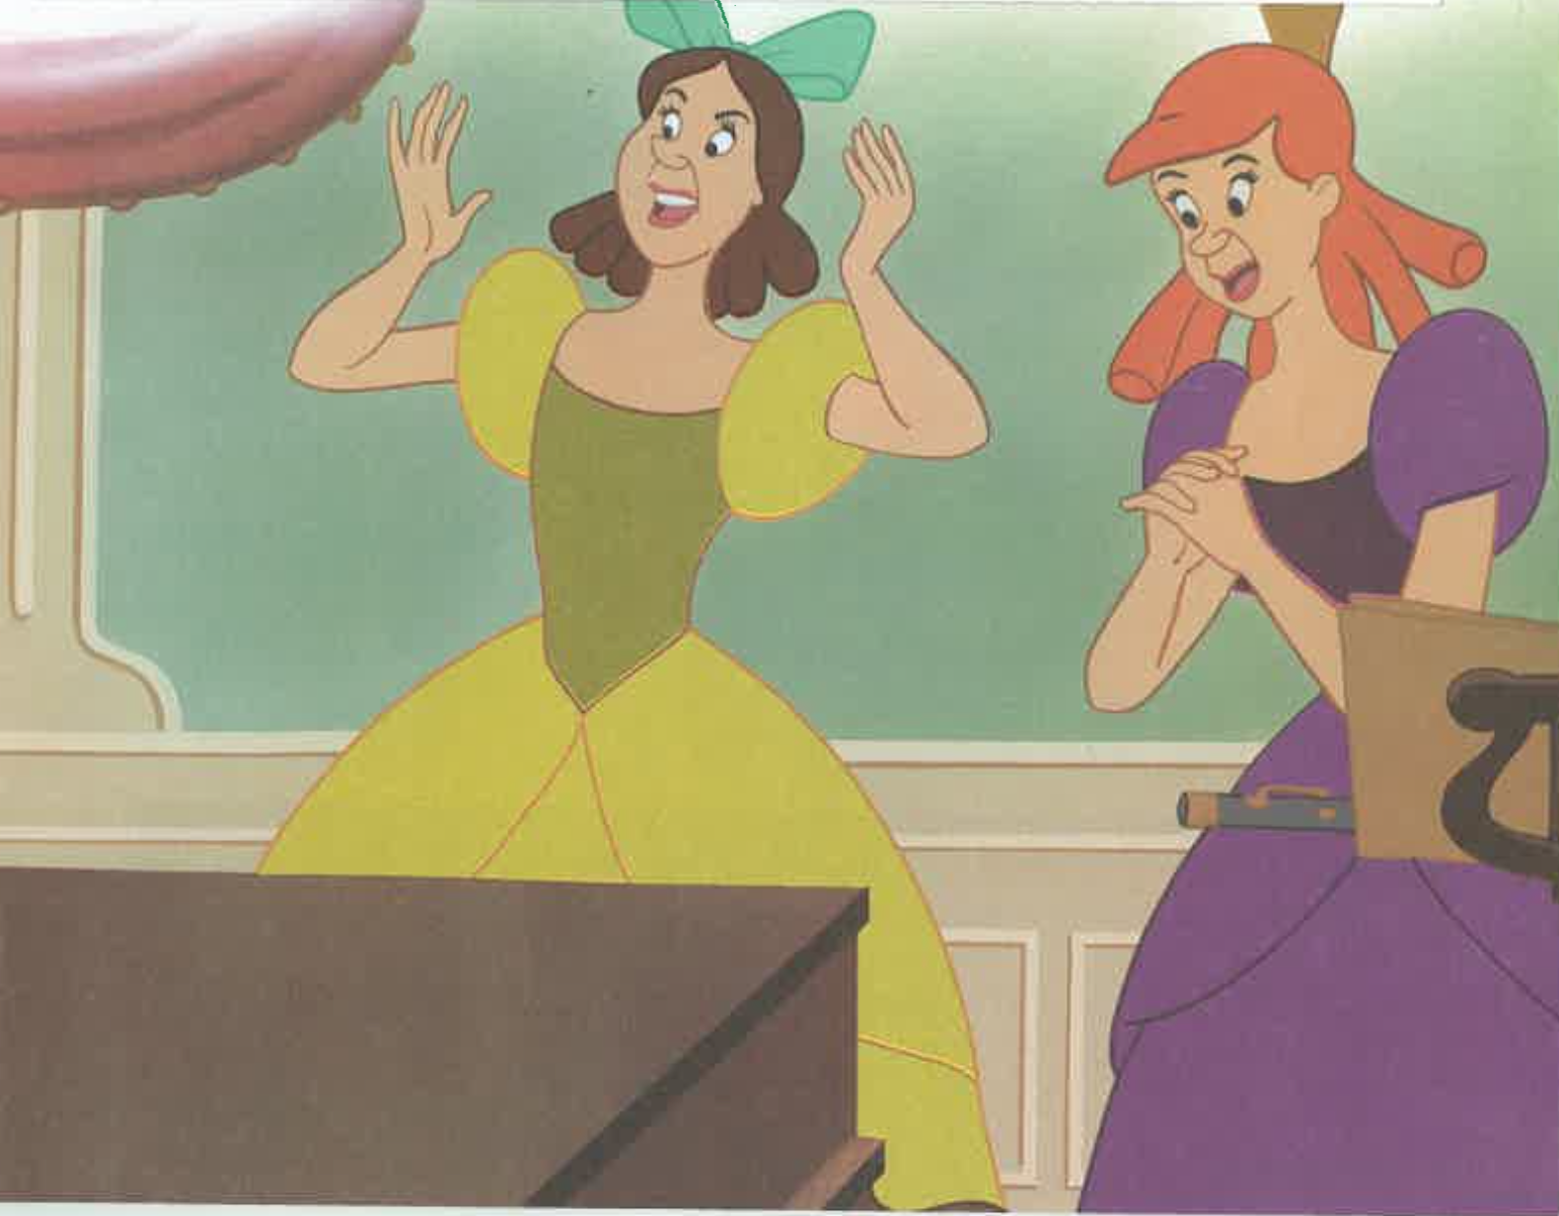

Slide 25
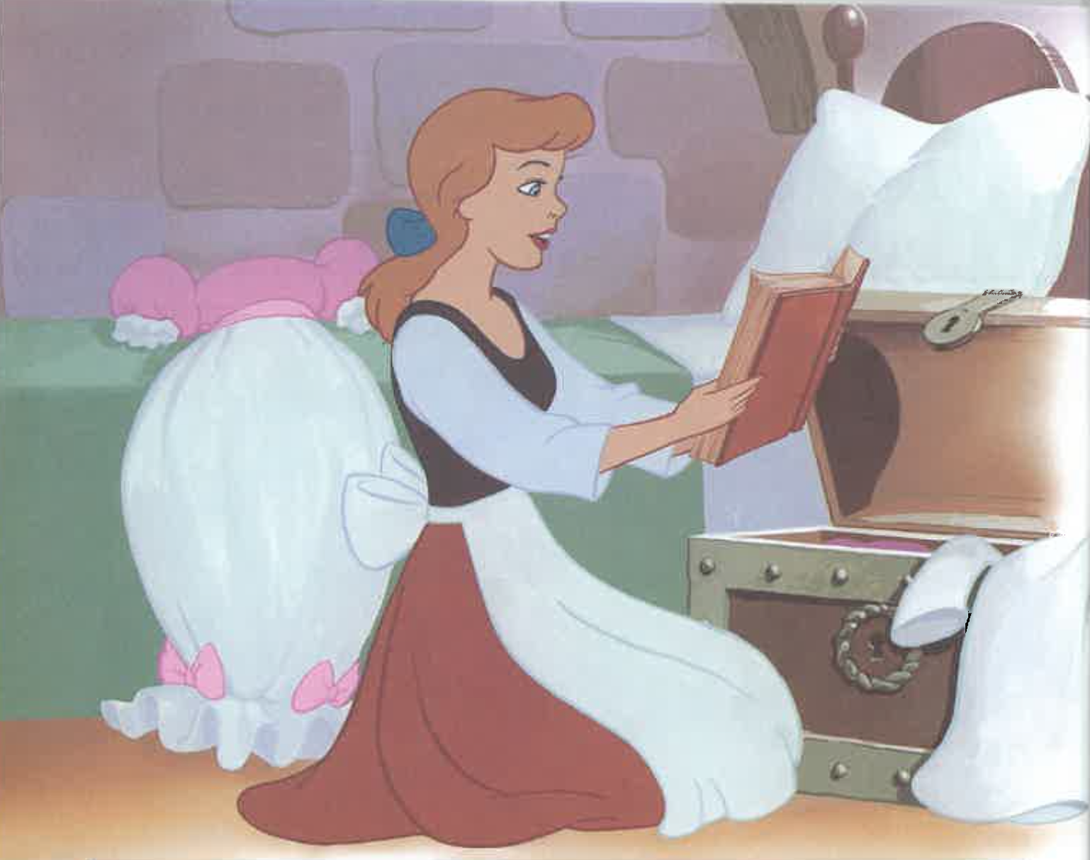

Slide 26
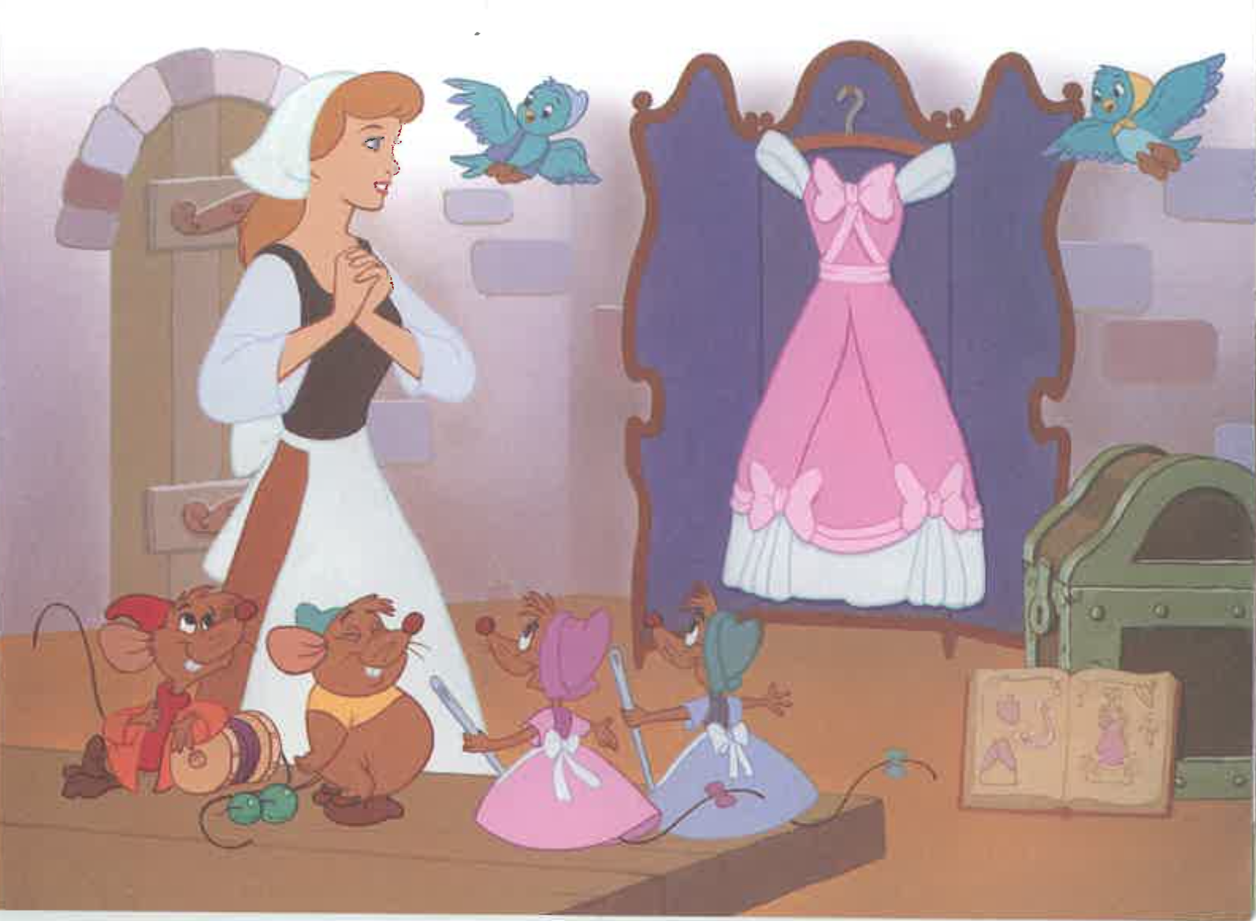

Slide 27
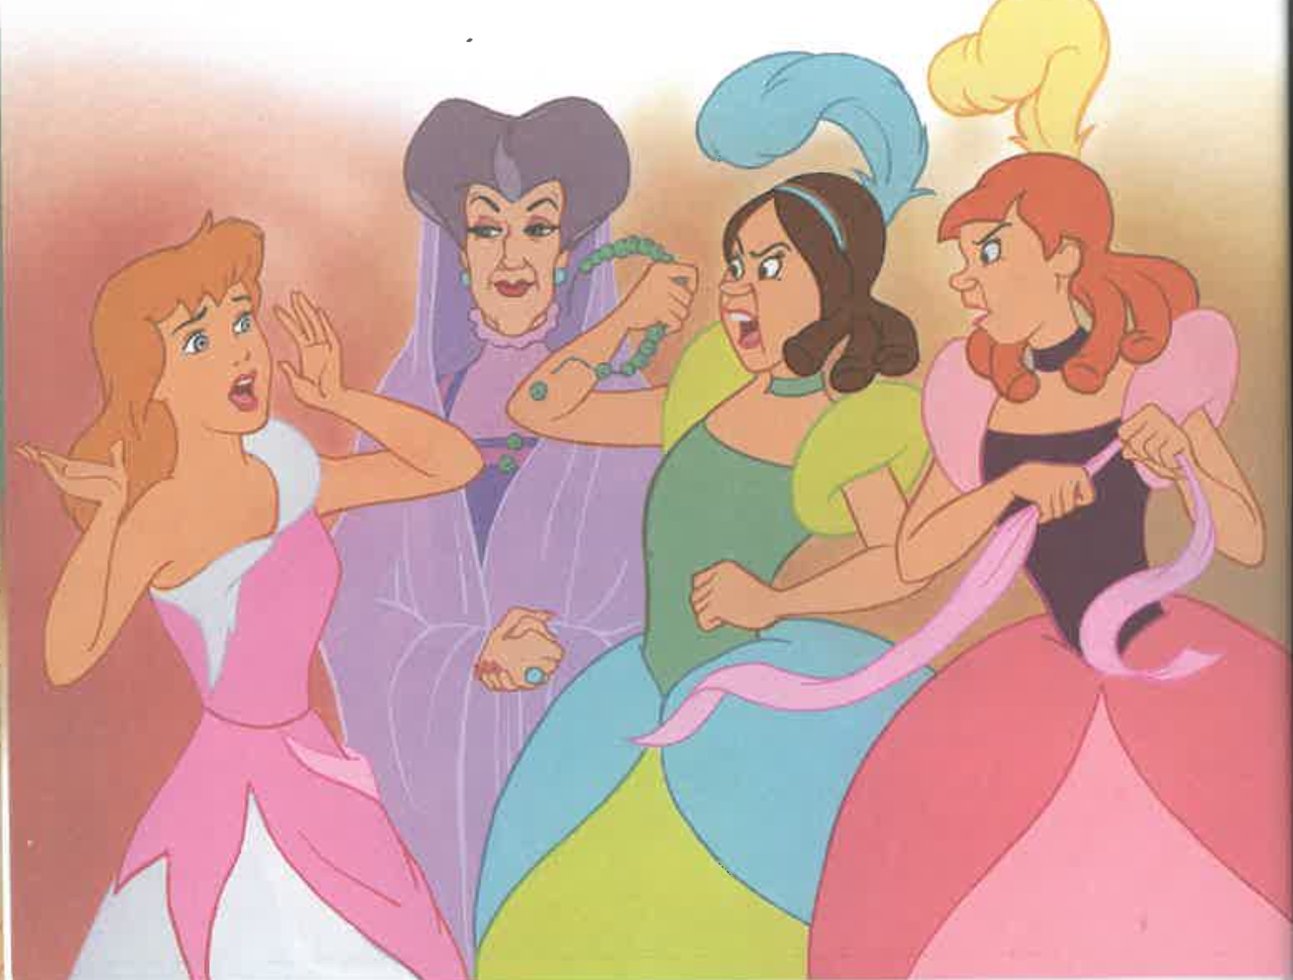

Slide 28
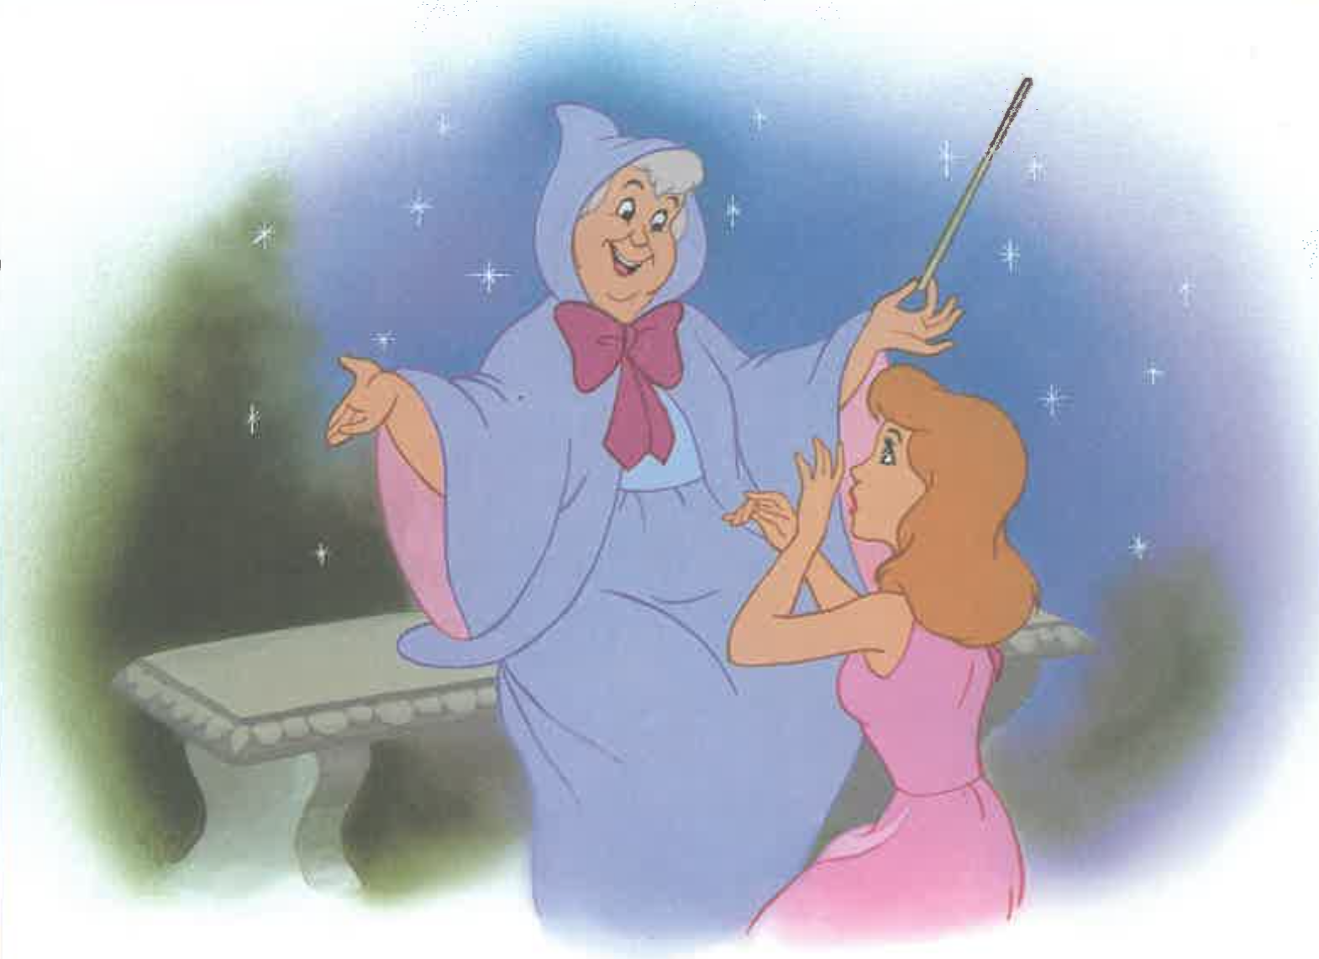

Slide 29
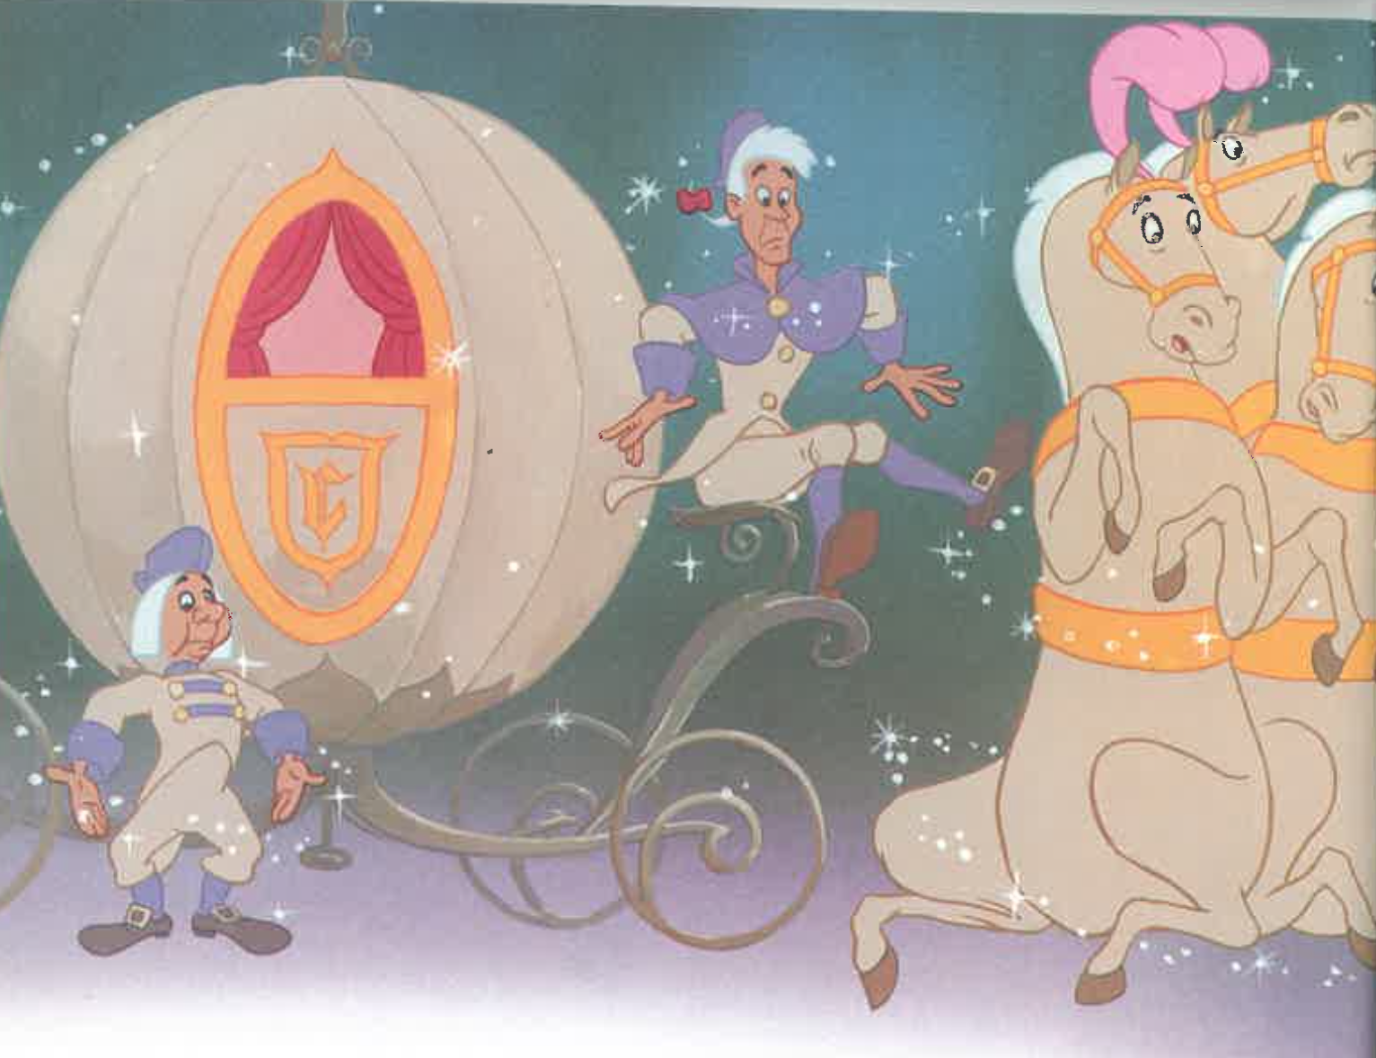

Slide 30
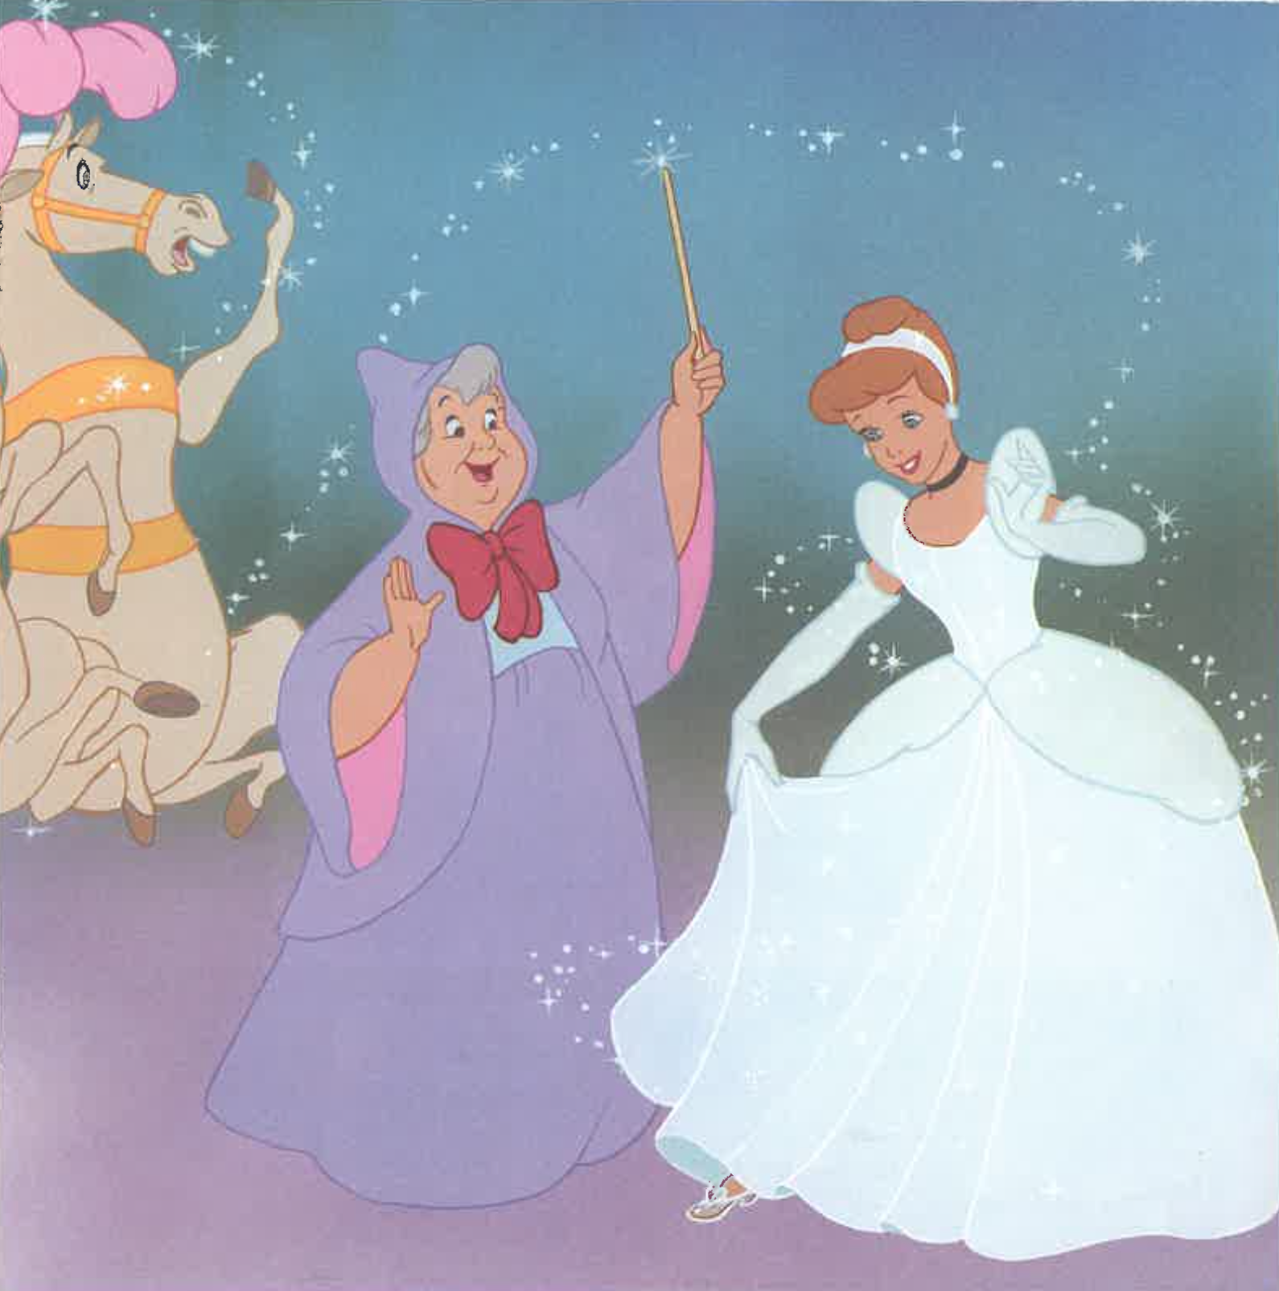

Slide 31
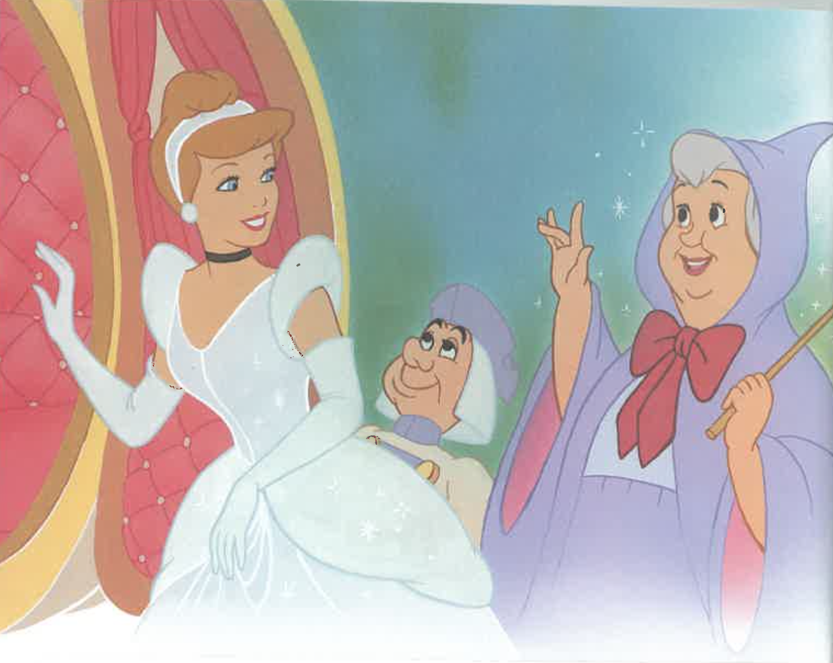

Slide 32
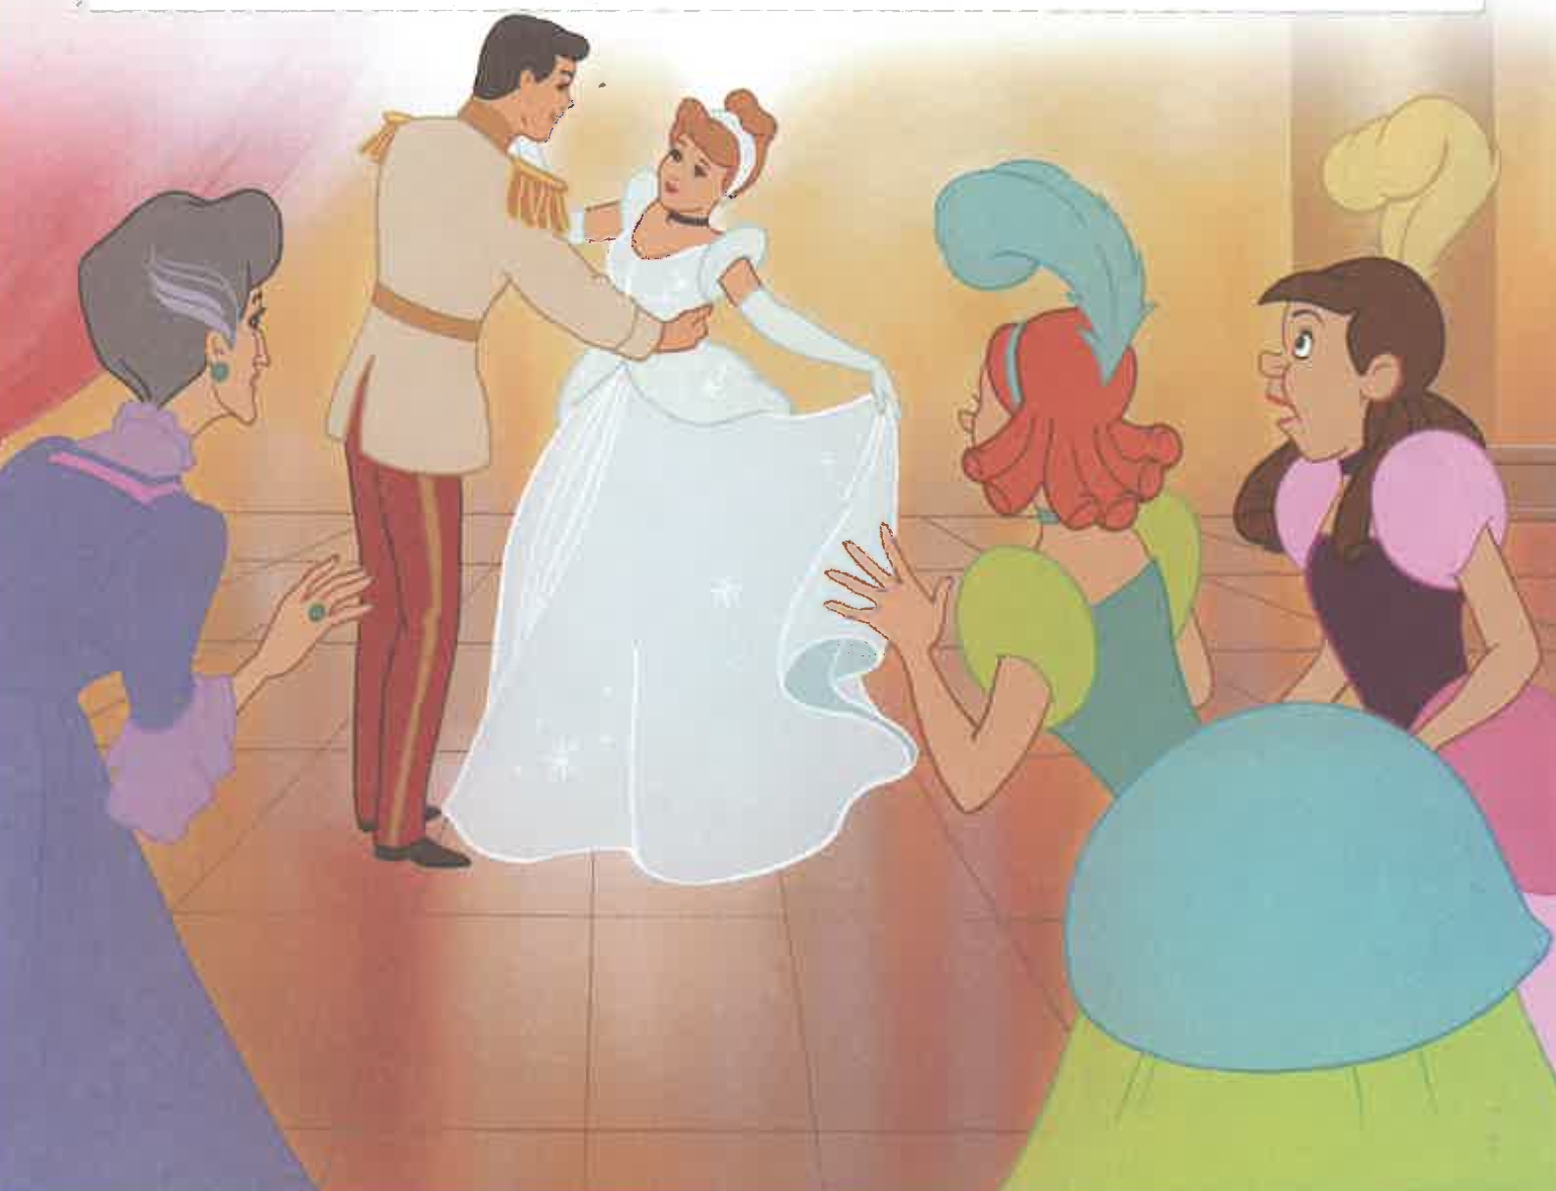

Slide 33
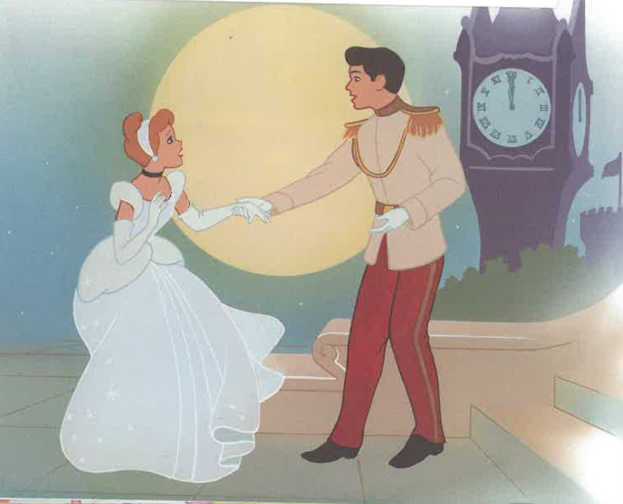

Slide 34
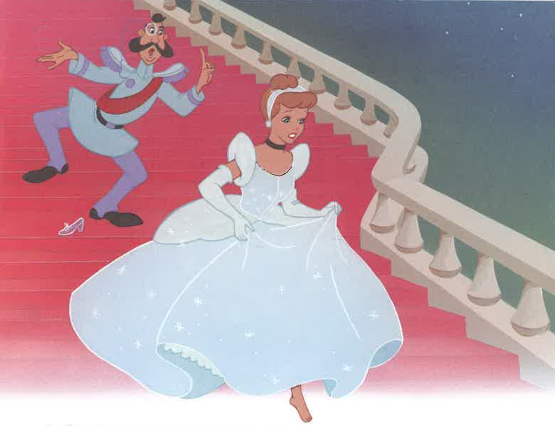

Slide 35
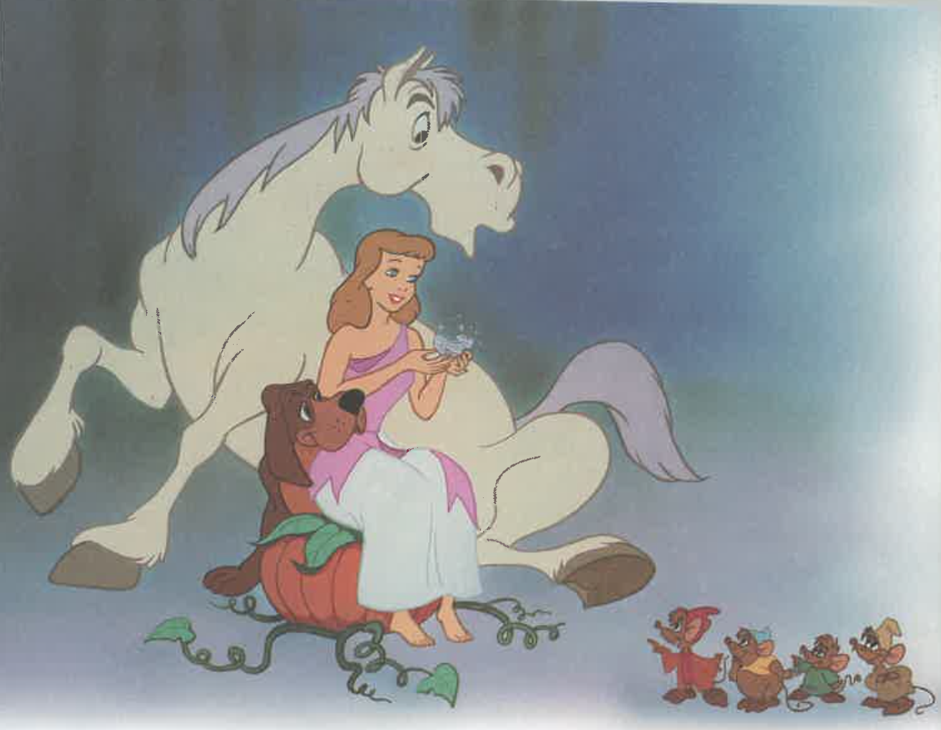

Slide 36
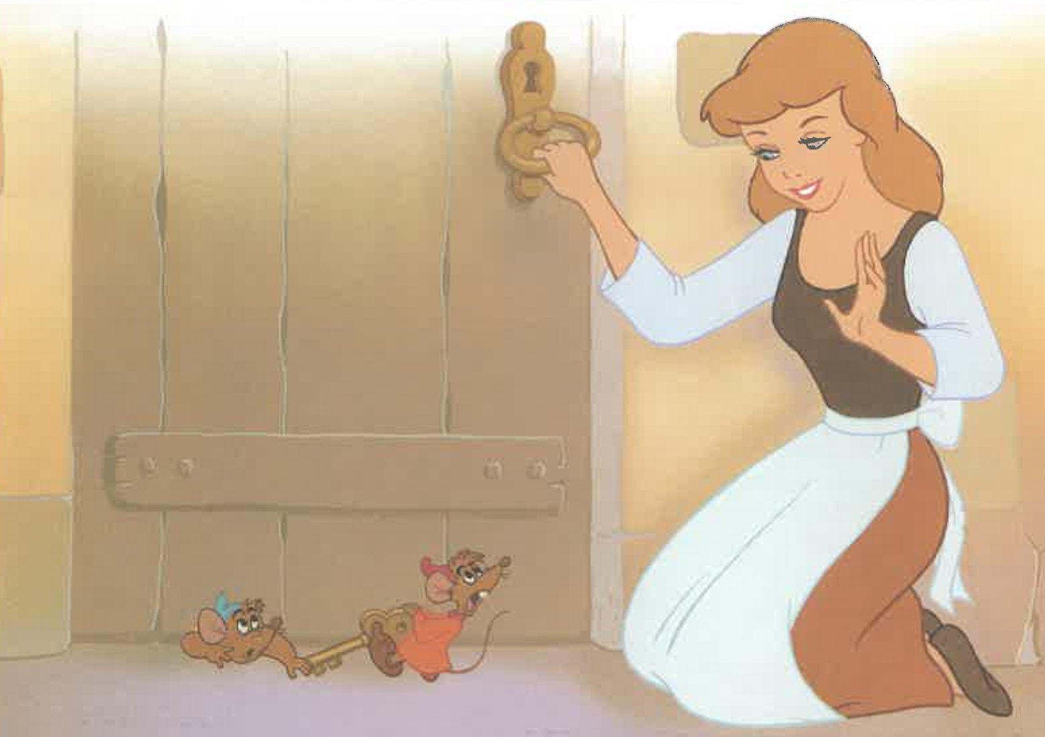

Slide 37
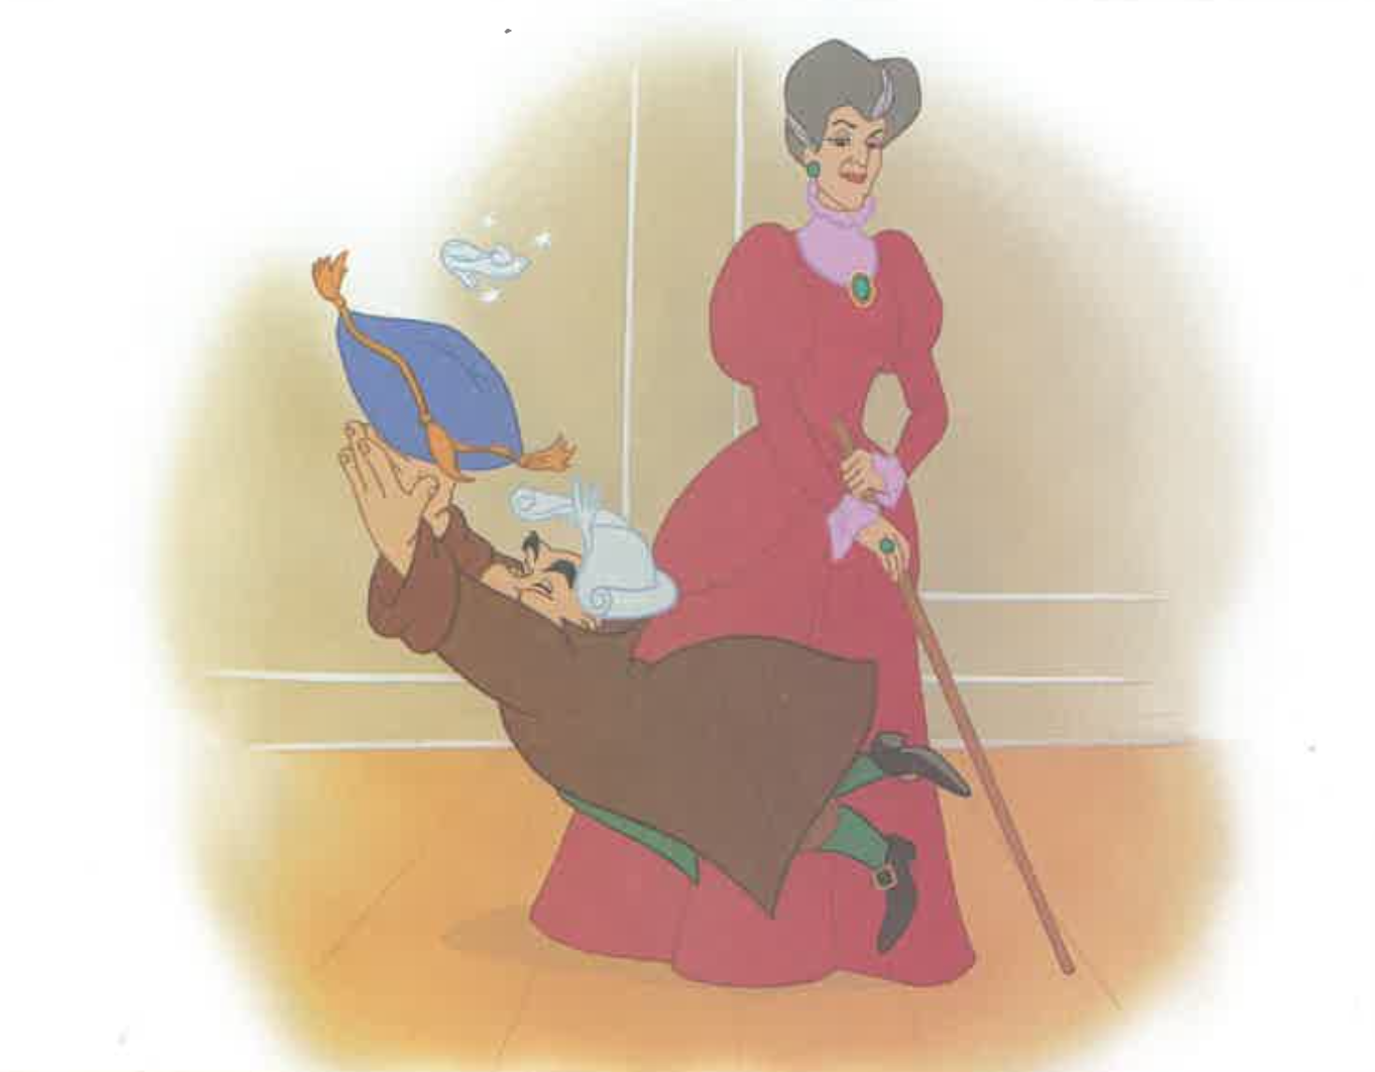

Slide 38
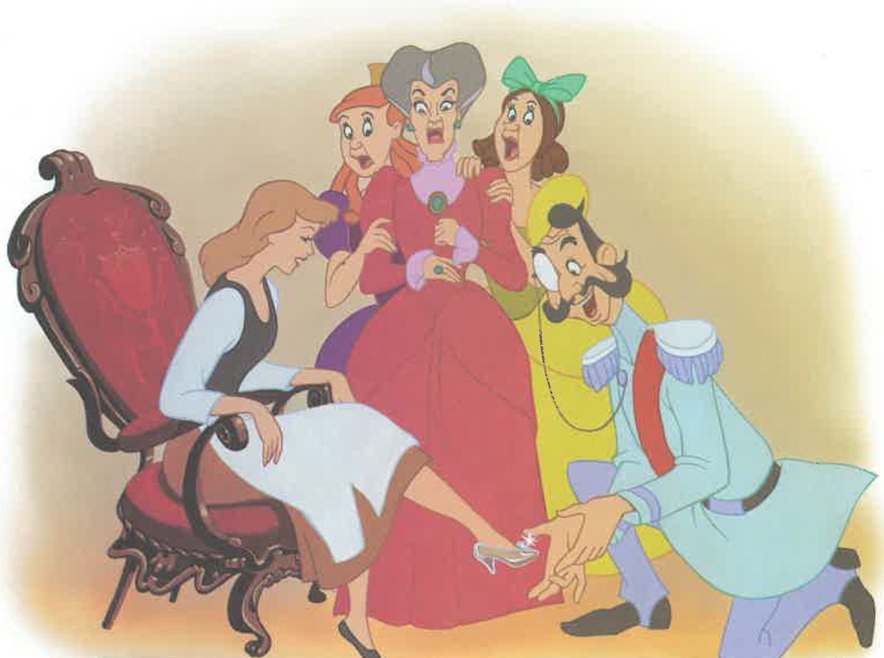

Slide 39
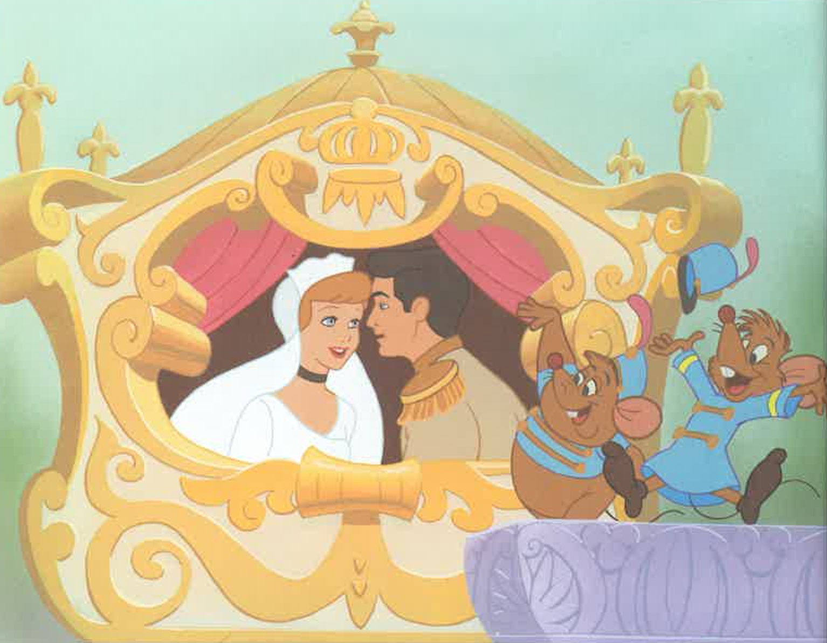

Slide 40
Notes:
Can you tell me the story of Cinderella?

Slide 41
Procedural Discourse
Notes:
Procedural Discourse Task (Sandwich) (~ 2 minutes)
Do not use a picture stimulus for this task.
“Let’s move on to something a little different. Tell me how you would make a peanut butter and jelly sandwich.”
(non-U.S. test sites may substitute another simple sandwich, such as Vegemite and cheese [Australia])
If no response in 10 seconds, give second prompt:
“If you were feeling hungry for a peanut butter and jelly sandwich, how would you make it?”

