Slide 1
DISCLOSURE STATEMENT
Jamila Minga, Ph.D., CCC-SLP, Assistant Professor, North Carolina Central University
Davida Fromm, Ph.D., Research Psychologist, Carnegie Mellon University
Melissa Johnson, Ph.D., CCC-SLP, Assistant Professor, Nazareth College
Brian MacWhinney, Ph.D., Professor, Carnegie Mellon University
Juliet Bourgeois-Berwyn, B.A., Graduate Student, North Carolina Central University
Disclosure: We have no relevant non-financial relationships with the content of this presentation. Minga, Fromm, and MacWhinney have financial relationships. This work is funded by NIH (NIH-NIDCD grant R01-DC008524 and 3R01-DC008534-s11).

Slide 2

RHD BANK DATABASE DEVELOPMENT:
GRAND ROUNDS
SEMINAR, SECTION 1155 Thursday, November 9, 2017

Slide 3
INTRODUCTION
Approximately 80% of adults with RHD have one or more communication impairments (Blake, Duffy, Myers, Tompkins, 2002).
  Fluent
  Intelligible
  Grammatical
Communication impairments are pragmatic
Pragmatic impairments can be observed via discourse -- ‘’language in use” (Cameron, 2001; Halliday, 1978)

Slide 4
“Loss of function of portions of either hemisphere can have significant consequences on the efficiency, quantity, and depth of communication and can dramatically affect quality of life and participation in social and vocational activities” (Blake, 2018; p.2).

Slide 5
“Lack of direct explorations to explain the deficits” (Blake, 2010, p. 527)
“Language production has not been a focus of treatment for adults with RHD” (Blake, 2018, p. 60)
Growing need to understand and quantify differences and changes in discourse production (Minga, 2016)

Slide 6
RHDBANK GRAND ROUNDS OVERVIEW
The Protocol, Purpose, Format, and Use

Slide 7
GRAND ROUNDS: PURPOSE
The purpose of the RHD Bank Grand Rounds is to:
describe/demonstrate typical discourse production deficits in RHD;
demonstrate assessment methods for discourse production deficits in RHD;
facilitate classroom and clinical instruction using the Grand Rounds and other resources of RHDBank.

Slide 8
RHD BANK DISCOURSE PROTOCOL (Minga et al., 2016)
Free speech samples (~10 min)
First-encounter conversation
(Kennedy, Strand et al., 1994; ~10 min)
Picture Description (~6 min)
Story Narrative (~5 min)
Procedural Discourse (~1-2 min)
Question Production (Minga, 2014; ~5-10 min)
General Short Form of the CBIP (Communicative Participation Item Bank; Baylor, Yorkston, Eadie, Kim, Chung, & Amtmann, 2013)
CLQT (Cognitive Linguistic Quick Test;
Helm-Estabrooks, 2001)
Apples Test
(Bickerton, Samson, Williamson, & Humphreys, 2011)
Indented Paragraph Test (Caplan, 1987)

Slide 9
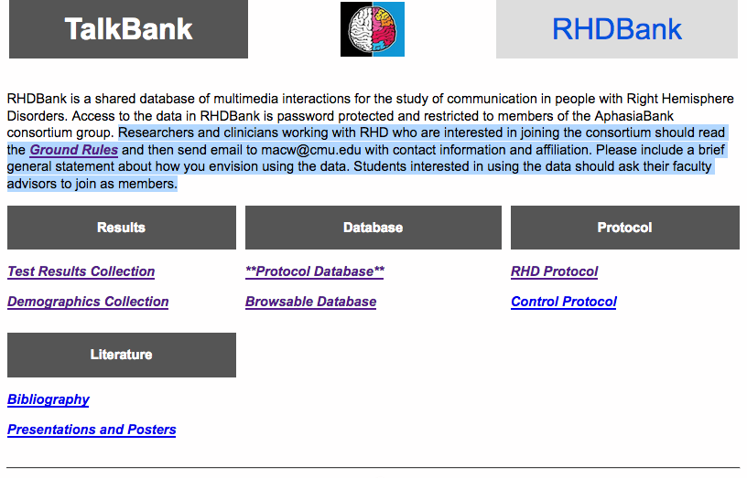
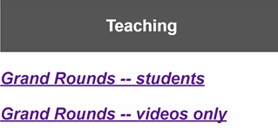
www.rhd.talkbank.org
Protocol
COMING JAN. 2018

Slide 10
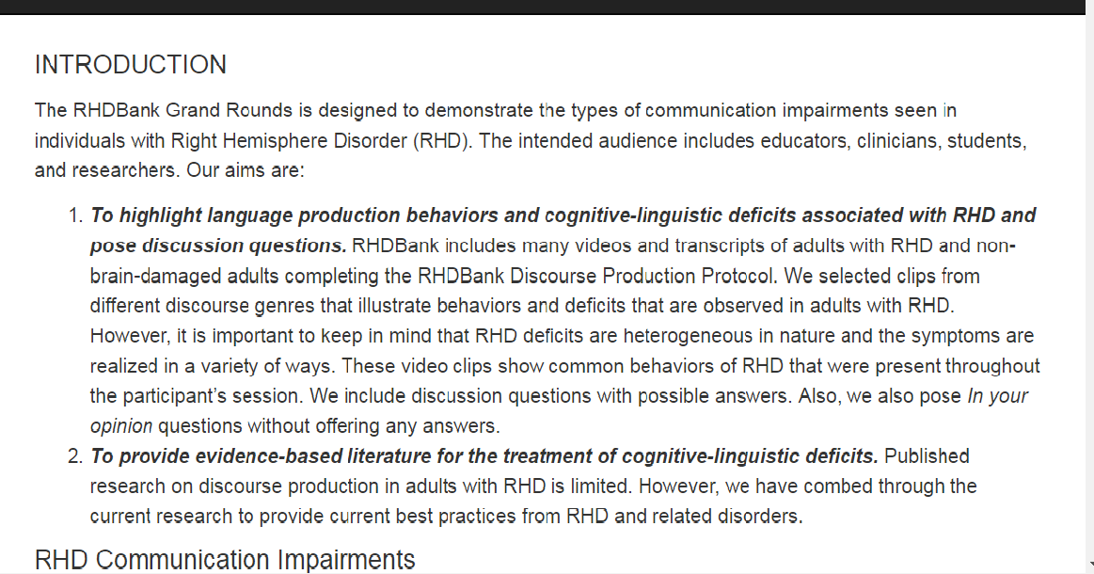

Slide 11
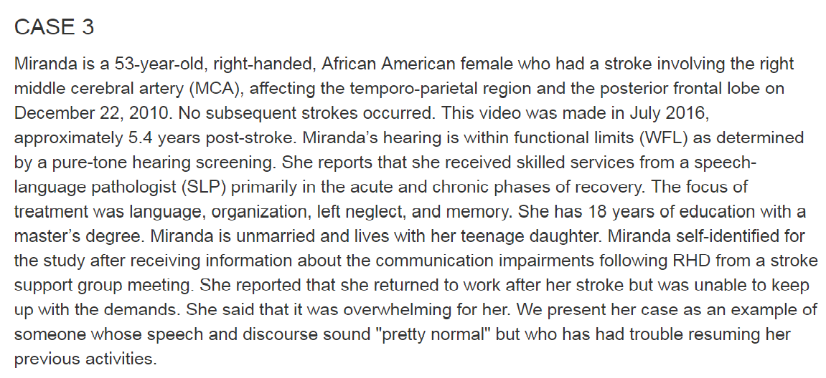

Slide 12
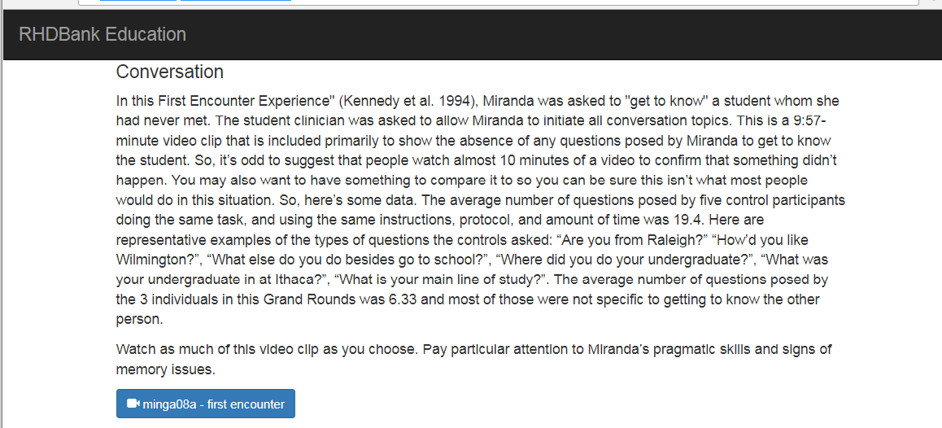
RHDBANK GRAND ROUNDS: CASE STUDIES
CASE 03: Miranda
ACCESS MEDIA HERE

Slide 13
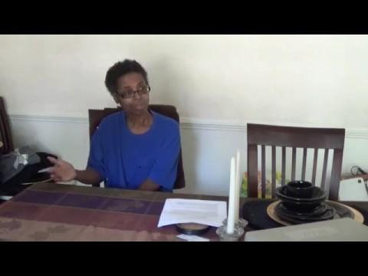
RHDBANK GRAND ROUNDS: MIRANDA
What pragmatic deficits do you see?
Do you notice any behaviors suggesting cognitive impairments?
Does Miranda meet the task goal?

Slide 14
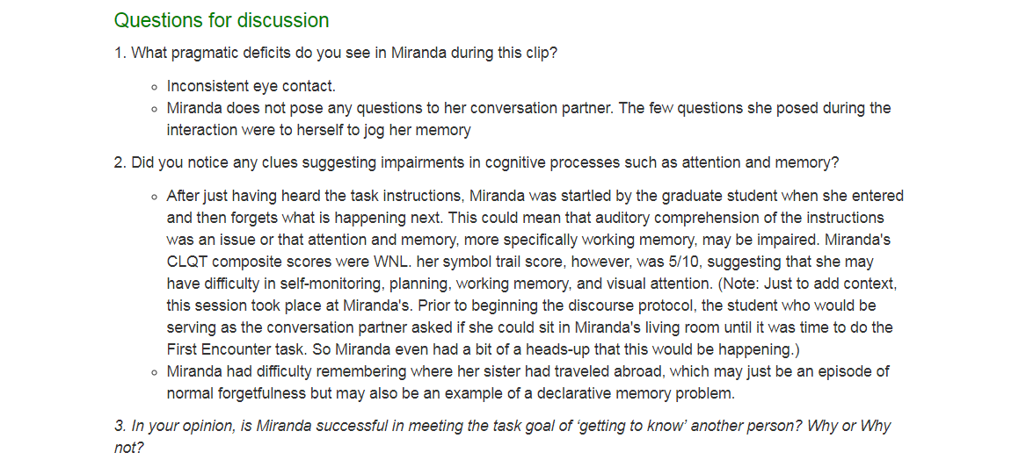
RHDBANK GRAND ROUNDS: MIRANDA

Slide 15
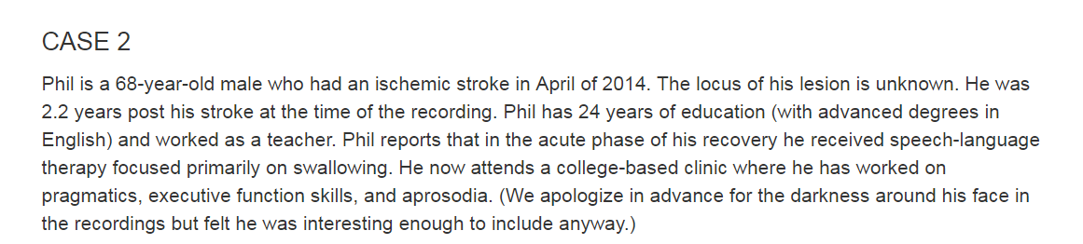
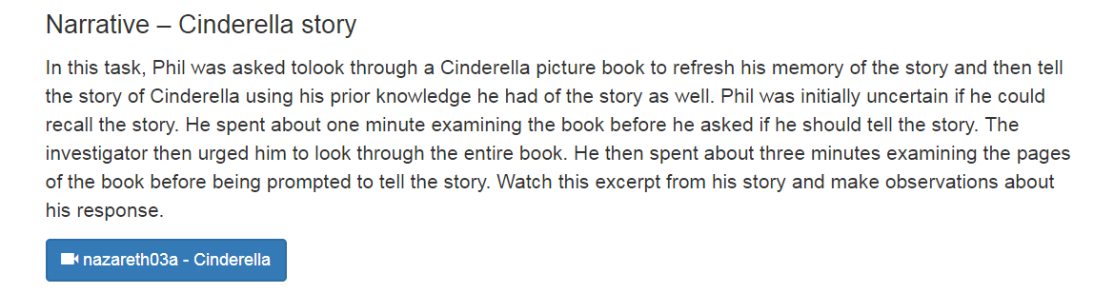
ACCESS MEDIA HERE

Slide 16
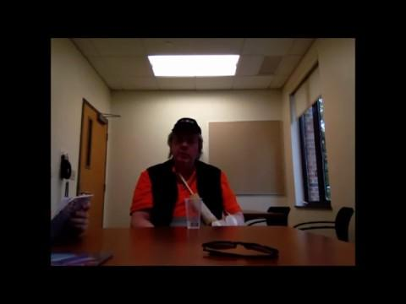
RHDBANK GRAND ROUNDS: PHIL
What cognitive impairments may contribute to Phil’s narrative?

Slide 17
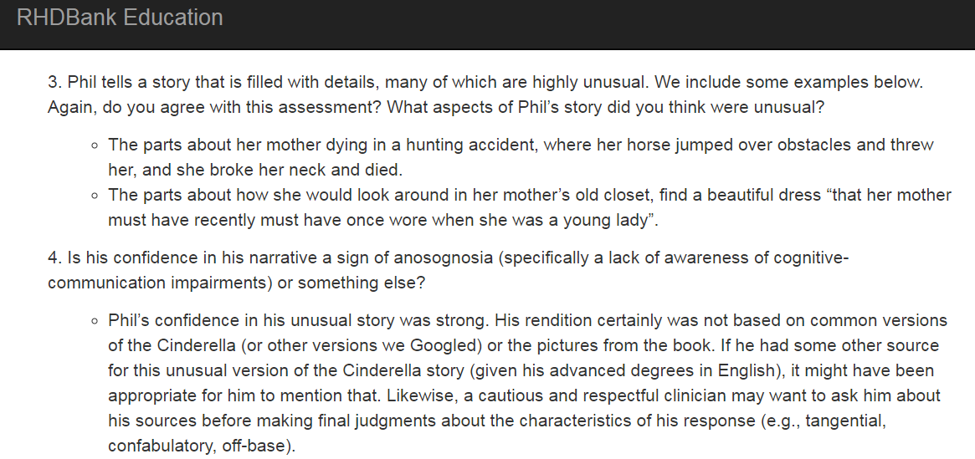

Slide 18
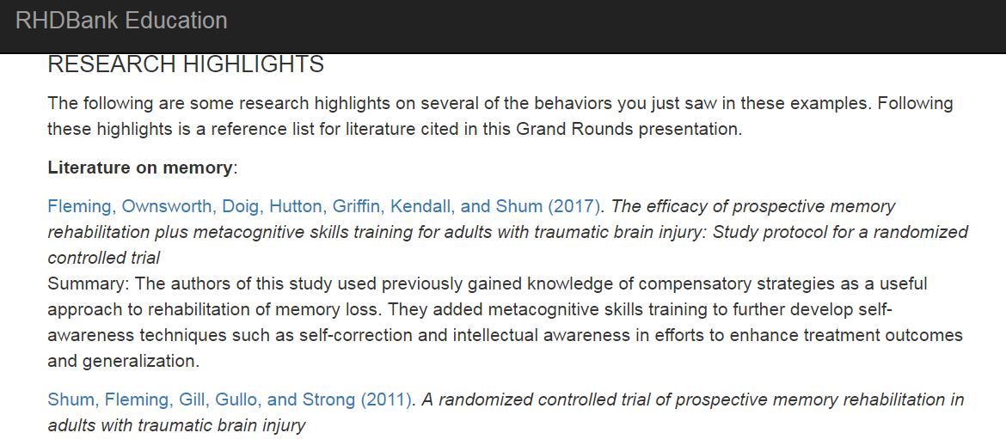

Slide 19
HOW CAN I USE THE RHDBANK?

Slide 20
RHD GRAND ROUNDS: USING THE RHDBANK
IN TEACHING:
View exemplars of discourse in RHD;
Compare discourse in RHD to persons with aphasia (PWA) and to healthy controls(HC);
Demonstrate assessment techniques in RHD;
Generate ideas for treatment approaches that could be measured using discourse protocols;
Measure student learning;
Generate an appreciation of the impairments and needs of people with RHD to stimulate clinical interest and confidence in developing professionals.

Slide 21
RHD GRAND ROUNDS: USING THE RHDBANK
IN CLINIC/PRACTICE:
Increase understanding of communication behaviors of adults with RHD in practicing clinicians;
Provide a resource for professionals to evaluate their patients with RHD as compared to others with RHD and to healthy controls;
Expose clinical fellows who may have limited exposure to the importance of meeting the needs of the RHD population;
Provide an opportunity for practicing clinicians to participate in research to advance understanding of communication behaviors of adults with RHD;
Stimulate development and assessment of novel treatment approaches.

Slide 22
RHD GRAND ROUNDS: USING THE RHDBANK
IN RESEARCH:
Characterize discourse in a large corpus of adults with RHD
Compare people with RHD to PWA and HC…
  Across a variety of discourse tasks (e.g., question use, story retelling, procedural discourse, conversation, etc.);
  Across a variety of parameters (e.g., coherence, main concept usage, parts of speech, length of utterance, # of utterances, # of questions, pronoun usage, etc.).
Examine individual characteristics and their relationship to discourse (e.g., age, sex, education, handedness, size/site of lesion, time post-onset, duration of tx., cognitive deficits, neglect, etc.).
Evaluate effectiveness of treatment approaches.
Notes:
MJ to briefly discuss prosody and coherence research
See MJ poster “Global Coherence of Story Narratives in RHD” on 11/11 at 8:30

Slide 23
STUDENT PERSPECTIVE: JULIET BOURGEOIS-BERWYN
Graduate Student - NCCU
JULIET BOURGEOIS, B.A. GRADUATE STUDENT, NCCU

Slide 24
HOW TO GET INVOLVED
Davida Fromm, Ph.D.

Slide 25

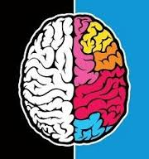
RHDBank
How to make Deposits and Withdrawals
How can I access the materials?
How can I contribute data?

Slide 26
Access
Faculty and licensed clinicians only (NIH and IRB restrictions)
Send an email to Brian MacWhinney at macw@cmu.edu
Include this information
  Name and contact information (address, phone)
  Professional affiliation
  Reason(s) why you want access

Slide 27
Access, cont.
User name and Password
  Videos
  Transcripts
  Browsable Database
  Demographic data
  Test results
  Cannot be shared with others unless they work under your supervision
User name and Password for Grand Rounds
  Can be shared with students and colleagues
  Discuss ethical principles of shared databases
  http://talkbank.org/share/ethics.html

Slide 28
Contribute
Create your own corpus
  Administer and record RHDBank discourse protocol to individuals with RHD or controls
  Administer test battery (RHD only)
  Send demographics, test results, video, and transcript

Slide 29
Contribute, cont.
Send videos of individuals with RHD
  Pre-post individual treatment discourse
  Group treatment sessions
  Conversation, interviews, picture description tasks, RHD test batteries
Send classroom activities and assignments that use the RHDBank materials
Send posters/presentations based on RHDBank materials

Slide 30
My contact information: fromm@andrew.cmu.edu

Slide 31
DISCUSSION AND QUESTIONS
Minga, Fromm, & Johnson

Slide 32
THANKS!
Any questions?
You can contact us.
www.rhdbank.org

Slide 33
CREDITS
The cases presented highlight well-documented areas of RHD deficits while providing information about possible communication behaviors in adults with RHD. We are indebted to the the people who graciously agreed to participate in the RHDBank research project. None of this would have been possible without the support and guidance of Brian MacWhinney (Carnegie Mellon University). Lily Jarold was enormously helpful with the video processing. We also thank Margaret Forbes who reviewed previous versions of this Grand Rounds and offered wise and valuable feedback.

Slide 34
REFERENCES
Baylor, C., Yorkston, K., Eadie, T., Kim, J., Chung, H., & Amtmann, D. (2013). The Communicative Participation Item Bank (CPIB): Item bank calibration and development of a disorder-generic short form. Journal of Speech Language and Hearing Research, 56, 1190-1208. PMID: 23816661.
Bickerton, Samson, Williamson, & Humphreys (2011). Separating forms of neglect using the apples test: Validation and functional prediction in chronic and acute stroke. Neuropsychology, 25(5), 567–580.
Blake, M. L. (2006). Clinical relevance of discourse characteristics after right hemisphere brain damage. American Journal of Speech-Language Pathology, 15, 255-267.
Blake, M. L. (2018). The right hemisphere and disorders of cognition and communication: Theory and clinical practice. San Diego, CA: Plural Publishing.
Caplan, B. (1987). Assessment of unilateral neglect: a new reading test. Journal of Clinical and Experimental Neuropsychology, 9(4), 359-364.
Helm-Estabrooks, N. (2001). Cognitive-Linguistic Quick Test. San Antonio, TX: Psychological Corp.

Slide 35
REFERENCES
Kennedy, Mary R.T., Strand, W.B., Edythe A., Burton,W., & Peterson, C. (1994). Analysis of First-Encounter Conversations of Right-Hemisphere-Damaged Adults. Clinical Aphasiology, 22,67-80.
Minga, J. M. (2014). Question use following right hemisphere brain damage (Order No. 3673059). Available from ProQuest Dissertations & Theses Global. (1652500781). Retrieved from http://nclive.org/cgi-bin/nclsm?url=http://search.proquest.com/docview/1652500781?accountid=12713
Minga, J., Johnson, M., Fromm, D., Forbes, M., MacWhinney, B., (2016). RHDBank database development: The discourse protocol. Abstract for Poster Presentation. The American Speech-Language and Hearing Association Annual Convention, Philadelphia, PA.
MacWhinney, B. (2007). The TalkBank Project. In J. C. Beal, K. P. Corrigan & H. L. Moisl (Eds.), Creating and Digitizing Language Corpora: Synchronic Databases, Vol.1.(pp. 163-180). Houndmills: Palgrave-Macmillan.

Slide 36
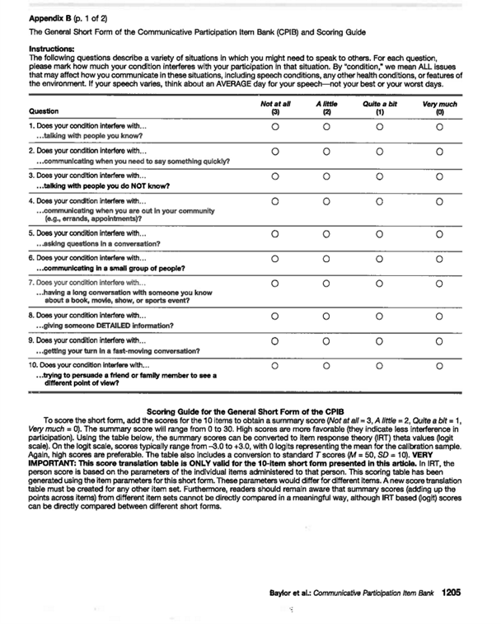
COMMUNICATION PARTICIPATION ITEM BATTERY (CPIB; Baylor et al., 2013)

Slide 37
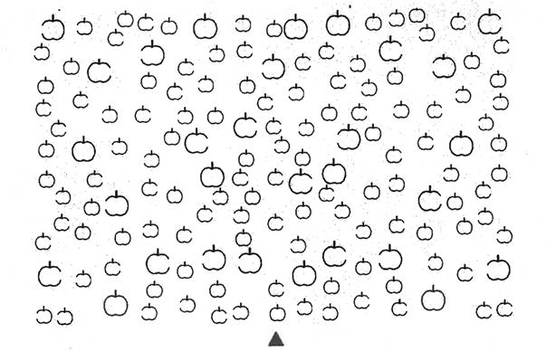
APPLES TEST (Bickerton et al., 2011)

Slide 38
INDENTED READING TASK (Caplan, 1987)
Trees brighten the countryside and soften the harsh lines of city
streets. Among them are our oldest and largest living
things. Trees are the best-known plants in man’s experience. They are
graceful and a joy to see. So it is no wonder that people want
to know how to identify them. A tree is a woody
plant with a single stem growing to a height of ten
feet or more. Shrubs are also woody, but they are usually
smaller than trees and tend to have many stems growing
in a clump. Trees are easiest to recognize by their leaves. By
studying the leaves of trees it is possible to
learn to identify them at a distance. One group of trees has simple leaves

Slide 39





UNFAMILIAR OBJECT-QUESTION TASK (Minga, 2014)

